Slide 1
Kativik Regional Government and its EASTERN ARCTIC UNDERWATER fibre optic network (EAUFON) PROJECT
KRG Regional Council
February 2025

Slide 2
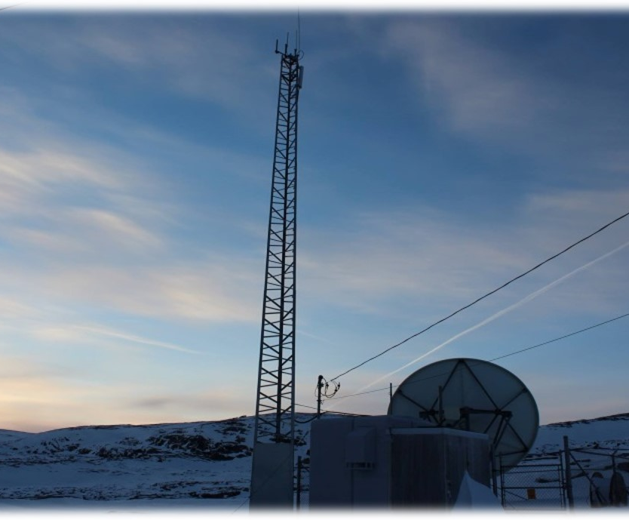
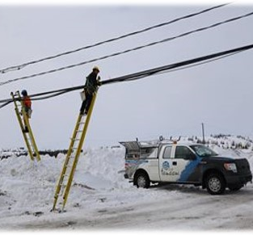
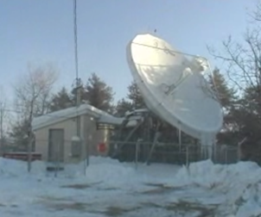
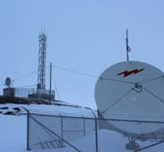
A BACKGROUND
2000 – 2005
The Kativik Regional Government (KRG) accepts to be Nunavik's Internet Service Provider
Financial agreements with Governments
Deployment of satellite earth stations in 14 communities
2004 – Deployment of wireless distribution system and the launch of Tamaani Internet

Slide 3
A BACKGROUND
2005 – 2010
Increasing Capacity 2004 – 10 Mbps 2005 – 50 Mbps 2010 – 150 Mbps
At this point, it was very clear that satellite was not the answer. It was extremely expensive and overused. Demand was rapidly increasing

Slide 4
A BACKGROUND
2011 – 2015
Exploring alternate solutions
Feasibility study was done to link Nunavik to the south using microwave towers
Feasibility study was done to consider a submarine fibre around Nunavik
An application to the Connecting Canadians program brought 1200 Mbps additional bandwidth

Slide 5
A BACKGROUND
2015 – 2018
Submarine Fibre is the way forward
A desktop study was commissioned for submarine fibre in the Nunavik region
An application to the Connect To Innovate program was made to fund a submarine fibre project

Slide 6
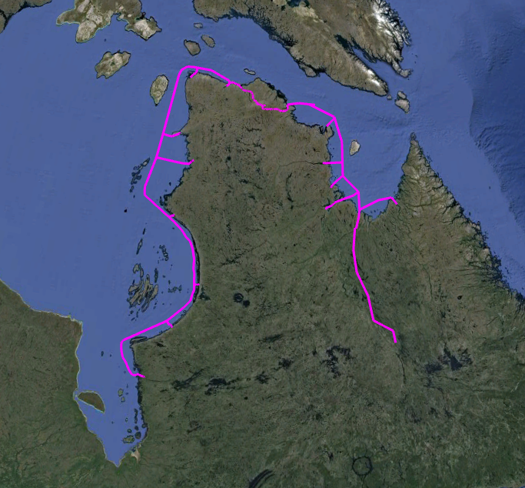
KRG EAUFON PROJECT
In 2019 KRG began the Project known now as EAUFON (Eastern Arctic Underwater Fibre Optic Network) to connect the Nunavik Communities with a reliable, dependable, and affordable High-Speed Fibre Optics connectivity.
The Fibre project consists of:
EAUFON 1 (Marine portion completed 100%), undersea fibre from Chisasibi to Puvirnituq connecting the communities of Whapmagoostui, Kuujjuaraapik, Umiujaq, and Inukjuak. A terrestrial fibre route from Kuujjuaq to Kawawachikamach.
EAUFON 2 (Completed 100%), undersea fibre from Puvirnituq to Akulivik, Ivujivik, Salluit, Deception Bay.
EAUFON 2 (Anticipated completion date: Summer 2026), A terrestrial fibre route from Deception Bay to Kangiqsujuaq.
EAUFON 3 (Anticipated start date: (August 2026), Undersea marine cable connecting from Kangiqsujuaq to Kuujjuaq with connectivity to Quaqtaq, Kangirsuk, Aupaluk, Tasiujaq, and Kangiqsualujjuaq.
At Chisasibi and Kawawachikamach, the fibre cable connects to the partner networks (Eeyou Communications and Sichuun) for connectivity to the internet. This creates redundancy for the communities in case of a fibre break.

Slide 7
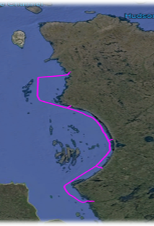
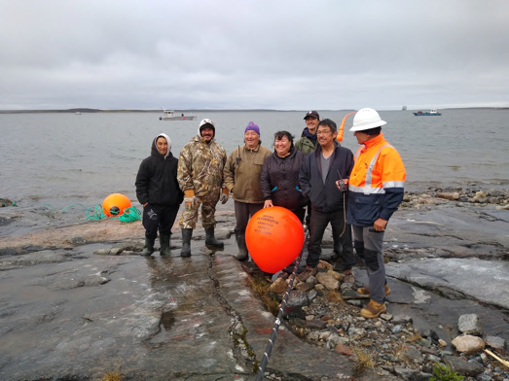
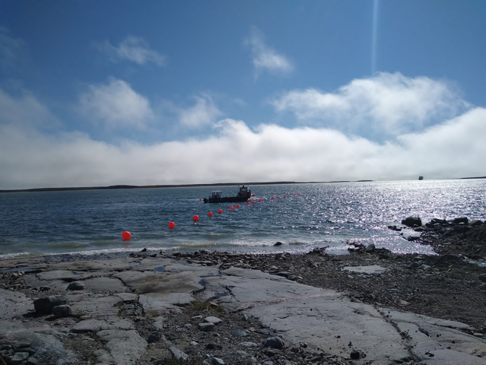
EAUFON 1
Marine Fibre Optic Cable from Chisasibi to Nunavik Communities of Kuujjuaraapik / Whapmagoustui, Umiujaq, Inukjuak & Puvirnituq
Put into Service on June 30, 2022
Low latency, high-capacity bandwidth at prices comparable to the south.

Slide 8
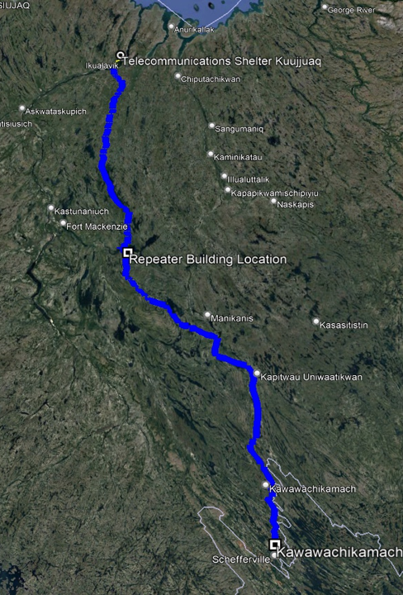
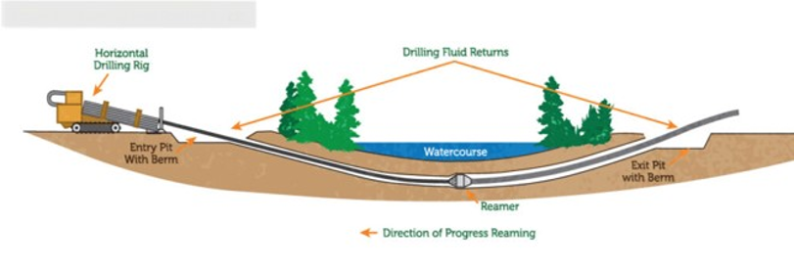

EAUFON 1 continued
Planned terrestrial link from Kuujjuaq to Kawawachickamach

Slide 9
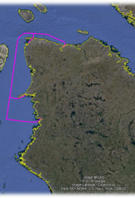
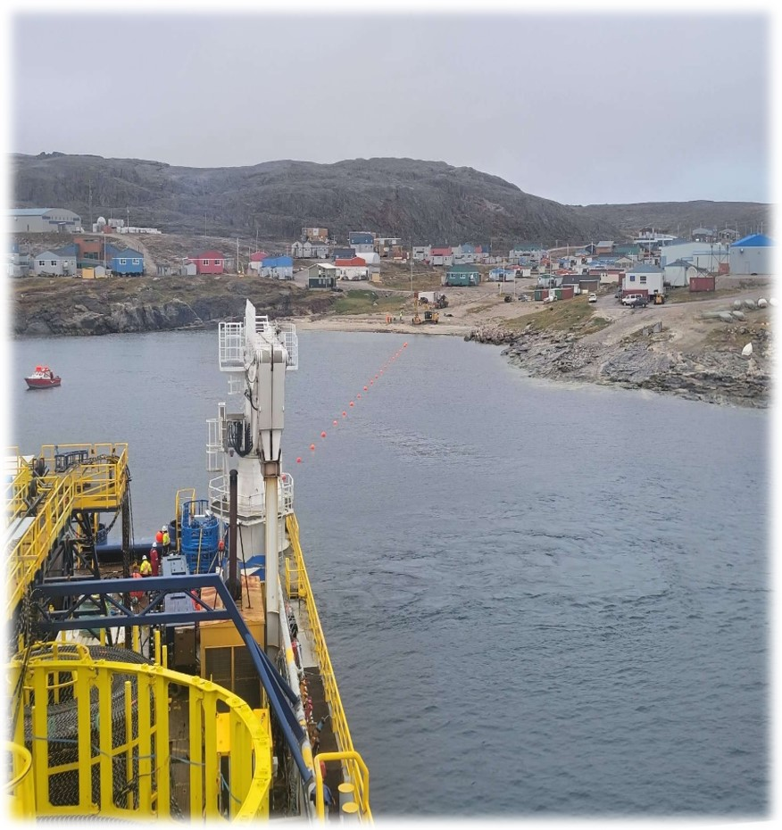
EAUFON 2
Quebec’s northernmost community of Ivujivik gets connected to fibre

Slide 10
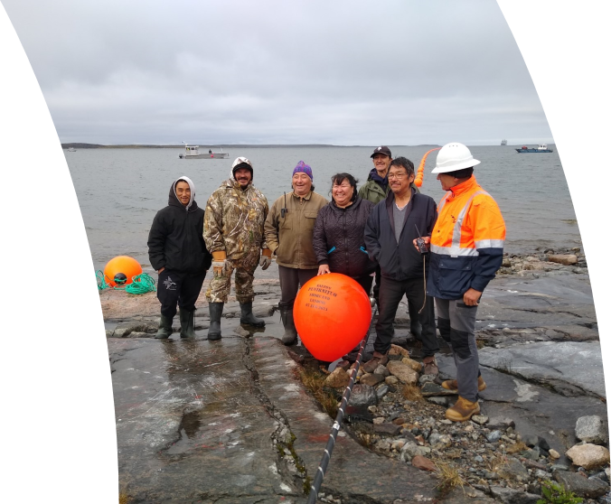
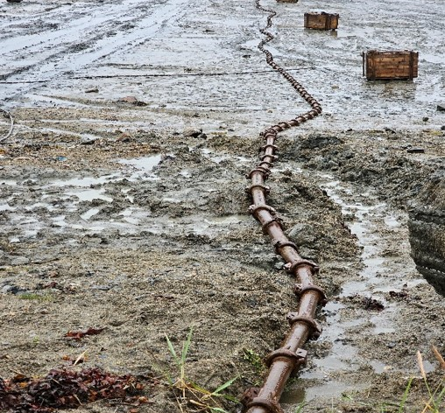
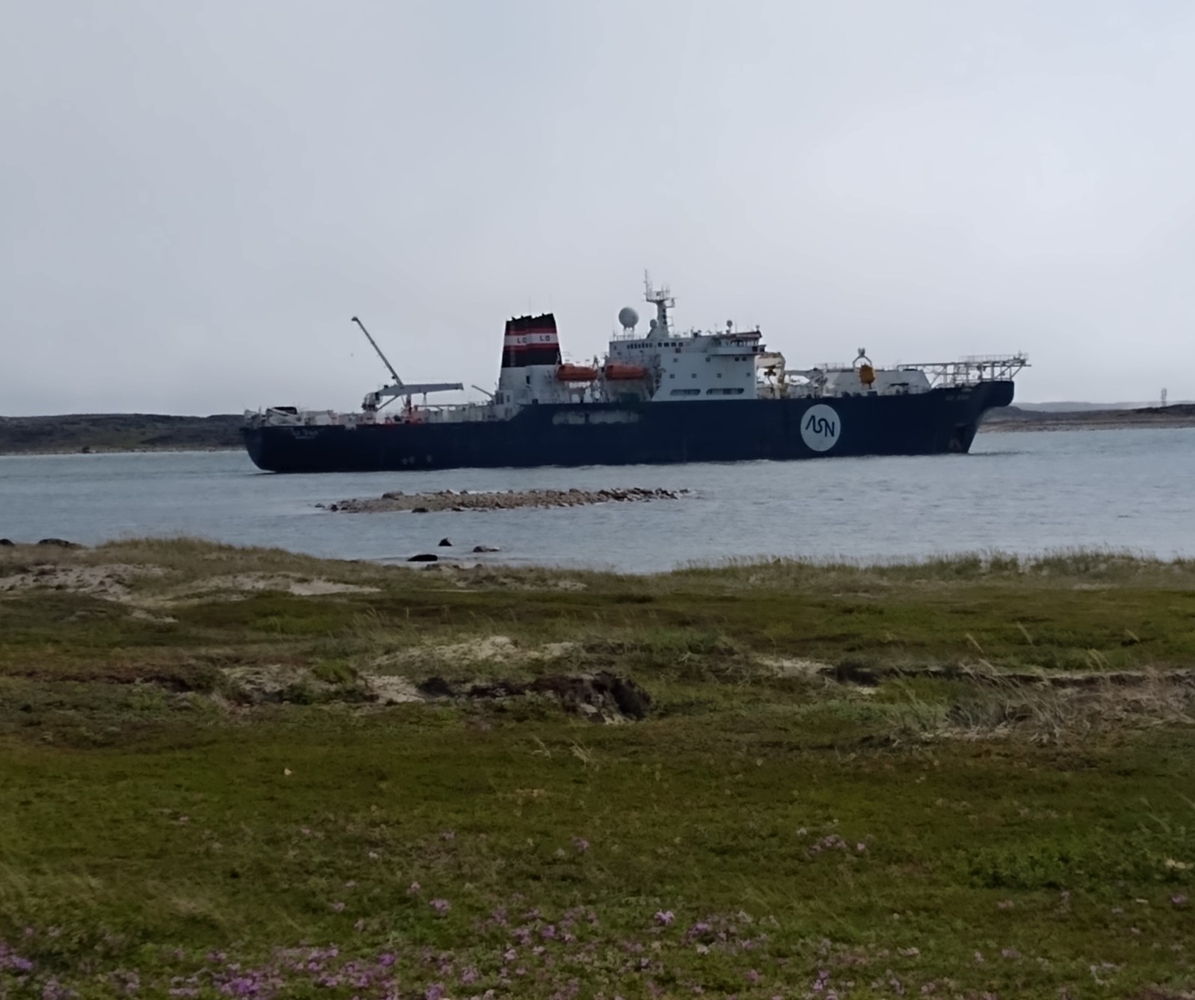
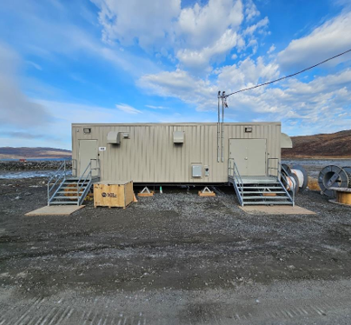
ACHIEVEMENTS TO DATE
7 out of 14 Nunavik communities are connected to the Fibre optic Network
Almost 1200 Km of Optical Fiber network installed in Hudson Bay
$328 million invested since 2018
Affordable High-Speed Internet

Slide 11
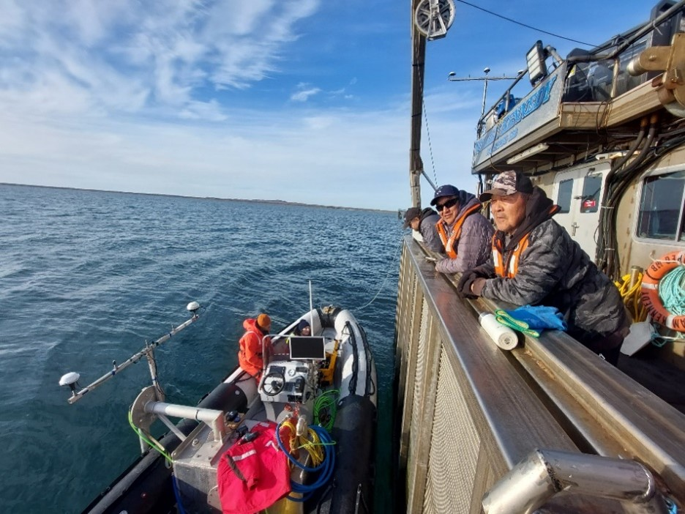
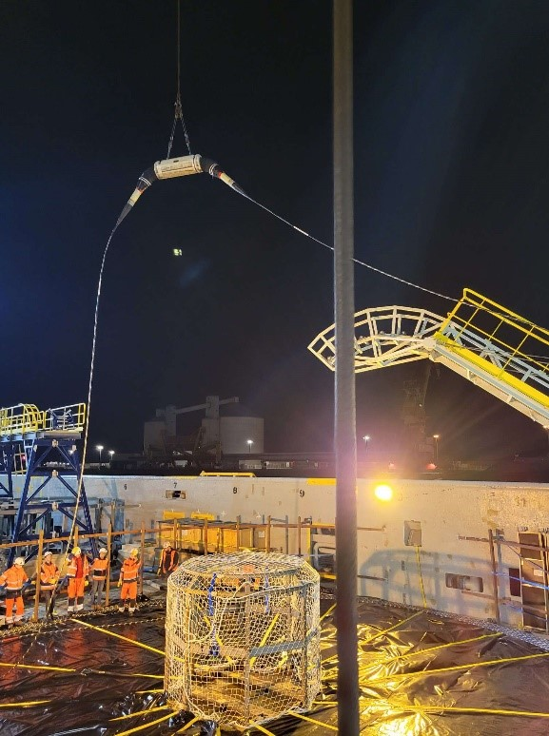
NOT WITHOUT CHALLENGES
The COVID pandemic and subsequent supply and labour issues had a significant impact on the installation schedules and led to an overall cost increase for the project
The marine program for EAUFON-2 was delayed by a year due to ship availability

Slide 12
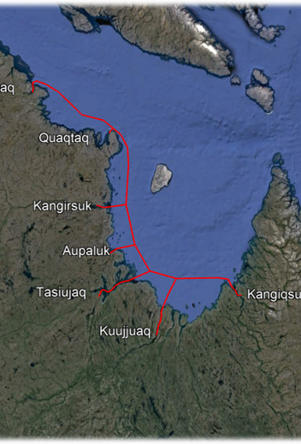
TO BE COMPLETED
Remaining 7 communities in Ungava Bay to be connected – estimated $158 million
2026 Connect Kangiqsujuaq to Salluit
2026 Connect remaining Ungava communities to the submarine fibre
2026 Terrestrial connection between Kuujjuaq and Kawawachikamach

Slide 13
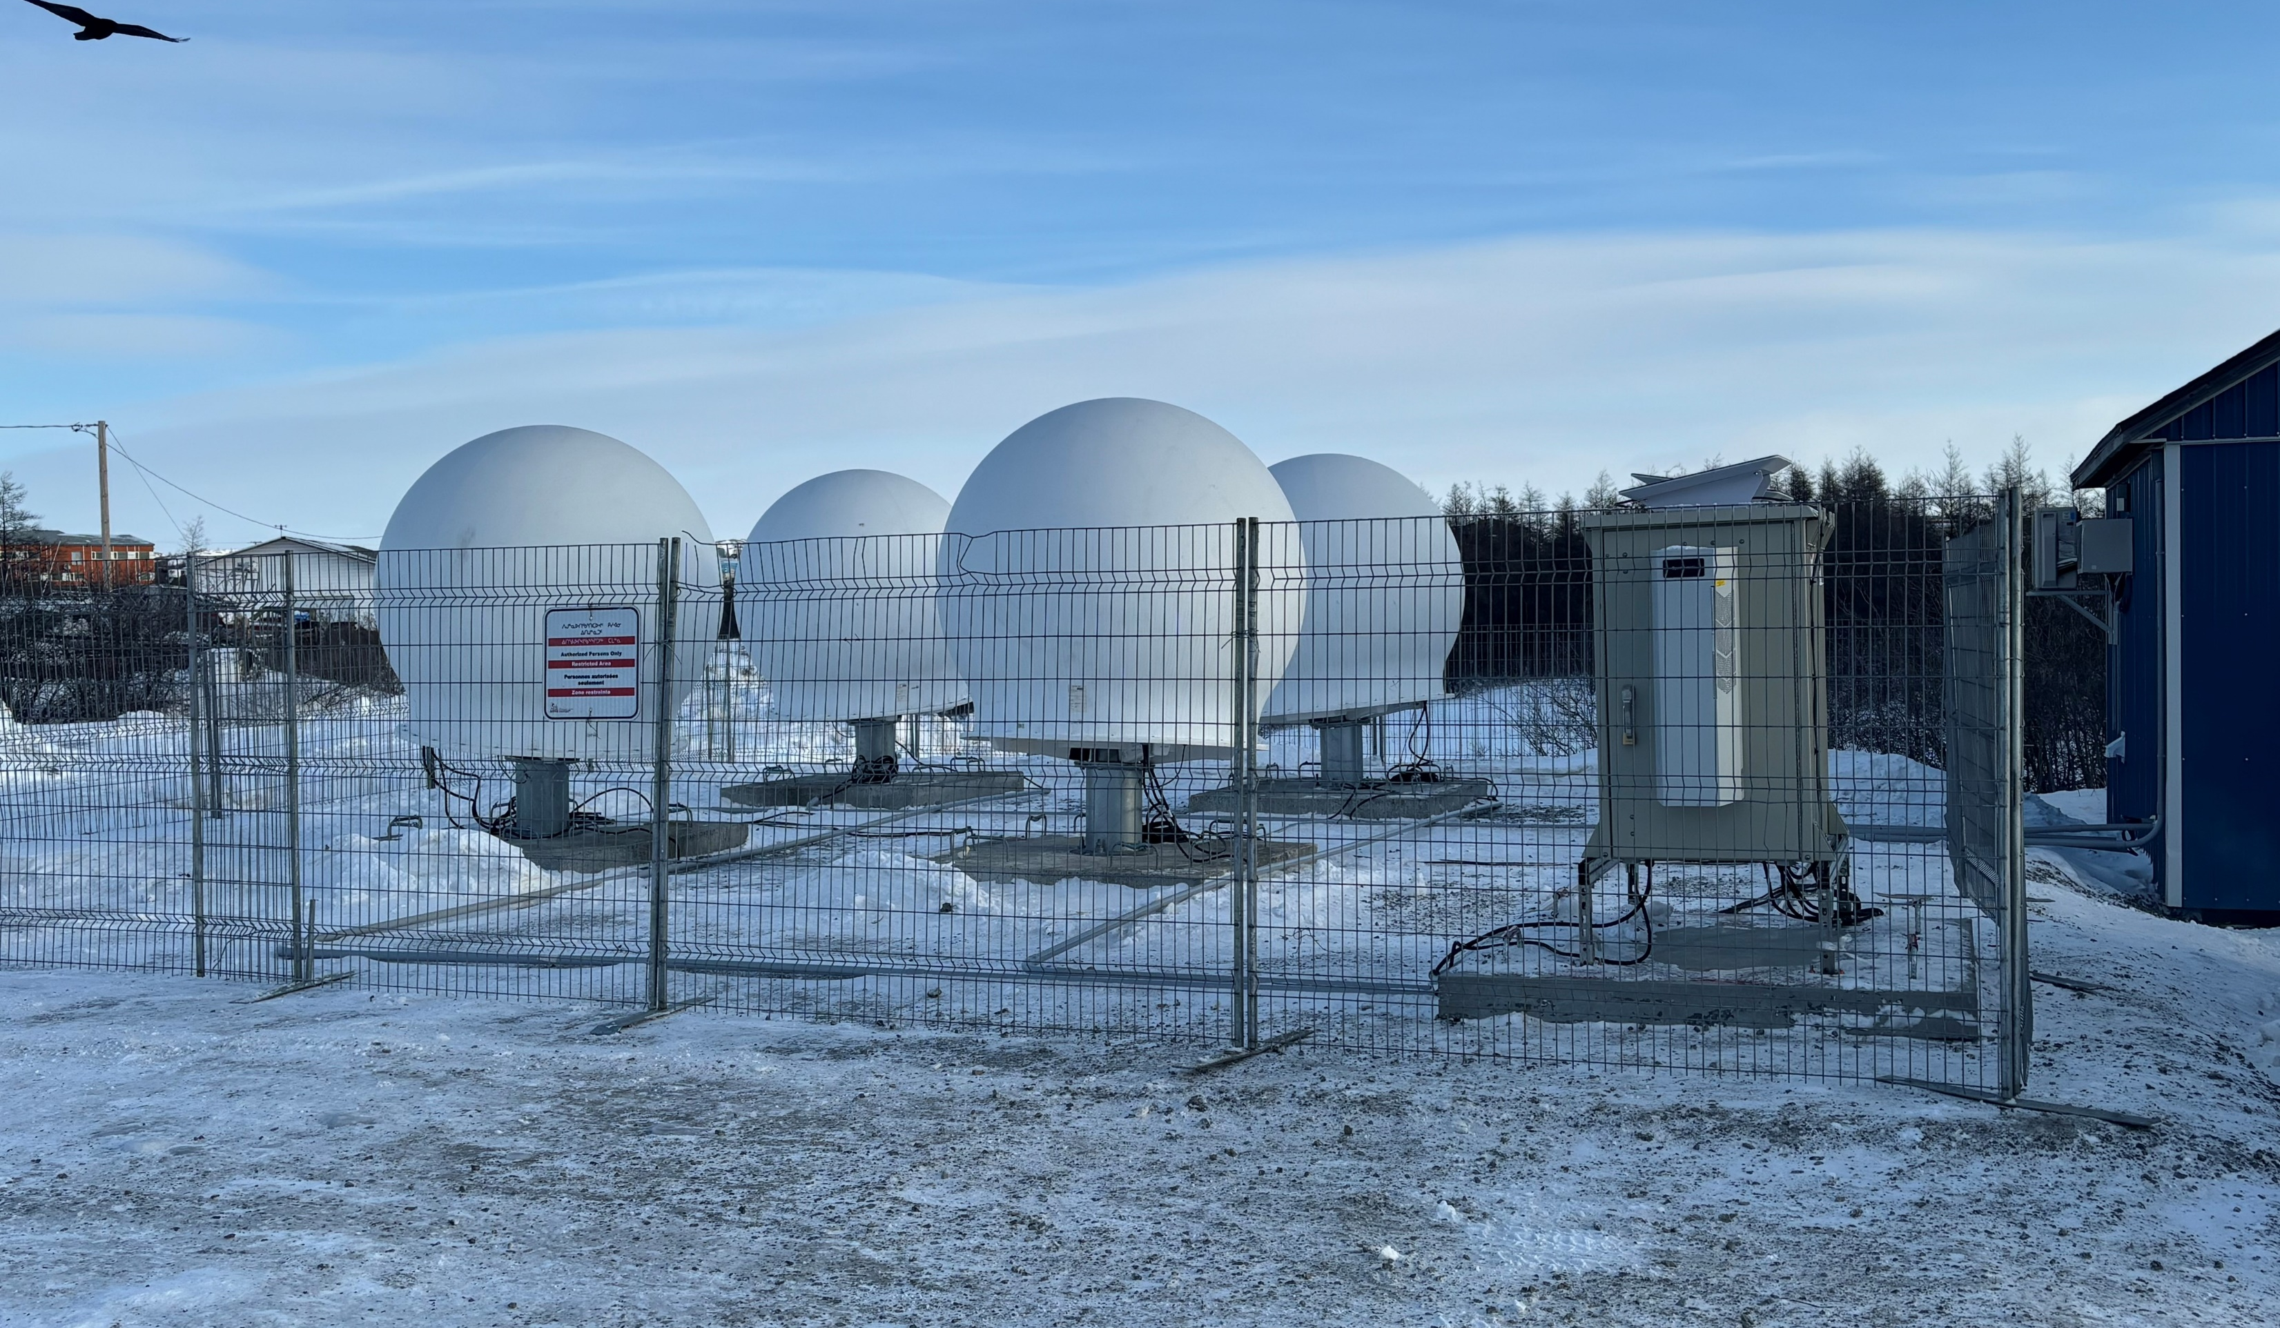
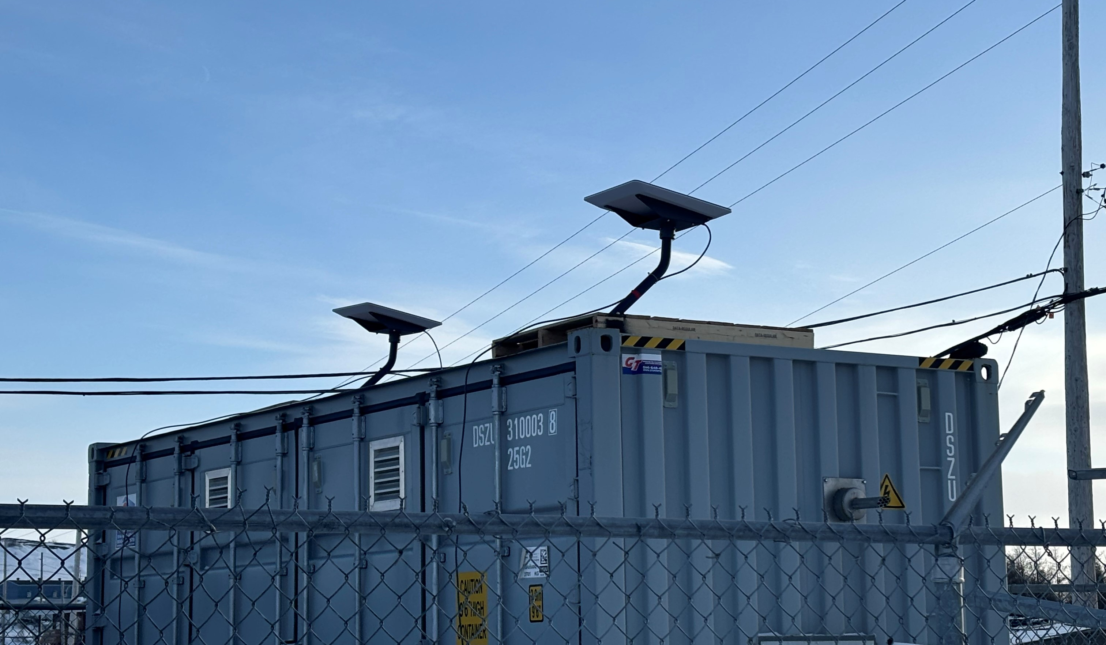
Low Latency Satellite still required
SpaceX Community Gateway installed in Kuujjuaq – 10Gbps capacity - scalable as required
SpaceX High Performance Terminals are being installed in Ungava Bay communities while waiting for the connection to the EAUFON fibre.
Will provide excellent redundancy for the submarine fiber network.

Slide 14
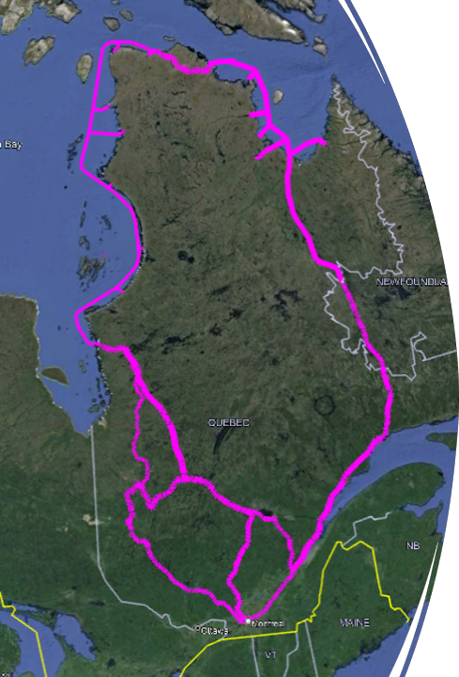
PUTTING IT ALL TOGETHER
A High Speed, High-Capacity network that will eliminate the Digital Divide
Full Redundancy
Low Latency

Slide 15

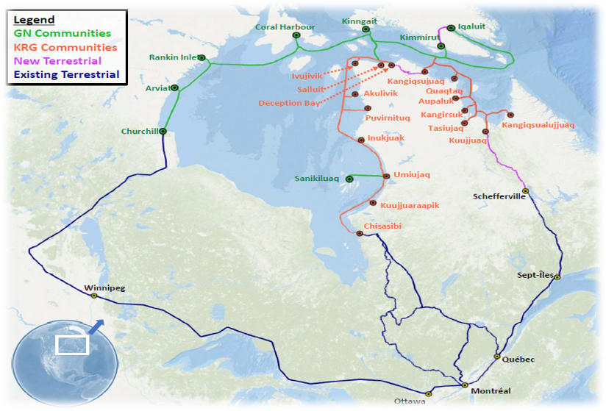
OR THIS…..
The KRG has built its network to be very extendable

Slide 16

WHY FIBRE?
With the implementation of a Fibre Optic cable bringing more dependable and reliable broadband/internet into Nunavik, it will broaden opportunities and open doors currently closed as a result of slow and unreliable connectivity.
The results of Fibre positively impact:
Socio & Economic value opportunities
Tele-Health opportunities
Tele-Education opportunities
Tele-Justice opportunities
No longer will accessing the internet be faster or slower depending on the time of day or how clear the skies are. Instead, the speed of the internet will be faster than ever and remain constant regardless of outside forces.
Over the longer term, a fibre optic solution is much more economical than satellite costs while providing 100% of Nunavik’s broadband requirements

Slide 17
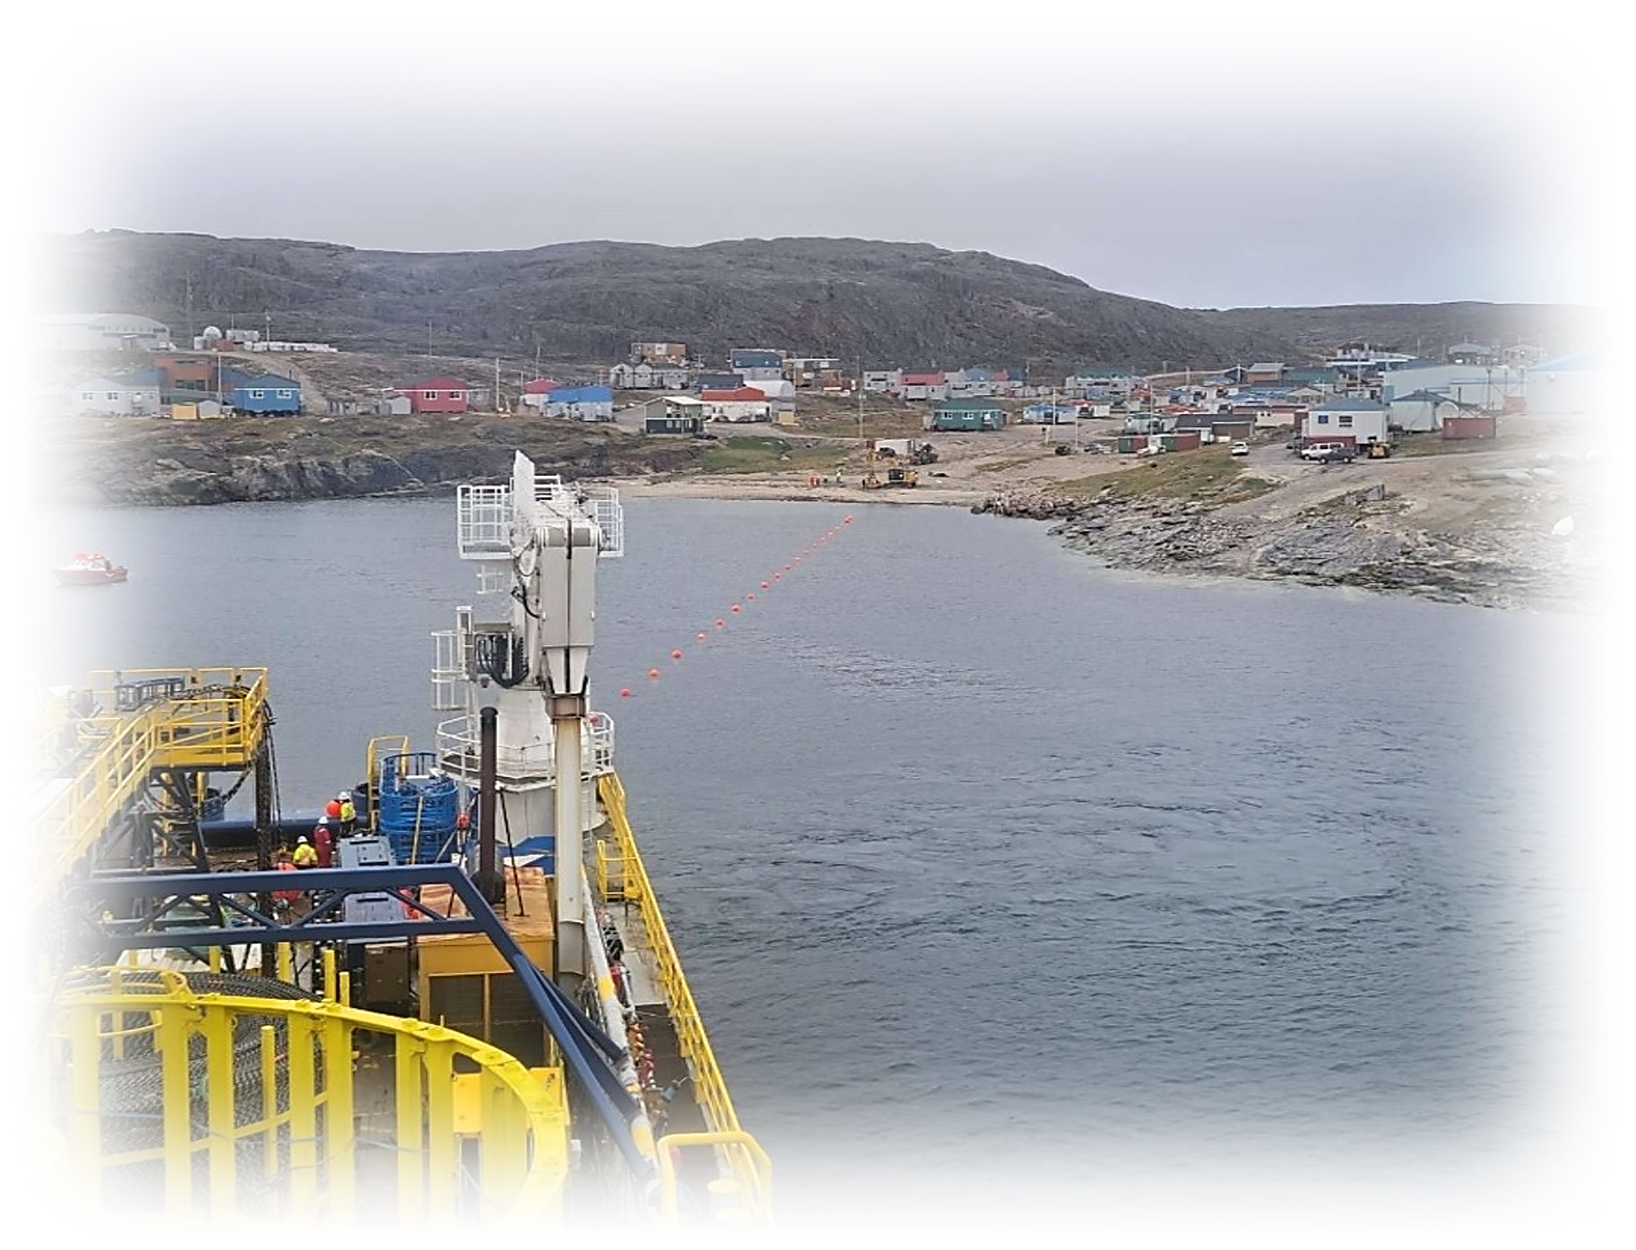








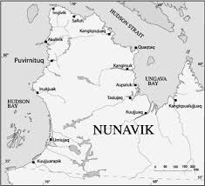

Acknowledgements

Slide 18
Thank You

