Slide 1

A Nunavik Community Organization
KRG Regional Council, February 2025

Slide 2
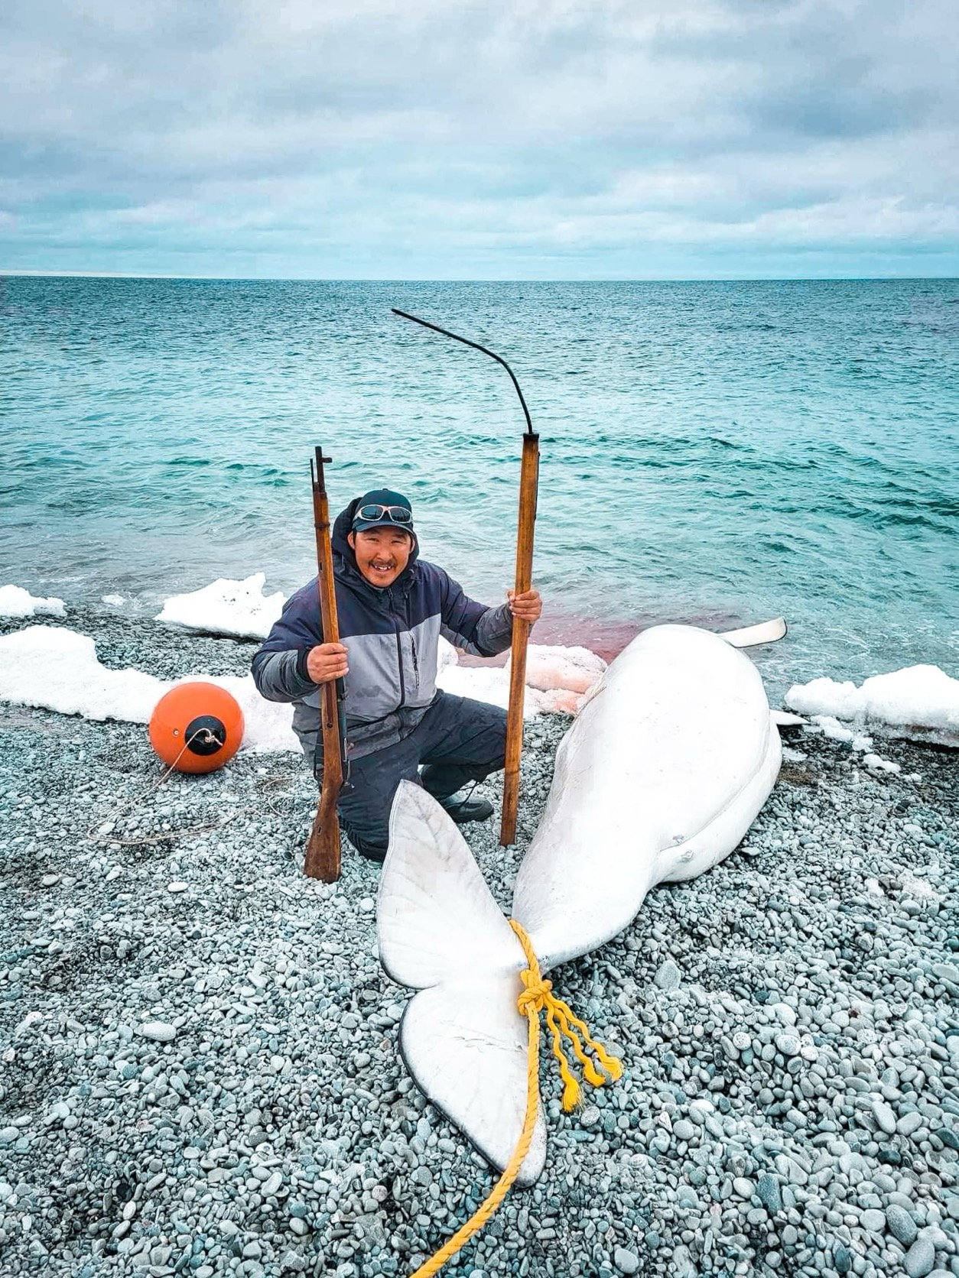
Mission
Promote cultural healing in Nunavik through community actions rooted in Inuit values and traditions

Slide 3
Values
Inuit cultural safety
Inuit leadership
Respect
Healing
Teaching
Compassion about inuit realities and lifestyles
Collaboration

Slide 4
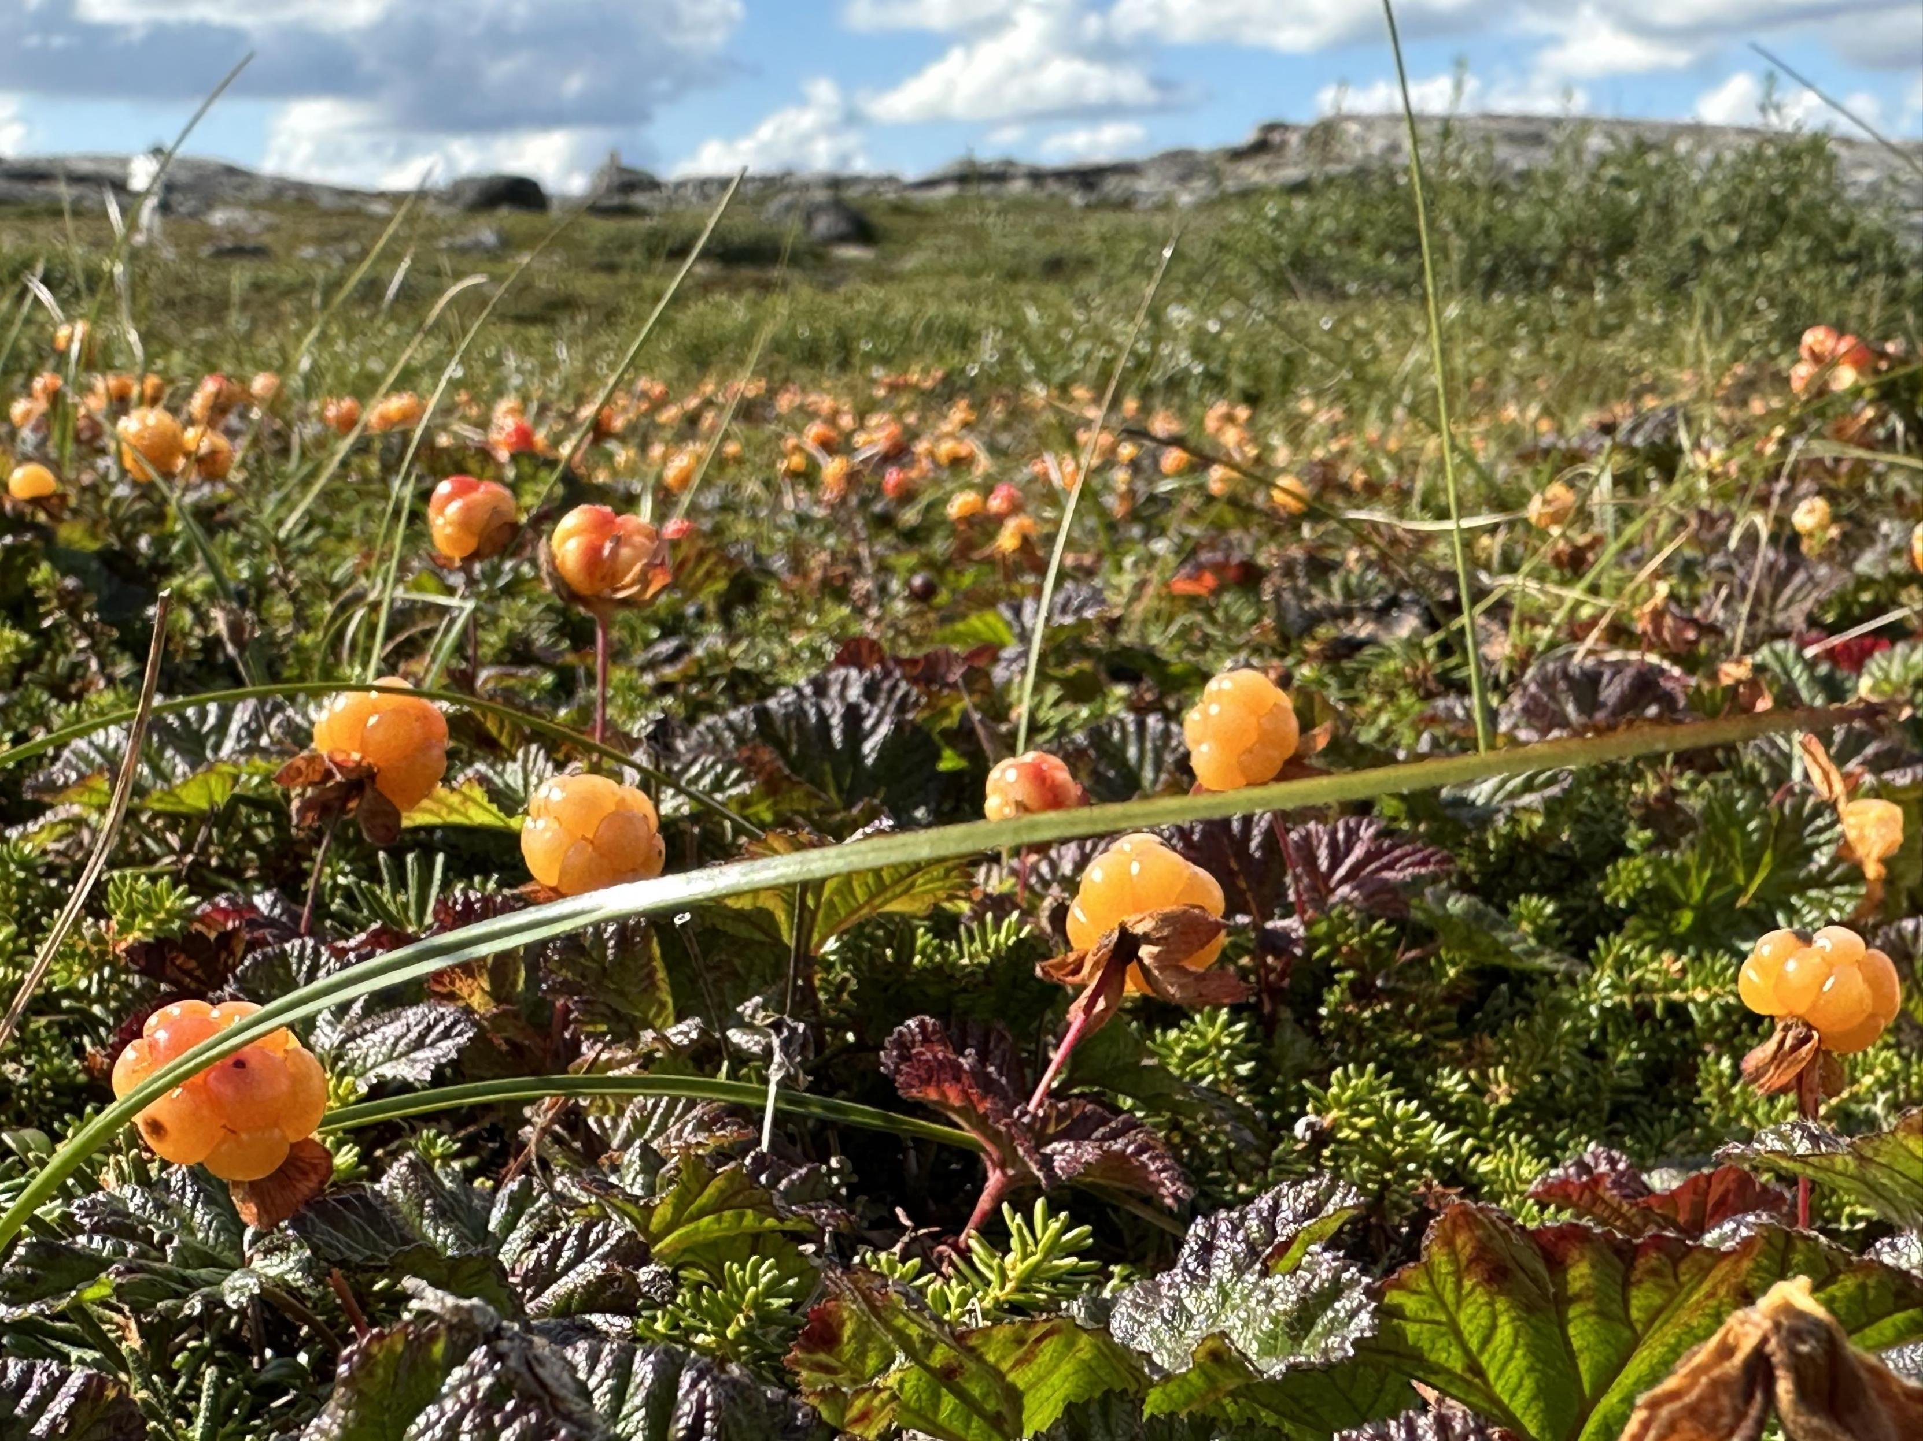
Objectives
PREVENTION
-Promote positive ways of living
-Offer activities to build self-esteem in Inuit youth
-Teach Inuit cultural-community values
INTERVENTION
Offer community-based services to lower :
-Criminalization of social issues
-Hospitalisation
-Substance abuse
-Psychosocial crises
-Suicide

Slide 5
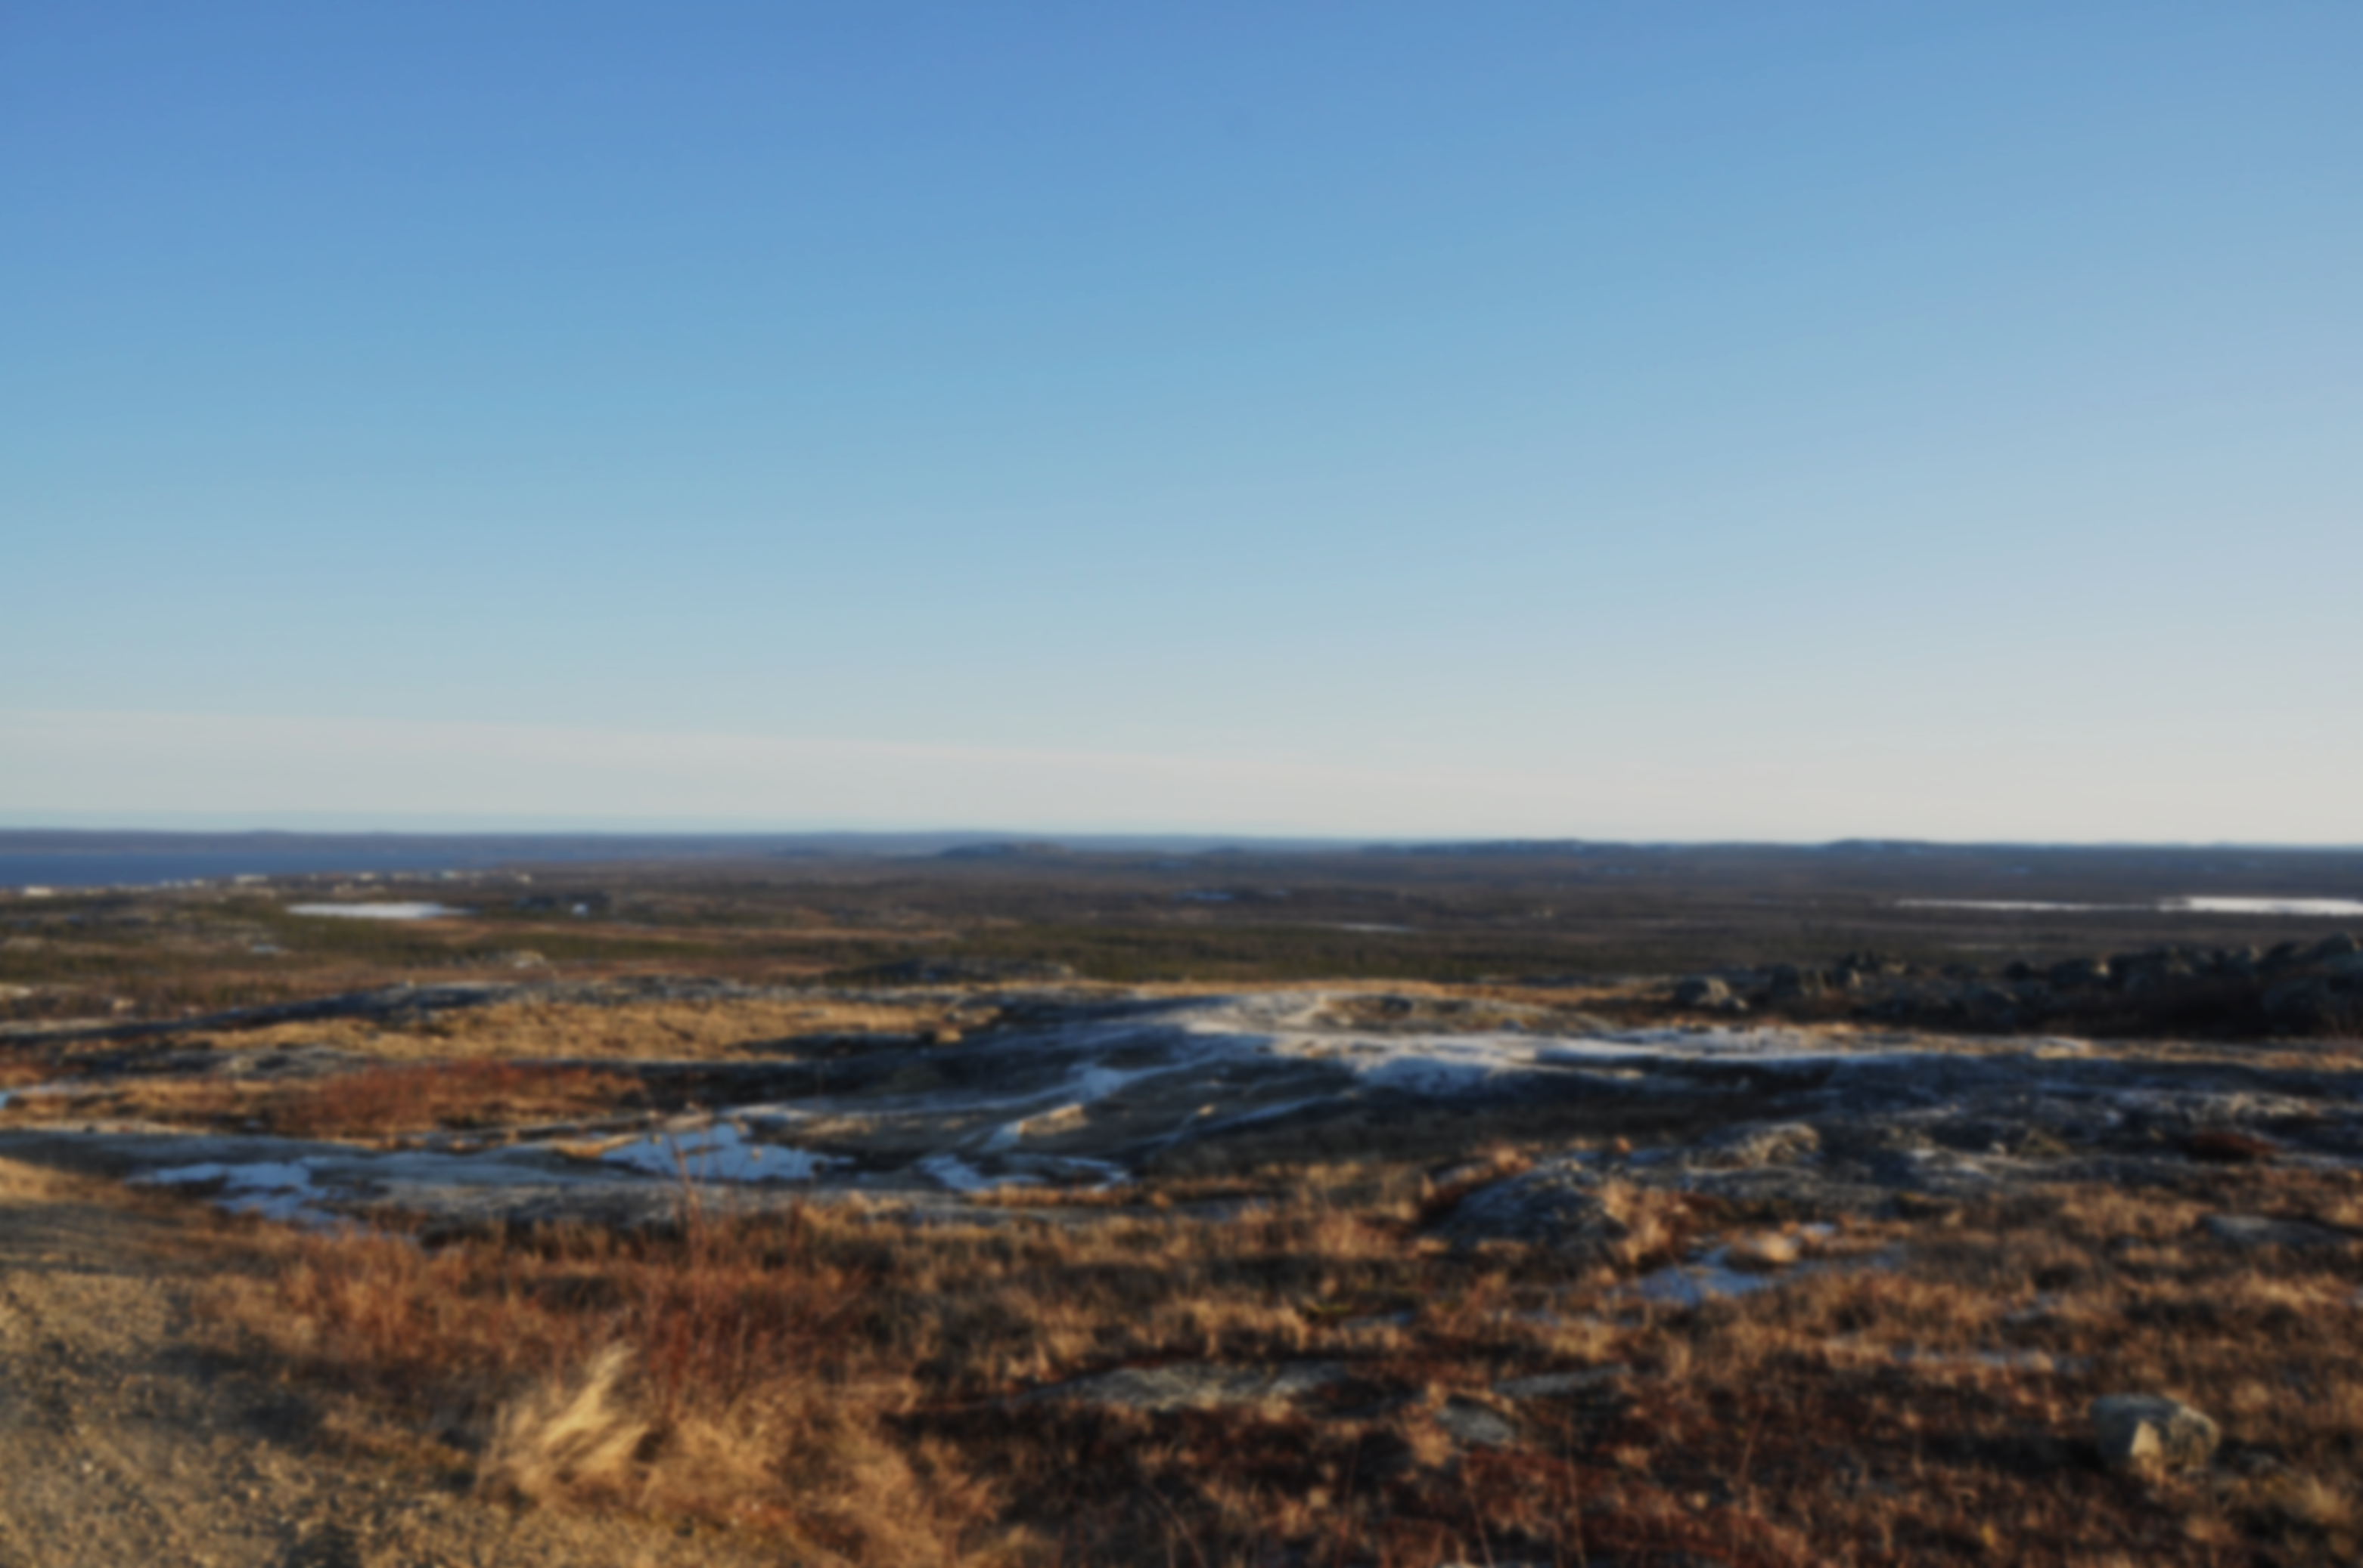
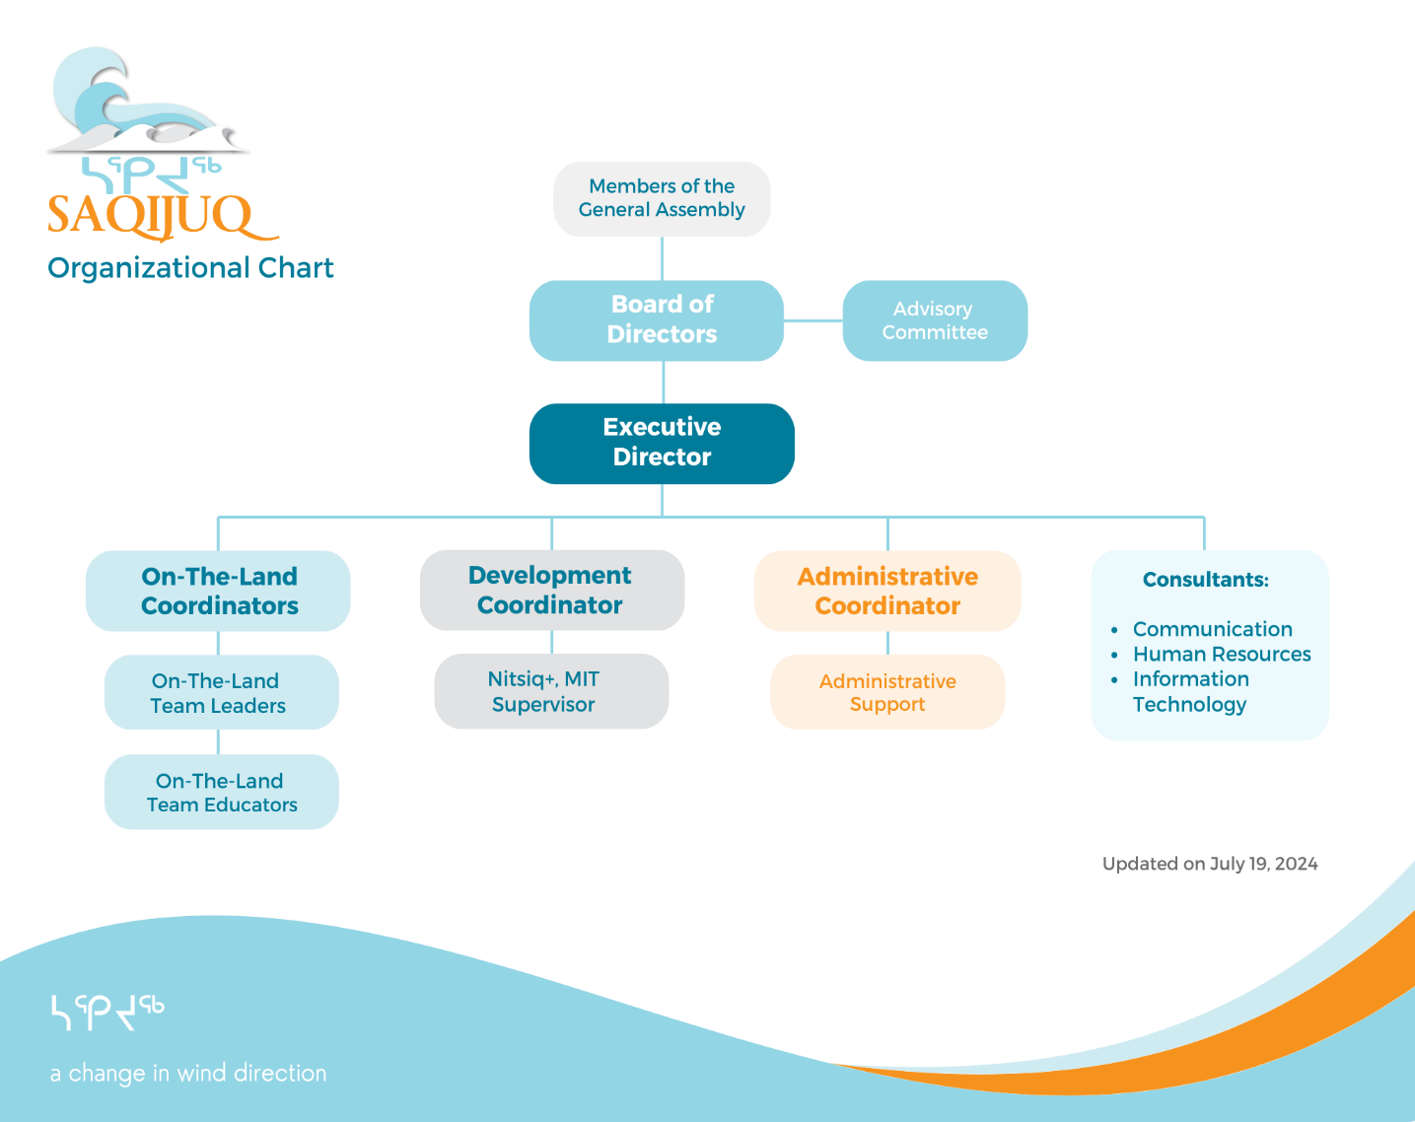
Organizational chart
91% of all Saqijuq jobs are held by Inuit
Notes:
We have 34 positions

Slide 6
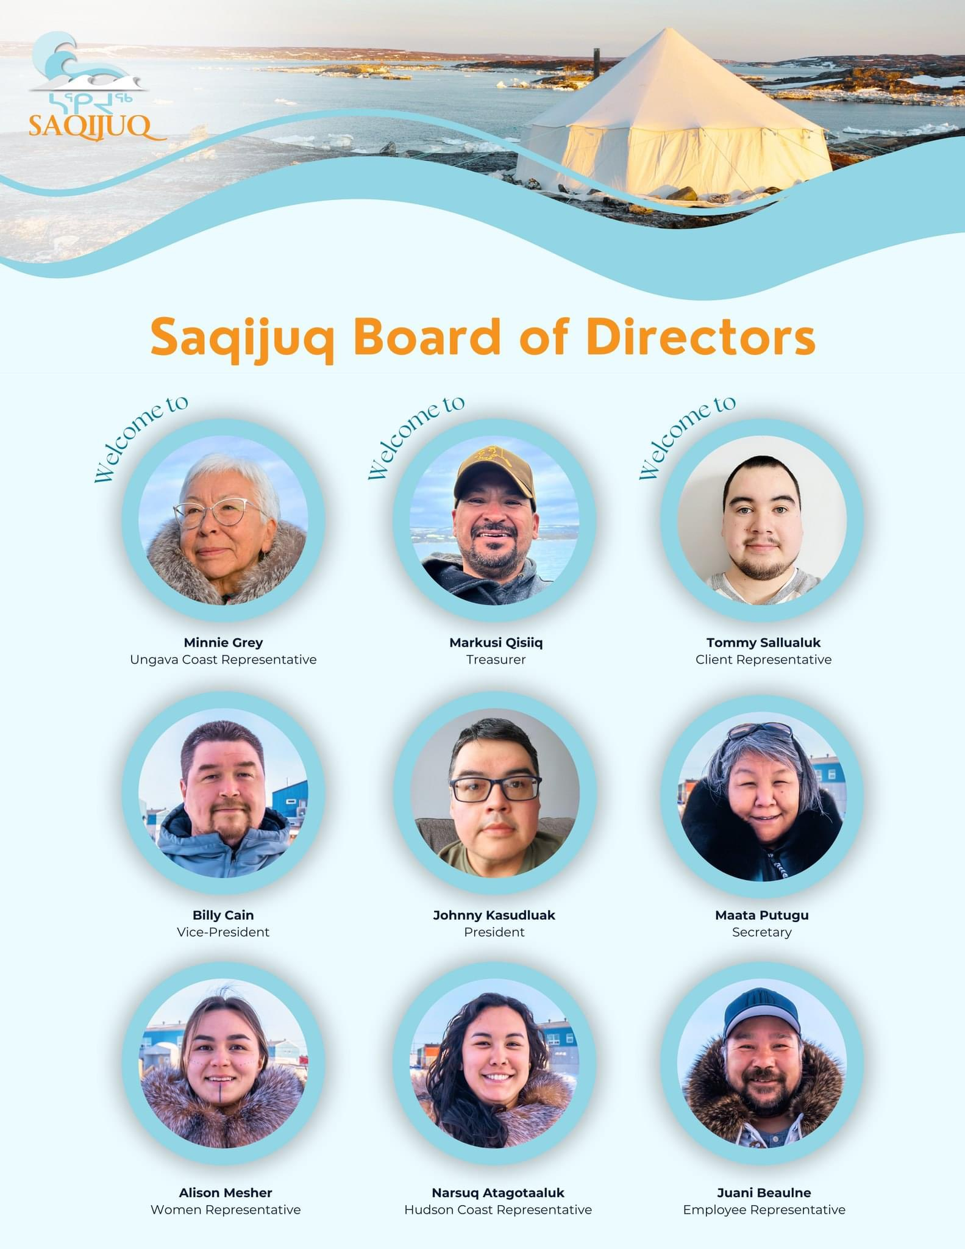

Slide 7
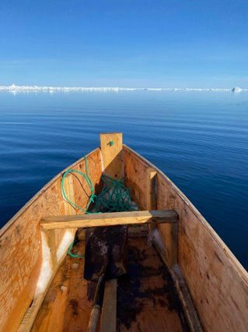
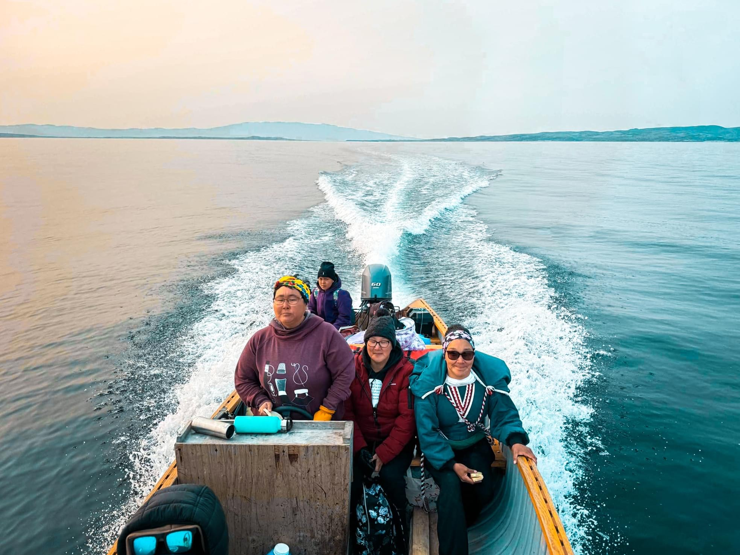
On-The-Land
ON-THE-LAND
Saqijuq OTL composes of men and women educators to offer many different cultural activities and workshops for the clients to participant.
The cultural values that are passed on to the most vulnerable individuals of the community by helping them reconnect to their roots
By reconnect our clients with their cultural, we teach them alternative coping tools instead of them potentially turning to drugs or alcohol.
OTL teams offer a community-based approach to interventions by bring clients back to their cultural identity.

Slide 8
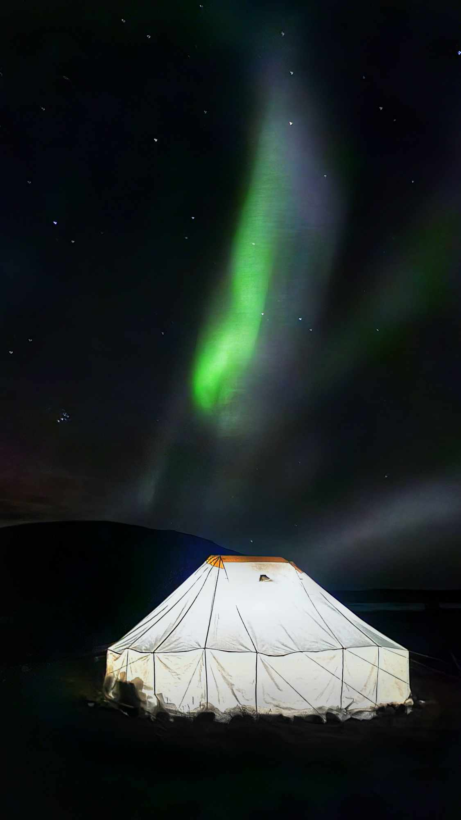
On-the-land
Everything harvested is offered to the community for elders, vulnerable families, community events and clients.
Currently in 6 communities: Inukjuak, Puvirnituq, Akulivik, Kuujjuaq, Kangirsuk and Kangiqsualujjuaq
In 2024,
More than 1950 participations
in
1500 outings/activities

Slide 9
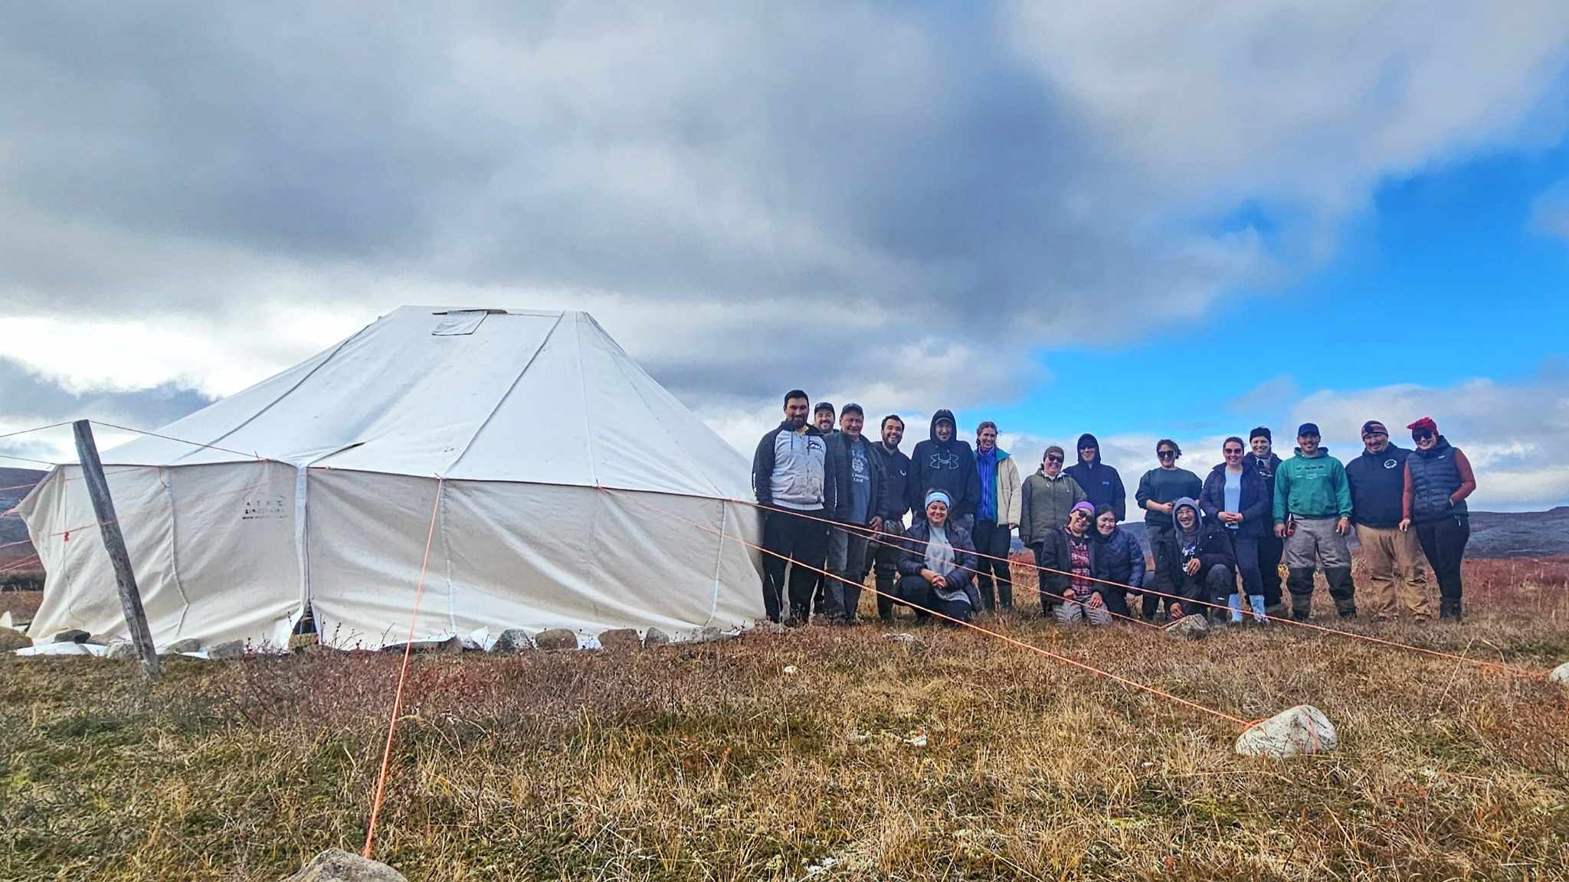
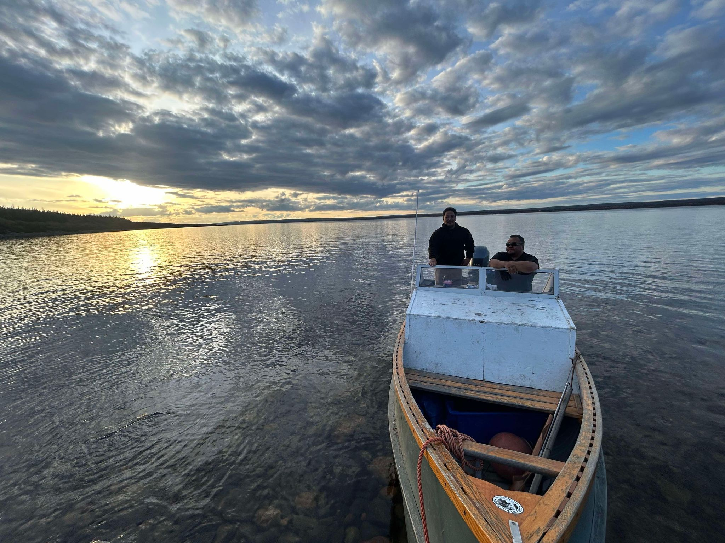
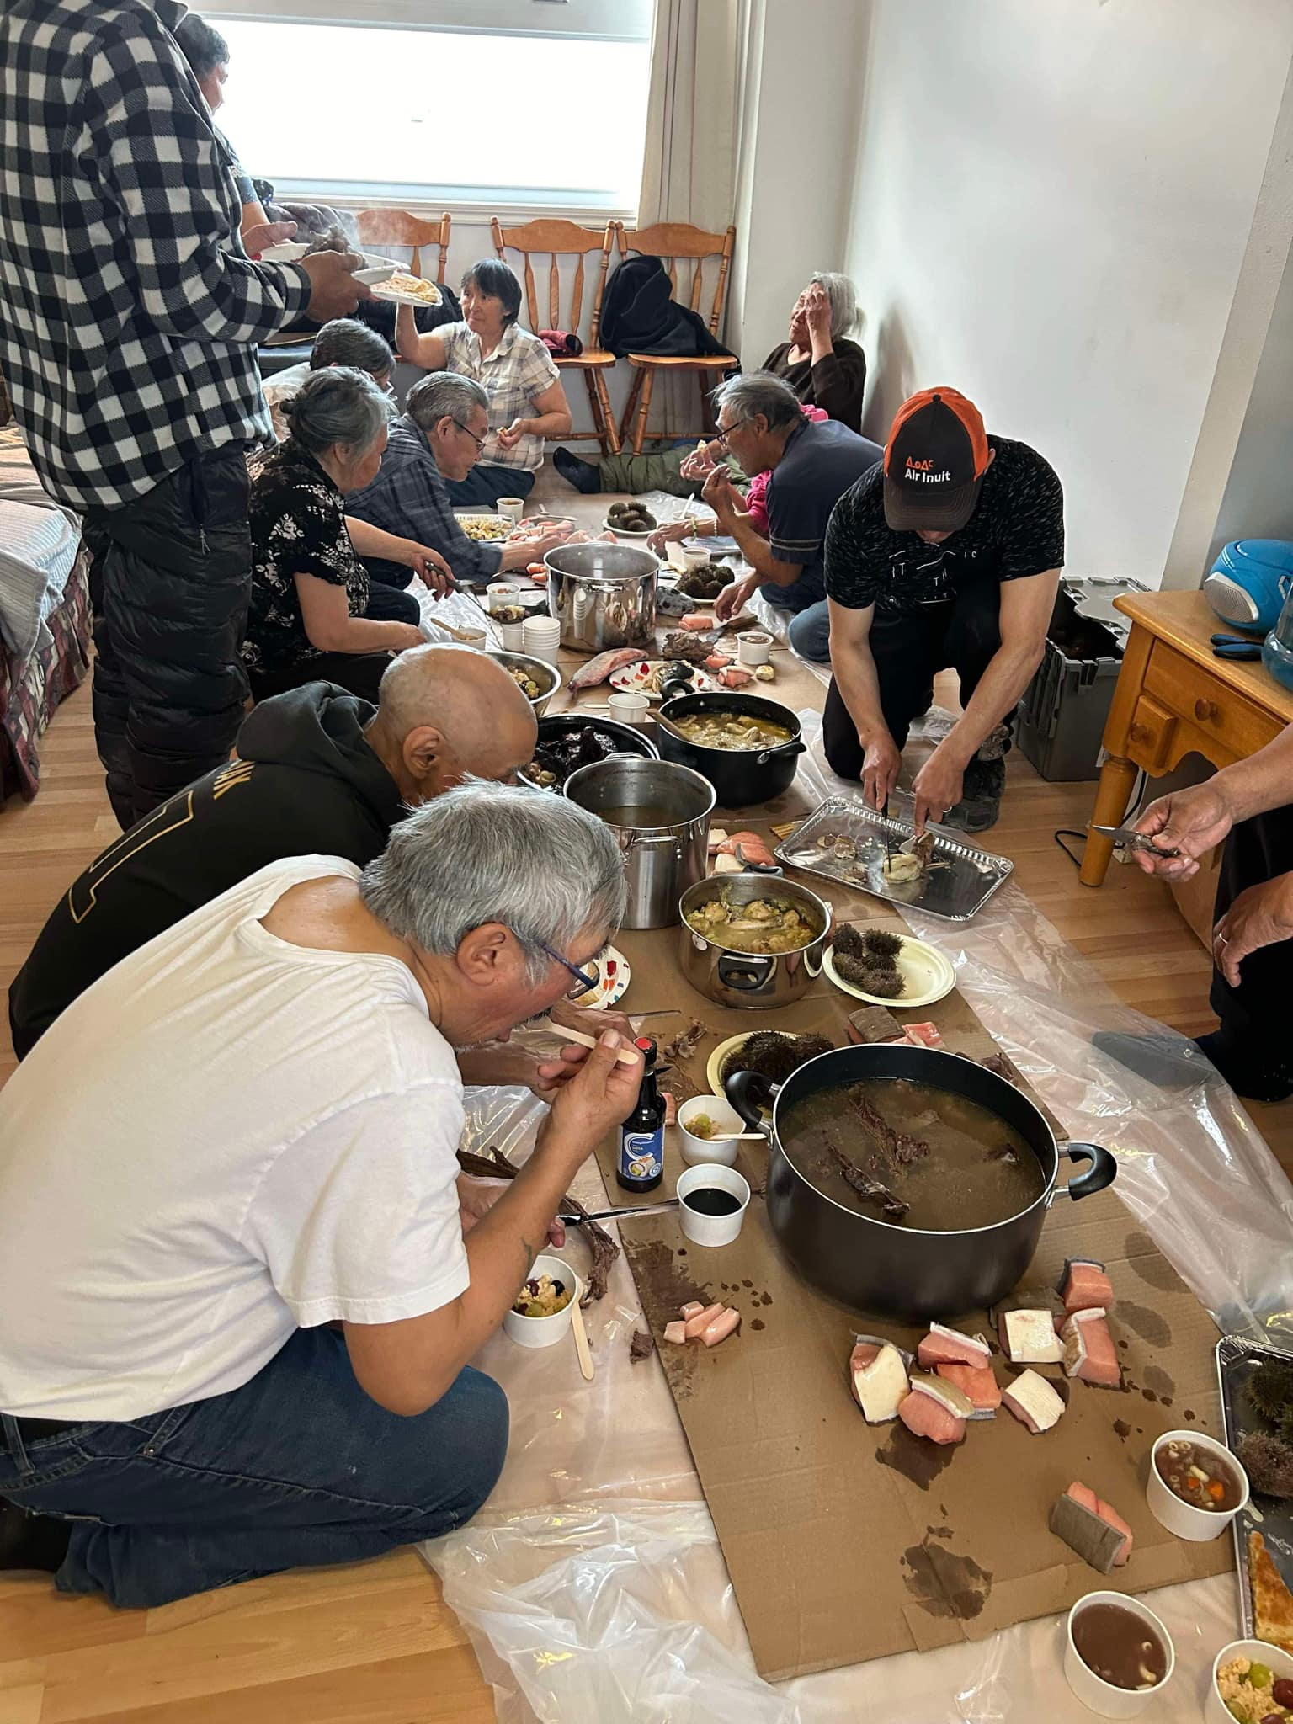
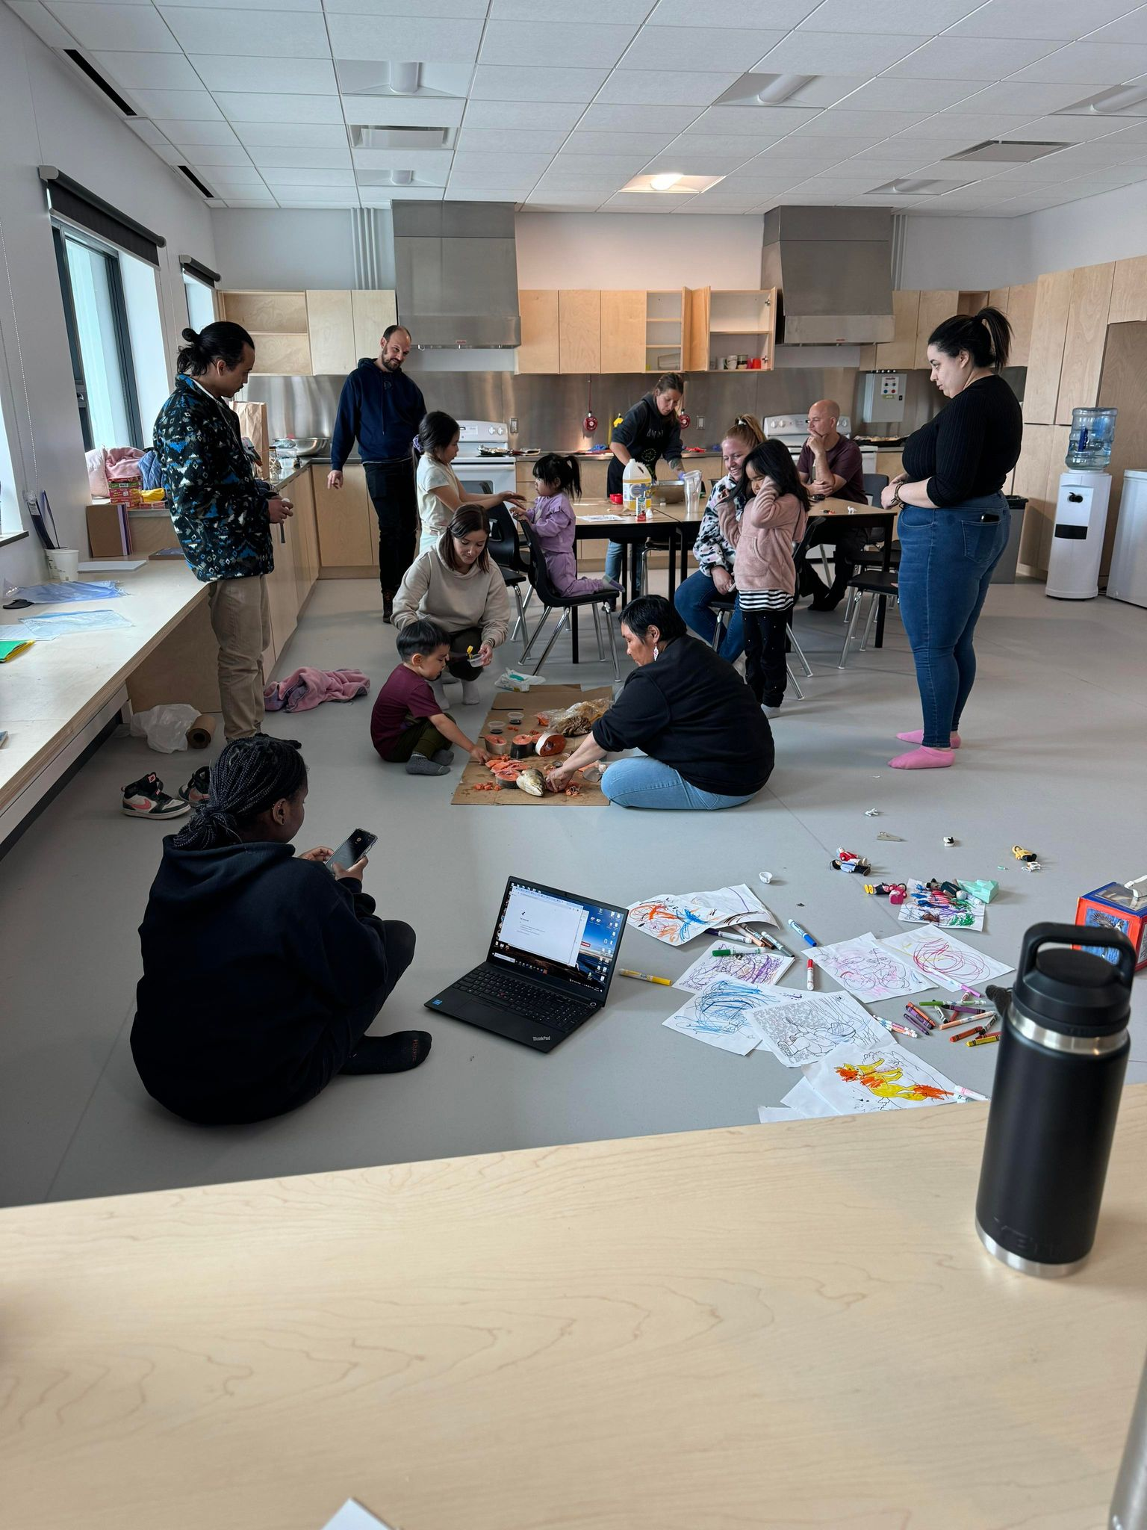
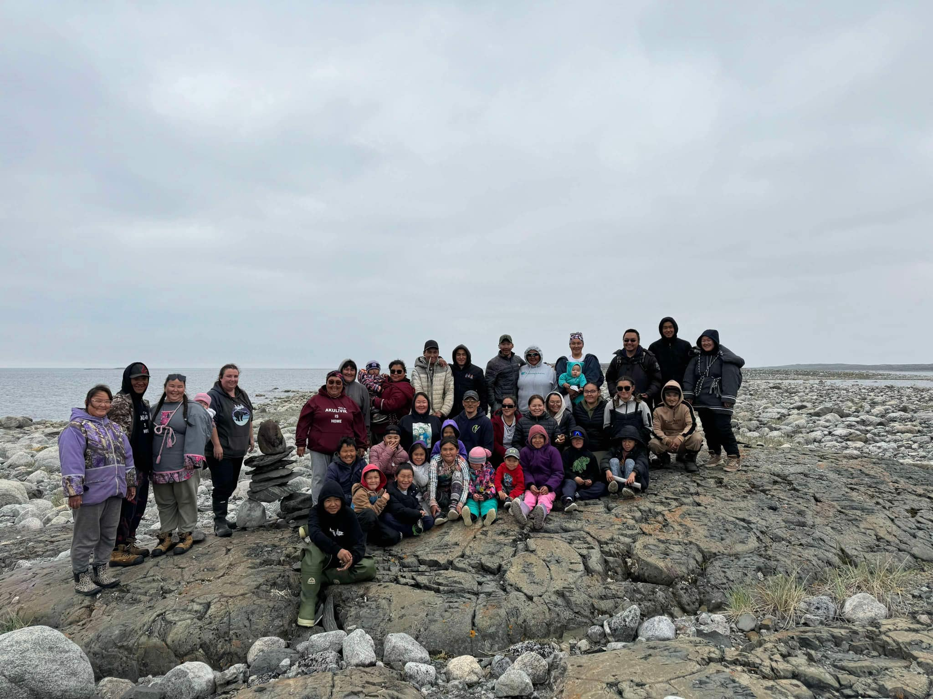

Slide 10
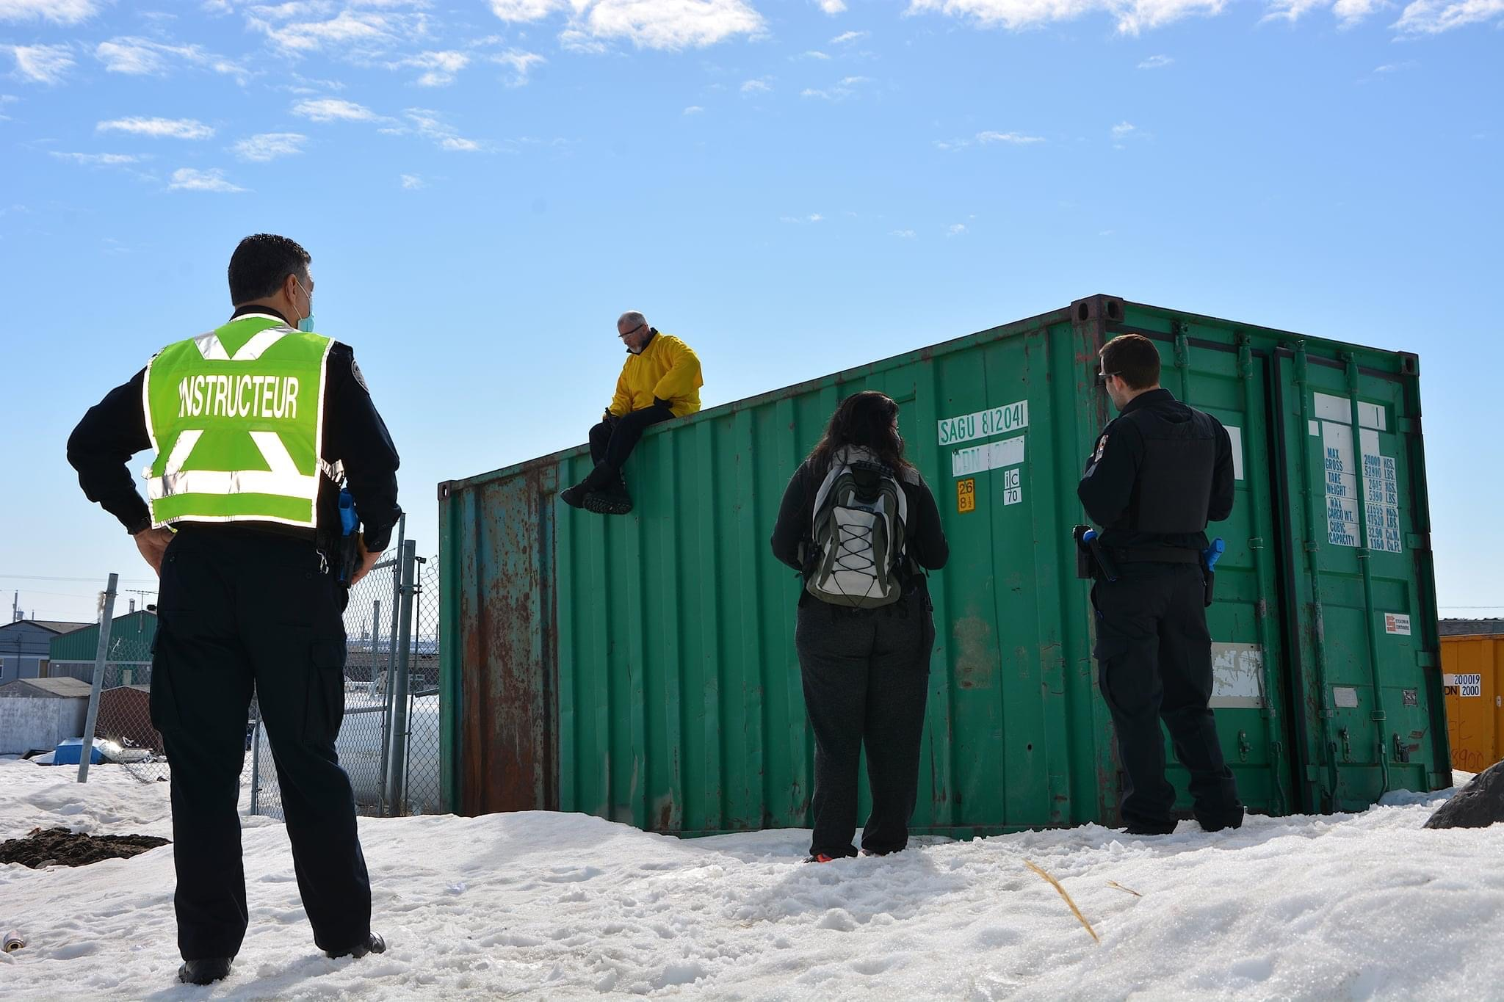
Mobile intervention team (MIT)
The MIT is a patrol team composed of a social worker and a police officer who patrols the community and respond to crisis such as : suicide crisis, conjugal violence, mental health and children at risk calls
They use de-escalation and pacification techniques in order to solve the crisis in the community with family and friends
Running in Puvirnituq in collaboration with IHC

Slide 11
Mobile Intervention Team
From January to December 2024:
595 interventions were done
85% of the interventions were resolved within the community
70% of the interventions were with women
97% of the interventions had no judicial intervention (detention, P-38)
74% of the clients were collaborative with the MIT

Slide 12
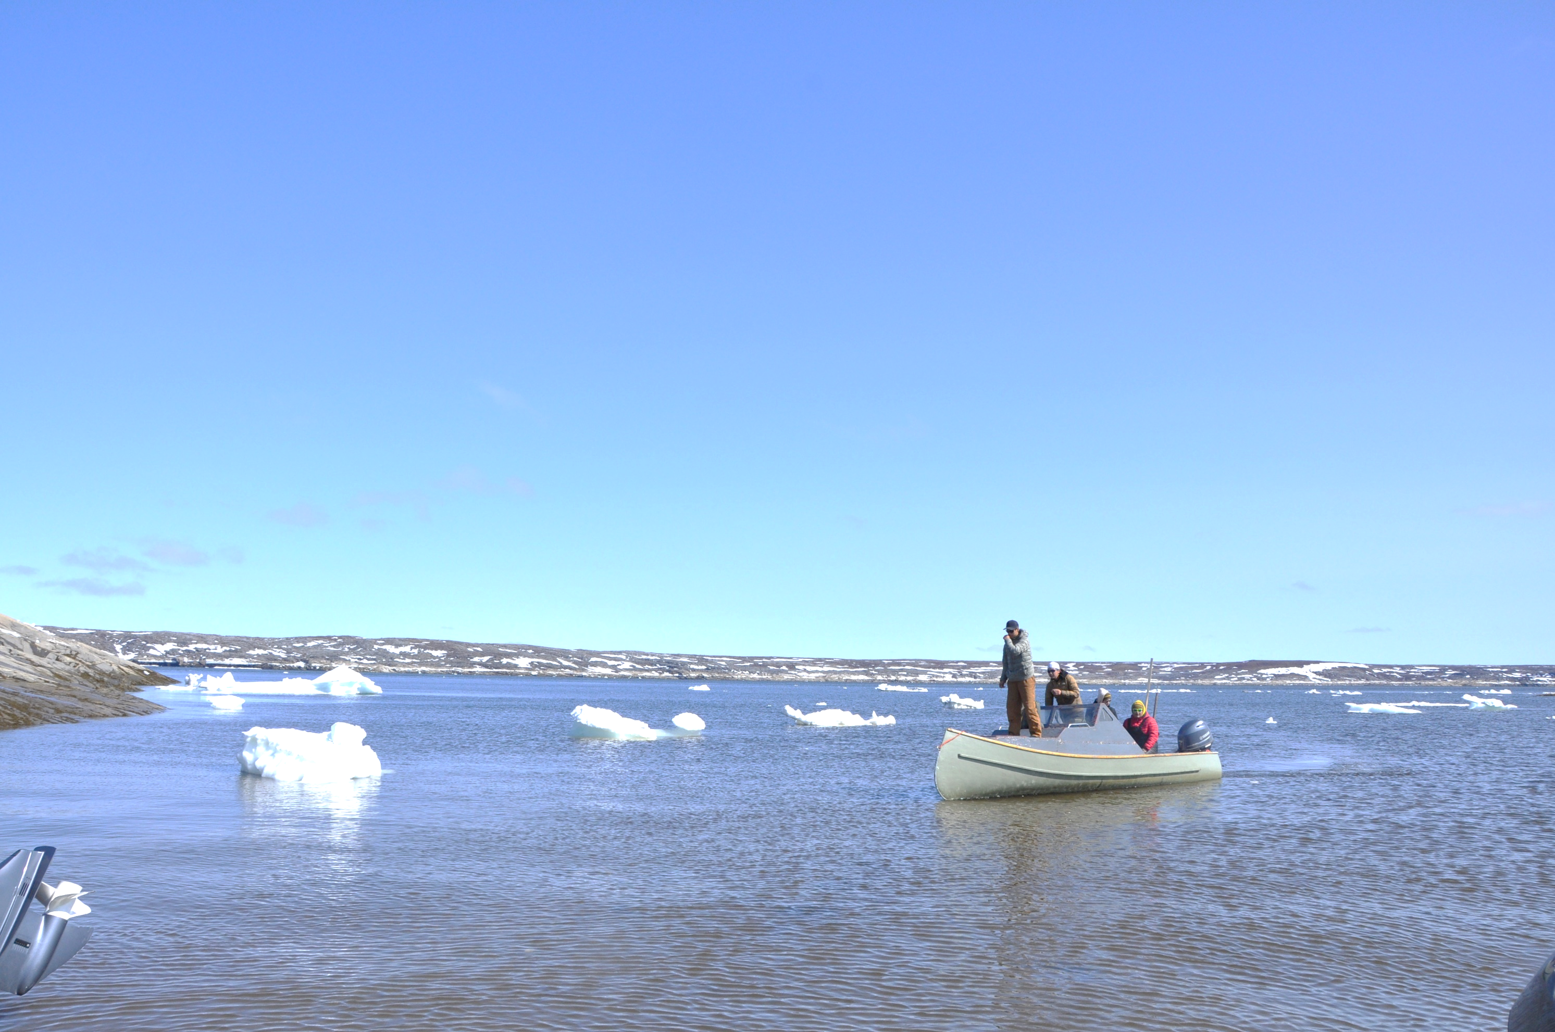
Finances
Main source of funding
Ungaluk 3.4 million per year (KRG and Makivvik)
Other funding sources
Quebec Ministry of Justice
Northern and Indigenous crime prevention fund
NRBHSS
Ministry of Public Security (federal and provincial)
SRPNI (secrétariat aux relations avec les Premières Nations et les Inuit)
Secrétariat à la condition féminine
Total of approximately $8 million for 2024

Slide 13
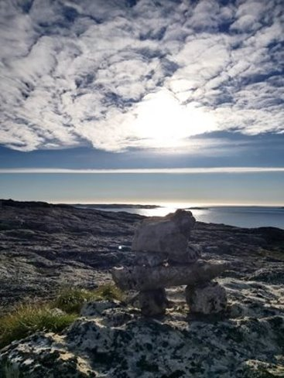
Upcoming steps
Developing MIT in Kuujjuaq
Expanding Saqijuq Across Nunavik
On-the-land workshops in collaboration with partners
Secure office spaces
Offer more services for all community members where Saqijuq is implimented

Slide 14
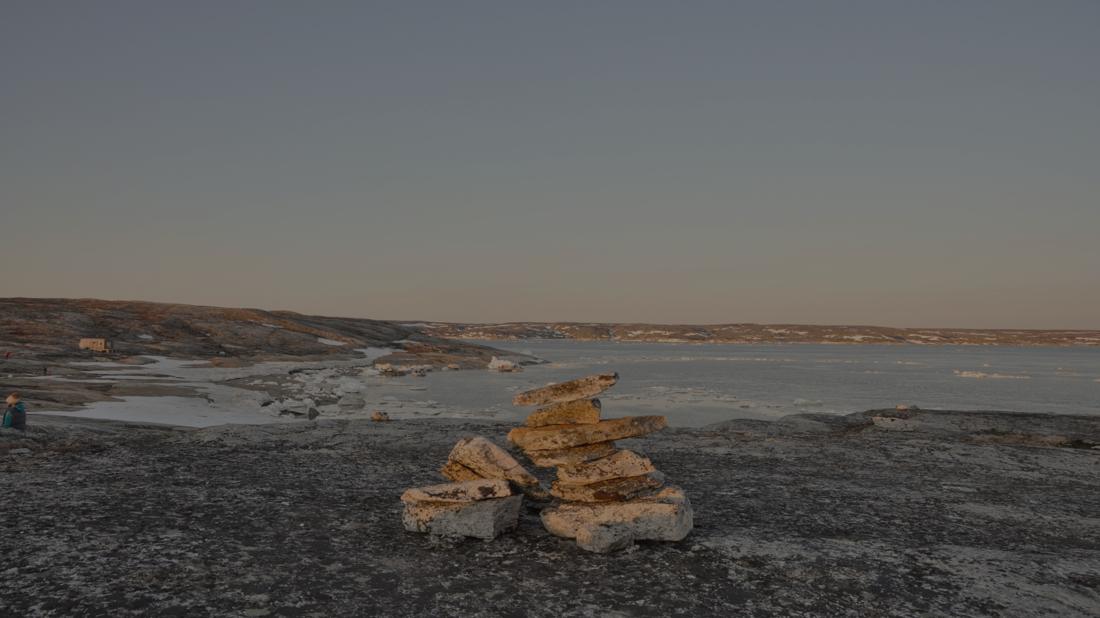
Any questions?
Nakurmiik!

