Slide 1

Nunavik Police Service
Criminal Stastictics
January to April 2025

Slide 2
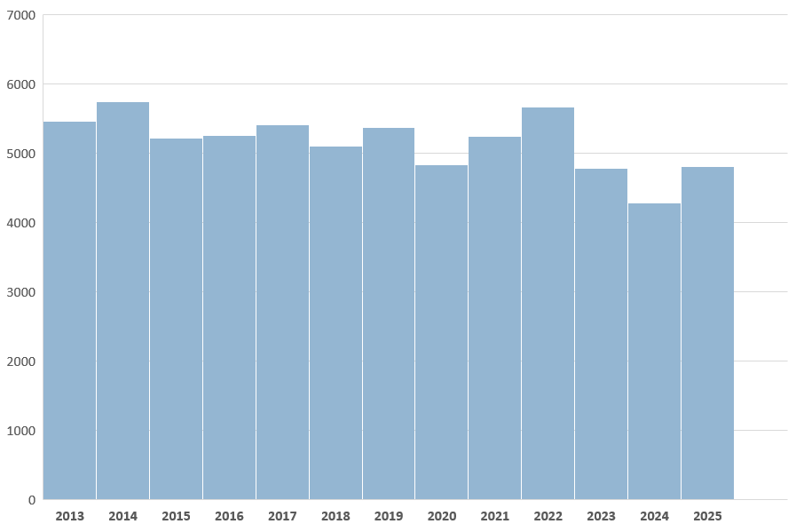
Total Criminal Incidents Evolution

Slide 3
Nunavik
Murder
Attempter Murder
Suicide
3-Year Comparison – January 1st to April 30

Slide 4
Nunavik
Crime against the person
Assault
Assault with a weapon
3-Year Comparison – January 1st to April 30th

Slide 5
Nunavik
Crime against the person
Sexual Assault
Sexual Assault with a weapon
3-Year Comparison – January 1st to April 30th

Slide 6
Nunavik
Declared Motor Vehicle Accidents
Fatal Accidents
3-Year Comparison – January 1st to April 30th

Slide 7
Nunavik
Crimes involving weapons
Careless use of firearm
Pointing a firearm
3-Year Comparison – January 1st to April 310th

Slide 8
Nunavik
Number of detentions
3-Year Comparison – January 1st to April 30th

Slide 9
Nunavik
Number of detentions
Adults detained criminally
Adults detained non-criminally
Youths detained criminally
Youths detained non-criminally
3-Year Comparison – January 1st to April 30th

Slide 10
Nunavik
Assistance files
Person in Distress
Search and Rescue
By-Law
3-Year Comparison – January 1st to April 30th

Slide 11
Nunavik
Summary – All Police Interventions
3-Year Comparison – January 1st to April 30th

Slide 12
Akulivik
Specific Crime Trends
Murder
Attempted Murder
3-Year Comparison – January 1st to April 30th

Slide 13
Akulivik
Specific Crime Trends
Assaults
Assault with a weapon
3-Year Comparison – January 1st to April 30th

Slide 14
Akulivik
Specific Crime Trends
Sexual Assault
Sexual Assault with a weapon
3-Year Comparison – January 1st to April 30th

Slide 15
Akulivik
Specific Crime Trends
3-Year Comparison – January 1st to April 30th

Slide 16
Akulivik
Summary – All Police Interventions
3-Year Comparison – January 1st to April 30th

Slide 17
Aupaluk
Specific Crime Trends
Murder
Attempted Murder
3-Year Comparison – January 1st to April 30th

Slide 18
Aupaluk
Specific Crime Trends
Assaults
Assault with a weapon
3-Year Comparison – January 1st to April 30th

Slide 19
Aupaluk
Specific Crime Trends
Sexual Assault
Sexual Assault with a weapon
3-Year Comparison – January 1st to April 30th

Slide 20
Aupaluk
Specific Crime Trends
3-Year Comparison – January 1st to April 30th

Slide 21
Aupaluk
Summary – All Police Interventions
3-Year Comparison – January 1st to April 30th

Slide 22
Inukjuak
Specific Crime Trends
Murder
Attempted Murder
3-Year Comparison – January 1st to April 30th

Slide 23
Inukjuak
Specific Crime Trends
Assaults
Assault with a weapon
3-Year Comparison – January 1st to April 30th

Slide 24
Inukjuak
Specific Crime Trends
Sexual Assault
Sexual Assault with a weapon
3-Year Comparison – January 1st to April 30th

Slide 25
Inukjuak
Specific Crime Trends
3-Year Comparison – January 1st to April 30th

Slide 26
Inukjuak
Summary – All Police Interventions
3-Year Comparison – January 1st to April 30th

Slide 27
Ivujivik
Specific Crime Trends
Murder
Attempted Murder
3-Year Comparison – January 1st to April 30th

Slide 28
Ivujivik
Specific Crime Trends
Assaults
Assault with a weapon
3-Year Comparison – January 1st to April 30th

Slide 29
Ivujivik
Specific Crime Trends
Sexual Assault
Sexual Assault with a weapon
3-Year Comparison – January 1st to April 30th

Slide 30
Ivujivik
Specific Crime Trends
3-Year Comparison – January 1st to April 30th

Slide 31
Ivujivik
Summary – All Police Interventions
3-Year Comparison – January 1st to April 30th

Slide 32
Kangiqsualujjuaq
Specific Crime Trends
Murder
Attempted Murder
3-Year Comparison – January 1st to April 30th

Slide 33
Kangiqsualujjuaq
Specific Crime Trends
Assaults
Assault with a weapon
3-Year Comparison – January 1st to April 30th

Slide 34
Kangiqsualujjuaq
Specific Crime Trends
Sexual Assault
Sexual Assault with a weapon
3-Year Comparison – January 1st to April 30th

Slide 35
Kangiqsualujjuaq
Specific Crime Trends
3-Year Comparison – January 1st to April 30th

Slide 36
Kangiqsualujjuaq
Summary – All Police Interventions
3-Year Comparison – January 1st to December 31st

Slide 37
Kangiqsujuaq
Specific Crime Trends
Murder
Attempted Murder
3-Year Comparison – January 1st to April 30th

Slide 38
Kangiqsujuaq
Specific Crime Trends
Assaults
Assault with a weapon
3-Year Comparison – January 1st to April 30th

Slide 39
Kangiqsujuaq
Specific Crime Trends
Sexual Assault
Sexual Assault with a weapon
3-Year Comparison – January 1st to April 30th

Slide 40
Kangiqsujuaq
Specific Crime Trends
3-Year Comparison – January 1st to April 30th

Slide 41
Kangiqsujuaq
Summary – All Police Interventions
3-Year Comparison – January 1st to April 30th

Slide 42
Kangirsuk
Specific Crime Trends
Murder
Attempted Murder
3-Year Comparison – January 1st to April 30th

Slide 43
Kangirsuk
Specific Crime Trends
Assaults
Assault with a weapon
3-Year Comparison – January 1st to April 30th

Slide 44
Kangirsuk
Specific Crime Trends
Sexual Assault
Sexual Assault with a weapon
3-Year Comparison – January 1st to April 30th

Slide 45
Kangirsuk
Specific Crime Trends
3-Year Comparison – January 1st to April 30th

Slide 46
Kangirsuk
Summary – All Police Interventions
3-Year Comparison – January 1st to April 30th

Slide 47
Kuujjuaq
Specific Crime Trends
Murder
Attempted Murder
3-Year Comparison – January 1st to April 30th

Slide 48
Kuujjuaq
Specific Crime Trends
Assaults
Assault with a weapon
3-Year Comparison – January 1st to April 30th

Slide 49
Kuujjuaq
Specific Crime Trends
Sexual Assault
Sexual Assault with a weapon
3-Year Comparison – January 1st to April 30th

Slide 50
Kuujjuaq
Specific Crime Trends
3-Year Comparison – January 1st to April 30th

Slide 51
Kuujjuaq
Summary – All Police Interventions
3-Year Comparison – January 1st to April 30th

Slide 52
Kuujjuaraapik
Specific Crime Trends
Murder
Attempted Murder
3-Year Comparison – January 1st to April 30th

Slide 53
Kuujjuaraapik
Specific Crime Trends
Assaults
Assault with a weapon
3-Year Comparison – January 1st to April 30th

Slide 54
Kuujjuaraapik
Specific Crime Trends
Sexual Assault
Sexual Assault with a weapon
3-Year Comparison – January 1st to April 30th

Slide 55
Kuujjuaraapik
Specific Crime Trends
3-Year Comparison – January 1st to April 31st

Slide 56
Kuujjuaraapik
Summary – All Police Interventions
3-Year Comparison – January 1st to April 30th

Slide 57
Puvirnituq
Specific Crime Trends
Murder
Attempted Murder
3-Year Comparison – January 1st to April 30th

Slide 58
Puvirnituq
Specific Crime Trends
Assaults
Assault with a weapon
3-Year Comparison – January 1st to April 30th

Slide 59
Puvirnituq
Specific Crime Trends
Sexual Assault
Sexual Assault with a weapon
3-Year Comparison – January 1st to April 30th

Slide 60
Puvirnituq
Specific Crime Trends
3-Year Comparison – January 1st to April 30th

Slide 61
Puvirnituq
Summary – All Police Interventions
3-Year Comparison – January 1st to April 30th

Slide 62
Quaqtaq
Specific Crime Trends
Murder
Attempted Murder
3-Year Comparison – January 1st to April 30th

Slide 63
Quaqtaq
Specific Crime Trends
Assaults
Assault with a weapon
3-Year Comparison – January 1st to April 30th

Slide 64
Quaqtaq
Specific Crime Trends
Sexual Assault
Sexual Assault with a weapon
3-Year Comparison – January 1st to April 30th

Slide 65
Quaqtaq
Specific Crime Trends
3-Year Comparison – January 1st to April 30th

Slide 66
Quaqtaq
Summary – All Police Interventions
3-Year Comparison – January 1st to April 30th

Slide 67
Salluit
Specific Crime Trends
Murder
Attempted Murder
3-Year Comparison – January 1st to April 30th

Slide 68
Salluit
Specific Crime Trends
Assaults
Assault with a weapon
3-Year Comparison – January 1st to April 30th

Slide 69
Salluit
Specific Crime Trends
Sexual Assault
Sexual Assault with a weapon
3-Year Comparison – January 1st to April 30th

Slide 70
Salluit
Specific Crime Trends
3-Year Comparison – January 1st to April 30th

Slide 71
Salluit
Summary – All Police Interventions
3-Year Comparison – January 1st to April 30th

Slide 72
Tasiujaq
Specific Crime Trends
Murder
Attempted Murder
3-Year Comparison – January 1st to April 30th

Slide 73
Tasiujaq
Specific Crime Trends
Assaults
Assault with a weapon
3-Year Comparison – January 1st to April 30th

Slide 74
Tasiujaq
Specific Crime Trends
Sexual Assault
Sexual Assault with a weapon
3-Year Comparison – January 1st to April 30th

Slide 75
Tasiujaq
Specific Crime Trends
3-Year Comparison – January 1st to April 30th

Slide 76
Tasiujaq
Summary – All Police Interventions
3-Year Comparison – January 1st to April 30th

Slide 77
Umiujaq
Specific Crime Trends
Murder
Attempted Murder
3-Year Comparison – January 1st to April 30th

Slide 78
Umiujaq
Specific Crime Trends
Assaults
Assault with a weapon
3-Year Comparison – January 1st to April 30th

Slide 79
Umiujaq
Specific Crime Trends
Sexual Assault
Sexual Assault with a weapon
3-Year Comparison – January 1st to April 30th

Slide 80
Umiujaq
Specific Crime Trends
3-Year Comparison – January 1st to April 30th

Slide 81
Umiujaq
Summary – All Police Interventions
3-Year Comparison – January 1st to April 30th

