Slide 1

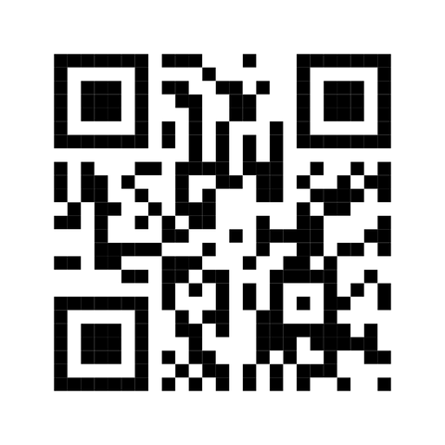


EXPAND YOUR HORIZONS
Facebook cover
BOOST YOUR REALITY

Slide 2

Vision of the campaign
This campaign tells a story of rebirth through knowledge:
the cold turns into light, play becomes learning, and reality is amplified by imagination.
Discover what knowledge can spark within you!

Slide 3

Creative objectives
1. Awareness and Recognition: Highlight the crucial role adults play in supporting the academic success of young people.
2. Visualization through AR: Utilize augmented reality to make the invisible impact of supportive gestures tangible and visible.
3. Cultural Empowerment: Foster a stronger sense of belonging and cultural pride to boost academic motivation and engagement.

Slide 4
Through the power of imagination, everyday places - the arena, the airport, the Coop, the school,
the community center - become meeting points between dreams and learning.
Together, they form a living network where perseverance takes root in culture and the land.

Slide 5




Learn today, lead tomorrow
You’re not doing it alone
Nourish your body, fuel your mind
Knowledge cuts like ice
General poster, airport
Community Center, Arena
Coop
School

Slide 6
This set of posters, each designed for a specific community space, emphasizes social and educational cohesion within the communities.

Slide 7

Visual concept example

Slide 8


Augmented Reality (AR) sticker
AIRPORT
Your future rises higher
Your future elevates with every step
In augmented reality, a plane takes off into the sky

Slide 9

ACTIVITIES
SCHOOL
EXPAND YOUR HORIZONS
INTERACTIVE PLATFORM
The platform aims to help students get to know themselves better and define their professional profile in a fun and empowering way.
It invites them to explore their interests, passions, and strengths, make connections with potential fields and careers, and build a positive and evolving self-image.
The approach focuses on play, creativity, and discovery, making career exploration engaging while grounding each young person’s journey in their culture, community, and land.

Slide 10
EXPAND YOUR HORIZONS
IKIAQBOX
IKIAQBOX is designed to bring young people and their families together in a creative, interactive, and heartwarming experience. By combining playful activities, an augmented reality message, and a shared baking moment, it encourages self-discovery, collaboration, and the joy of learning together.
Inside this box, discovery begins.
Bake, play, and explore together - every activity, every flavor, and every spark of imagination helps you expand your horizons.

