Slide 1

Our Mission & Vision
Tusaajuit bridges the gap between educational and health care services by giving community members access to educational resources about hearing loss and facilitating access to hearing care. Tusaajuit will address the root causes of hearing loss by focusing on prevention. It aims to reduce the long-term impacts of hearing loss and improve the well-being and social integration of hard-of-hearing individuals.

Slide 2
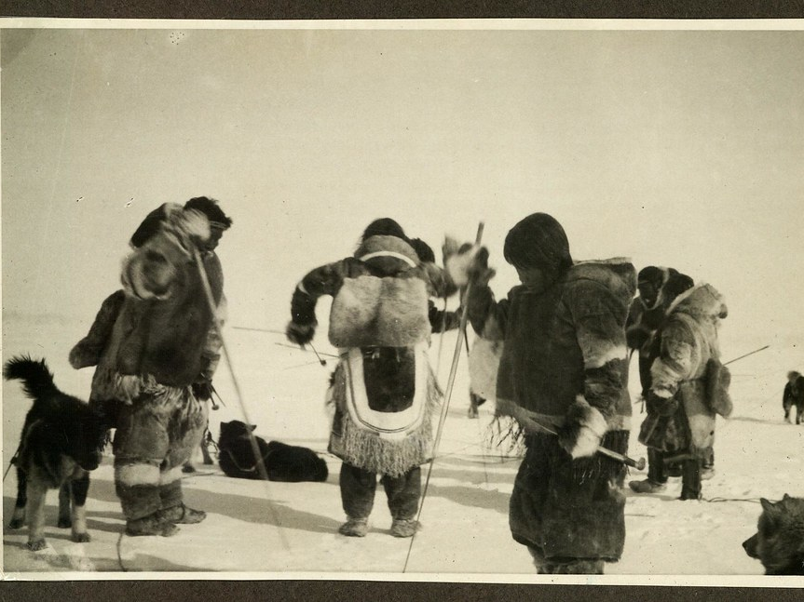
Hearing Wellness and Social Impacts in Indigenous Communities
Focusing on Inuit Traditions and Hearing Health
15–20 Minute Presentation
This Photo by Unknown Author is licensed under CC BY-SA

Slide 3

Introduction to Hearing Wellness
• Hearing wellness means maintaining good hearing health through prevention, protection, and support.
• It impacts communication, learning, safety, and social connection.
• In Indigenous communities, hearing wellness is connected to overall well-being and cultural continuity.

Slide 4
Causes and Types of Hearing Loss
• Conductive: Problems in the outer or middle ear.
• Sensorineural: Inner ear or nerve damage (common form of permanent loss).
• Mixed: Combination of both.
• Common causes: loud noise exposure, infections, aging, genetics, and untreated ear conditions.

Slide 5
Indigenous Perspectives on Hearing Health
• Hearing is deeply tied to storytelling, oral history, and traditional knowledge.
• Hearing loss can affect participation in cultural practices and community life.
• Indigenous approaches emphasize balance, connection, and holistic wellness.

Slide 6
Social and Emotional Impacts of Hearing Loss
• Communication barriers may lead to isolation and reduced participation in community events.
• Feelings of frustration, embarrassment, or stigma are common.
• In small, close-knit communities, hearing loss can affect relationships and identity.

Slide 7
Hearing Loss and Dementia
What the Research Shows
People with mild hearing loss are 2× more likely to develop dementia.
Those with moderate hearing loss are 3× more likely, and with severe loss, the risk increases to 5×.
Studies (e.g., Johns Hopkins, WHO, Lancet Commission) confirm that hearing loss is one of the top modifiable risk factors for dementia in later life.

Slide 8
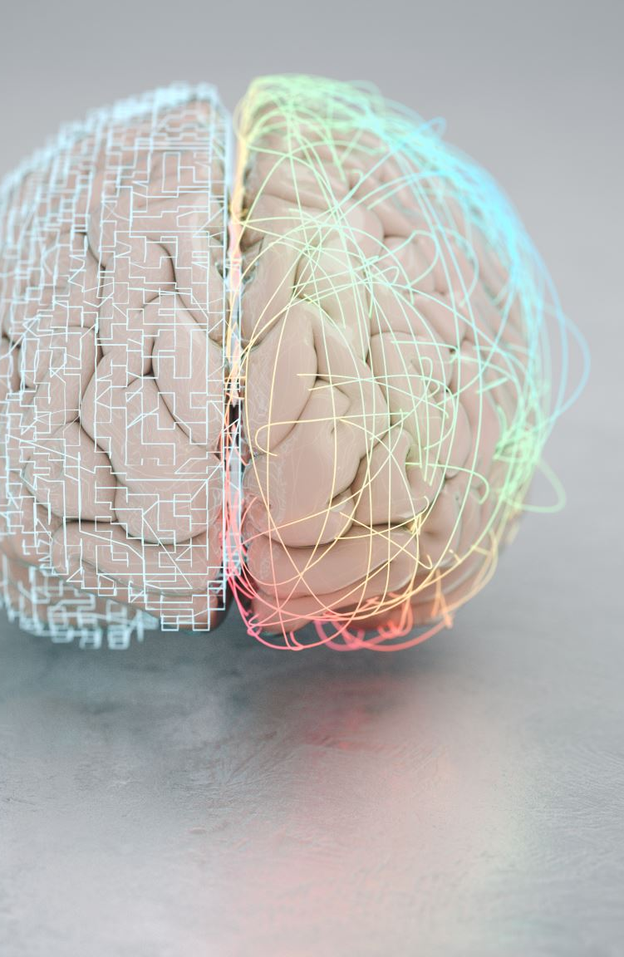
How Hearing Loss Effects the Brain
Cognitive Load: The brain works harder to process unclear sounds, leaving fewer resources for memory and thinking.
Social Isolation: Difficulty hearing leads to withdrawal from conversations and activities, increasing loneliness—a known risk factor for dementia.
Brain Structure Changes: Long-term hearing deprivation can reduce stimulation to brain regions responsible for sound and language, contributing to cognitive decline.

Slide 9
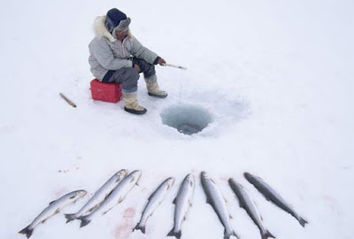
Hearing Loss and Inuit Hunting Traditions
Hearing plays a vital role in traditional Inuit hunting — detecting animal sounds, ice movement, and weather cues.
Hearing loss can increase safety risks and reduce participation in hunting trips.
Transmission of hunting knowledge (through sound and instruction) may be impacted.
Supports such as hearing aids or cochlear implants can help preserve connection to tradition.
This Photo by Unknown Author is licensed under CC BY-NC-ND

Slide 10



Access to Hearing Healthcare in Remote Communities
Limited access to audiology services in northern and remote regions.
High cost of travel and equipment.
Language and cultural barriers in healthcare delivery.
Mobile clinics, tele-audiology, and community-based training are improving access.
This Photo by Unknown Author is licensed under CC BY-NC
This Photo by Unknown Author is licensed under CC BY-NC-ND
This Photo by Unknown Author is licensed under CC BY-SA-NC

Slide 11
Support Systems and Community Approaches
Family and community support are crucial in managing hearing loss.
Indigenous-led health programs emphasize cultural safety and inclusion.
Support groups reduce isolation and promote awareness.

Slide 12


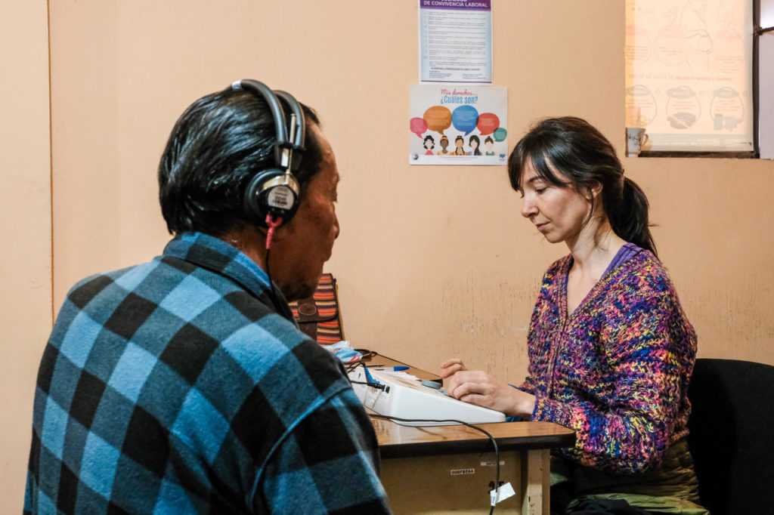
Prevention and Awareness Strategies
Avoid prolonged exposure to loud noises.
Regular hearing check-ups, especially for children and elders.
Promote culturally appropriate education about hearing protection.
Encourage open discussion about hearing loss in communities.
This Photo by Unknown Author is licensed under CC BY-NC-ND

Slide 13
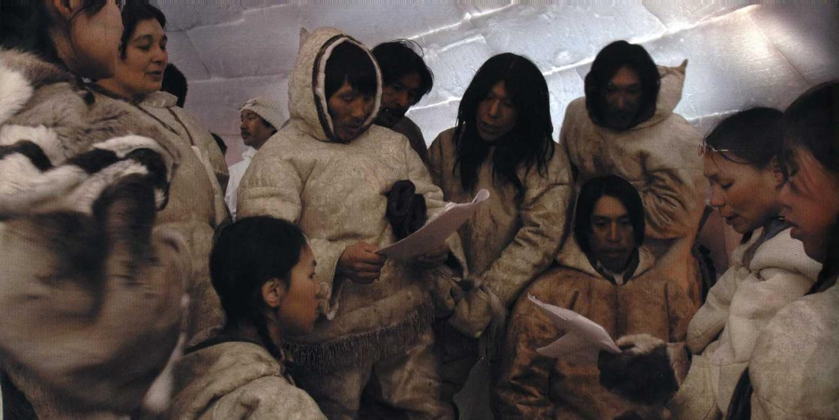
Success Stories and Ongoing Initiatives
• Inuit organizations collaborating with audiologists to offer local services.
• Hearing aid donation programs and awareness campaigns.
• Youth education on hearing wellness and traditional knowledge.

Slide 14
Conclusion and Key Takeaways
Hearing wellness supports communication, culture, and community well-being.
Hearing loss impacts Inuit traditions and social connection.
Collaborative, culturally grounded approaches are key to effective hearing care.

