Slide 1
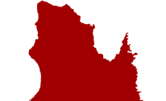

Public Security in Nunavik
Preliminary Observations and Insights from the Interim Chief of Police Jean-Francois Bernier
2026-01-12

Slide 2

Presenter: IC Jean-Francois Bernier NPS
Currently on a service loan to the NPS from the Quebec City Police Service, where I hold the rank of Deputy Chief.
27 ½ years of service as a police officer, including:
  2 years for the Montreal Police Service (Patrol);
  5 years as a loan of service to the Sûreté du Québec on high-profile organized crime investigations;
  20 ½ years for the Quebec City Police Service, in various roles:
    Patrol
    Training
    Investigations (narcotics and organized crime specialist)
    Special services (Critical Incident Commander)
    Governance and Administration
  Current Interim Chief for the Nunavik Police Service, sworn-in on November 28th 2025

Slide 3
Nunavik Police Service Mission
In accordance with the Police Act, our mission is to:
  Protect the lives and property of citizens;
  Maintain peace, order and public security;
  Prevent and suppress crime. Apprehend offenders;
  Enforce laws and municipal by-laws.

Slide 4
NPS Last 24 hrs
Importance of Providing Real-Time Information to the DGO’s office
  Format: Daily email communication with bullet-point summaries of significant files in each community
  Content: Confidential and sensitive information is removed
  Purpose: To ensure KRG leadership has accurate, up-to-date knowledge of law enforcement and public safety situations in all communities.
Examples:
Note: For urgent matters, such as shootings and major incidents, I always call or send a text message immediately.

Slide 5
Key Observations
Violence
  High degree of violence reported
  Elevated rates of crimes against persons
  Serious crimes are frequent, including:
    Murders and attempted murders
    Stabbings
    Domestic and intra-familial offences
    High number of medical evacuations
  Low incidence of property crimes and economic crimes such as theft or fraud
Intoxication
  Offenders are almost always under the influence of drugs or alcohol during incidents
Confrontation with Police
  High rate of non-cooperation among offenders, witnesses and bystanders
  Some actively resist, confront or even ambush officers. Examples: 2 shootings in Inukjuak
Disproportionate Statistics
  All the above occur at significantly higher levels compared to southern communities
  Additionally, the dark figure of crime – unreported or undetected offences – is likely substantial in Nunavik, given the low level of public confidence in police services

Slide 6
2024 Statistical Comparison
 | Quebec City Police Service | Nunavik Police Service
Population (Sensus 2021) | 594,556 | 10,784
Staffing | 872 police officers, 214 civilians 1,086 total | 165 police officers, 9 civilians 174 total
Yearly calls for service | 416,937 | 24,033
Yearly criminal files | 42,241 | 8,176
Murders | 3 | 3
Attempted murders | 10 | 2
Sexual assaults | 579 | 365
Assault vs police | 89 | 119
Avg number of calls per day on mental health issues | 18 | Unknown

Slide 7
Stat Can’s Crime Severity Index for 2024
Nunavik’s Crime Severity Index are dramatically higher than provincial
and national averages, indicating an exceptionally severe and violent crime
environment compared to the rest of Quebec and Canada
 | CRIME SEVERITY INDEX | VIOLENT CRIME SEVERITY INDEX
VILLE DE QUÉBEC | 62.78 | 87.49
MONTREAL | 75.72 | 112.51
PROV of QUÉBEC | 63.01 | 97.04
CANADA | 77.89 | 99.87
NUNAVUT | 415.23 | 649.11
NW TERRITORIES | 526.92 | 571.63
NUNAVIK | 801.05 | 2,046.04

Slide 8
Opinion Moving Forward
→ Public Safety must be established as a top priority for Nunavik’s leadership
→ Our common goal should be to address the key issues affecting our Nunavik communities:
  Violence
  Alcohol and drug abuse
→ Strategic Approach: Implement a multi-sectoral strategy built through four pillars:
  Prevention
  Health
  Repression
  Governance and Community Empowerment
→ Complete prohibition is not a viable mid to long term solution
  Instead, develop measures to control availability while ensuring that profits from alcohol sales fund prevention and health initiatives such as awareness campaigns and rehabilitations programs.
→ All actions must be coordinated through the Public Security Committee

Slide 9
Factors to a successful deescalation process
Knowledge
Experience
Training
Proper equipment
Personal skills
Suspect’s choices and actions

Slide 10
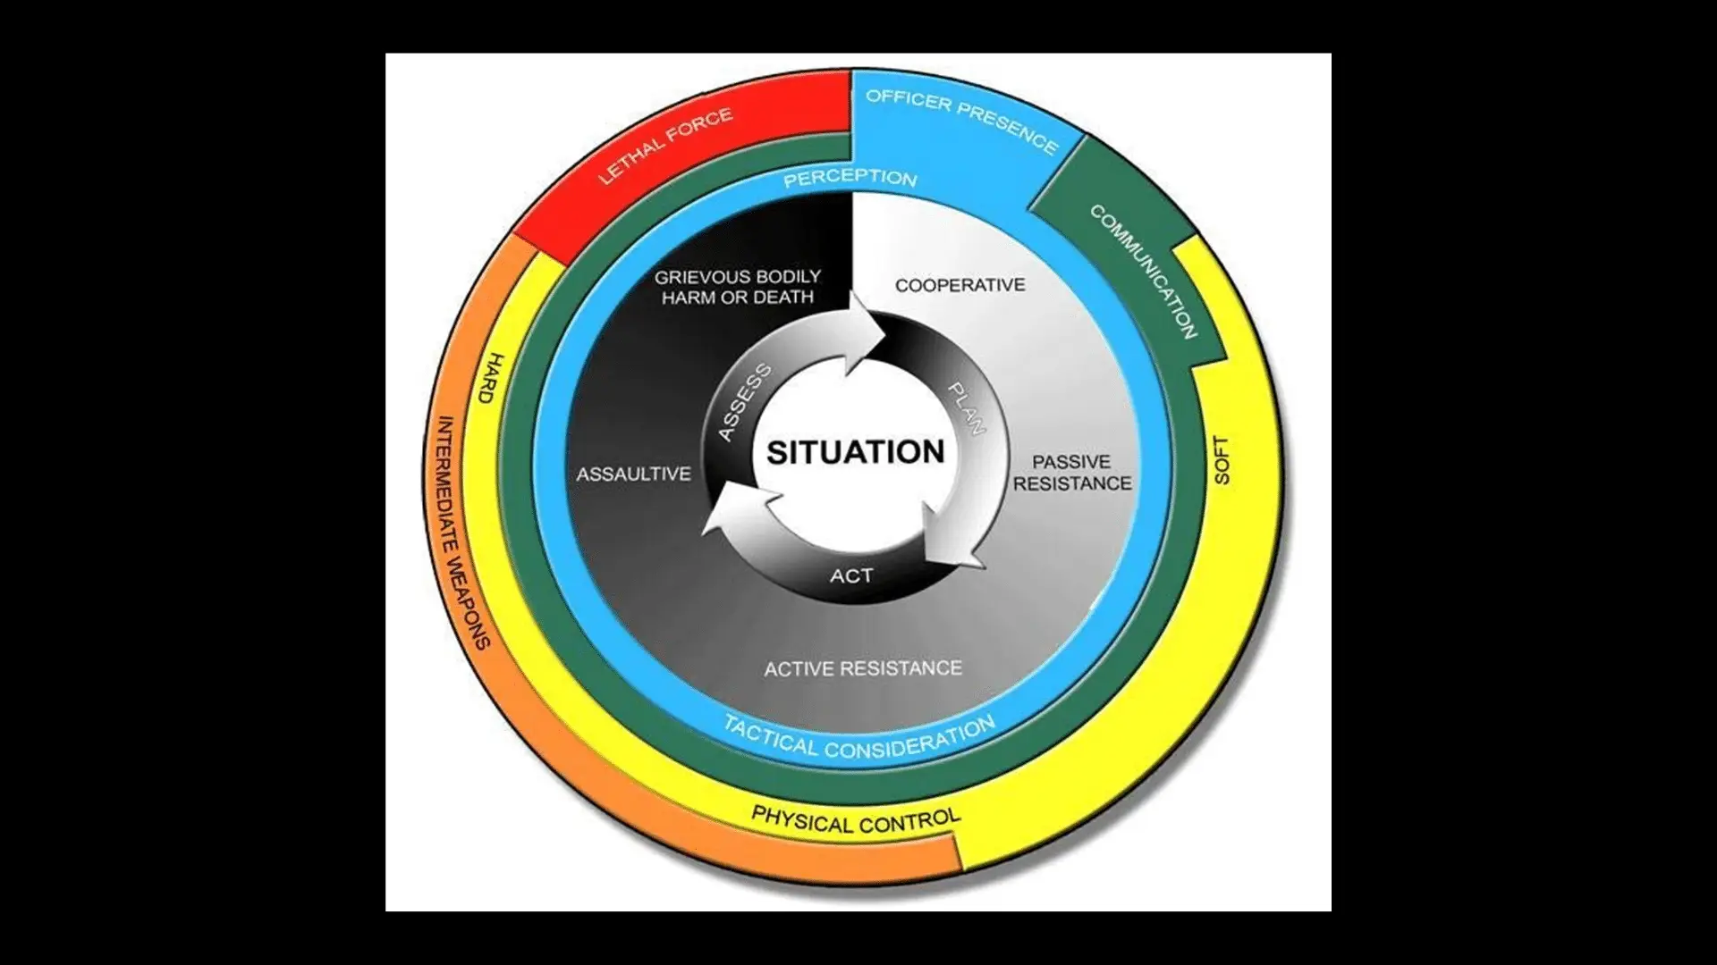
When deescalation fails or isn’t possible:
Canadian Use
of Force Model

Slide 11
Life Priorities for Law Enforcement
1- Victims
2- Citizens
3- Police Officers
4- Specialized Weapons And Tactics (SWAT)
5- Subject
6- Evidence
7- Equipment
Risk tolerance evolves from very low for P1 to very high for P7

Slide 12
Police surveillance mechanisms
Deontology – Professional Standards - BEI
Deontology:
An administrative tribunal responsible for receiving and reviewing complaints and reports concerning individuals subject to the Code of Ethics of Québec Police Officers. The tribunal examines complaints from the public regarding actions taken by police officers in the performance of their duties and interactions with the public, to determine whether these actions constitute a breach of the Code
12 months limitation period applies to file a complaint
A police officer cannot be sanctioned by both the Deontology Tribunal and their Employer for the same misconduct.

Slide 13
Police surveillance mechanisms
Deontology – Professional Standards - BEI
Professional Standards
Internal process within the Nunavik Police Service
Applies the Ordinance of Internal Discipline for Members of the Nunavik Police Service
No formal prescription period; however, once the Chief becomes aware of a situation, action must be taken within 9 months to sanction the employee.
A police officer cannot be sanctioned by both the Deontology Tribunal and their Employer for the same misconduct.
Possible sanctions include: Written warning, Suspension, Demotion or Termination.

Slide 14
Police surveillance mechanisms
Deontology – Professional Standards - BEI
BEI: Independent Investigation Bureau
Established: June 27, 2016
Status: Independent Police Service and oversight body
Leadership: Headed by Brigitte Bishop, a highly respected former Crown Attorney
Mandate: Investigate the actions or omissions by police officers that may constitute a criminal offence
Scope of intervention: Incidents where a person (other than an on-duty police officer), dies, sustains a serious injury, or is injured by a firearm used by a police officer during a police intervention or while in custody of a police service.

Slide 15
Police surveillance mechanisms
Deontology – Professional Standards - BEI
BEI:
The BEI also handles all criminal allegations involving police officers when the victim or complainant is a member of the First Nations or Inuit communities
Investigates any allegation of sexual offences committed by an on-duty police officer
Parallel investigations might be required when an incident meets BEI criteria and criminal acts are committed by a suspect who survives the police intervention. Only three police services are authorized to conduct these parallel investigations :
  Sûreté du Québec
  Service de police de la Ville de Montréal (SPVM)
  Service de police de la Ville de Québec (SPVQ)

Slide 16
Communications expectations
We do not comment active investigations
  Reason: To avoid interfering with ongoing operations and ensure the integrity of the process.
  Example: Use of “Holdbacks” and the need to protect the evidence for court proceedings
  Example: Risks associated with partial images published online (e.g., Quebec’s Grande-Allée case in 2021)
Does the public have the right to know ?
  Off course ! But not everything at any given time
  However, this right is not absolute and must be balanced against critical priorities:
    Officer safety
    Public Safety
    Integrity of evidence for court proceedings
  Transparency is essential, but it cannot compromise ongoing investigations or endanger lives

Slide 17
Questions and Discussions

