Slide 1

Nunavik Police Service
Criminal Stastictics
January to December 2025

Slide 2
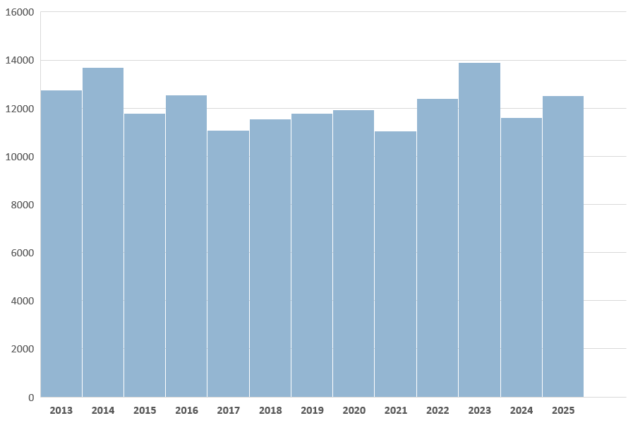

Total Criminal Incidents Evolution

Slide 3
Nunavik
Murder
Attempter Murder
Suicide
3-Year Comparison – January 1st to December 31st

Slide 4
Nunavik Crime against the person
Assault
Assault with a weapon
3-Year Comparison – January 1st to December 31st

Slide 5
Nunavik Crime against the person
Sexual Assault
Sexual Assault with a weapon
3-Year Comparison – January 1st to December 31st

Slide 6
Nunavik Declared Motor Vehicle Accidents
Fatal Accidents
3-Year Comparison – January 1st to December 31st

Slide 7
Nunavik Crimes involving weapons
Careless use of firearm
Pointing a firearm
3-Year Comparison – January 1st to December 31st

Slide 8
Nunavik Number of detentions
3-Year Comparison – January 1st to December 31st

Slide 9
Nunavik Number of detentions
Adults detained criminally
Adults detained non-criminally
Youths detained criminally
Youths detained non-criminally
3-Year Comparison – January 1st to December 31st

Slide 10
Nunavik Assistance files
Person in Distress
Search and Rescue
By-Law
3-Year Comparison – January 1st to December 31st

Slide 11
Nunavik Summary – All Police Interventions
3-Year Comparison – January 1st to December 31st

Slide 12
Akulivik Specific Crime Trends
Murder
Attempted Murder
3-Year Comparison – January 1st to December 31st

Slide 13
Akulivik Specific Crime Trends
Assaults
Assault with a weapon
3-Year Comparison – January 1st to December 31st

Slide 14
Akulivik Specific Crime Trends
Sexual Assault
Sexual Assault with a weapon
3-Year Comparison – January 1st to December 31st

Slide 15
Akulivik Specific Crime Trends
3-Year Comparison – January 1st to December 31st

Slide 16
Akulivik Summary – All Police Interventions
3-Year Comparison – January 1st to December 31st

Slide 17
Aupaluk Specific Crime Trends
Murder
Attempted Murder
3-Year Comparison – January 1st to December 31st

Slide 18
Aupaluk Specific Crime Trends
Assaults
Assault with a weapon
3-Year Comparison – January 1st to December 31st

Slide 19
Aupaluk Specific Crime Trends
Sexual Assault
Sexual Assault with a weapon
3-Year Comparison – January 1st to December 31st

Slide 20
Aupaluk Specific Crime Trends
3-Year Comparison – January 1st to December 31st

Slide 21
Aupaluk Summary – All Police Interventions
3-Year Comparison – January 1st to December 31st

Slide 22
Inukjuak Specific Crime Trends
Murder
Attempted Murder
3-Year Comparison – January 1st to December 31st

Slide 23
Inukjuak Specific Crime Trends
Assaults
Assault with a weapon
3-Year Comparison – January 1st to December 31st

Slide 24
Inukjuak Specific Crime Trends
Sexual Assault
Sexual Assault with a weapon
3-Year Comparison – January 1st to December 31st

Slide 25
Inukjuak Specific Crime Trends
3-Year Comparison – January 1st to December 31st

Slide 26
Inukjuak Summary – All Police Interventions
3-Year Comparison – January 1st to December 31st

Slide 27
Ivujivik Specific Crime Trends
Murder
Attempted Murder
3-Year Comparison – January 1st to December 31st

Slide 28
Ivujivik Specific Crime Trends
Assaults
Assault with a weapon
3-Year Comparison – January 1st to December 31st

Slide 29
Ivujivik Specific Crime Trends
Sexual Assault
Sexual Assault with a weapon
3-Year Comparison – January 1st to December 31st

Slide 30
Ivujivik Specific Crime Trends
3-Year Comparison – January 1st to December 31st

Slide 31
Ivujivik Summary – All Police Interventions
3-Year Comparison – January 1st to December 31st

Slide 32
Kangiqsualujjuaq Specific Crime Trends
Murder
Attempted Murder
3-Year Comparison – January 1st to December 31st

Slide 33
Kangiqsualujjuaq Specific Crime Trends
Assaults
Assault with a weapon
3-Year Comparison – January 1st to December 31st

Slide 34
Kangiqsualujjuaq Specific Crime Trends
Sexual Assault
Sexual Assault with a weapon
3-Year Comparison – January 1st to December 31st

Slide 35
Kangiqsualujjuaq Specific Crime Trends
3-Year Comparison – January 1st to December 31st

Slide 36
Kangiqsualujjuaq Summary – All Police Interventions
3-Year Comparison – January 1st to December 31st

Slide 37
Kangiqsujuaq Specific Crime Trends
Murder
Attempted Murder
3-Year Comparison – January 1st to December 31st

Slide 38
Kangiqsujuaq Specific Crime Trends
Assaults
Assault with a weapon
3-Year Comparison – January 1st to December 31st

Slide 39
Kangiqsujuaq Specific Crime Trends
Sexual Assault
Sexual Assault with a weapon
3-Year Comparison – January 1st to December 31st

Slide 40
Kangiqsujuaq Specific Crime Trends
3-Year Comparison – January 1st to December 31st

Slide 41
Kangiqsujuaq Summary – All Police Interventions
3-Year Comparison – January 1st to December 31st

Slide 42
Kangirsuk Specific Crime Trends
Murder
Attempted Murder
3-Year Comparison – January 1st to December 31st

Slide 43
Kangirsuk Specific Crime Trends
Assaults
Assault with a weapon
3-Year Comparison – January 1st to December 31st

Slide 44
Kangirsuk Specific Crime Trends
Sexual Assault
Sexual Assault with a weapon
3-Year Comparison – January 1st to December 31st

Slide 45
Kangirsuk Specific Crime Trends
3-Year Comparison – January 1st to December 31st

Slide 46
Kangirsuk Summary – All Police Interventions
3-Year Comparison – January 1st to December 31st

Slide 47
Kuujjuaq Specific Crime Trends
Murder
Attempted Murder
3-Year Comparison – January 1st to December 31st

Slide 48
Kuujjuaq Specific Crime Trends
Assaults
Assault with a weapon
3-Year Comparison – January 1st to December 31st

Slide 49
Kuujjuaq Specific Crime Trends
Sexual Assault
Sexual Assault with a weapon
3-Year Comparison – January 1st to December 31st

Slide 50
Kuujjuaq Specific Crime Trends
3-Year Comparison – January 1st to December 31st

Slide 51
Kuujjuaq Summary – All Police Interventions
3-Year Comparison – January 1st to December 31st

Slide 52
Kuujjuaraapik Specific Crime Trends
Murder
Attempted Murder
3-Year Comparison – January 1st to December 31st

Slide 53
Kuujjuaraapik Specific Crime Trends
Assaults
Assault with a weapon
3-Year Comparison – January 1st to December 31st

Slide 54
Kuujjuaraapik Specific Crime Trends
Sexual Assault
Sexual Assault with a weapon
3-Year Comparison – January 1st to December 31st

Slide 55
Kuujjuaraapik Specific Crime Trends
3-Year Comparison – January 1st to December 31st

Slide 56
Kuujjuaraapik Summary – All Police Interventions
3-Year Comparison – January 1st to December 31st

Slide 57
Puvirnituq Specific Crime Trends
Murder
Attempted Murder
3-Year Comparison – January 1st to December 31st

Slide 58
Puvirnituq Specific Crime Trends
Assaults
Assault with a weapon
3-Year Comparison – January 1st to December 31st

Slide 59
Puvirnituq Specific Crime Trends
Sexual Assault
Sexual Assault with a weapon
3-Year Comparison – January 1st to December 31st

Slide 60
Puvirnituq Specific Crime Trends
3-Year Comparison – January 1st to December 31st

Slide 61
Puvirnituq Summary – All Police Interventions
3-Year Comparison – January 1st to December 31st

Slide 62
Quaqtaq Specific Crime Trends
Murder
Attempted Murder
3-Year Comparison – January 1st to December 31st

Slide 63
Quaqtaq Specific Crime Trends
Assaults
Assault with a weapon
3-Year Comparison – January 1st to December 31st

Slide 64
Quaqtaq Specific Crime Trends
Sexual Assault
Sexual Assault with a weapon
3-Year Comparison – January 1st to December 31st

Slide 65
Quaqtaq Specific Crime Trends
3-Year Comparison – January 1st to December 31st

Slide 66
Quaqtaq Summary – All Police Interventions
3-Year Comparison – January 1st to December 31st

Slide 67
Salluit Specific Crime Trends
Murder
Attempted Murder
3-Year Comparison – January 1st to December 31st

Slide 68
Salluit Specific Crime Trends
Assaults
Assault with a weapon
3-Year Comparison – January 1st to December 31st

Slide 69
Salluit Specific Crime Trends
Sexual Assault
Sexual Assault with a weapon
3-Year Comparison – January 1st to December 31st

Slide 70
Salluit Specific Crime Trends
3-Year Comparison – January 1st to December 31st

Slide 71
Salluit Summary – All Police Interventions
3-Year Comparison – January 1st to December 31st

Slide 72
Tasiujaq Specific Crime Trends
Murder
Attempted Murder
3-Year Comparison – January 1st to December 31st

Slide 73
Tasiujaq Specific Crime Trends
Assaults
Assault with a weapon
3-Year Comparison – January 1st to December 31st

Slide 74
Tasiujaq Specific Crime Trends
Sexual Assault
Sexual Assault with a weapon
3-Year Comparison – January 1st to December 31st

Slide 75
Tasiujaq Specific Crime Trends
3-Year Comparison – January 1st to December 31st

Slide 76
Tasiujaq Summary – All Police Interventions
3-Year Comparison – January 1st to December 31st

Slide 77
Umiujaq Specific Crime Trends
Murder
Attempted Murder
3-Year Comparison – January 1st to December 31st

Slide 78
Umiujaq Specific Crime Trends
Assaults
Assault with a weapon
3-Year Comparison – January 1st to December 31st

Slide 79
Umiujaq Specific Crime Trends
Sexual Assault
Sexual Assault with a weapon
3-Year Comparison – January 1st to December 31st

Slide 80
Umiujaq Specific Crime Trends
3-Year Comparison – January 1st to December 31st

Slide 81
Umiujaq Summary – All Police Interventions
3-Year Comparison – January 1st to December 31st

