Slide 1
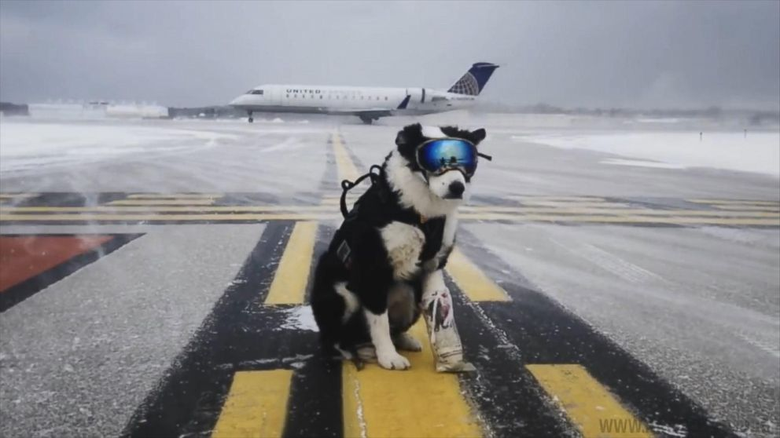

Dog incursions on airside

Slide 2

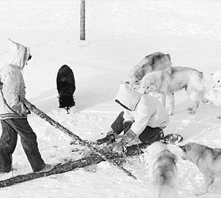
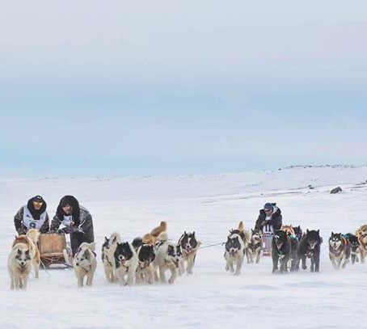
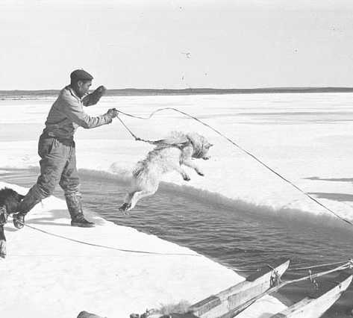
Acknowledgment of the history and importance of dogs in Nunavik

Slide 3
We must comply with the CARs to hold the airport operating certificate.
The Canadian Aviation Regulations (CARs) require Wildlife Management Plans.
Successful plans reduce hazards by making airports less attractive to animals by:
Managing habitats
Excluding mammals through the use of fencing
Dispersing
Removing
Despite the corrective action, the safety reporting system has identified a trend in dog incursions on airside.

Slide 4
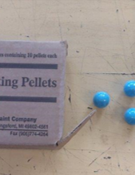
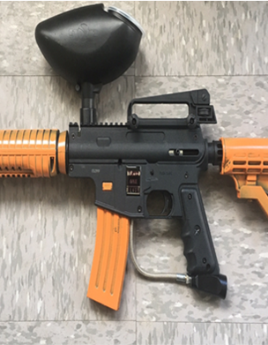
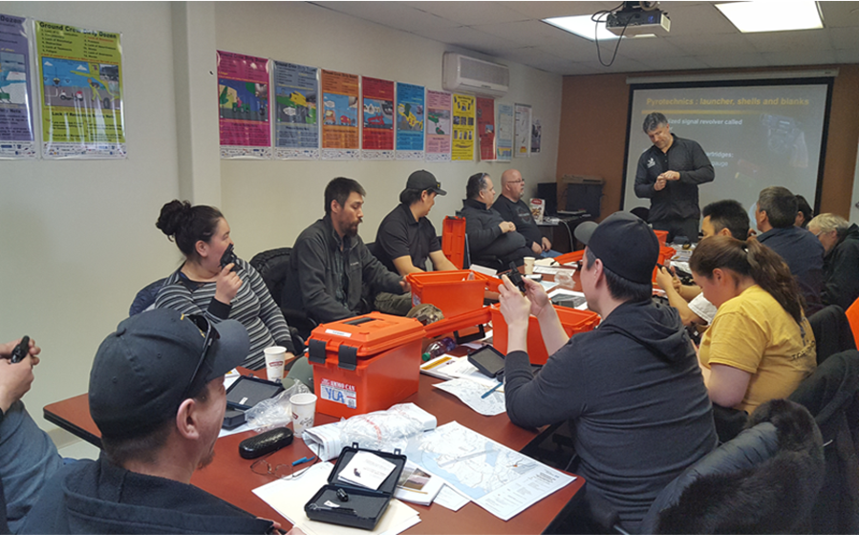
Our preventive measures
Wildlife management training
Airside safety directives
Wildlife control equipment (pyro and paintball guns)
Monitor fences and gates

Slide 5

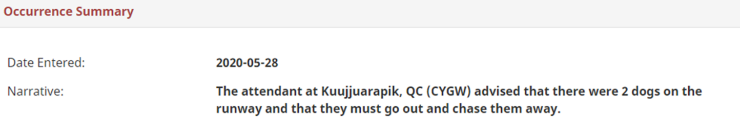
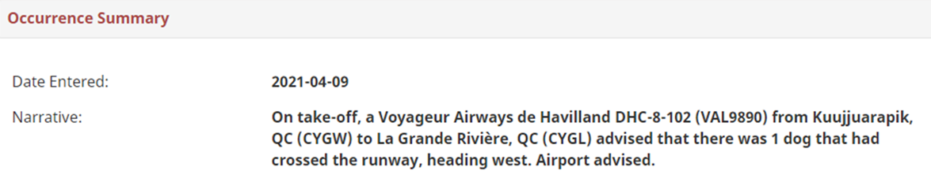
Transport Canada collects and monitors aviation occurrence information through an online reporting portal.
What is reportable? Unauthorized incursion or operating irregularity involving animals, vehicles, pedestrians, or aircrafts.
Who can report on us? Air crew, ourselves, and other staff
Ex 1:
Ex2:

Slide 6
We are still seeing dog incursions despite the measures we are taking
In 2020, there were 110 dog reports from the 14 airports. Of these,
9 reports of dogs on runway while an aircraft was moving
1 aircraft overshot in Ivujivik due to dog on runway
1 strike reported with no remain found, no damage and no impact on operations in Kuujjuaraapik
80% of the reports came from 4 airports: Kuujjuaraapik (25%), Puvirnituq (23%), Aupaluk (18%), and Kangiqsualujjuaq (14%)

Slide 7
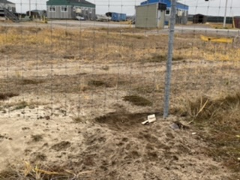
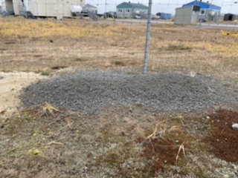
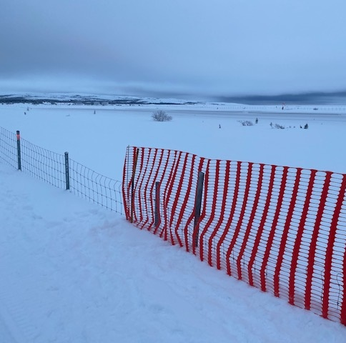
What’s happening and what we are doing in Kuujjuaraapik?
Airport proximity to residential area and local landfill site created a habitual path for dogs.
The sandy terrain makes it easy for dogs to dig holes into airside.
Adding gravel to holes digged by dogs.
The snow covers the fence during winter time so mammals can walk onto airside.

Slide 8
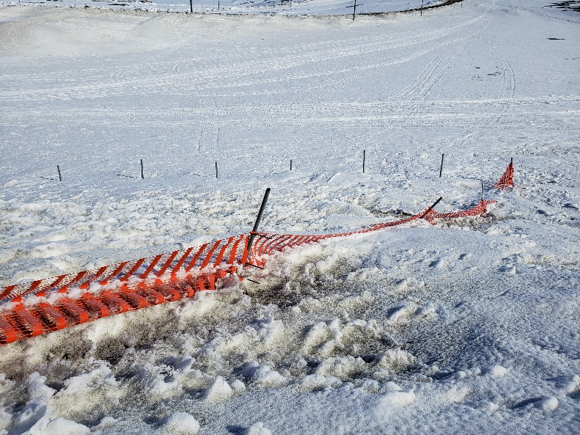
What’s happening and what we are doing in Puvirnituq?
The fence is deteriorating from permafrost and weather (wind and snow)
We’ve established a partnership with the NV for removing dogs from airside
Airport and airline are aware and alert: they monitor dog activities on airside
Some dogs are marked with paintball to identify repeat offenders

Slide 9
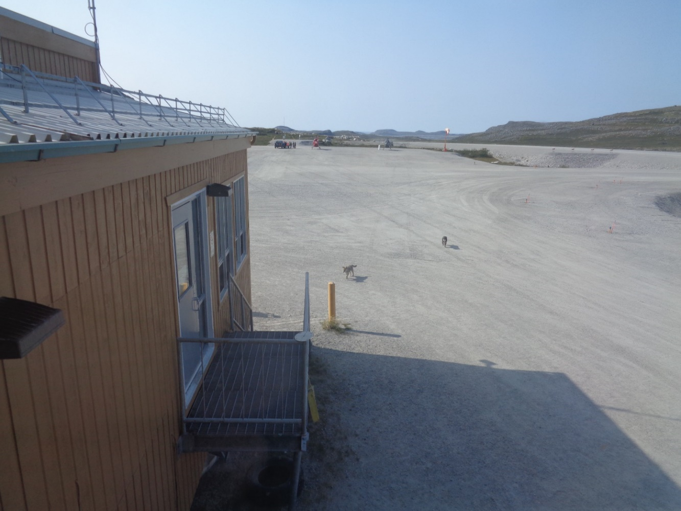
What’s happening in Kangiqsualujjuaq?
Dogs get into airside via the openings underneath the terminal and garage
Dog packs were located close to airport property

Slide 10
What’s happening at the other airports?
The fence is deteriorating from permafrost
Vandalism of airport fencing
Inaccessibility of perimeter fencing to conduct maintenance
Akulivik
1 m
Ivujivik

Slide 11
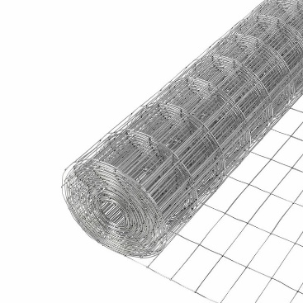

What actions have we taken to mitigate dogs from coming onto airside?
Fixed holes in the fences
Backfilled holes under fences
Installed fencing material under buildings
Chased dogs out of airport grounds
Used pyro and paintball guns
Increased the frequency of our runway checks
Reported major fencing issues to MTQ, including the permafrost issues and fences bentover on a long distance due to extreme weather
Despite our efforts, dog presence lowers the safety level of our airports

Slide 12
We need your help!
We want to work with your communities, dog catchers and dog management policies.
Dogs and aircrafts can’t be together.
We need to ensure aviation safety, your safety, our communities’ safety.

Slide 13
We need your help!
Ensure
your community has an active dog catcher program
Meet
with Mayors and advocate for bylaws
Enforce
bylaws (fees and the justification for the termination of dogs)
Monitor
landfill projects that attract wildlife
Conduct
public awareness to your village that there is a problem with dogs at the airport

Slide 14
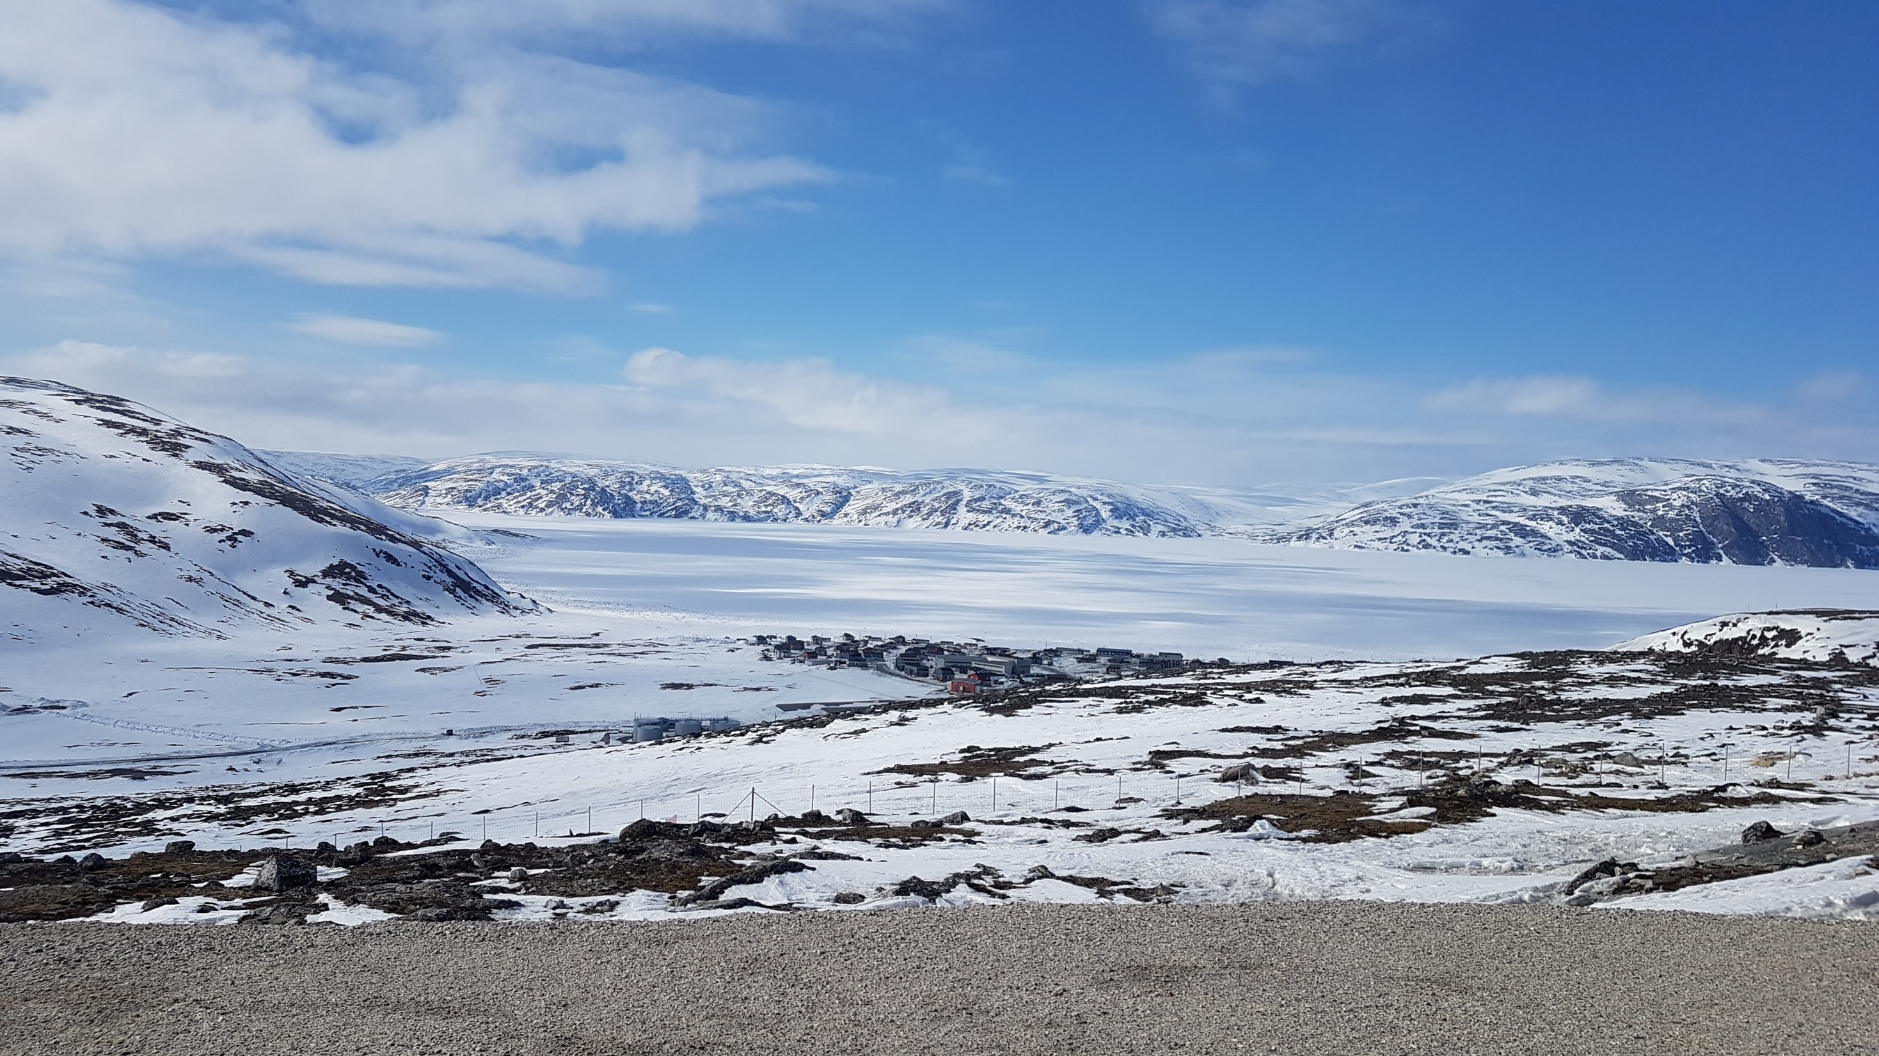
Nakurmiik!

