Slide 1

Nunavik
Specific Crime Trends
Assaults
Sexual Assaults
3-Year Comparison – January 1st to April 30

Slide 2
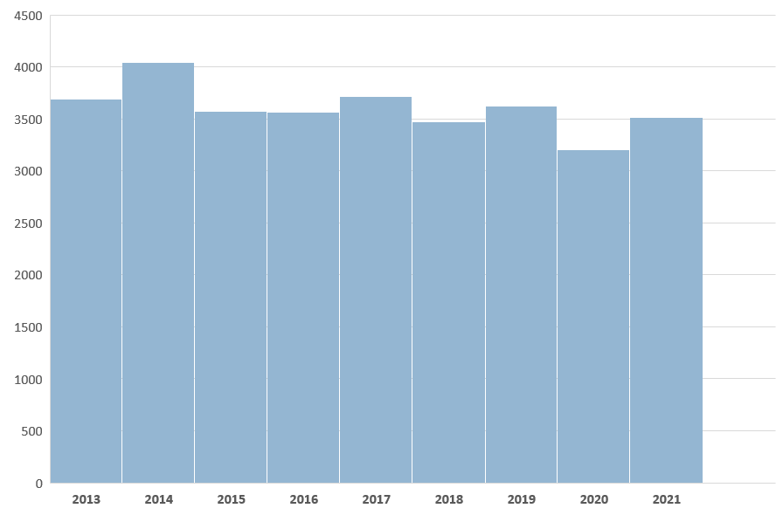
Total Criminal Incidents Evolution

Slide 3
Nunavik
Crime committed in a context of conjugal violence
Assaults level 1
Assaults level 2
Assault level 1: simple assault
Assault level 2: assault with a weapon or causing bodily harm
Assault level 3: aggravated assault
3-Year Comparison – January 1st to April 30

Slide 4
Nunavik
Declared Motor Vehicle Accidents
Accidents under 1000$ of damages
Accidents over 1000$ of damages
3-Year Comparison – January 1st to April 30

Slide 5
Nunavik
Crimes involving weapons
Careless use of firearm
Pointing a firearm
3-Year Comparison – January 1st to April 30

Slide 6
Nunavik
Number of detentions
Adults detained criminally
Adults detained non-criminally
Youths detained criminally
Youths detained non-criminally
3-Year Comparison – January 1st to April 30

Slide 7
Nunavik
Assistance files
Suicide
Search and Rescue
Person in Distress
By-Law
3-Year Comparison – January 1st to April 30

Slide 8
Nunavik
Summary – All Police Interventions
3-Year Comparison – January 1st to April 30

Slide 9
Akulivik
Specific Crime Trends
Assaults
Sexual Assaults
3-Year Comparison – January 1st to April 30

Slide 10
Akulivik
Summary – All Police Interventions
3-Year Comparison – January 1st to April 30

Slide 11
Aupaluk
Specific Crime Trends
Assaults
Sexual Assaults
3-Year Comparison – January 1st to April 30

Slide 12
Aupaluk
Summary – All Police Interventions
3-Year Comparison – January 1st to April 30

Slide 13
Inukjuak
Specific Crime Trends
Assaults
Sexual Assaults
9
3-Year Comparison – January 1st to April 30

Slide 14
Inukjuak
Summary – All Police Interventions
3-Year Comparison – January 1st to April 30

Slide 15
Ivujivik
Specific Crime Trends
Assaults
Sexual Assaults
3-Year Comparison – January 1st to April 30

Slide 16
Ivujivik
Summary – All Police Interventions
3-Year Comparison – January 1st to April 30

Slide 17
Kangiqsualujjuaq
Specific Crime Trends
Assaults
Sexual Assaults
3-Year Comparison – January 1st to April 30

Slide 18
Kangiqsualujjuaq
Summary – All Police Interventions
3-Year Comparison – January 1st to April 30

Slide 19
Kangiqsujuaq
Specific Crime Trends
Assaults
Sexual Assaults
6
1
3-Year Comparison – January 1st to April 30

Slide 20
Kangiqsujuaq
Summary – All Police Interventions
3-Year Comparison – January 1st to April 30

Slide 21
Kangirsuk
Specific Crime Trends
Assaults
Sexual Assaults
3-Year Comparison – January 1st to April 30

Slide 22
Kangirsuk
Summary – All Police Interventions
3-Year Comparison – January 1st to April 30

Slide 23
Kuujjuaq
Specific Crime Trends
Assaults
Sexual Assaults
3-Year Comparison – January 1st to April 30

Slide 24
Kuujjuaq
Summary – All Police Interventions
3-Year Comparison – January 1st to April 30

Slide 25
Kuujjuaraapik
Specific Crime Trends
Assaults
Sexual Assaults
3-Year Comparison – January 1st to April 30

Slide 26
Kuujjuaraapik
Summary – All Police Interventions
3-Year Comparison – January 1st to April 30

Slide 27
Puvirnituq
Specific Crime Trends
Assaults
Sexual Assaults
3-Year Comparison – January 1st to April 30

Slide 28
Puvirnituq
Summary – All Police Interventions
3-Year Comparison – January 1st to April 30

Slide 29
Quaqtaq
Specific Crime Trends
Assaults
Sexual Assaults
3-Year Comparison – January 1st to April 30

Slide 30
Quaqtaq
Summary – All Police Interventions
3-Year Comparison – January 1st to April 30

Slide 31

Salluit
Specific Crime Trends
Assaults
Sexual Assaults
3-Year Comparison – January 1st to April 30

Slide 32
Salluit
Summary – All Police Interventions
3-Year Comparison – January 1st to April 30

Slide 33
Tasiujaq
Specific Crime Trends
Assaults
Sexual Assaults
3-Year Comparison – January 1st to April 30

Slide 34
Tasiujaq
Summary – All Police Interventions
3-Year Comparison – January 1st to April 30

Slide 35
Umiujaq
Specific Crime Trends
Assaults
Sexual Assaults
1
3-Year Comparison – January 1st to April 30

Slide 36
Umiujaq
Summary – All Police Interventions
3-Year Comparison – January 1st to April 30

