Slide 1

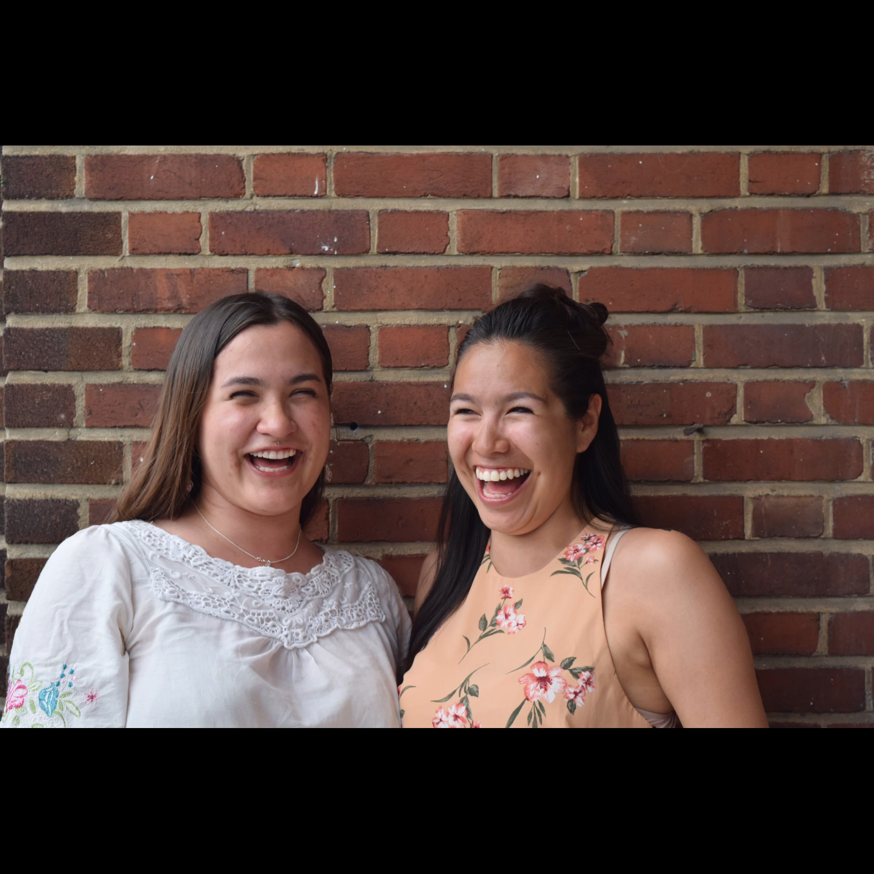

Find your direction,
Create your path
THE FIRST INTERNSHIP PROGRAM EXCLUSIVELY FOR NUNAVIMMIUT
KRG COUNCIL PRESENTATION
June 2021

Slide 2
PRESENTATION PLAN
What is the Pijunnaqunga program?
  1.1 Team members
  1.2 The program
  The application process
  3 main activities
Overview of 2017-2021
  2.1 Timeline
  2.2 Statistics
  2.3 Tools and procedures
  2.4 Testimonials

Slide 3



WHAT IS PIJUNNAQUNGA?
Pijunnaqunga is a Kativik Regional Government internship program for Nunavimmiut that offers
(short-term on-the-job training), with the goal of and
PAID internships
increase
their presence in the Nunavik’s workforce.
empowering Inuit

Slide 4
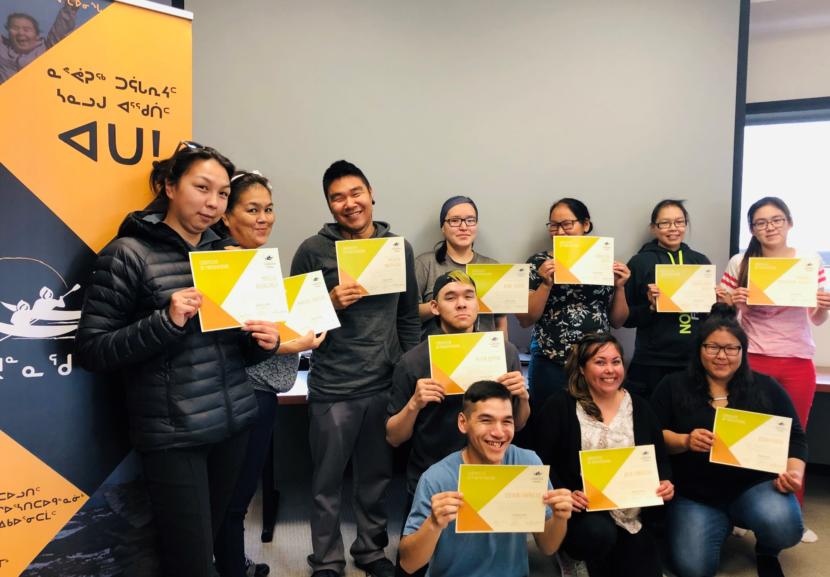
WHAT IS PIJUNNAQUNGA?
Be an Inuk Nunavimmiuq;
Have graduated high school or equivalent work experience*;
Be over 18 years of age (unless you graduated high school).
ELIGIBILITY CRITERIA :
* Individuals who demonstrate strong motivation and great potential to succeed in this program but do not match the previous criteria will be considered.

Slide 5


WHAT IS PIJUNNAQUNGA?
Great tool for Nunavik organizations
Selection process taken care of
50% of salary reimbursed
If the candidate is not in the same community: airfare, 50% of housing, coordination of travel, etc., is covered.
Great tool for Nunavimmiut
Try a new job (no experience needed)
Gain work experience and new skills
Develop network within
Nunavik organizations
* Continuous support from Pijunnaqunga’s internship coordinator *

Slide 6
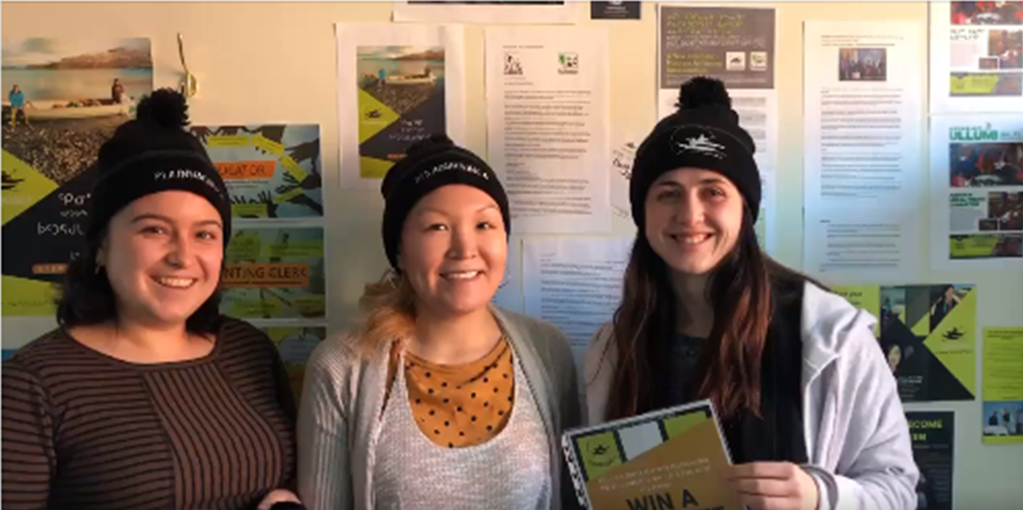

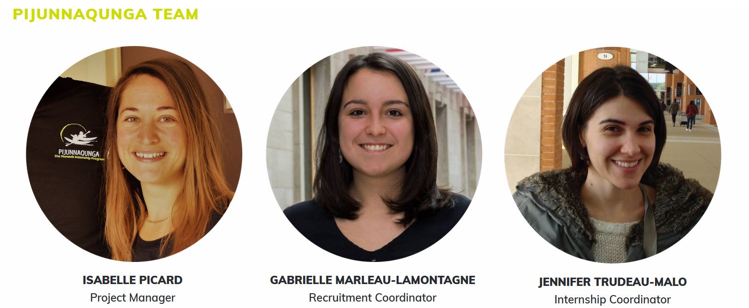
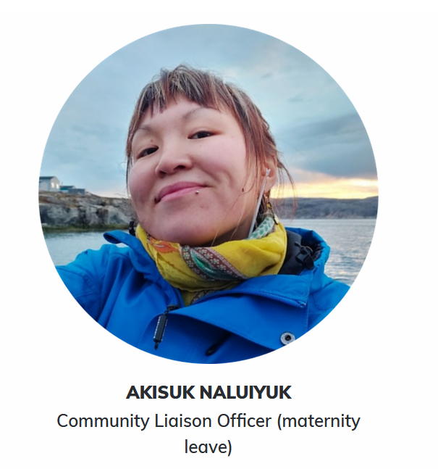

1.1 PRESENTATION TEAM MEMBERS

Slide 7



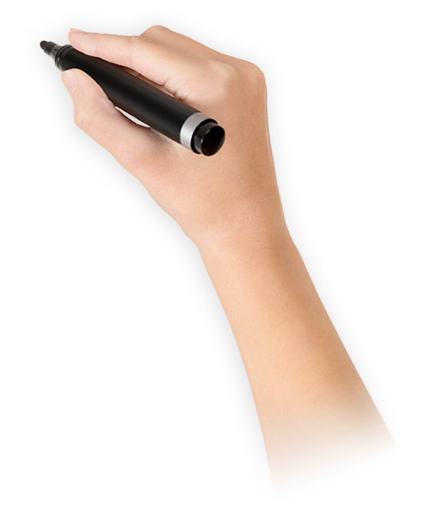


1.2 THE PROGRAM
The application process
APPLICATIONS
TRAINING
Ongoing
2 weeks in person
INTERVIEWS
On the phone
& In person
INTERNSHIP
Up to 10 weeks

Slide 8
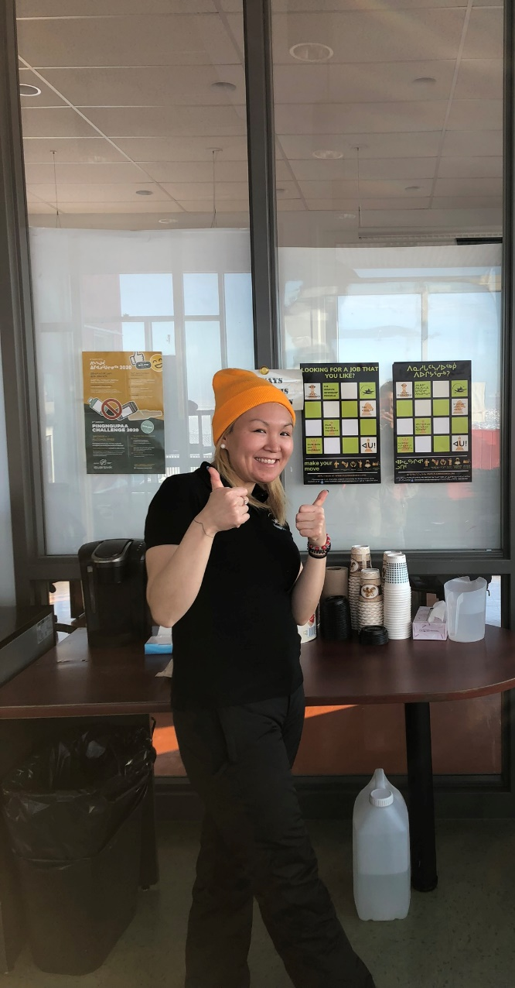
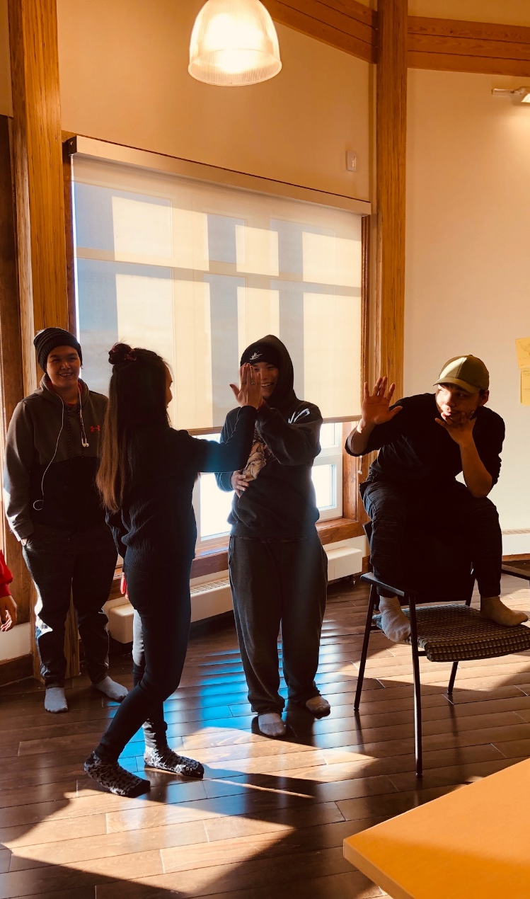
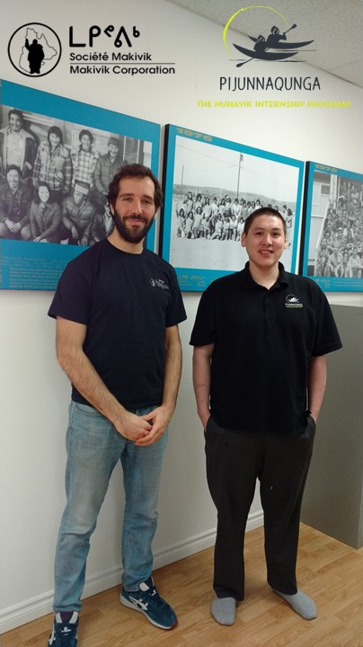
1.2 3 MAIN ACTIVITIES
RECRUITMENT
TRAINING
INTERNSHIPS

Slide 9

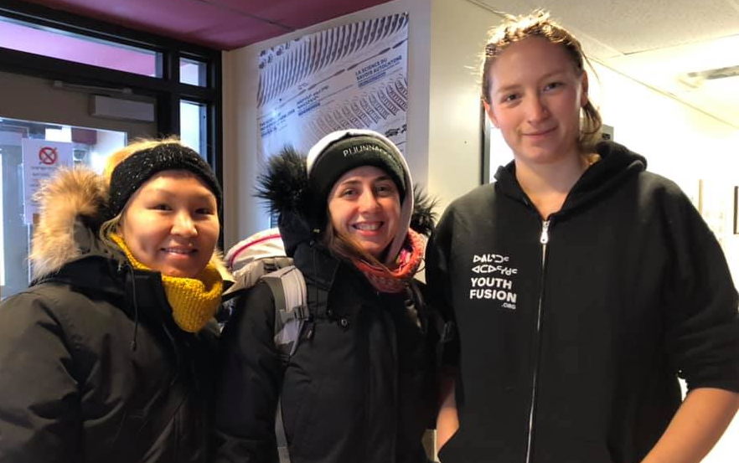
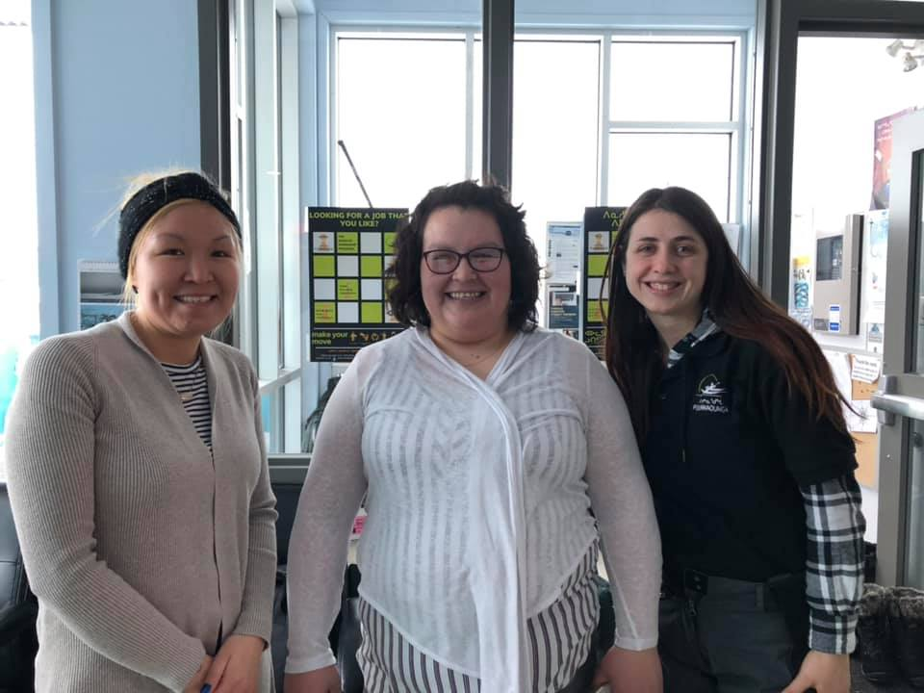
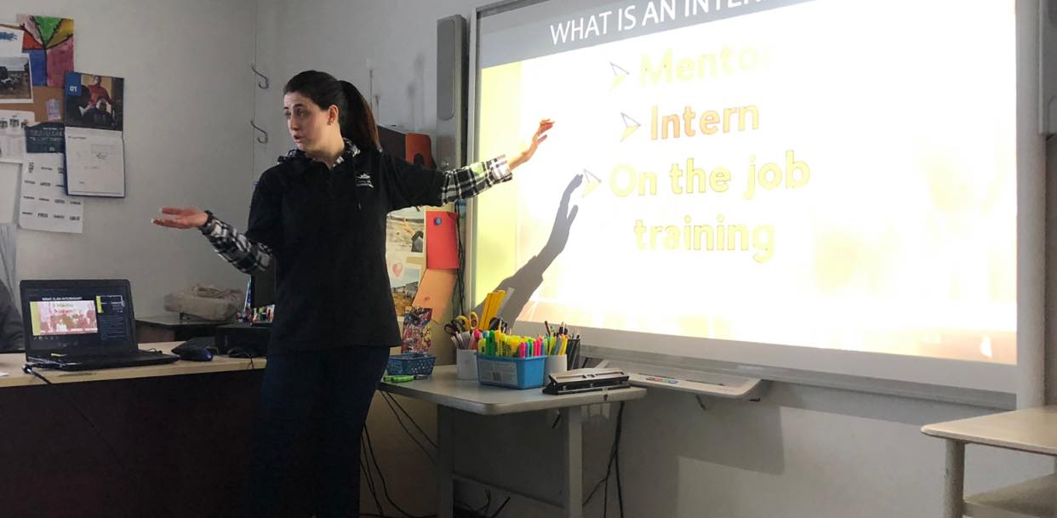
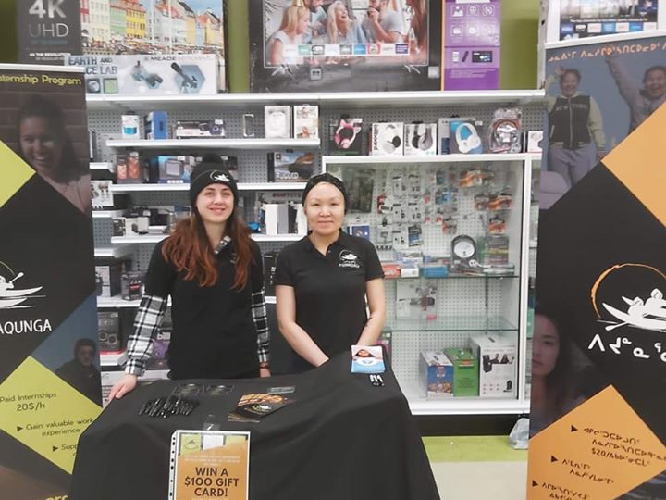
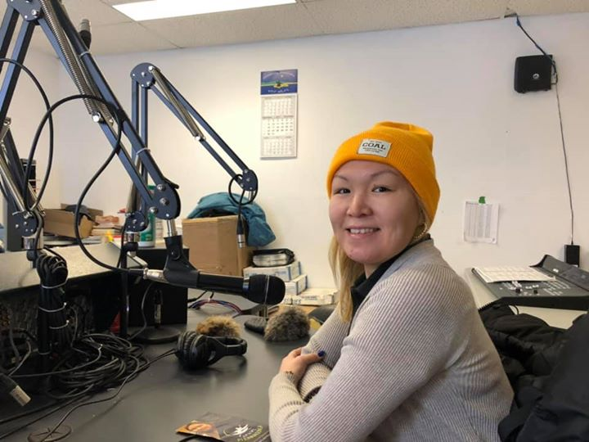
1.2 RECRUITMENT TOUR
ACTIVITIES TAKING PLACE DURING OUR RECRUITMENT TOURS:
Co-op store Kiosks
Radio announcements
Sec.4-5 presentation
Meeting with the school staff
Meeting with Youth Fusion coordinators
Meeting with LEOs
Meeting with Mayors and Town
managers
Meeting with well-established local
professionals
Putting up posters around town
Interviews with candidates
Marie, YF coordinator in Tasiujaq
Luciana, LEO in Tasiujaq
Presentation to sec. 4-5 students
Kiosk at the Co-op in Aupaluk
Radio announcement

Slide 10
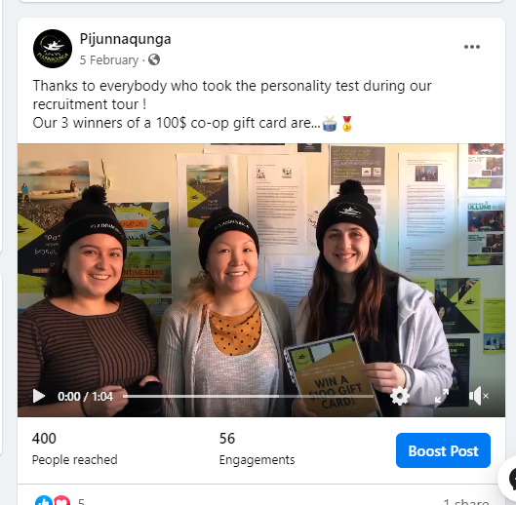
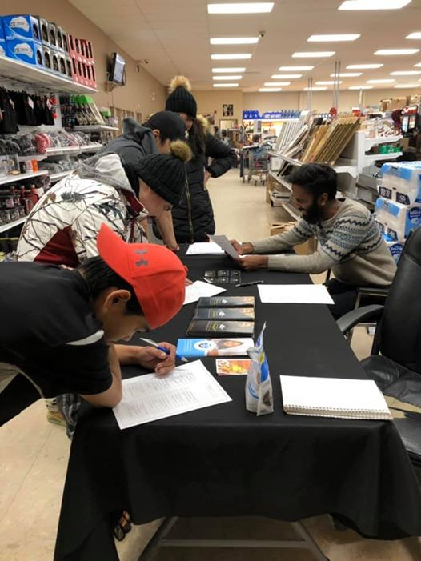
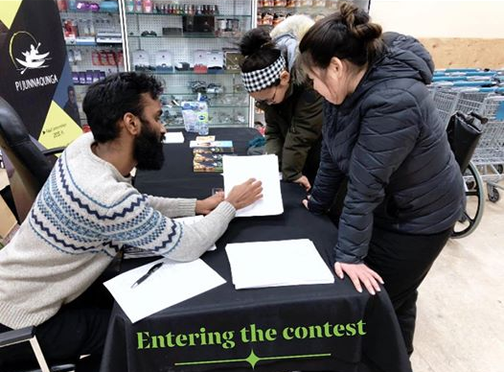
1.2 RECRUITMENT TOUR
RECRUITMENT TOUR CONTEST
– Career test –
Each recruitment tour, we have a contest which is a great way to attract people to the table and increase the traffic on our Facebook page.
Last time, we offered a short career test based on the Holland code. The results helped people to see career options based on the things they enjoy doing.
We had 50 participants in 6 communities.
Average of 28 applicants per tour

Slide 11
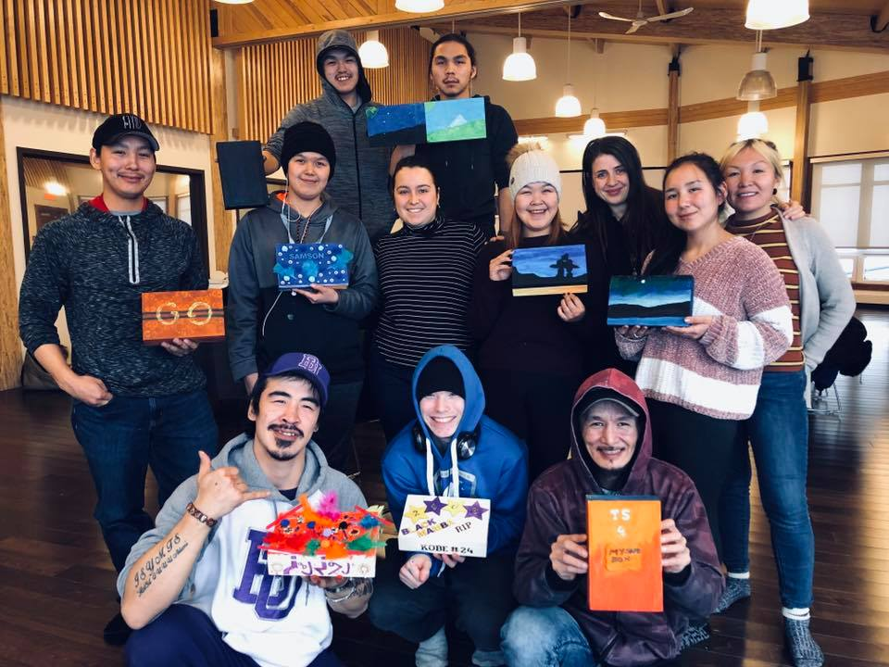
1.2 THE PIJUNNAQUNGA TRAINING
Location:
Community where the majority of applicants are from.
Duration:
Two weeks
The training is an important component of the selection process! It allows us to:
Develop a relation of trust with the participants
Evaluate their work habits and basic skills
Get to know them, including their aspirations and interests.
Participants:
Average of 9 per training

Slide 12

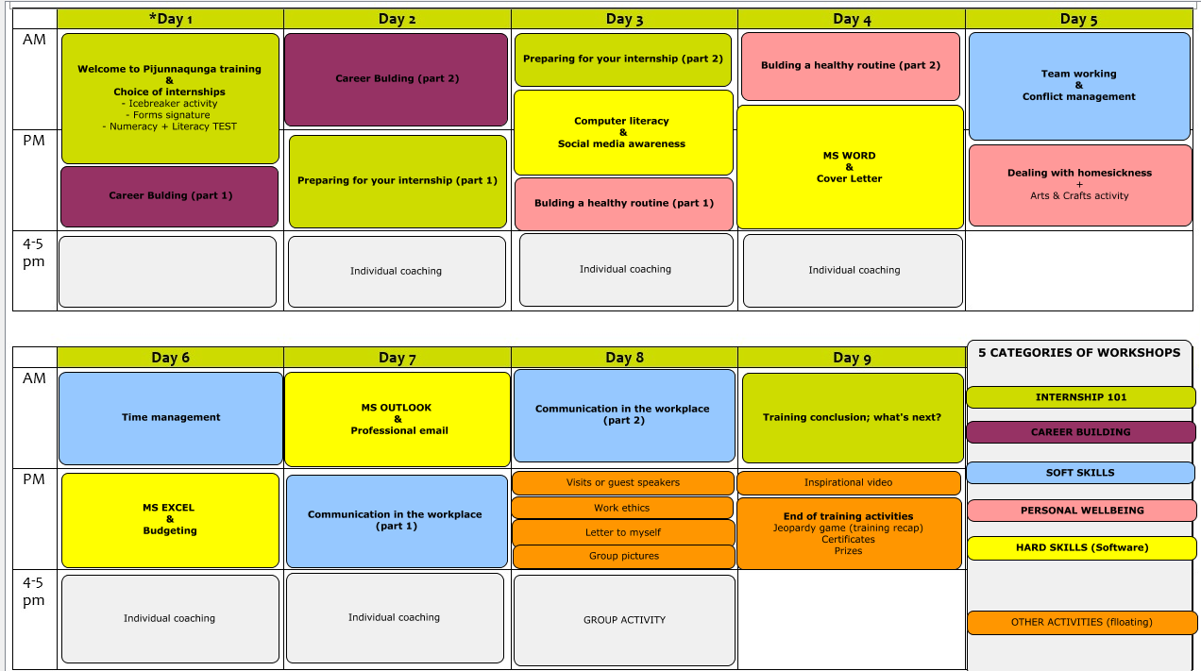
1.2 TRAINING SCHEDULE EXAMPLE

Slide 13























1.2 INTERNSHIPS DEVELOPPED
We are continuously looking to develop more internships!
IT Technician
Project Manager
Communication agent
Accountant
Project Coordinator
Sanajiit Project Officer
Employment Services agent
Reporter-Editor
Program Officer
Administrative assitant
Income tax agent
Educator

Slide 14
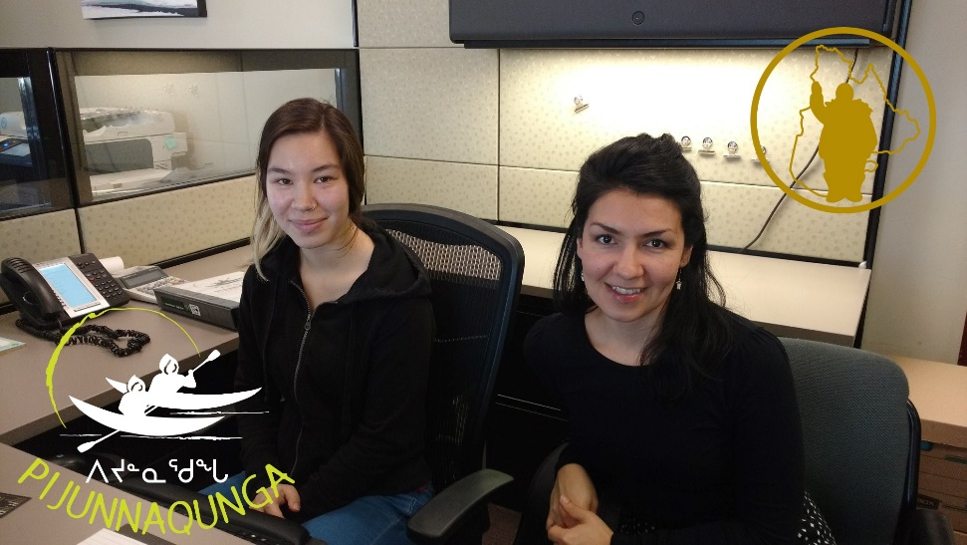
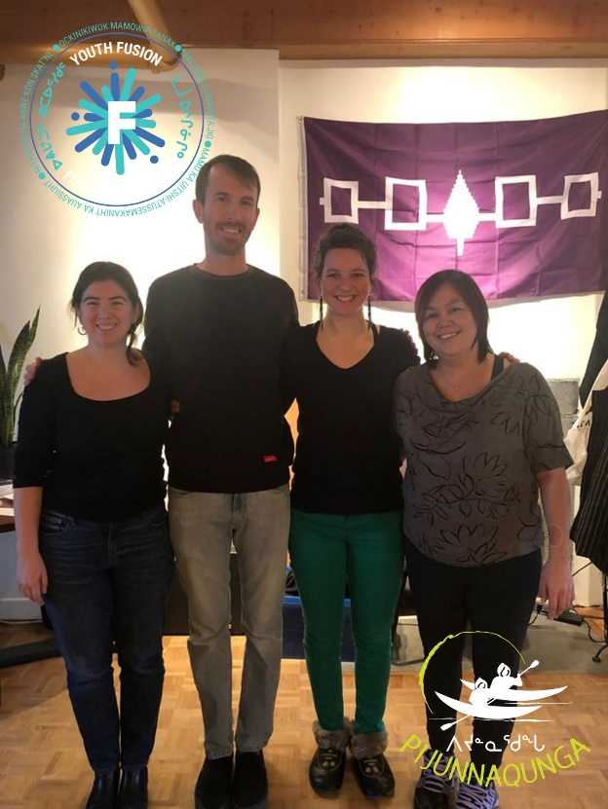
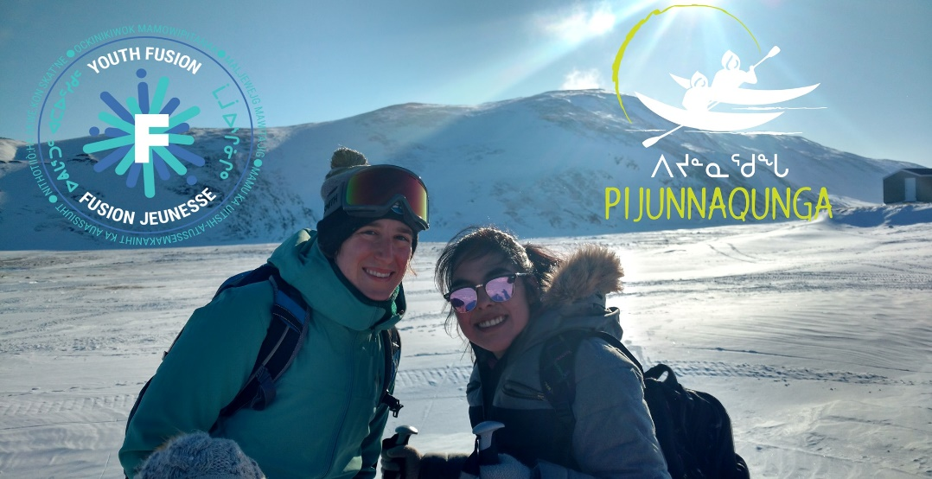
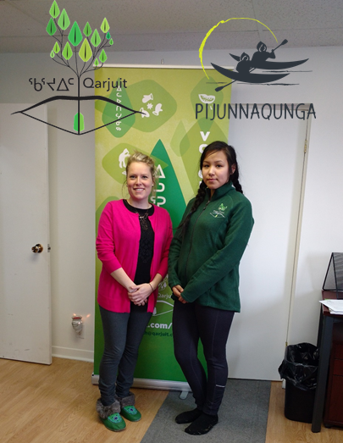
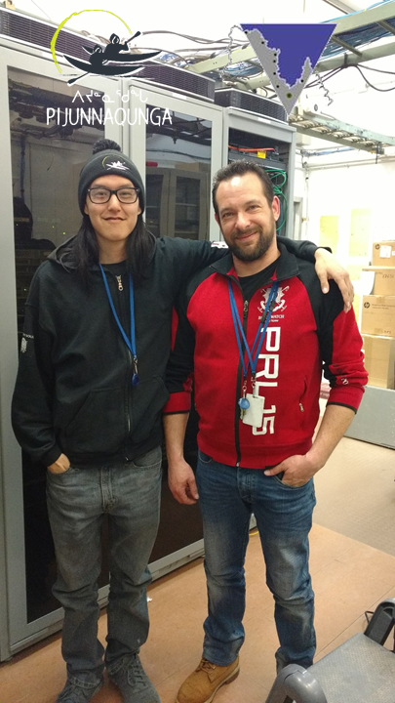
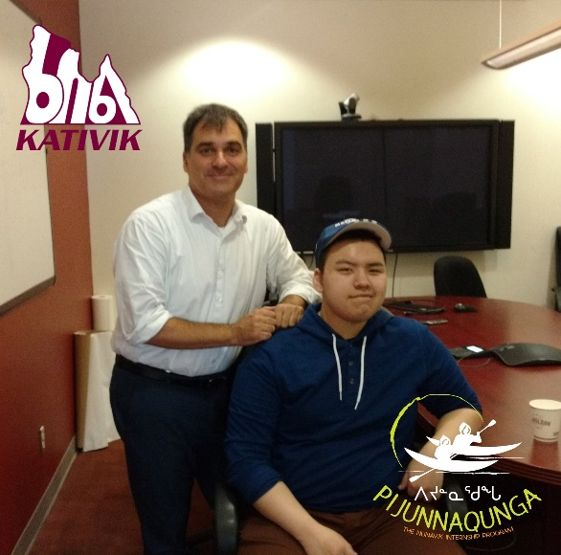
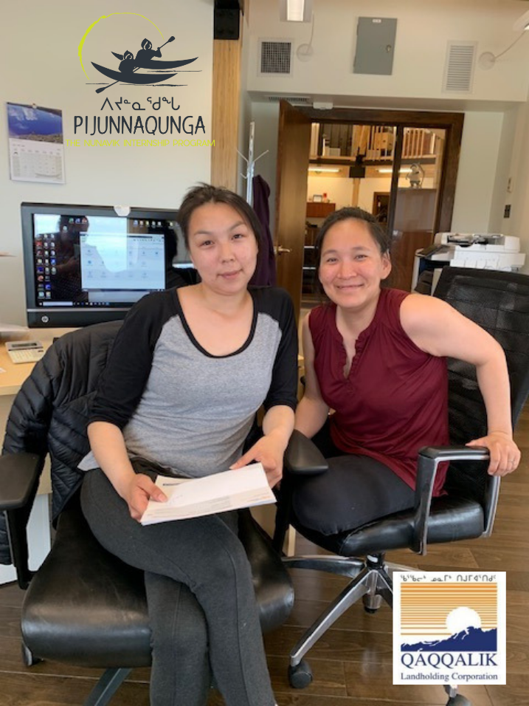
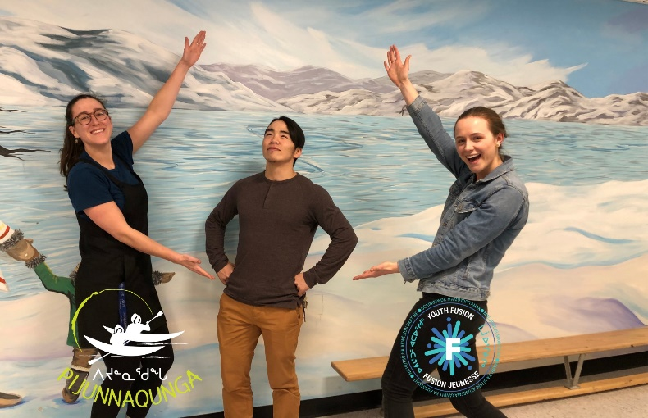
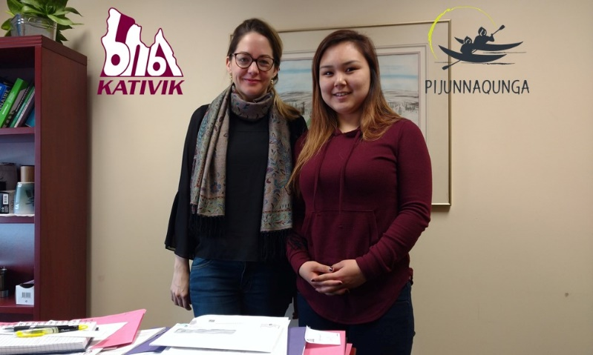
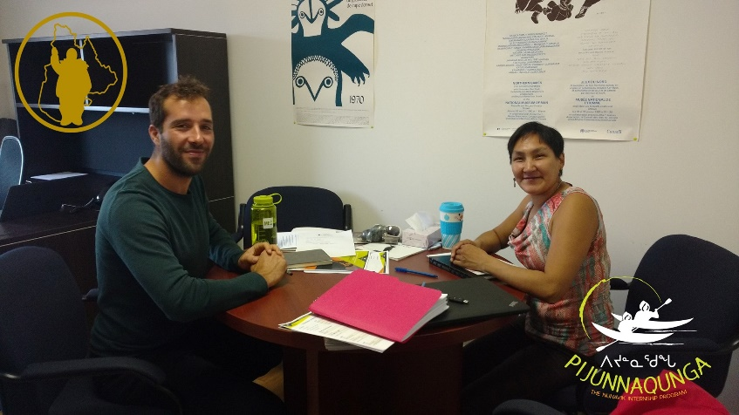
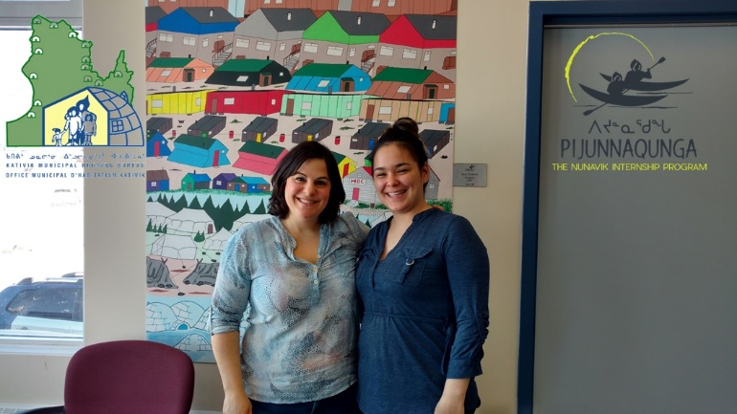
2. OVERVIEW OF 2017-2021

Slide 15
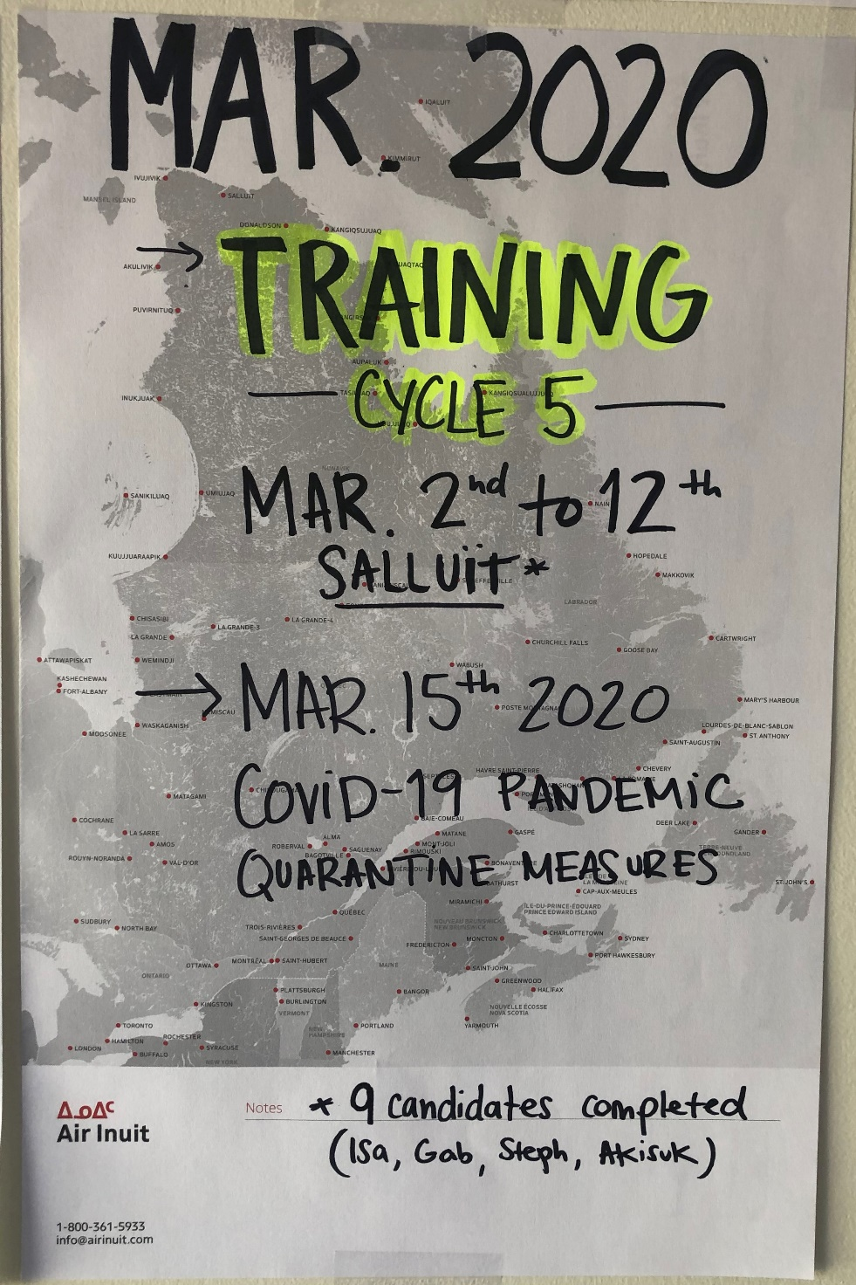
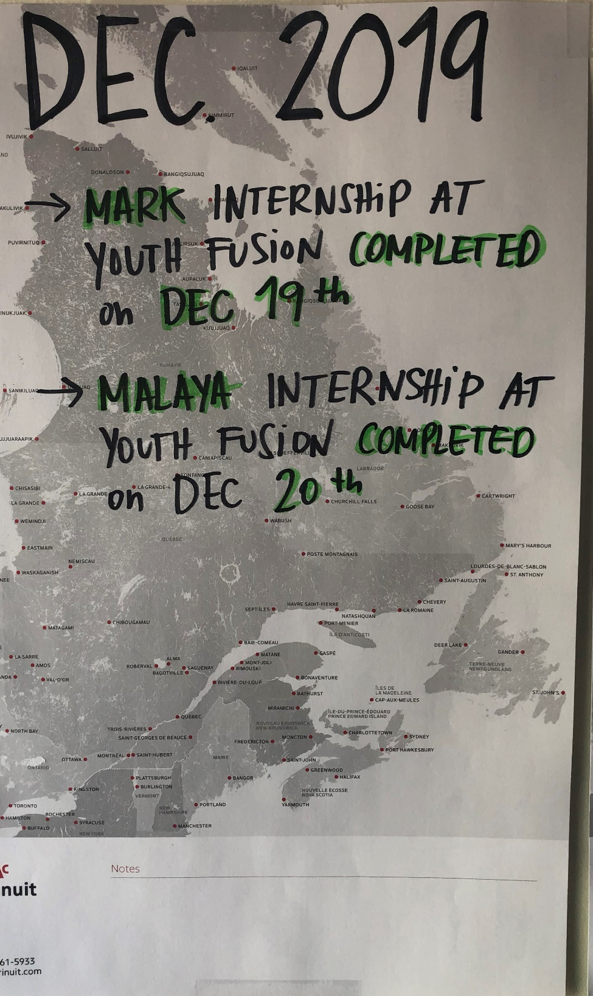
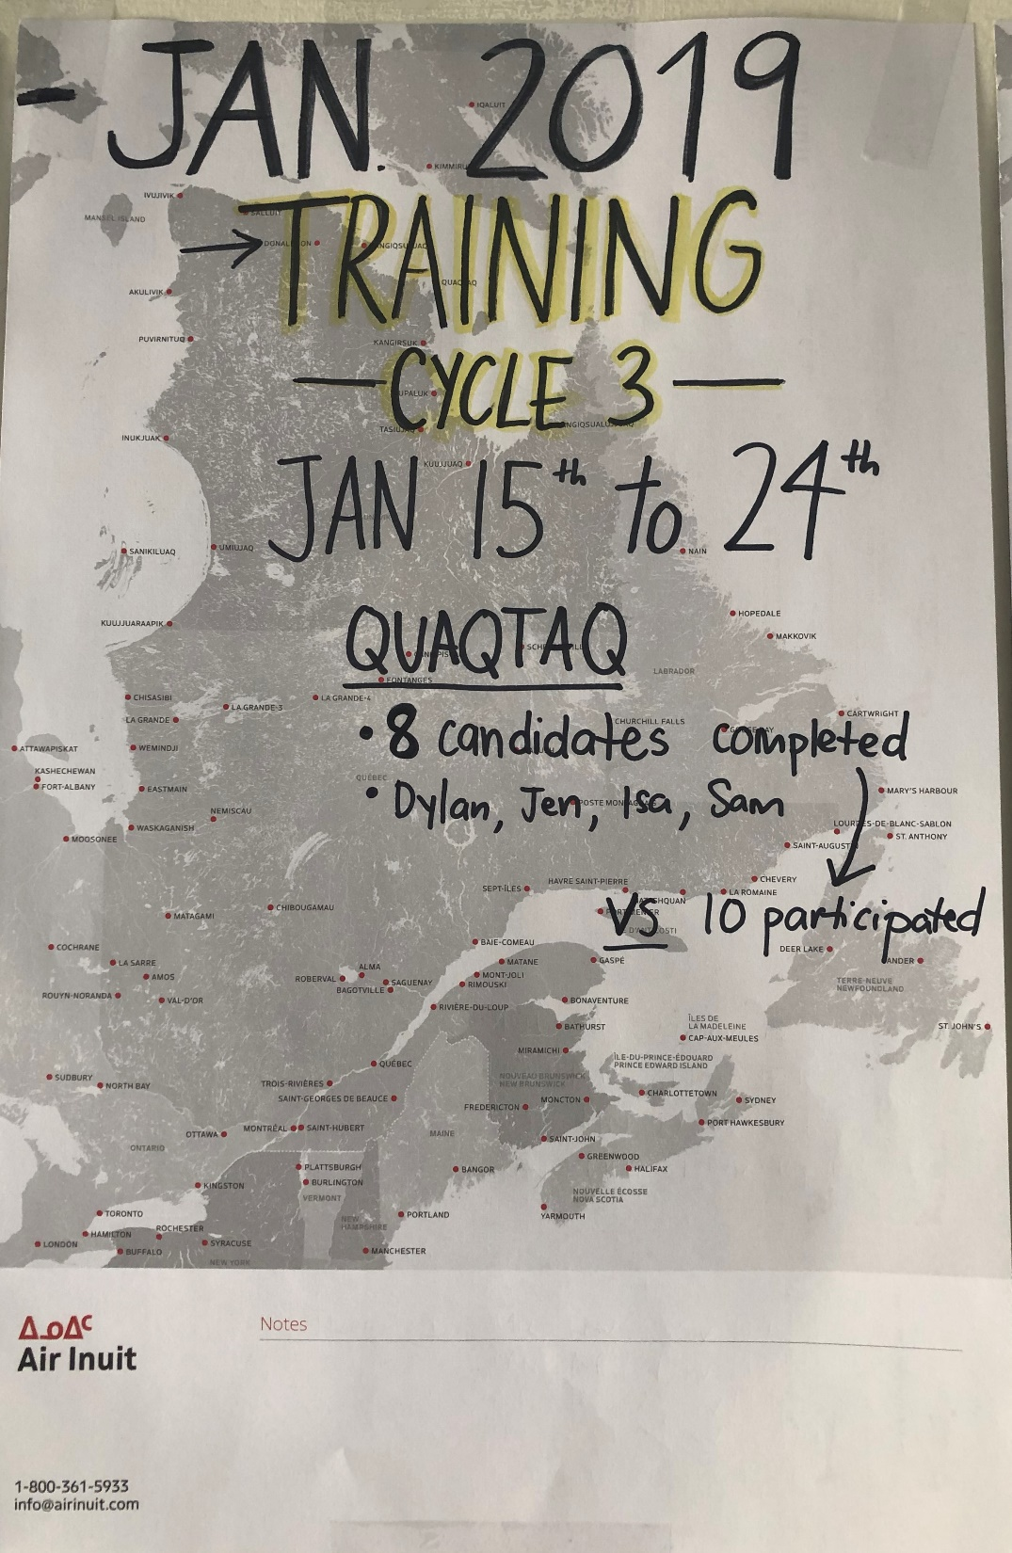
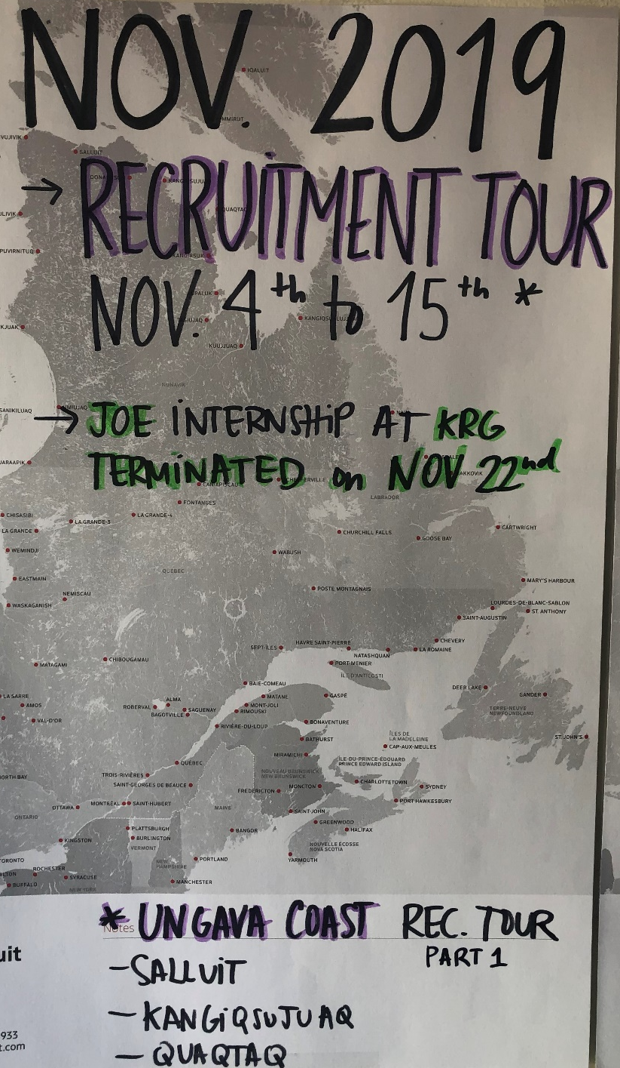
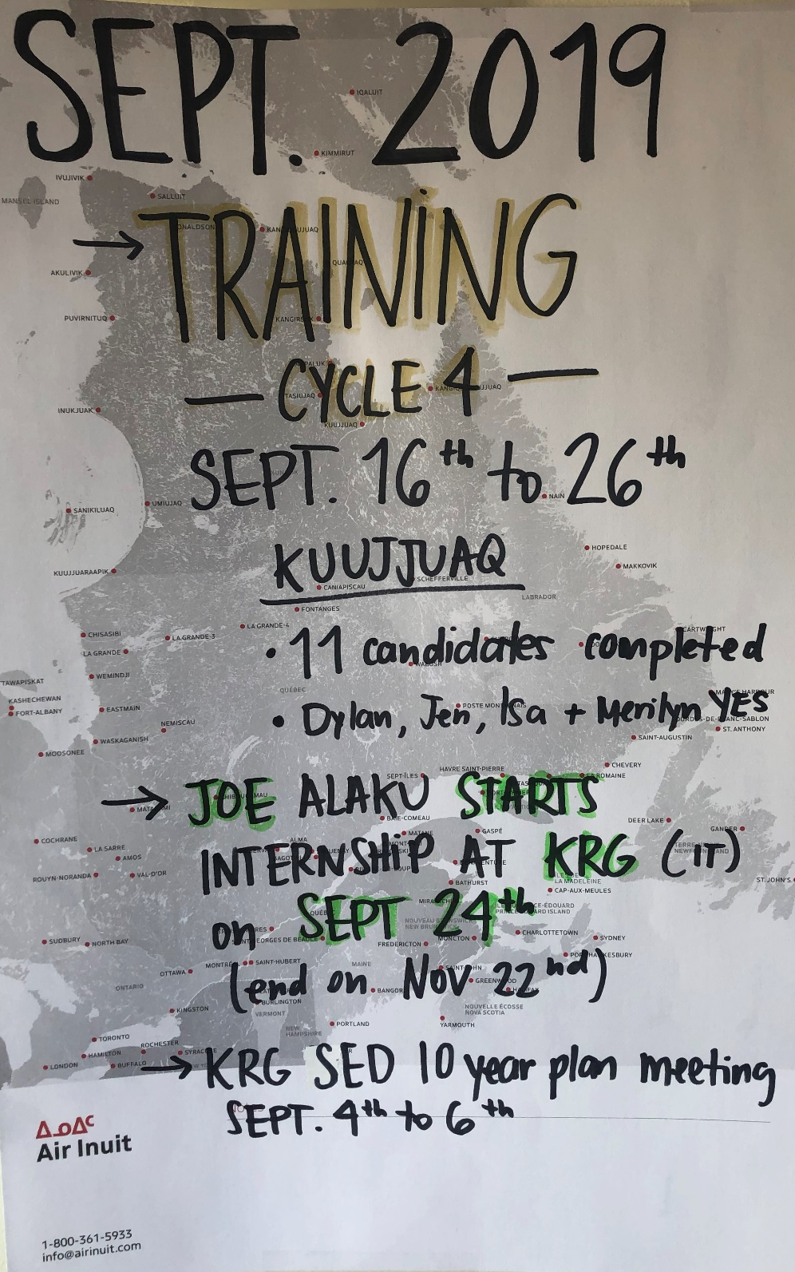
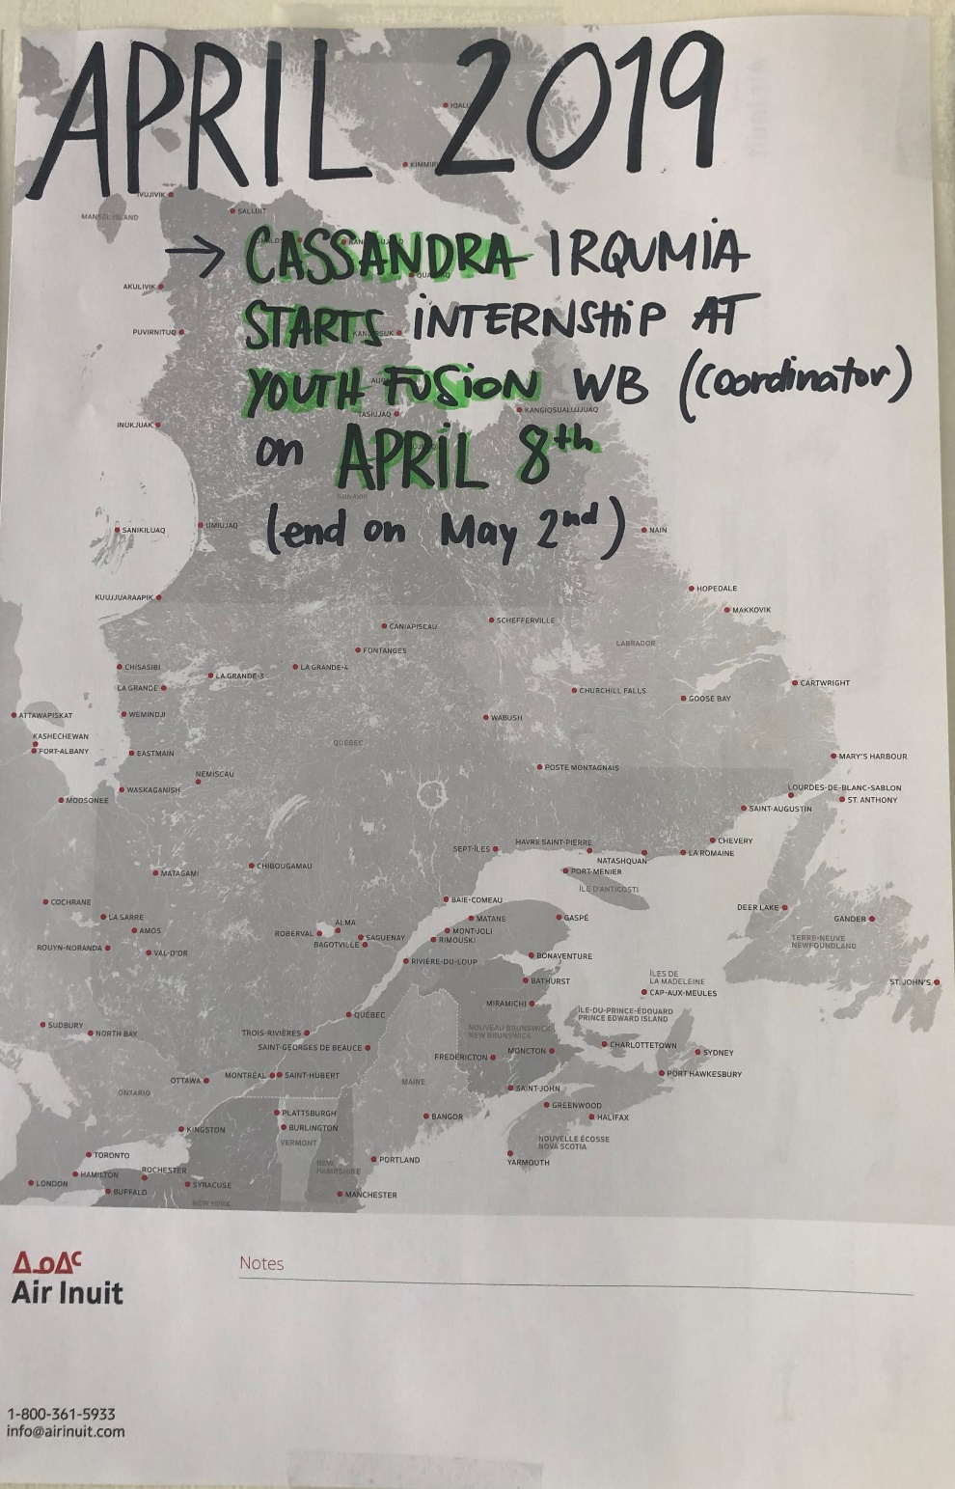
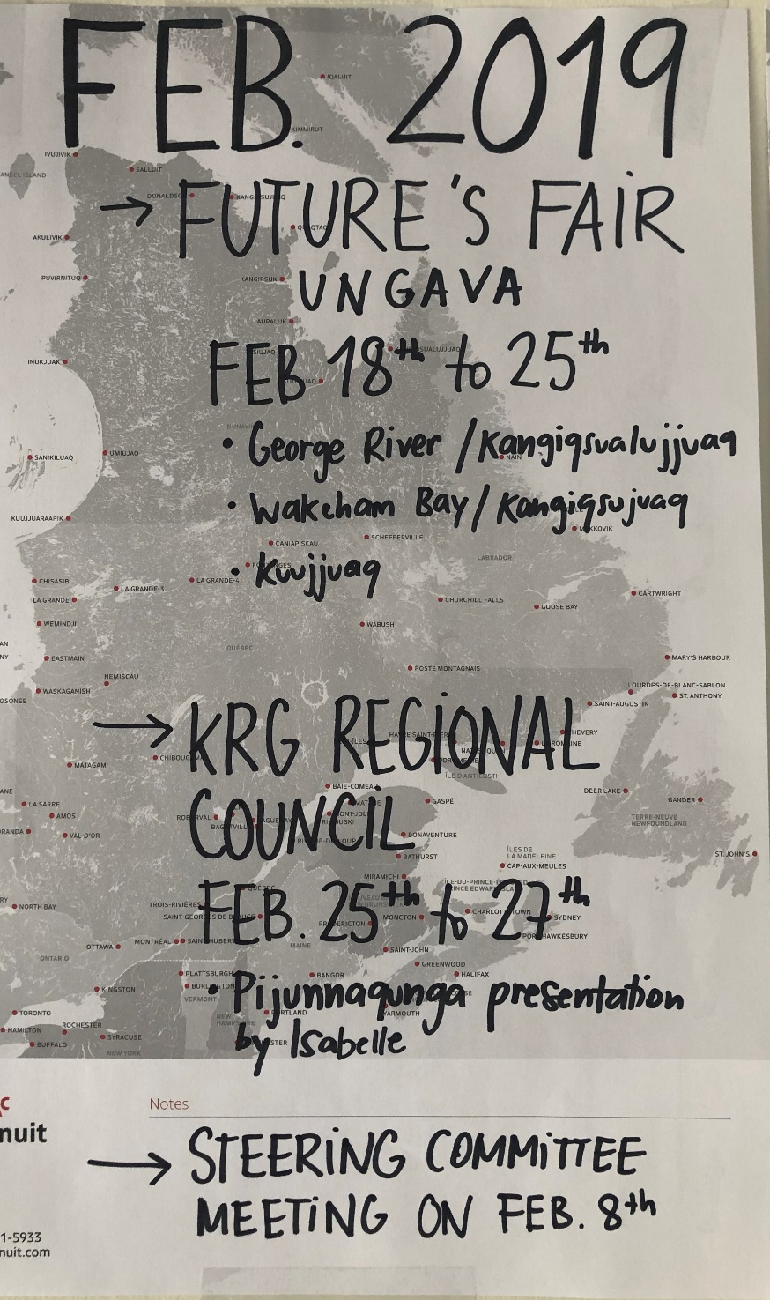
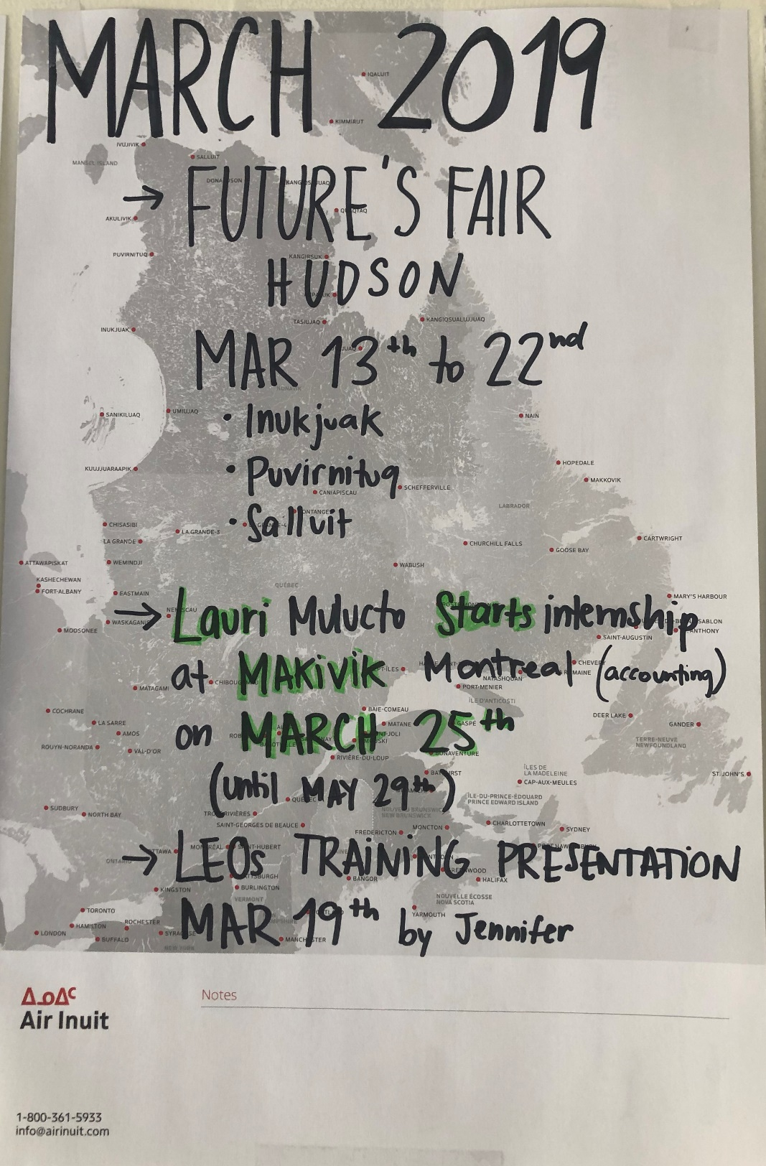
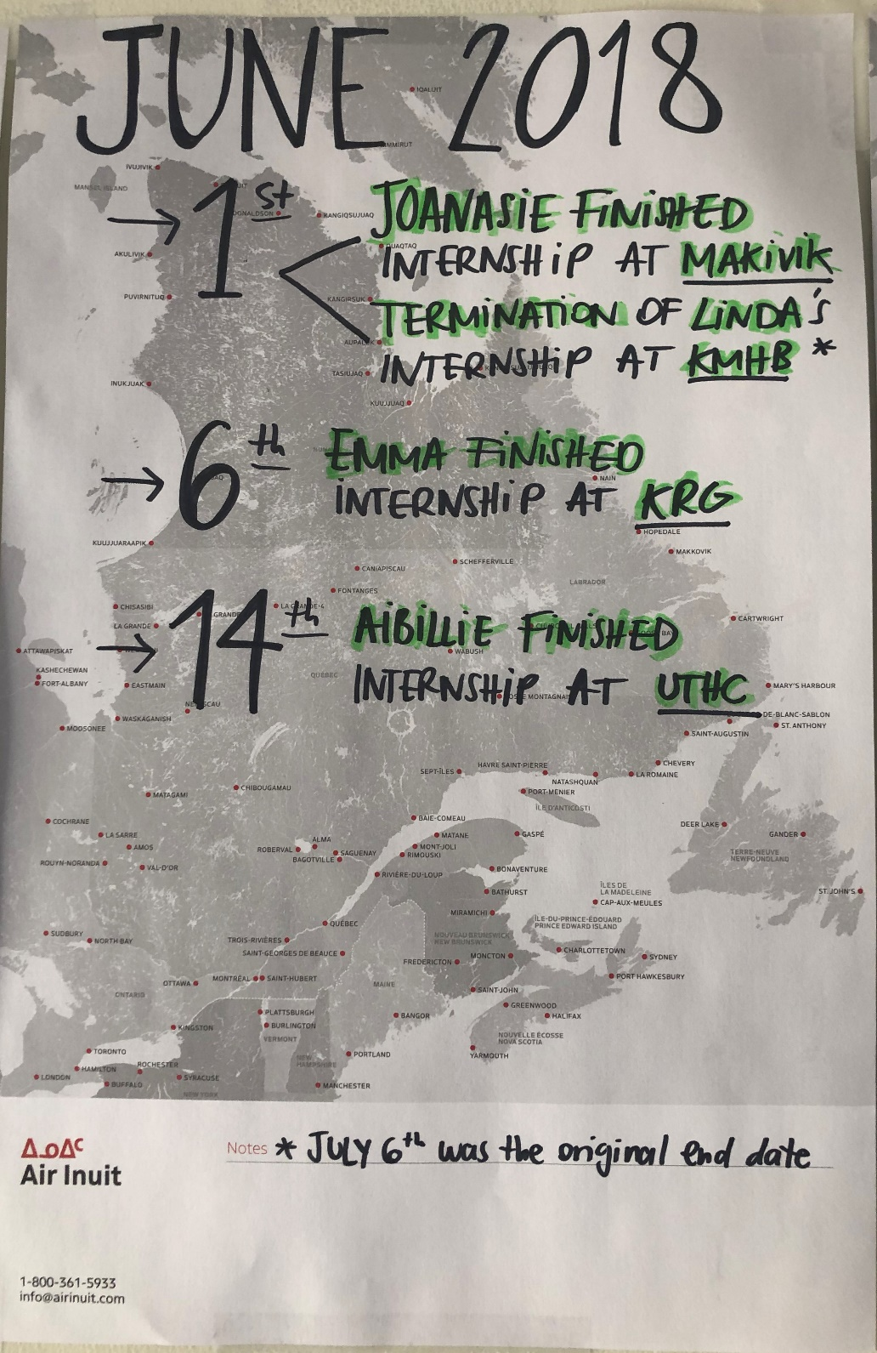
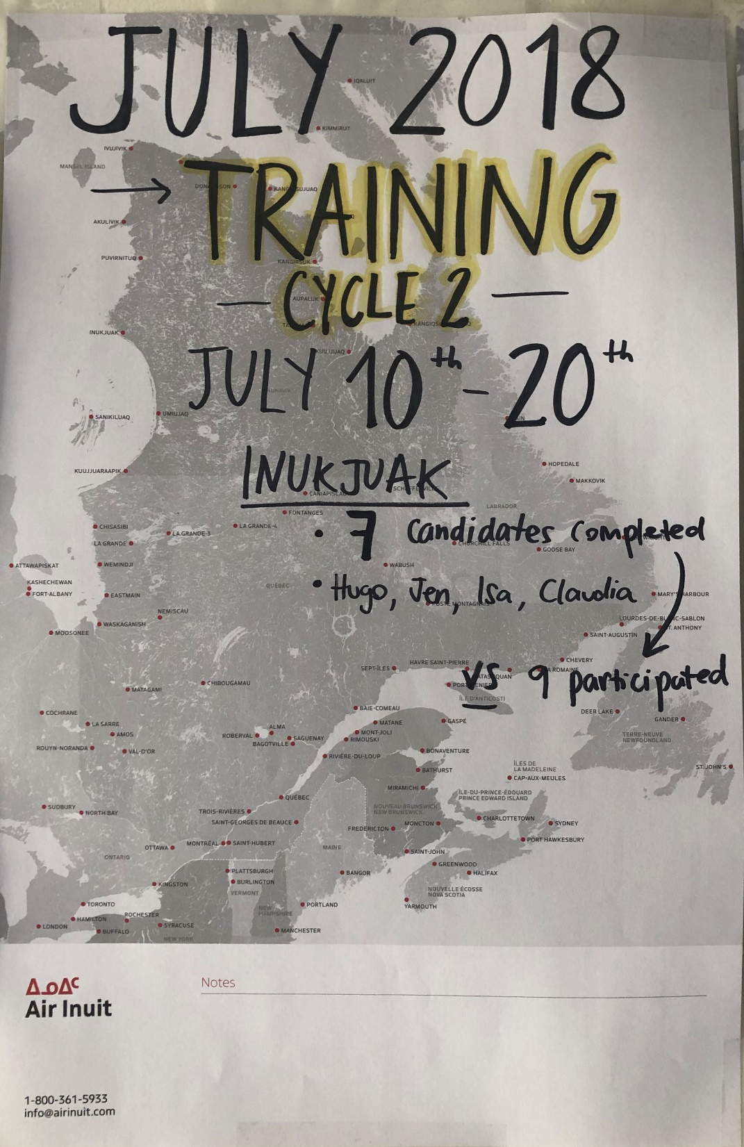
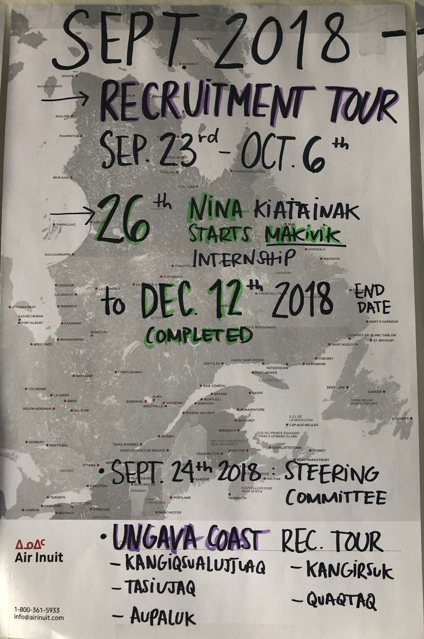
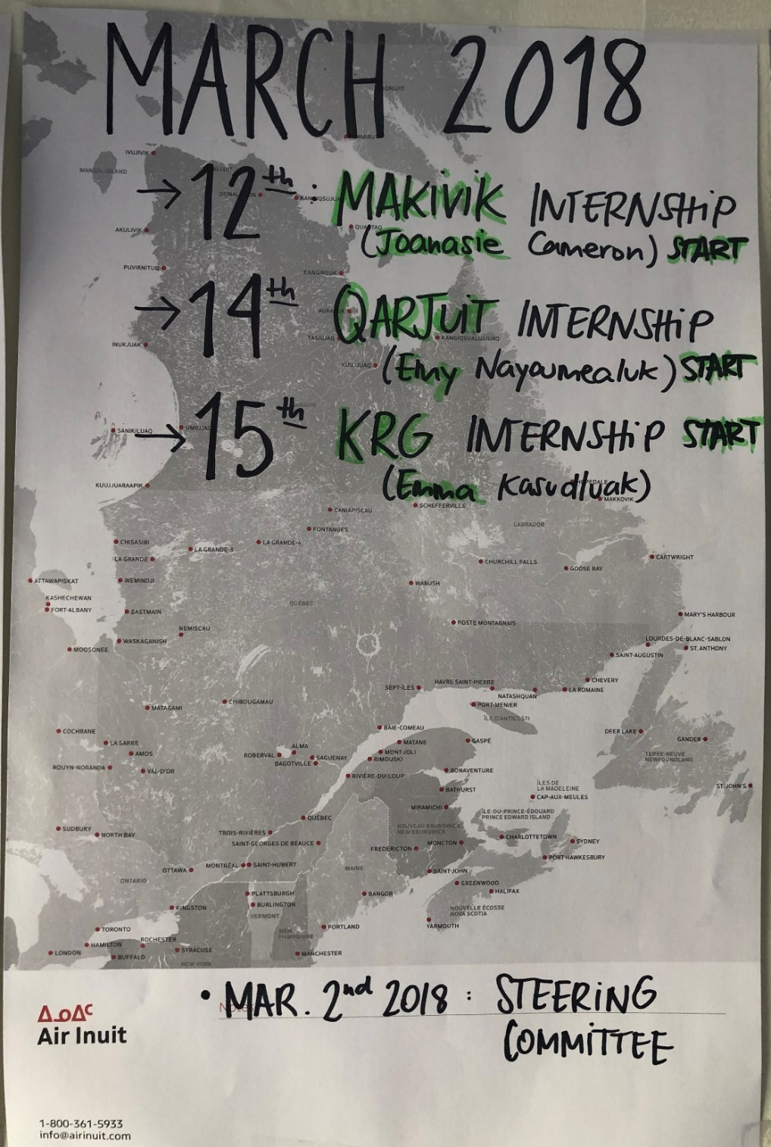
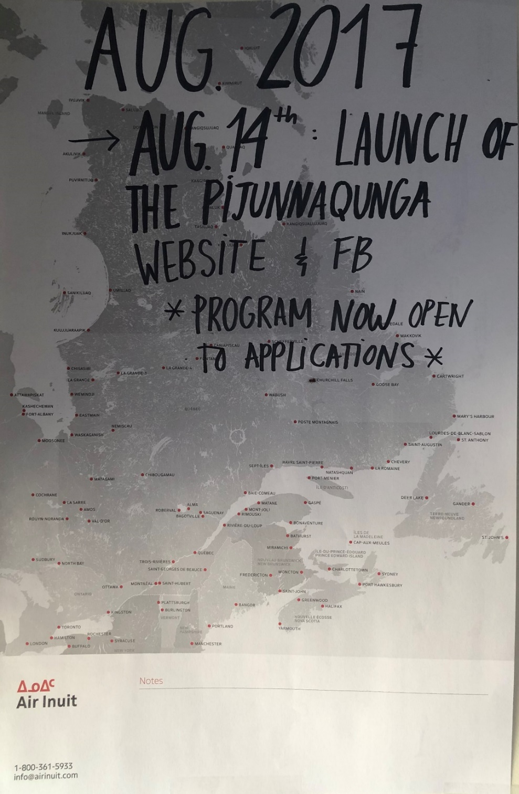
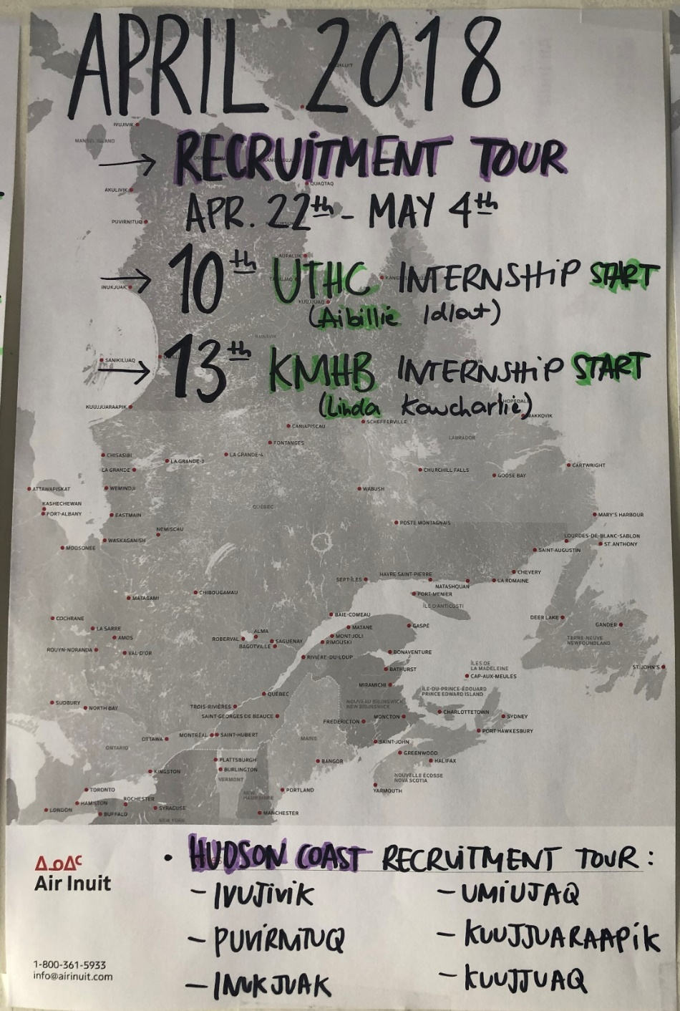
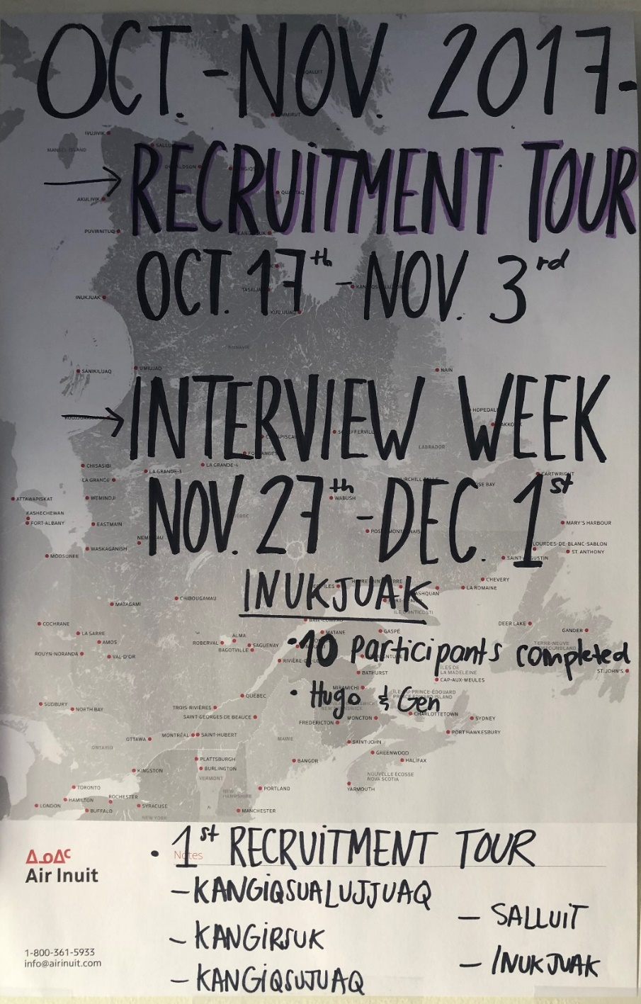
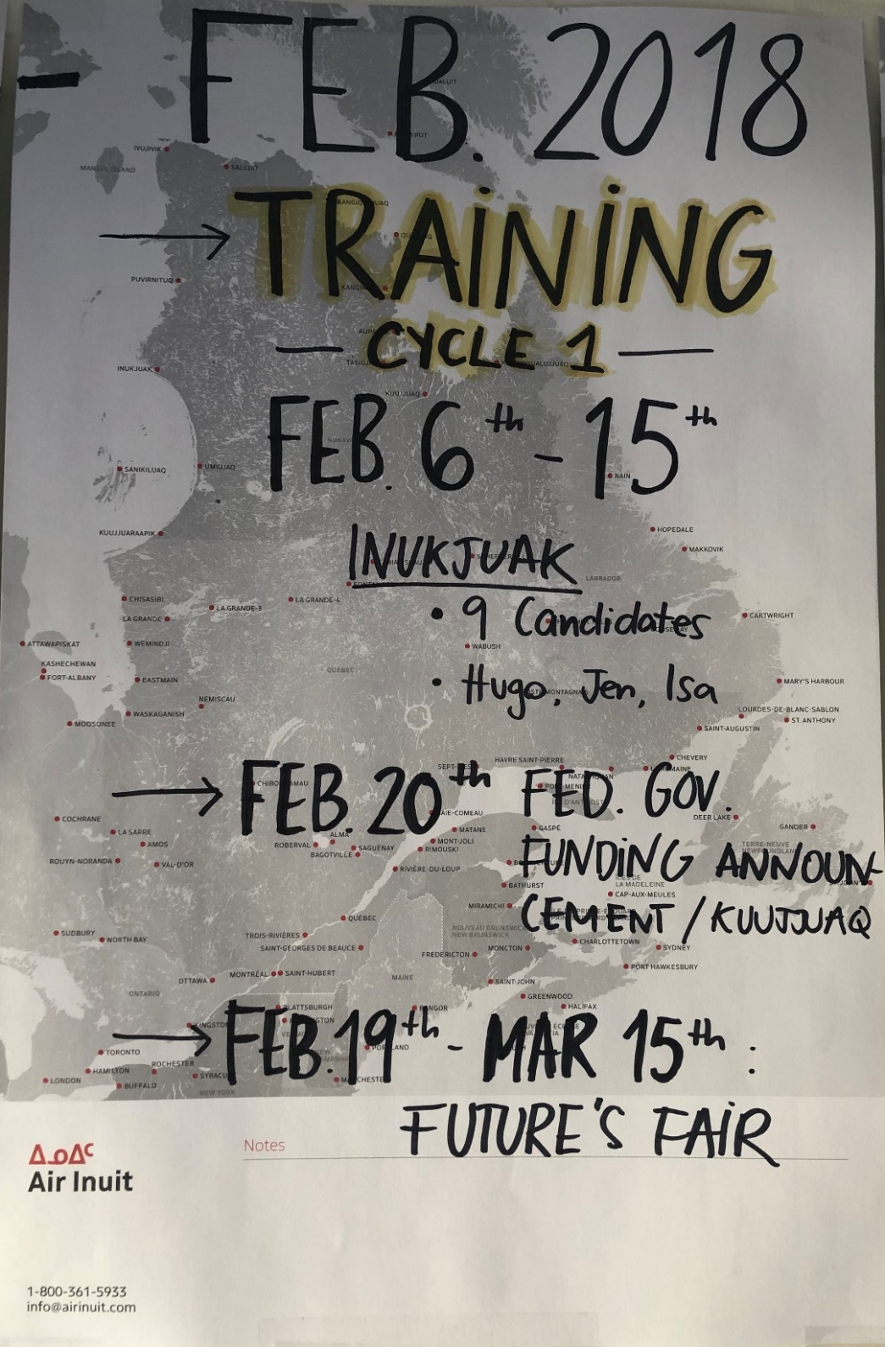
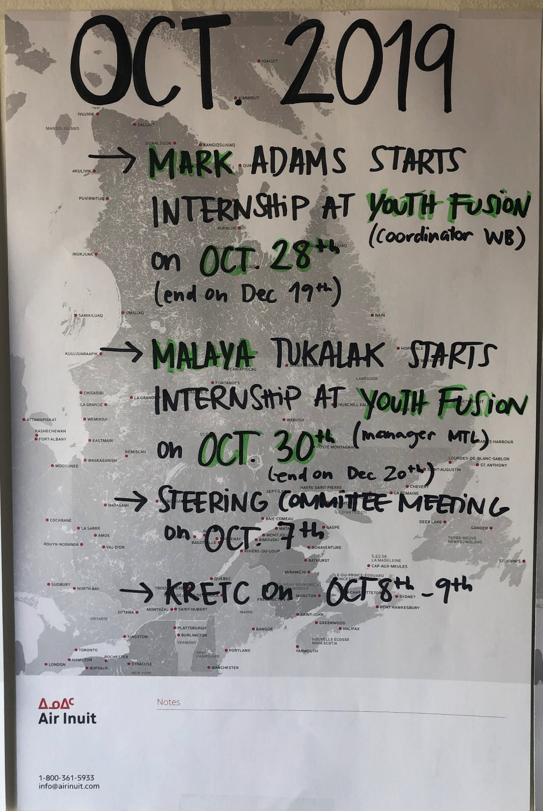
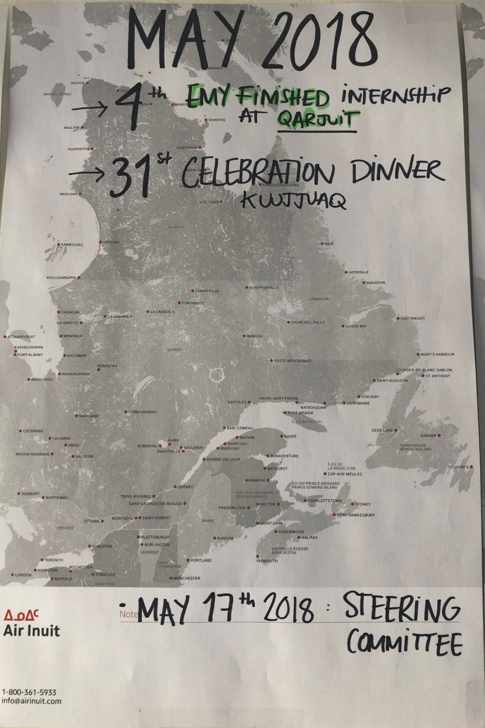
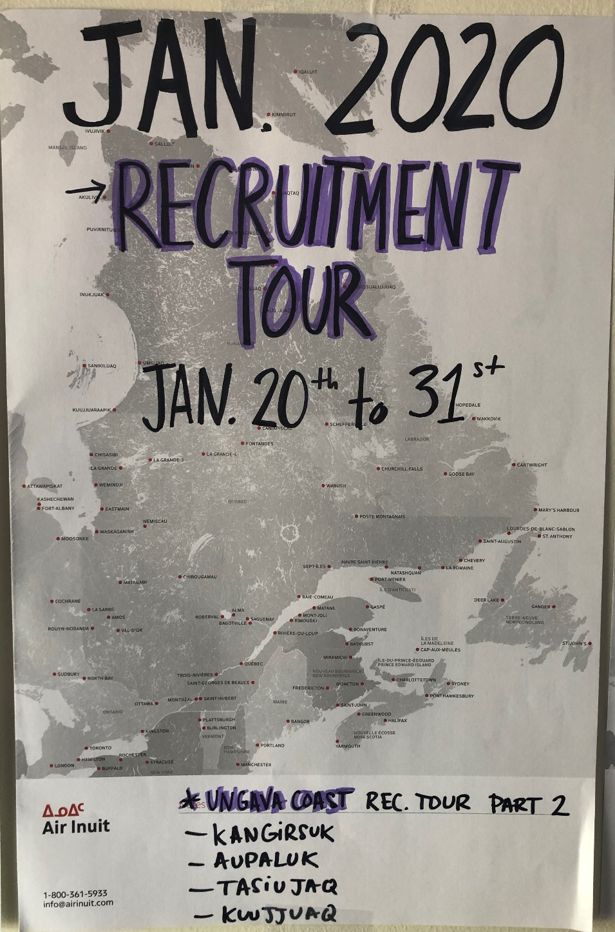
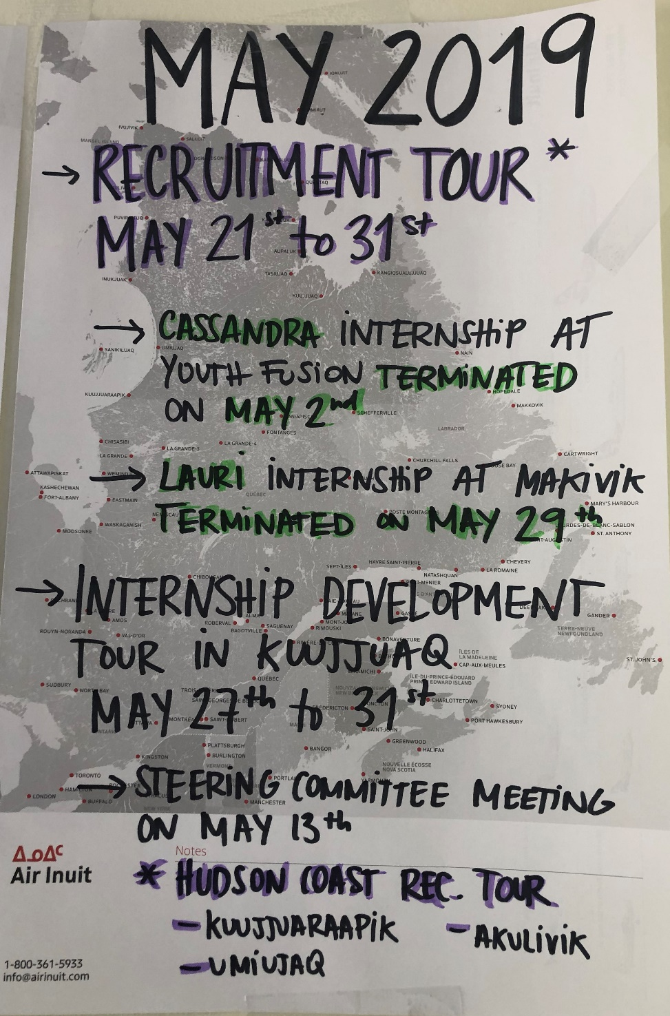
2.1 TIMELINE
Since the pandemic…
JULY 2020
INTERNSHIP
Qaqqalik Landholding corporation of Salluit
NOVEMBER 2020
TRAINING CYCLE 6
First training in Montreal

Slide 16
2.2 STATISTICS 2017-2021
From August 21st 2017 to March 31st 2021:
160 participants applied to the Pijunnaqunga program
54 trainees participated in the 6 Pijunnaqunga 2-week training in 5 different communities
12 interns had an internship opportunity in 4 different locations
22 internships developed with 13 different partner organizations

Slide 17


2.2 STATISTICS AND IMPACT OF COVID
Since April 2020…
STATISTICS
23 participants applied to the Pijunnaqunga program
6 trainees participated in the 6th Pijunnaqunga training *First training in Montreal*
1 intern completed their internship
4 new internships developed with 4 different organizations (Qaqqalik, KI, NRBHSS, NLHCA)
IMPACT OF COVID
No recruitment tour and Future’s fair since February 2020
VS 3 tours scheduled pre-covid
No training up north since March 2020
VS 3 training scheduled pre-covid
7 internships postponed
(5 Nunavik, 2 Montreal)
Notes:
Postponing of our entire calendar

Slide 18



2.3 TOOLS AND PROCEDURES
RECRUITMENT
Application form
Reference form
Database
Phone interview form
In-person interview form
Guide How to become an intern
Power point presentation for schools
Guides for the recruitment process and follow-up
TRAINING
11 workshops (PPT presentations and exercises)
Training journal
Workshop evaluations
Candidate’s code of conduct
Trainee daily evaluation
Candidate’s self-evaluation
Candidate’s daily evaluation
Candidate’s training evaluation
Coaching session form
INTERNSHIPS
Internship description
Internship agreement
Candidate’s profile
Midterm and final evaluations (mentors & interns)
Midterm and final self-evaluations (mentors & interns)
Action Plan
Mentor’s guide
Intern’s guide
Intern’s weekly assesment
Weekly learning objectives framework
Internship follow-up form (mentors & interns)
Professional development plan

Slide 19



2.3 TOOLS AND PROCEDURES
LOGISTICS & PROCEDURES
Interns and trainees database
House rental contracts
Participants Status forms: On-hold, on-hold trainee, trainee to reinvite, closed, terminated, completed
File opening check list
Messages templates
Training results
PROMOTION
Website
Facebook
Pamphlets
Posters
Promotional items
PARTNERSHIPS
Handout & summary for organizations
Handout for YES and LEOs

Slide 20

2.4 TESTIMONIALS
“ I passed my internship and I have never felt so great about it because I achieved something that I always wanted to do for the Youth Fusion and as a life goal, they offered me a job […] It’s a great way to start my New Year.’’
- Mark Adams, 25 years old Kangiqsujuaq

Slide 21

2.4 TESTIMONIALS
“ I am very grateful for this opportunity because it helped me to regain motivation and confidence in myself. Before my internship, I felt limited to the responsibilities of a young mother. Now, I know I can do anything. “
Emy Nayoumealuk, 20 years old
Inukjuak

Slide 22

2.4 TESTIMONIALS
“The Pijunnaqunga program helped me in many different ways, inside and outside the office. I now know I’m capable to do anything if I put my mind to it. I strongly recommend the program to the youths.“
- Emma Kasudluak, 19 years old
Inukjuak

Slide 23


QUESTIONS AND VARIA
Comments or questions?

