Slide 1



ᑐᕌᒐᑦᓭᑦ ᓇᕝᕚᒐᓱᐊᒍᒃ,
ᐊᕐᖁᑎᑦᓴᓕᐅᕋᓱᐊᒋᑦ
ᐃᓄᐃᑦyK9o˛6y
ᑮᐋᔩ ᑭᒡᒐᑐᕐᑎᖏᓐᓄᑦ ᑕᑯᓐᓇᕋᑦᓴᓕᐊᕕᓂᖅ
ᔫᓂ 2021

Slide 2
ᑕᑯᓐᓇᕋᑦᓴᓕᐊᑉ ᐋᕐᕿᓯᒪᒍᓯᖓ
ᓱᓇᐅᕙ ᐱᔪᓐᓇᖁᖔ?
1.2 ᐱᔪᓐᓇᖁᖔ
ᐃᓕᒐᓱᐊᕐᓂᖅ
3 ᑐᖕᖓᕖᑦ ᓱᖃᑦᓯᐅᑏᑦ
ᓱᓂᕕᓂᖏᑦ 2017-ᒥ-2021-ᒧᑦ
2.1 ᐃᓂᓪᓚᑎᕐᓯᒪᓂᖏᑦ
2.2 ᐋᕐᕿᓯᒪᒍᓰᑦ
2.3 ᐃᑲᔪᕐᓯᐅᑏᑦ ᐊᒻᒪᓗ ᐱᔭᑦᓴᕆᔭᐅᔪᑦ
2.4 ᐅᖃᐅᓯᑦᓴᕆᔭᐅᔪᑦ

Slide 3



ᓱᓇᐅᕙ ᐱᔪᓐᓇᖁᖔ?
ᐱᔪᓐᓇᖁᖔ ᑲᑎᕕᒃ ᓄᓇᓕᓕᒫᑦ ᑲᕙᒪᖓᑕ ᐊᑖᒍᑦ ᐱᓇᓱᒐᖃᕐᑎᓯᕕᐅᕗᒃ ᓄᓇᕕᒻᒥᐅᓄᑦ ᐱᕕᑦᓴᖃᕐᑎᓯᑦᓱᓂ ᐊᑭᓕᕐᑐᑕᐅᓂᒃᑯᑦ ᐱᓇᓱᑦᑎᑕᐅᑫᓐᓇᓂᕐᒥᒃ (ᐊᑯᓃᖕᖏᑐᒥᒃ ᐱᓇᓱᒐᕐᒥᒃ ᐱᒋᐅᕐᓴᑎᑕᐅᓗᓂ), ᑐᕌᒐᖃᕐᑎᓯᒐᓱᐊᕐᓂᑯᑦ ᐃᓄᓐᓂᒃ ᐱᔪᓐᓇᓯᑎᑦᓯᒐᓱᐊᕐᓂᒥᒃ ᐊᒻᒪᓗ ᐳᕐᑐᓯᒋᐊᖁᓪᓗᒋᑦ ᓄᓇᕕᒻᒥ ᐱᓇᓱᕝᕕᓂᒃ ᓄᐃᑕᓂᖏᑦ.

Slide 4
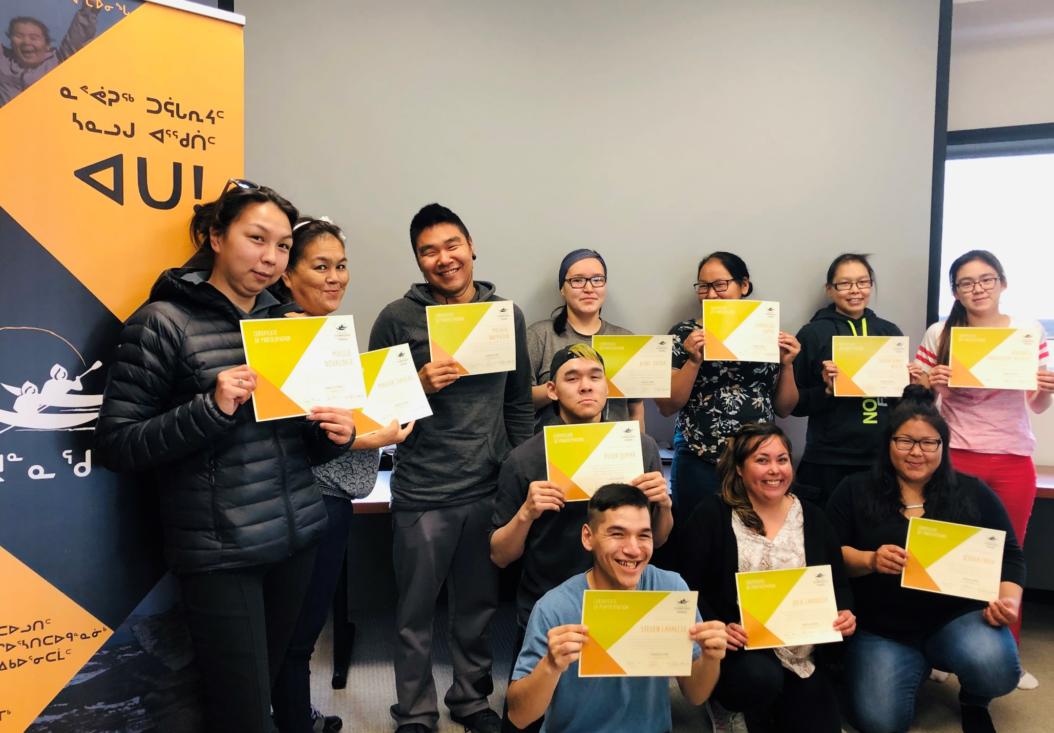
ᓱᓇᐅᕙ ᐱᔪᓐᓇᖁᖔ?
ᐃᓄᑐᐃᓐᓇᐅᓗᓂ ᓄᓇᕕᒻᒥᐅᑕᐅᓗᓂ;
ᐳᕐᑐᓂᕐᓴᒥ ᐱᔭᕇᒍᓯᕐᑕᐅᓯᒪᒋᐊᓕᒃ ᐅᕝᕙᓘᓐᓃᑦ ᐱᓇᓱᐊᕐᓯᒪᓗᓂ ᐊᑦᔨᐸᓱᖓᓂᒃ*;
ᐅᑭᐅᖃᕐᓗᓂ 18-ᓂᒃ ᑕᑉᐸᐅᖓᓕᒫᖅ (ᐱᔭᕇᒍᓯᕐᑕᐅᓯᒪᒍᕕᓪᓘᓃᑦ ᐳᕐᑐᓂᕐᓴᒥ).
ᐱᕕᑦᓴᖃᕐᑎᑕᐅᒍᓐᓇᓂᖏᑦᑕ ᒪᓕᒐᖏᑦ:
* ᐃᓄᐃᑦ ᐃᓚᐅᒍᒪᓪᓚᕆᓐᓂᒥᓂᒃ ᑕᑯᑦᓴᐅᑎᑦᓯᒍᑎᒃ ᐱᔭᕇᒍᓐᓇᓚᕆᓐᓂᒥᓂᓪᓗ ᑕᒪᑦᓱᒥᖓ ᑭᓯᐊᓂ ᐱᕕᑦᓴᖃᕈᓐᓇᓯᐊᕋᑎᒃ ᐃᓱᒪᒋᔭᐅᕋᔭᕐᑐᑦ.

Slide 5


ᓱᓇᐅᕙ ᐱᔪᓐᓇᖁᖔ?
ᐱᐅᔫᓂᖓ ᓄᓇᕕᒻᒥ ᑎᒥᐅᔫᔪᓄᑦ
ᓂᕈᐊᕐᓃᑦ ᑲᒪᒋᔭᐅᕇᕐᑐᑦ
50% ᑮᓇᐅᑦᔭᓵᕆᔭᐅᔪᑦ ᐅᑎᕐᕕᐅᒍᑎᐅᓲᑦ
ᐱᓇᓱᑦᑐᓴᖅ ᓄᓇᓕᒻᒥᐅᖑᖕᖏᑯᓂ: ᖃᖓᑦᑕᐅᑎᖏᑦ, 50% ᐊᓂᕐᕋᖃᕐᑎᑕᐅᓂᖓ, ᑐᕌᕐᕕᓴᖓ ᓄᓇᓕᒃ, ᐊᓯᖏᓪᓗ, ᐊᑭᓕᕐᑕᐅᒍᓐᓇᑐᑦ.
ᐱᐅᔫᓂᖓ ᓄᓇᕕᒻᒥᐅᓄᑦ
ᓄᑖᒥᒃ ᐱᓇᓱᒐᕐᒥᒃ ᐆᑦᑐᕋᕐᓂᖅ (ᐱᓇᓱᐊᕐᓯᒪᔫᕆᐊᑐᖕᖏᑐᖅ)
ᐱᓇᓱᑦᓯᒪᔫᓯᓗᓂ ᐱᔪᓐᓇᐅᑎᑖᕐᓗᓂᓗ ᓄᑖᓂᒃ
ᐱᑐᑦᓯᒪᐅᑎᓕᐅᕐᓗᓂ ᓄᓇᕕᒻᒥ ᑎᒥᐅᔫᔪᑎᒍᑦ
* ᐃᑲᔪᕐᓯᔭᐅᖏᓐᓇᖃᑦᑕᓗᓂ ᐱᔪᓐᓇᖁᖔᑉ ᐊᑕᐅᑦᓯᑰᕐᑎᓯᔨᖓᓂᒃ *

Slide 6
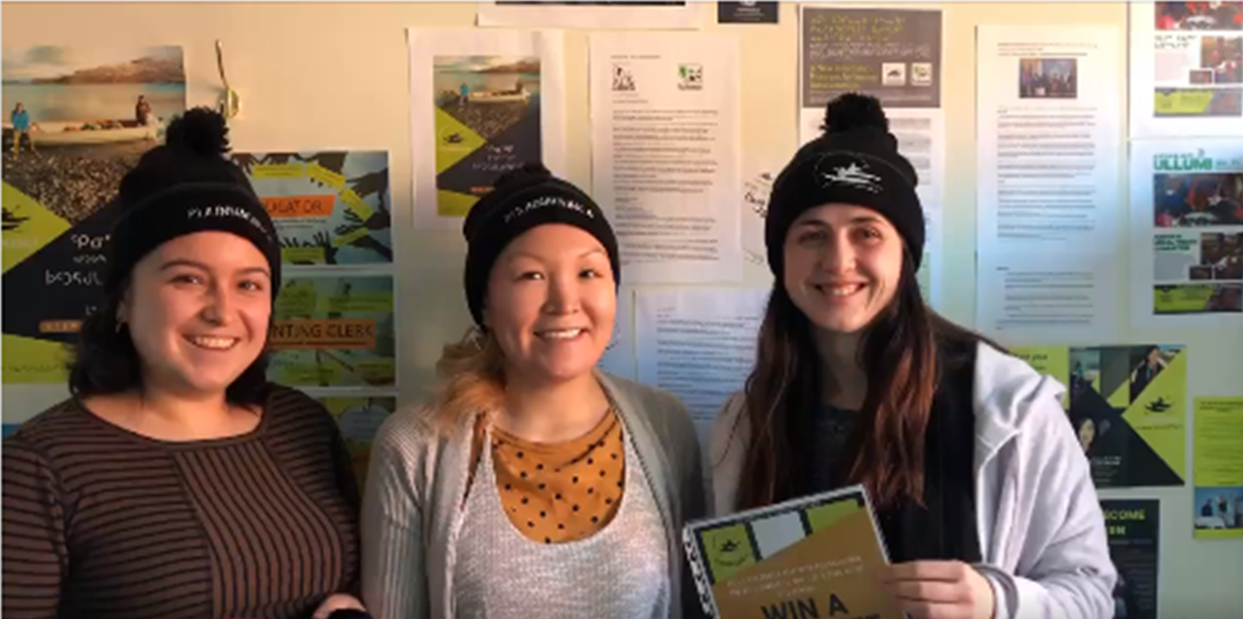

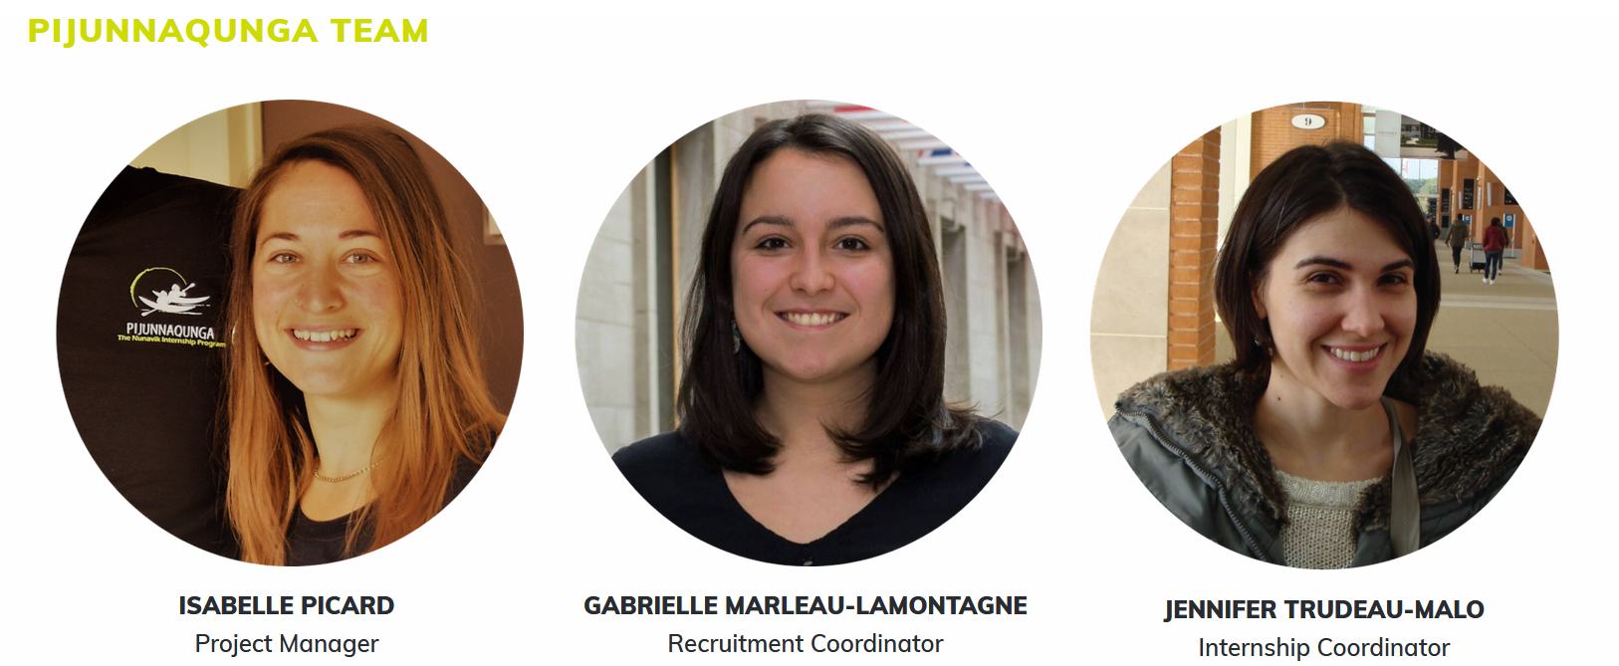
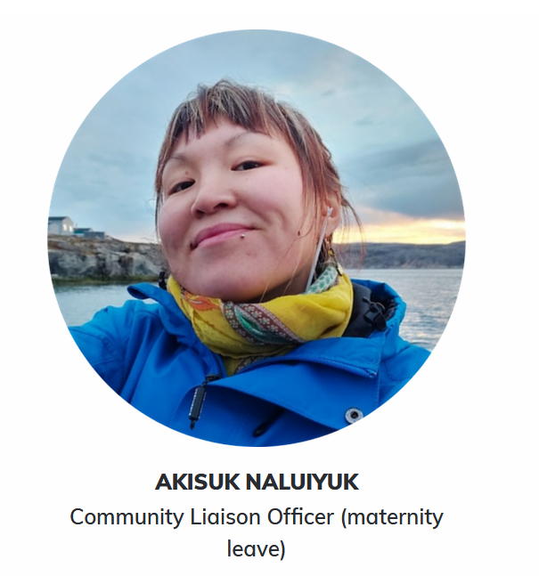

1.1 ᑕᑯᓐᓇᕋᑦᓴᓕᐅᕐᑐᕕᓃᑦ ᐱᓇᓱᑦᑎᐅᖃᑎᒌᑦᑐᑦ

Slide 7





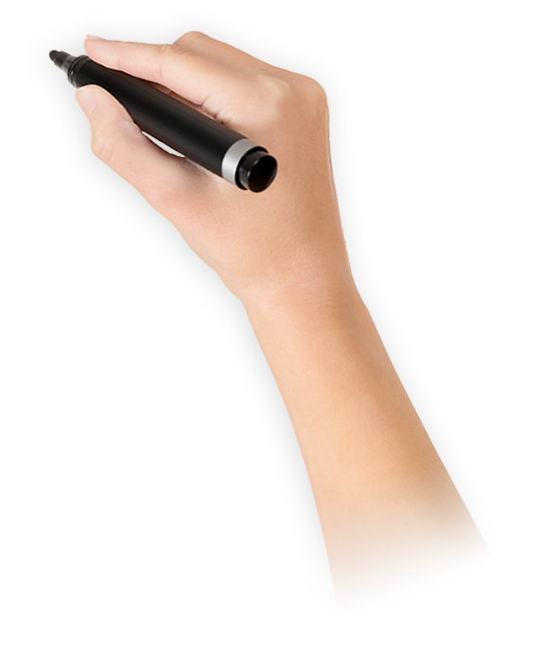
1.2 ᐱᔪᓐᓇᖁᖔ
ᖃᓄᖅ ᐃᓕᒐᓱᐊᕐᓂᐅᕆᐊᓖᑦ
ᐃᓕᒐᓱᐊᕐᓃᑦ
ᐱᒋᐅᕐᓴᑎᑕᐅᓂᖅ
ᑲᔪᓯᔪᖅ
ᐱᓇᓱᐊᕈᓰᓐᓂᒃ 2-ᓂᒃ ᐁᓯᒪᓗᓂ
ᐊᐱᕐᓲᔭᕐᓃᑦ
ᐅᖄᓚᐅᑎᑦᑯᑦ ᑲᑎᓐᓂᑯᓪᓗ
ᐱᓇᓱᑫᓐᓇᓂᖅ
ᐱᓇᓱᐊᕈᓯᓐᓄᑦ 10-ᓄᑦ ᑎᑭᓪᓗᒍ

Slide 8
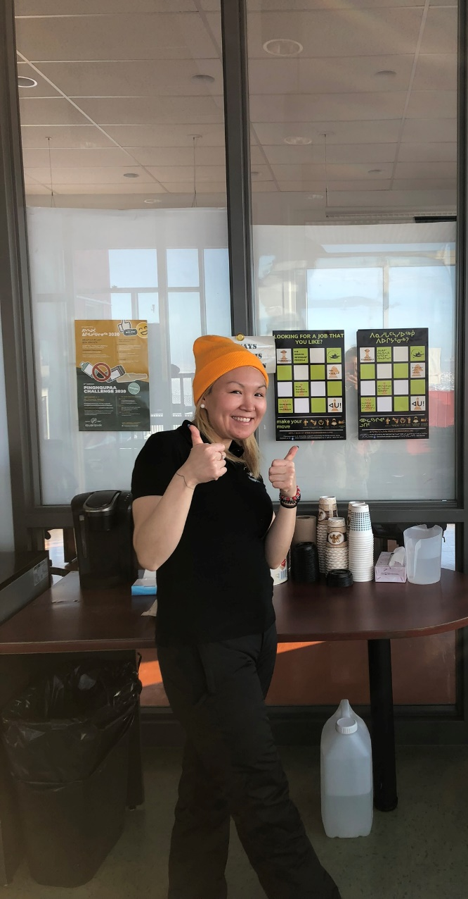
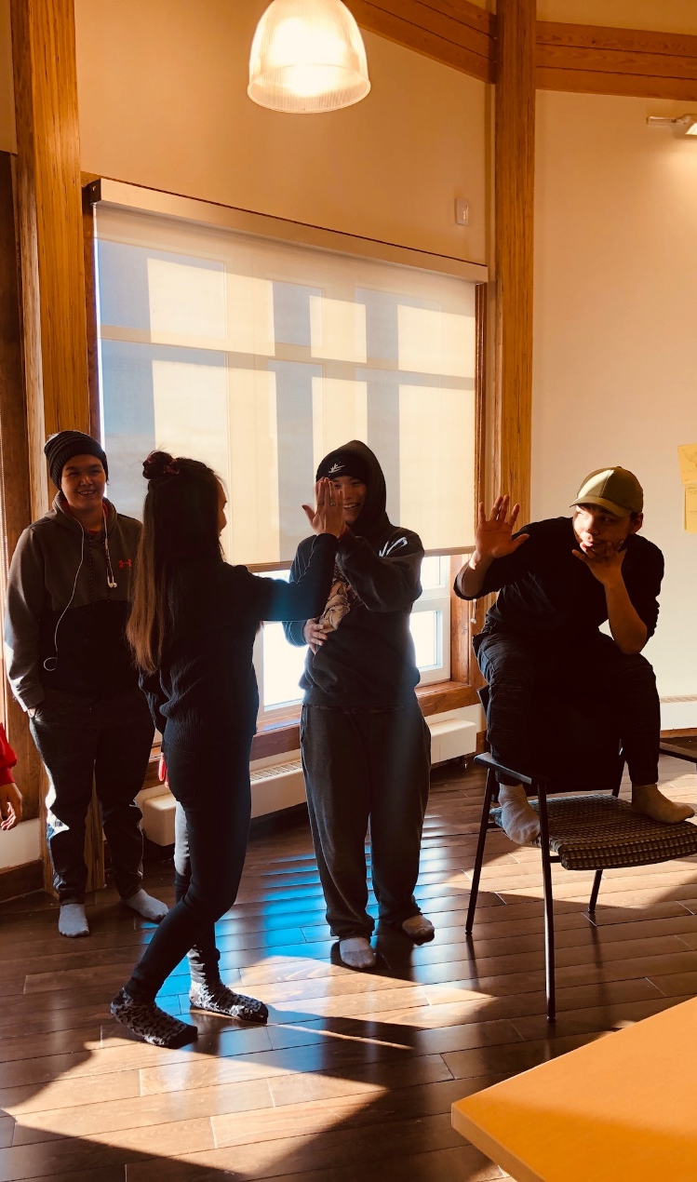
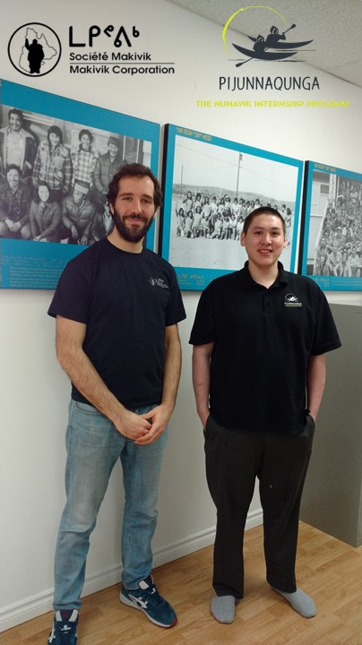
1.2 3 ᑐᖕᖓᕖᑦ ᓱᖃᑦᓯᐅᑏᑦ
ᐱᓇᓱᑦᑐᓴᕐᓯᐅᓂᖅ
ᐱᒋᐅᕐᓴᑎᑕᐅᓂᖅ
ᐱᓇᓱᑫᓐᓇᓂᖅ

Slide 9

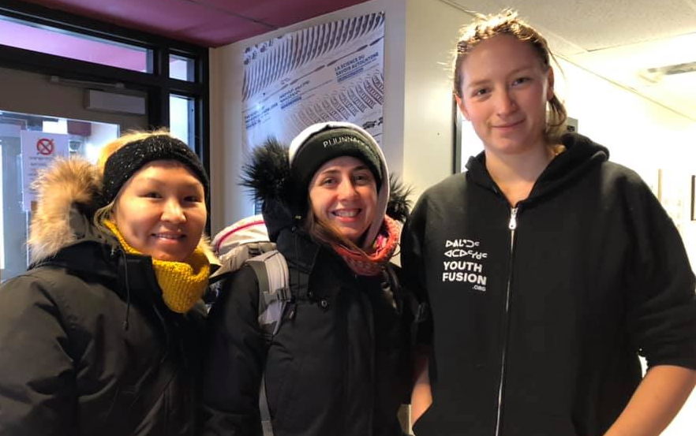
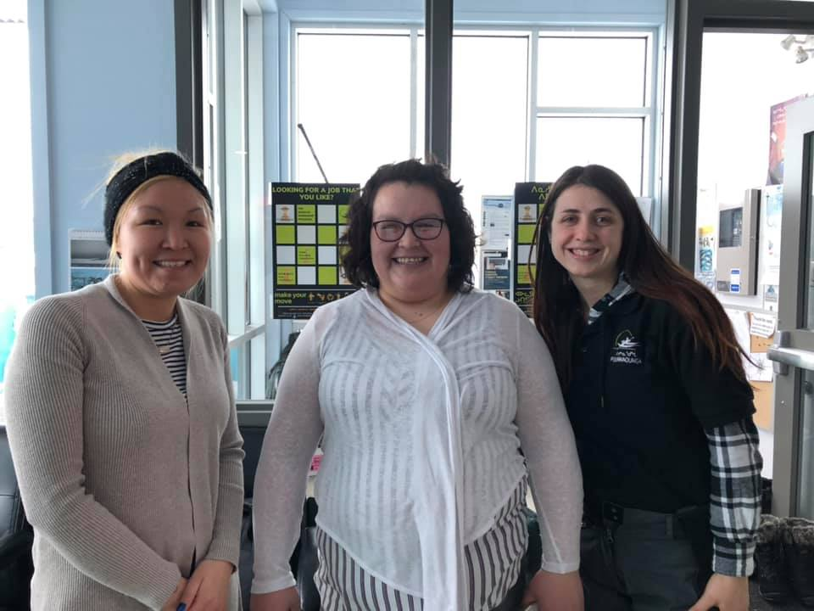
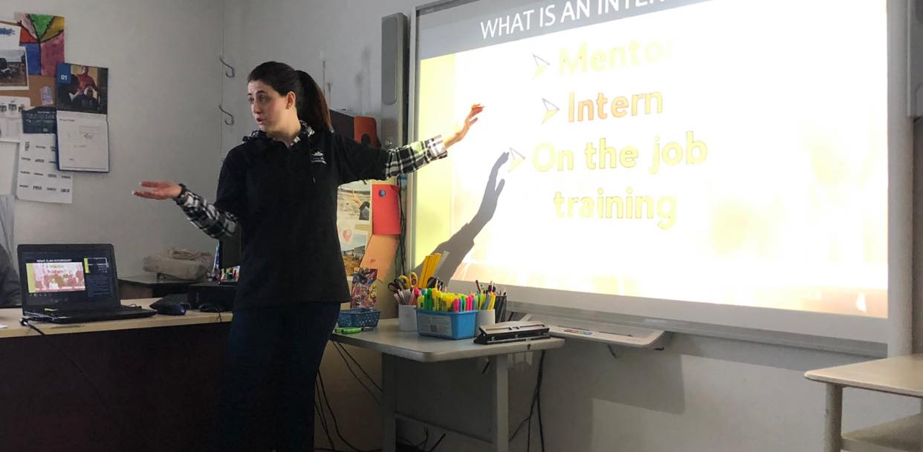
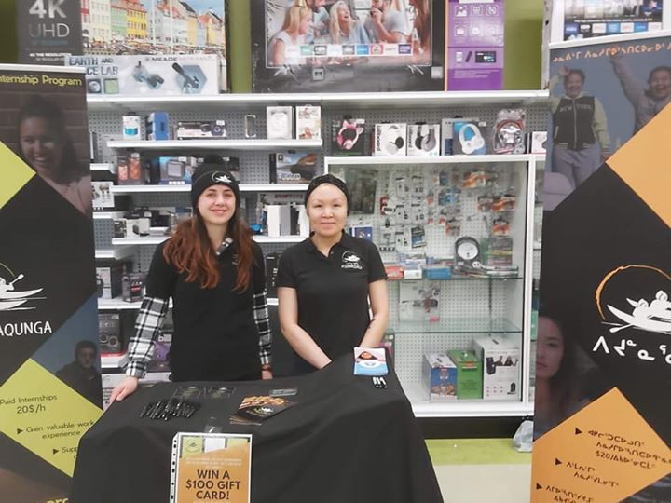
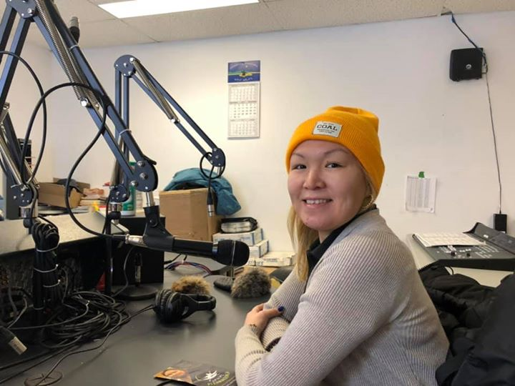
1.2 ᐱᓇᓱᑦᑐᓴᕐᓯᐅᓂᖅ
ᓱᖃᑦᓯᐅᑎᕕᓃᑦ ᐱᓇᓱᑦᑐᓴᕐᓯᐅᓂᑦᑎᓂ:
ᑯᐊᐸᒃᑯᓂ ᑕᑯᑦᓴᐅᓂᖃᕐᑎᓯᓂᖅ
ᑐᓴᐅᑎᒃᑯᑦ ᑐᓴᕐᓴᐅᑎᑦᓯᖃᑦᑕᓂᖅ
ᐳᕐᑐᓂᕐᓴᓂ.4-5 ᑕᑯᑦᓴᐅᑎᑦᓯᖃᑦᑕᓂᖅ
ᑲᑎᖃᑎᖃᕐᓂᖅ ᐃᓕᓐᓂᐊᕕᓐᓂ ᐱᓇᓱᑦᑎᓂᒃ
ᑲᑎᖃᑎᖃᕐᓂᖅ ᐃᓅᓱᑦᑐᐃᑦ ᐱᕙᓪᓕᐊᑎᖏᑦᑕ ᐊᑕᐅᑦᓯᑰᕐᑎᓯᔨᖏᓐᓂᒃ
ᑲᑎᓯᖃᑦᑕᓂᖅ LEO-ᓂᒃ
ᑲᑎᓯᖃᑦᑕᓂᖅ ᓯᕗᓕᕐᑎᓂᒃ ᓄᓇᓕᒻᒥᓗ ᐊᐅᓚᑦᓯᔨᓂᑦ
ᑲᑎᓯᖃᑦᑕᓂᖅ ᓄᓇᓕᒻᒥ ᐱᔪᓐᓇᐅᑎᓕᓐᓂᒃ
ᐊᑭᓐᓇᒥᐅᑕᓂᒃ ᓄᓇᓕᒻᒥ ᓂᕕᙰᖃᑦᑕᓂᖅ
ᐊᐱᕐᓲᔭᕐᓂᖅ ᐃᓚᐅᒍᒪᕋᔭᕐᑐᓂᒃ
ᒪᕇ, YF ᐊᑕᐅᑦᓯᑰᕐᑎᓯᔨ ᑕᓯᐅᔭᒥ
ᓘᓯᓇ, LEO ᑕᓯᐅᔭᒥ
ᑕᑯᑦᓴᐅᑎᑦᓯᓂᖅ ᐳᕐᑐᓂᕐᓴᓄᑦ. 4-5
ᐊᐅᐸᓗᒻᒥ ᑯᐊᐸᒥ ᑕᑯᑦᓴᐅᑎᑦᓯᓂᖅ
ᑐᓴᐅᑎᒃᑯᑦ ᑐᓴᕐᓴᐅᑎᑦᓯᓂᖅ

Slide 10
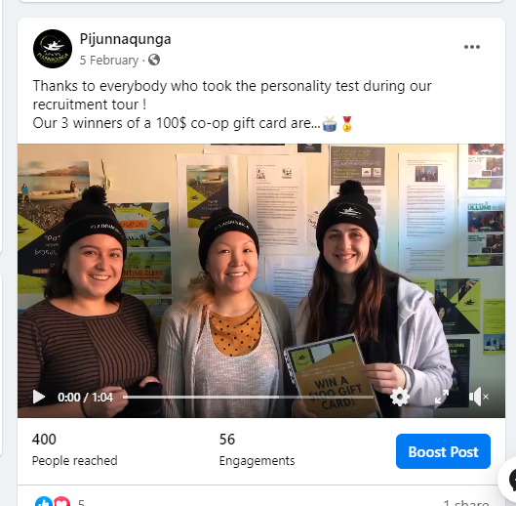
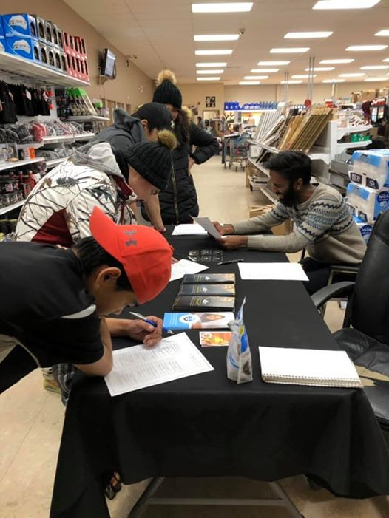
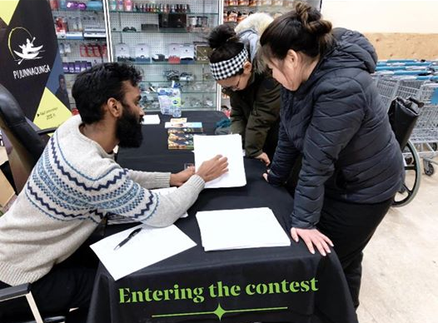
1.2 ᐱᓇᓱᑦᑐᓴᕐᓯᐅᓂᖅ
ᐱᓇᓱᑦᑐᓴᕐᓯᐅᓂᒃᑯᑦ ᐱᓕᐅᑦᔨᑎᑦᓯᓂᖅ
– ᐱᓇᓱᒐᕐᒥᒃ ᐆᑦᑐᕋᕐᓂᖅ –
ᐱᓇᓱᑦᑐᓴᕐᓯᐅᖃᑦᑕᑎᓪᓗᑕ ᐊᑐᓂ, ᐱᓕᐅᑦᔨᑎᑦᓯᖃᑦᑕᑐᒍᑦ ᐃᓄᓐᓂᒃ ᐱᒍᒪᓕᕐᑎᓯᒐᓱᐊᕐᓂᑯᑦ ᑕᒪᑦᓱᒥᖓ ᐊᒻᒪᓗ ᖃᕆᑕᐅᔭᒃᑯᑦ ᕓᔅᐳᒃᑎᒍᑦ ᑕᑯᑦᓴᐅᓕᐅᒥᖁᑦᓱᒋᑦ ᒪᑉᐱᒐᕗᑦ.
ᑭᖑᓪᓕᐹᒥ, ᐱᓇᓱᒐᕐᒥᒃ ᐆᑦᑐᕋᐅᑎᒥᒃ ᖃᐅᔨᓴᕐᓯᒪᔪᒍᑦ ᑐᖕᖓᕕᒋᑦᓱᒍ ᖄᓚᓐ ᐱᑐᕈᑎᖓᓂᒃ. ᖃᐅᔨᑎᑦᓯᒍᑏᑦ ᐃᑲᔪᕐᓯᓯᒪᔪᑦ ᐃᓄᓐᓂᒃ ᓱᓇᓂᒃ ᐱᓇᓱᒐᕐᓂᒃ ᐱᕕᑦᓴᖃᕋᓗᐊᕐᒪᖔᑕ ᑐᖕᖓᕕᒋᑦᓱᒋᑦ ᐊᓕᐊᒋᔭᖏᑦ.
50-ᓂᒃ ᐃᓚᐅᔨᐊᖃᕐᓯᒪᕗᒍᑦ ᓄᓇᓕᓐᓂ 6 ᐃᓗᐊᓂ.
ᐃᓕᒐᓱᐊᕐᑐᐃᑦ 28 ᑲᑎᑦᓱᒋᑦ ᐊᕐᕕᑕᕐᓂᑕᒫᑦ

Slide 11
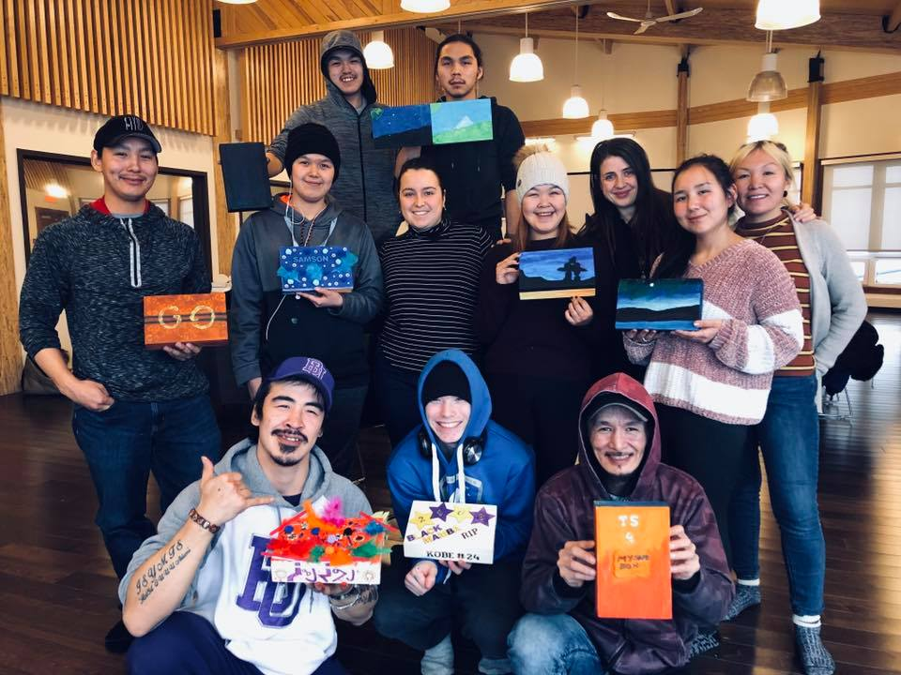
1.2 ᐱᔪᓐᓇᖁᖔᒥᒃ ᐱᒋᐅᕐᓴᑎᑕᐅᓂᖏᑦ
ᓇᓃᓐᓂᖓ: ᓄᓇᓕᒻᒥ ᐃᓕᒐᓱᐊᕐᑐᕕᓃᑦ ᐅᓄᕐᓂᖏᑦ ᐊᒥᓲᓂᑉᐸᐅᓂᖏᓐᓄᑦ ᖃᖓᓪᓗᐊᖅ: ᒪᕐᕉᓂᒃ ᐱᓇᓱᐊᕈᓰᓐᓂᒃ
The training is an important component of the selection process! It allows us to:
Develop a relation of trust with the participants
Evaluate their work habits and basic skills
Get to know them, including their aspirations and interests.
ᐃᓚᐅᔪᕕᓃᑦ:
ᐅᓄᕐᓂᖏᑦ 9 ᐱᒋᐅᕐᓴᑎᑕᐅᓂᖃᕐᓂᑕᒫᑦ

Slide 12

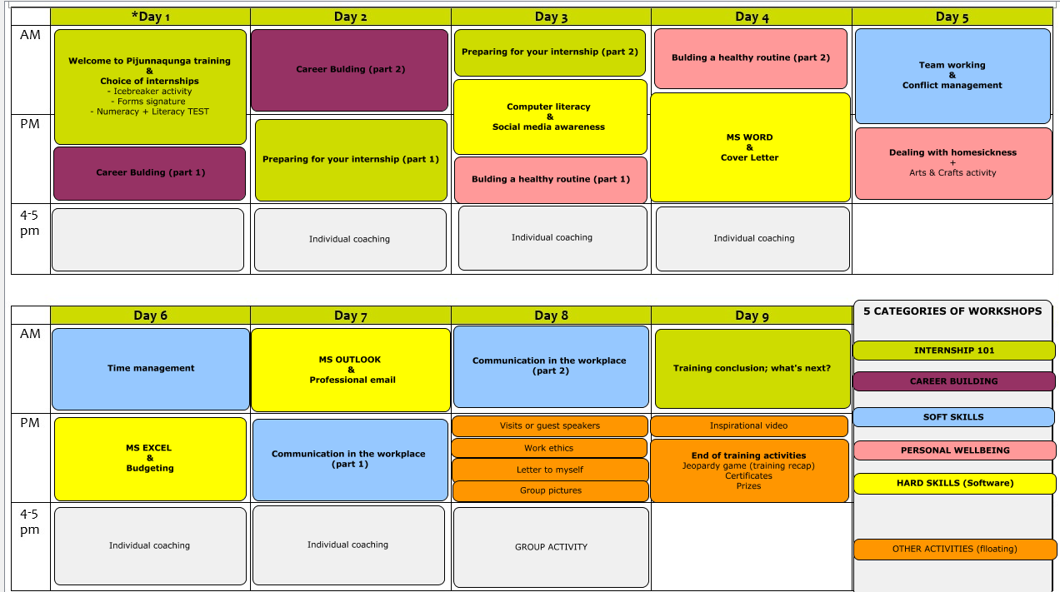
1.2 ᐱᒋᐅᕐᓴᑎᑕᐅᓃᑦ ᐅᓪᓗᖁᑎᖓ ᐆᑦᑑᑎ

Slide 13




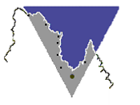


















1.2 ᐱᓇᓱᑫᓐᓇᕈᓐᓇᓯᓂᖓ
We are continuously looking to develop more internships!
IT Technician
Project Manager
Communication agent
Accountant
Project Coordinator
Sanajiit Project Officer
Employment Services agent
Reporter-Editor
Program Officer
Administrative assitant
Income tax agent
Educator

Slide 14
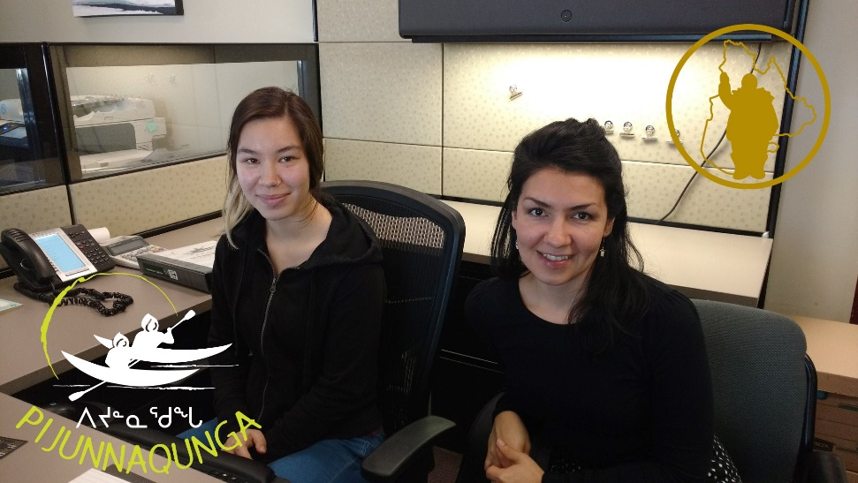
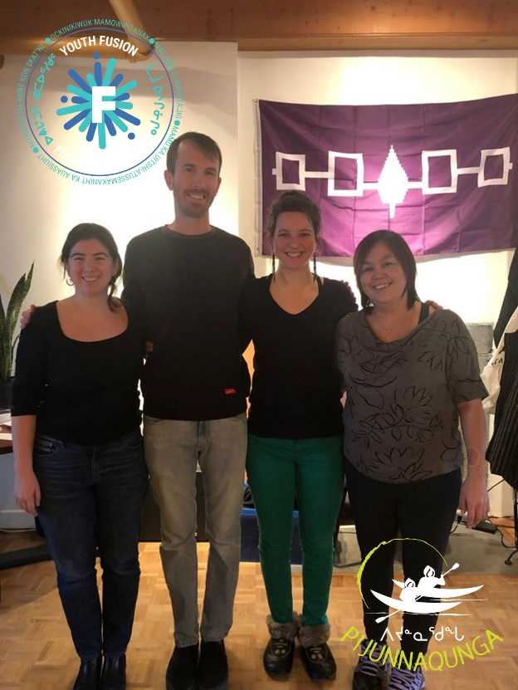


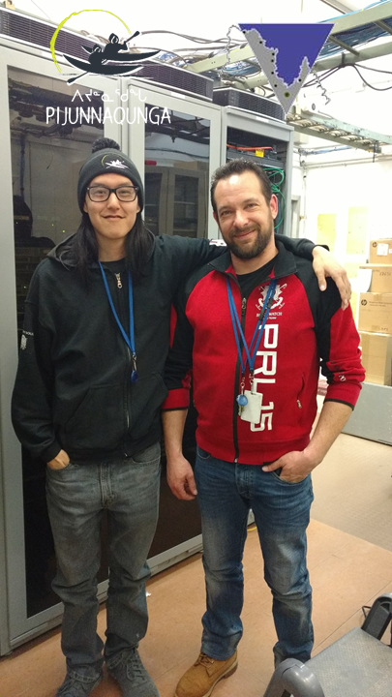
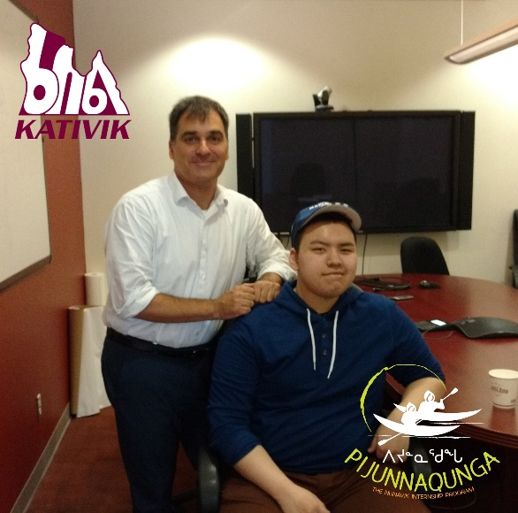

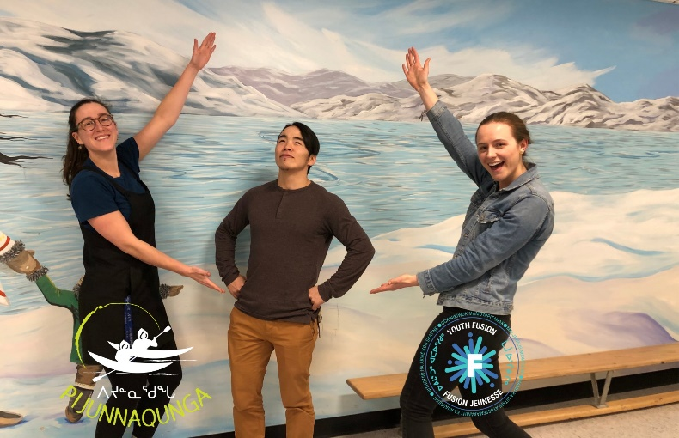
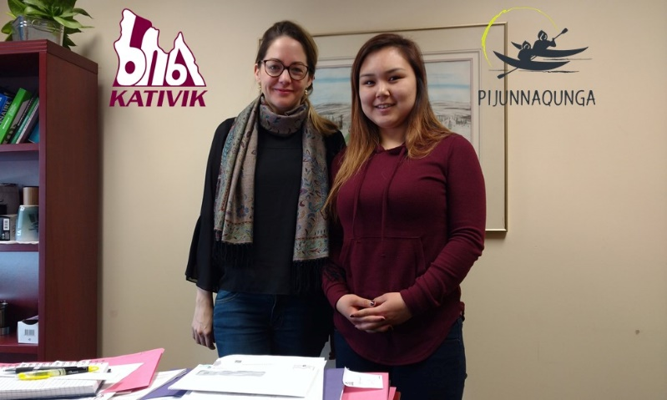
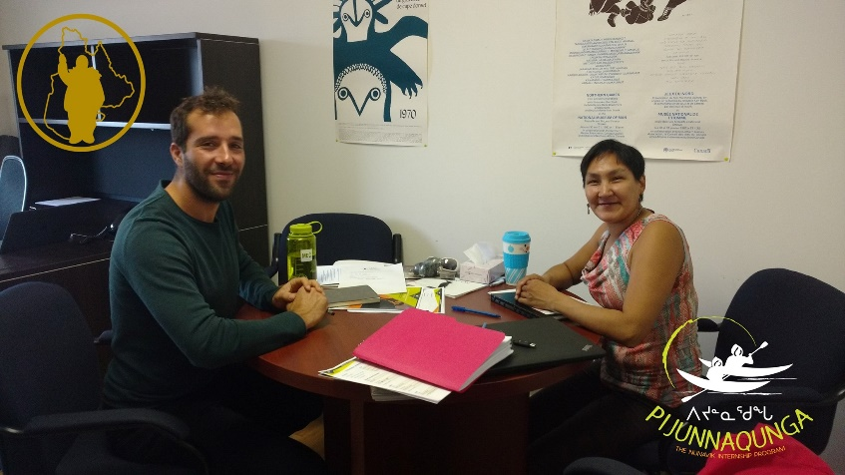

2. ᓱᓂᕕᓂᖏᑦ 2017-2021

Slide 15
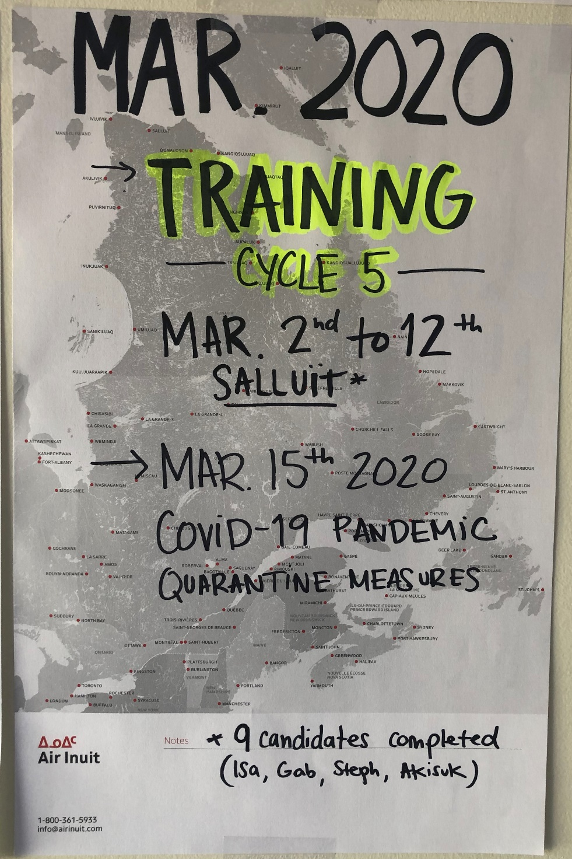
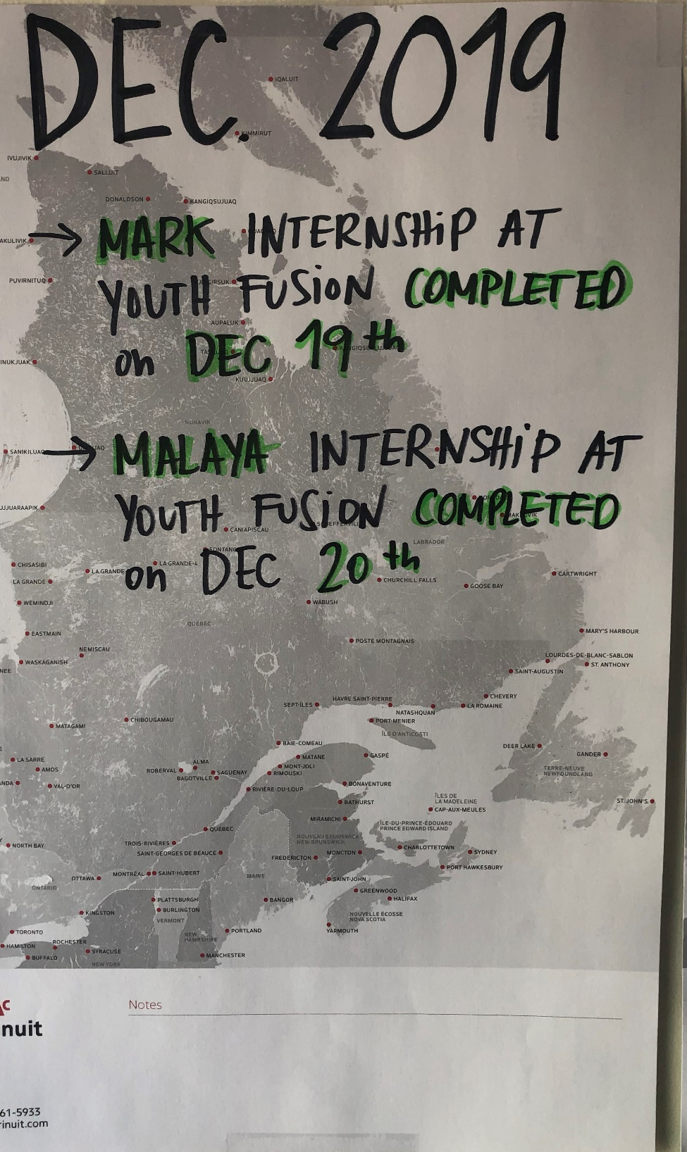
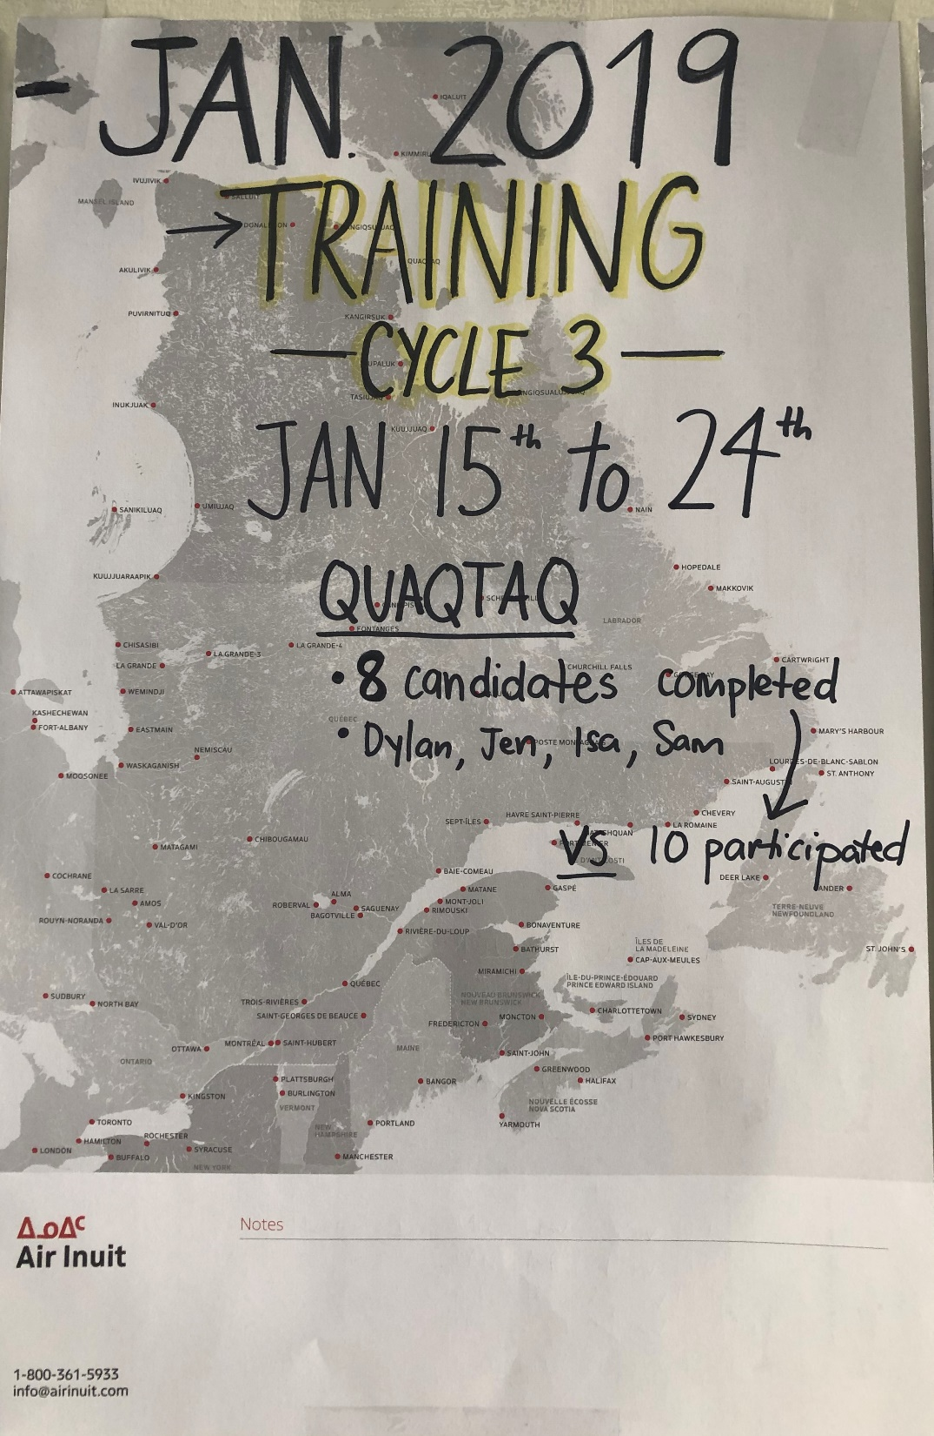
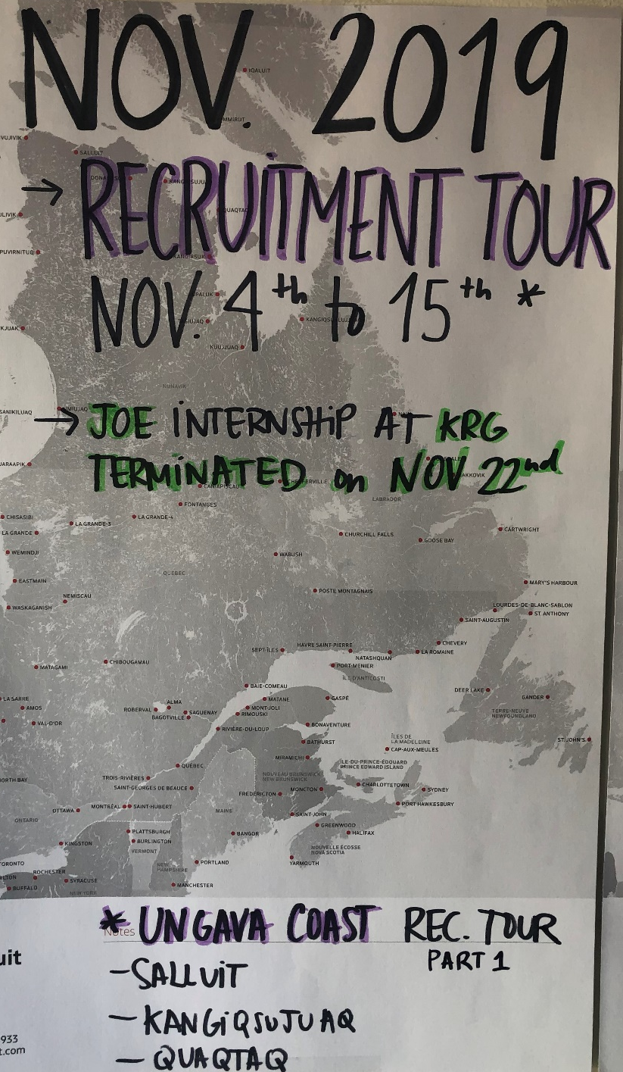
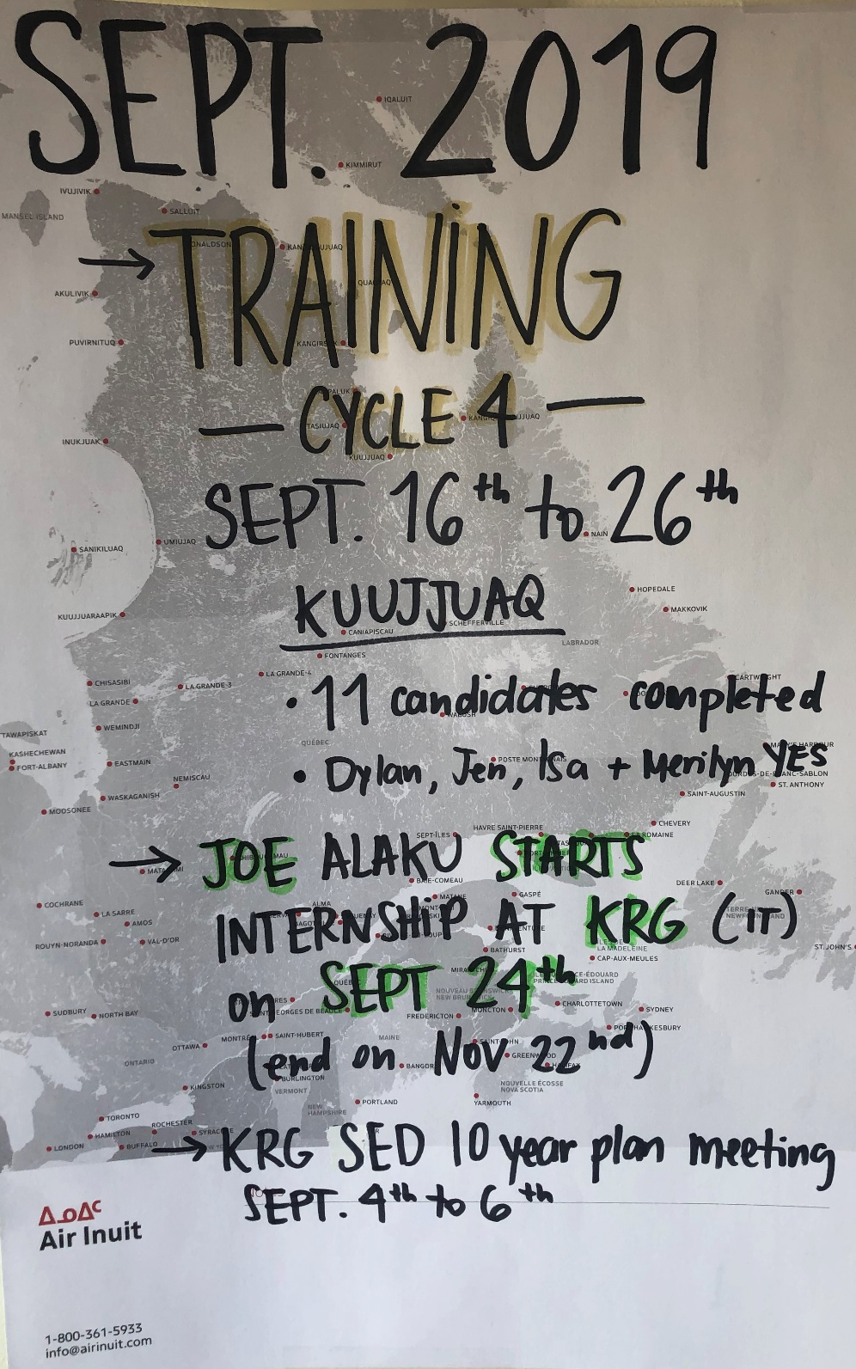
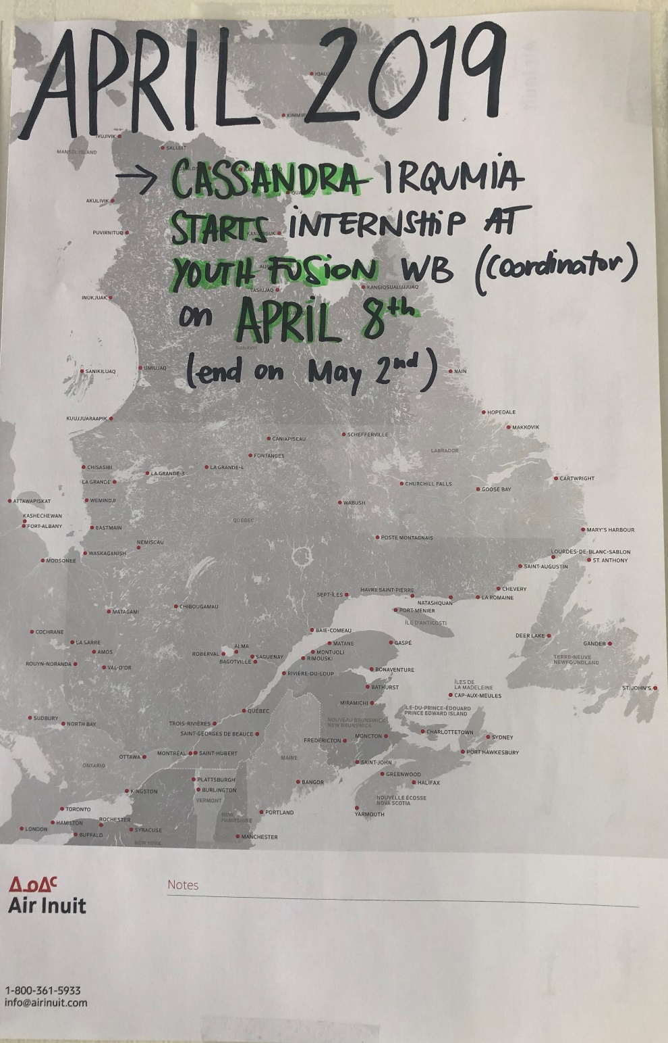
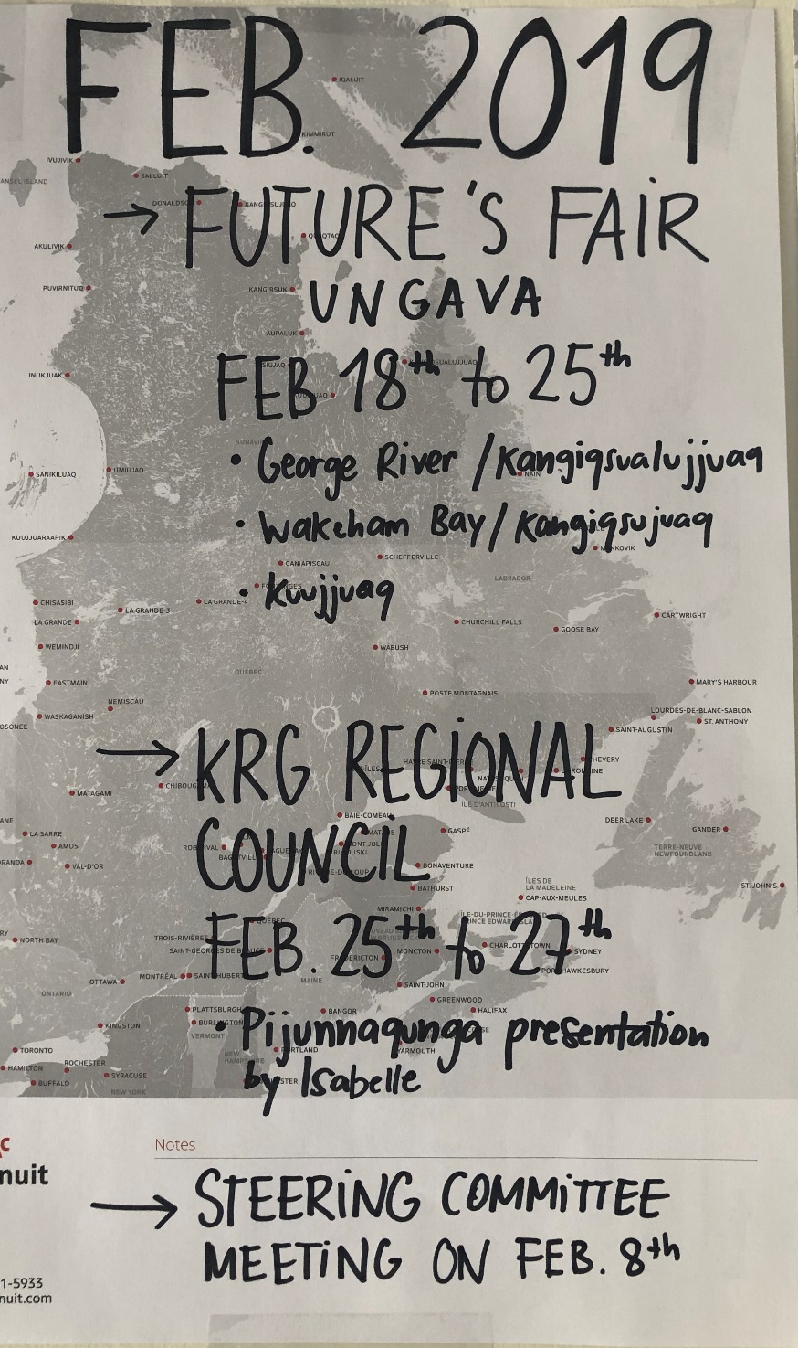
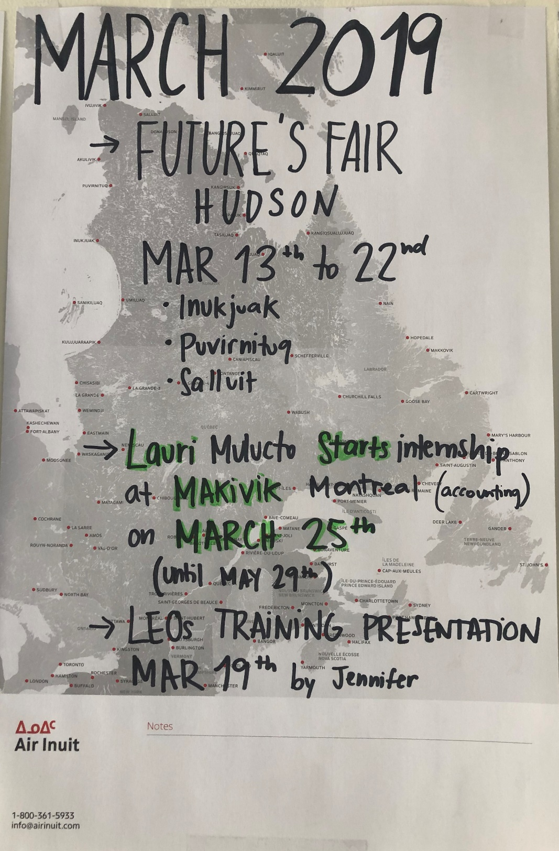
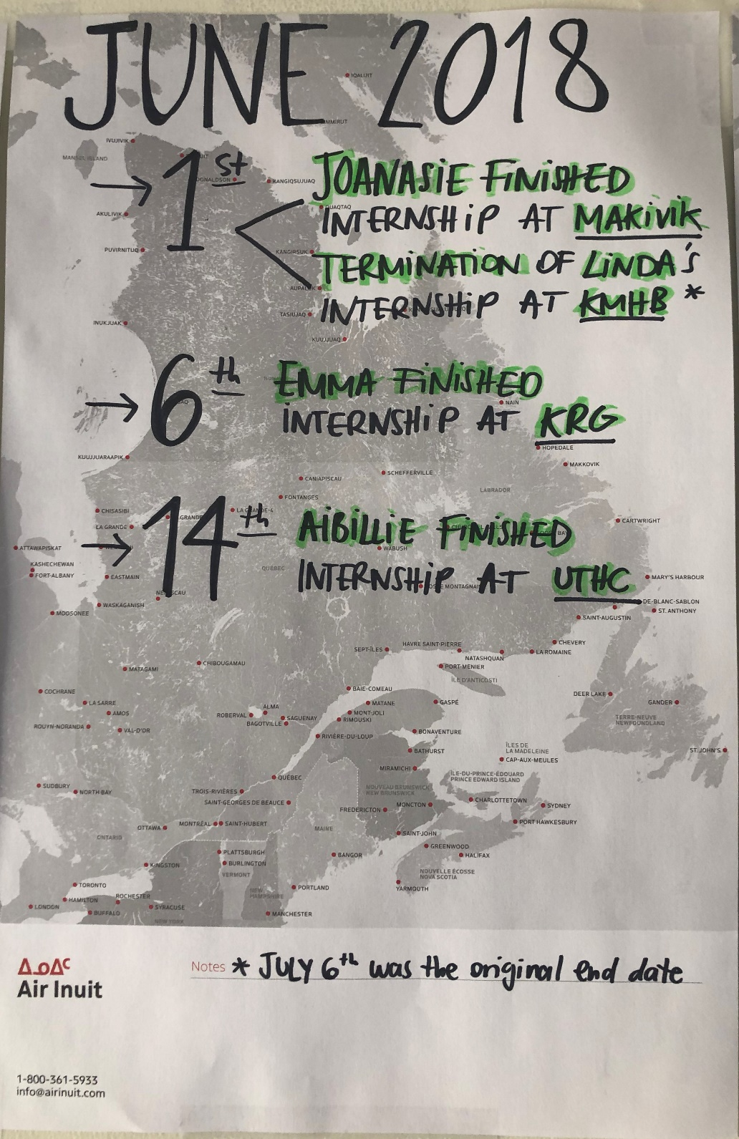
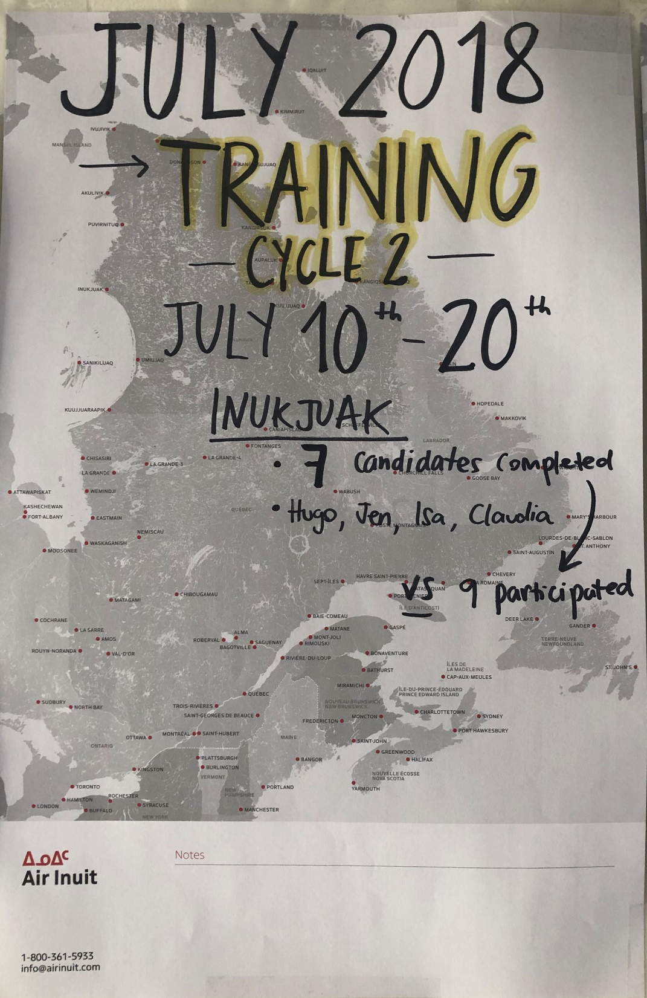
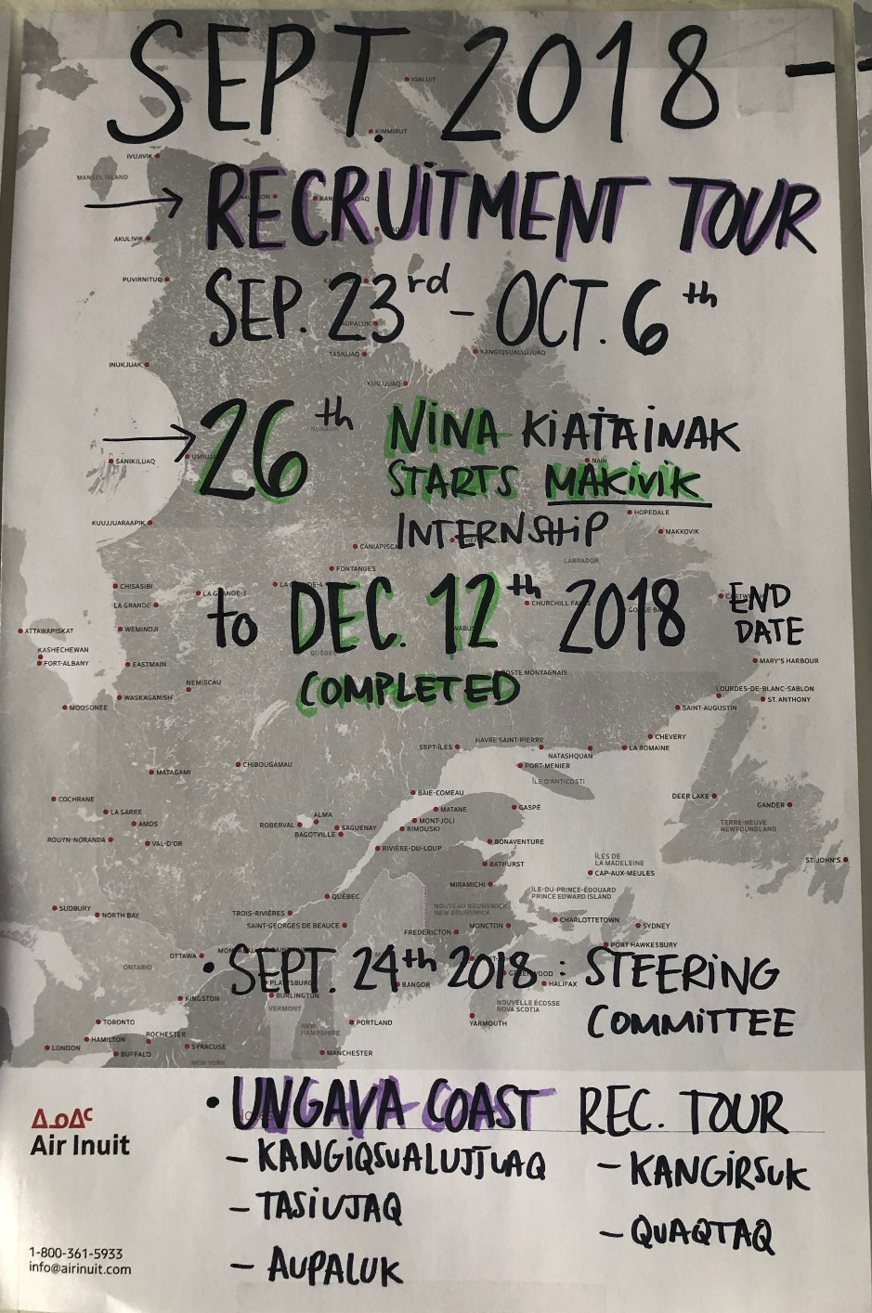
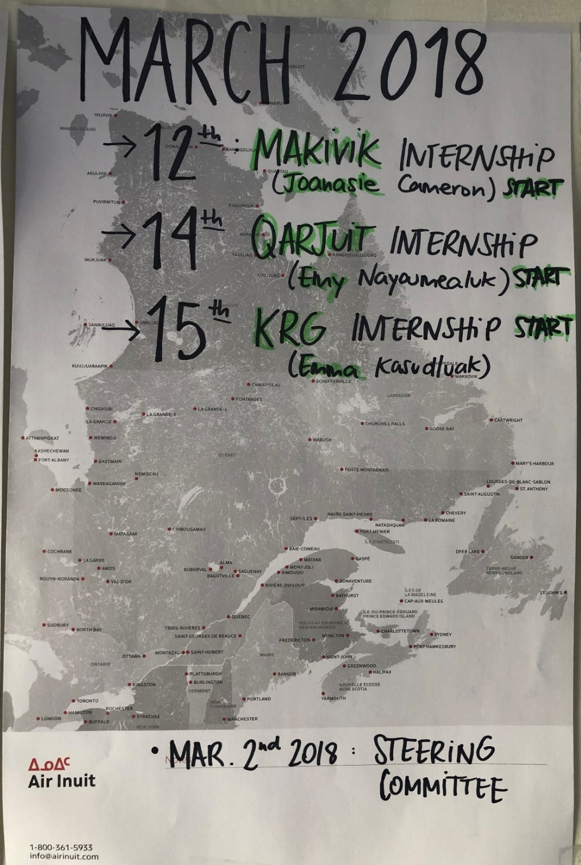
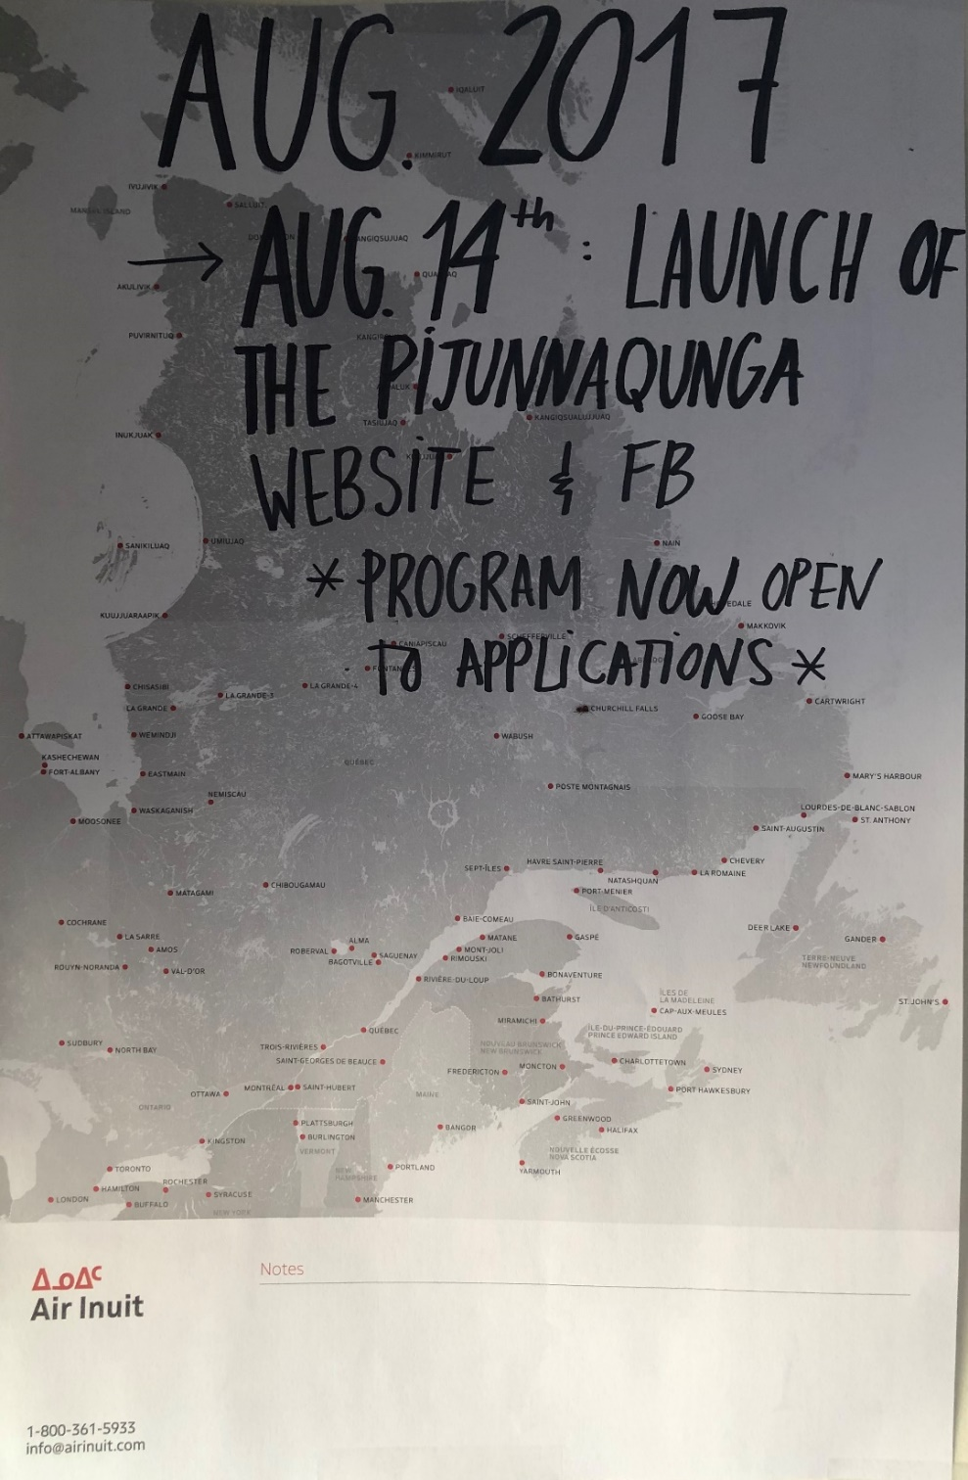
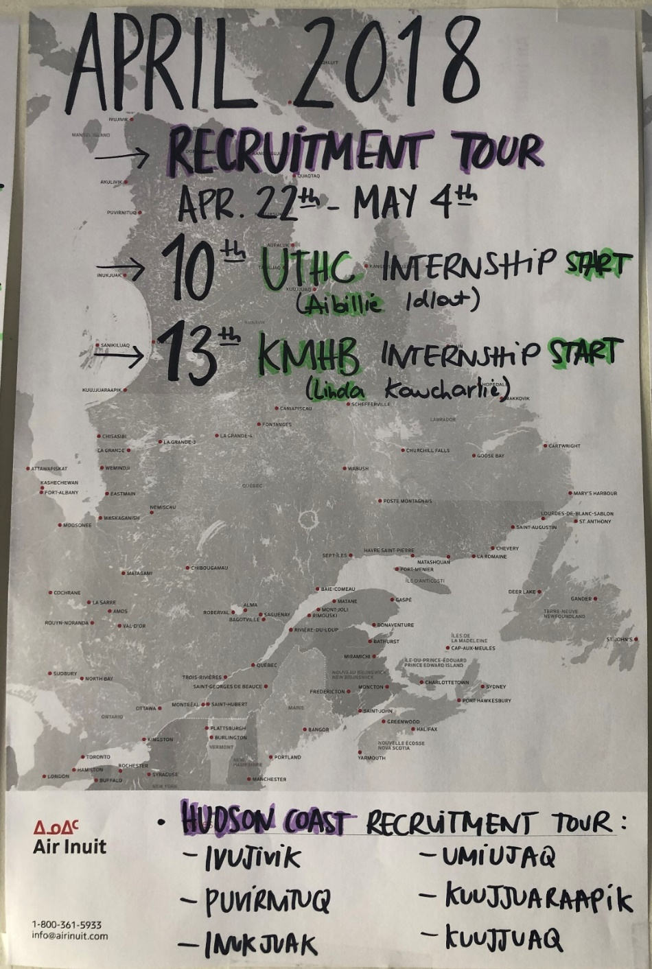
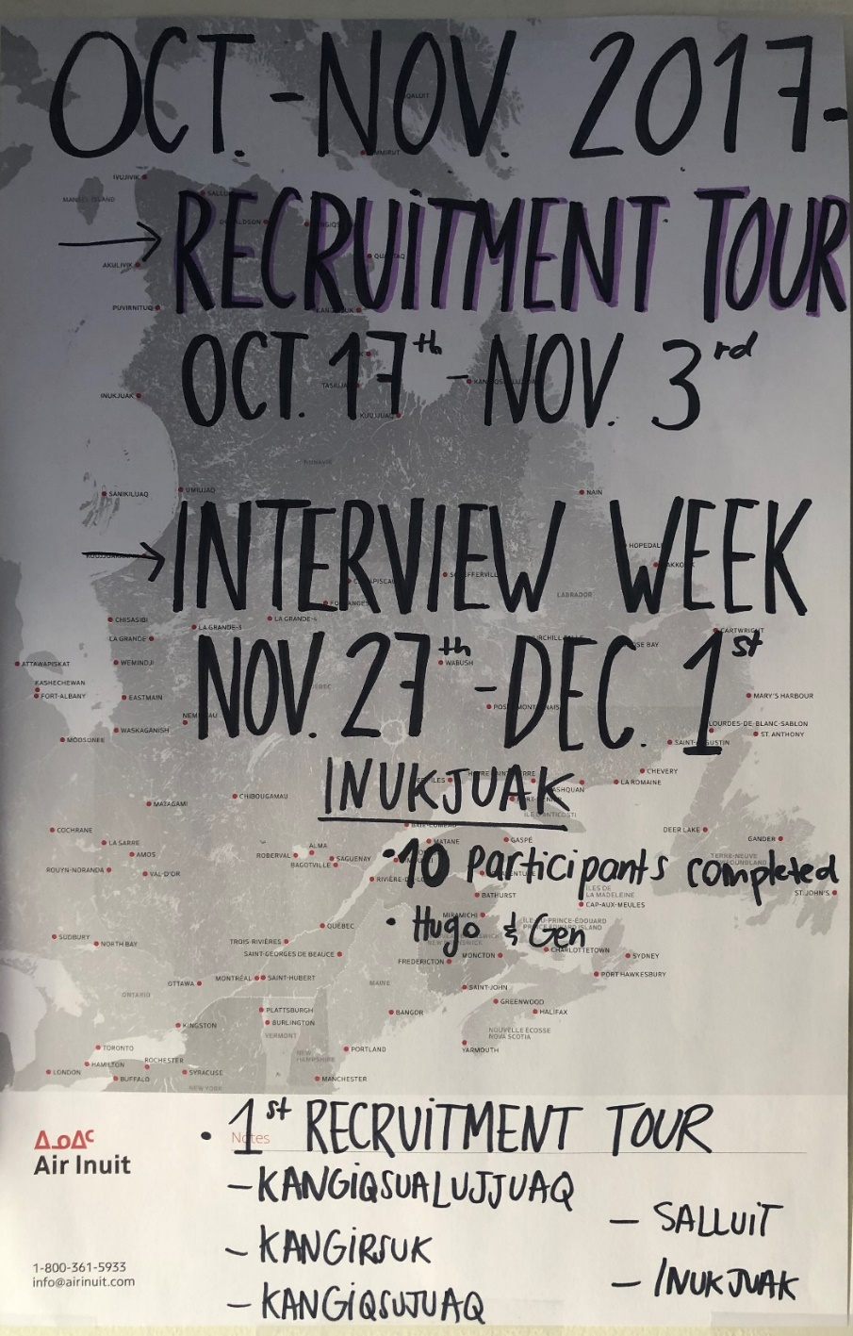
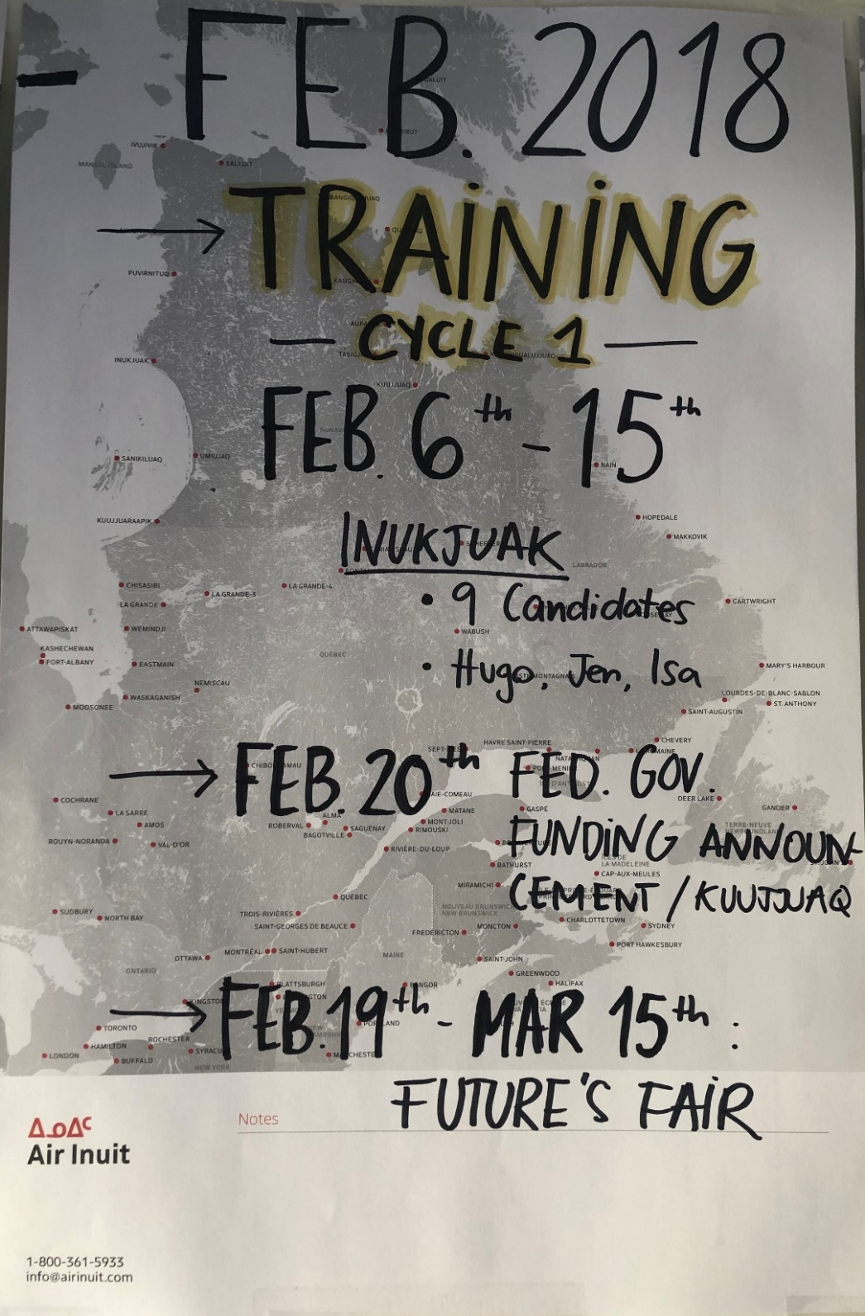
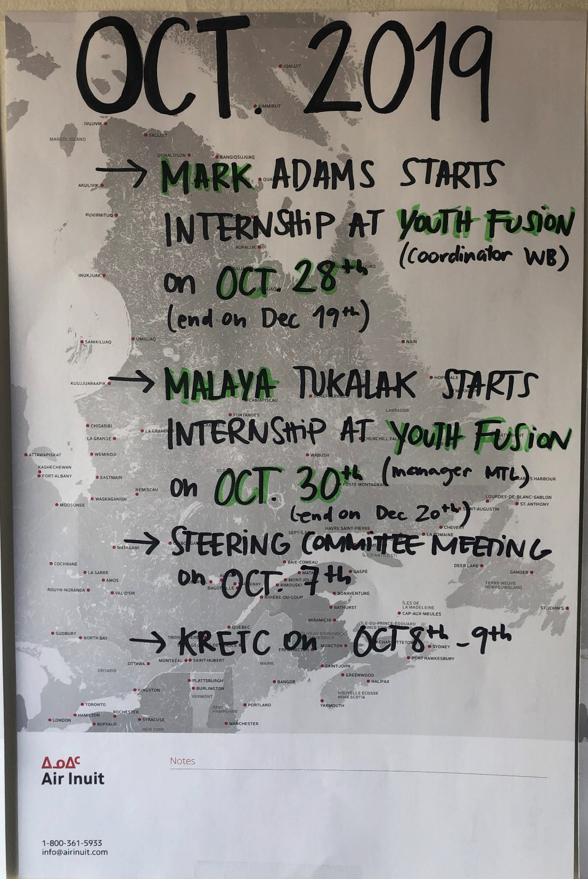
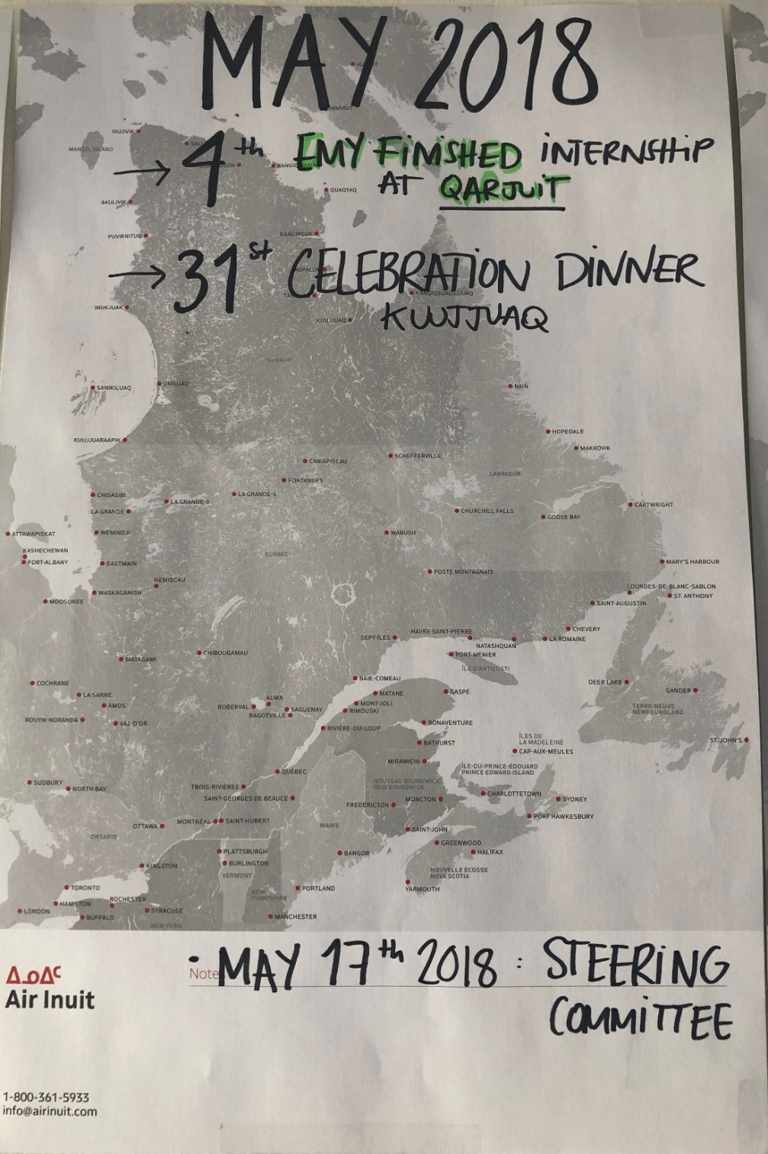
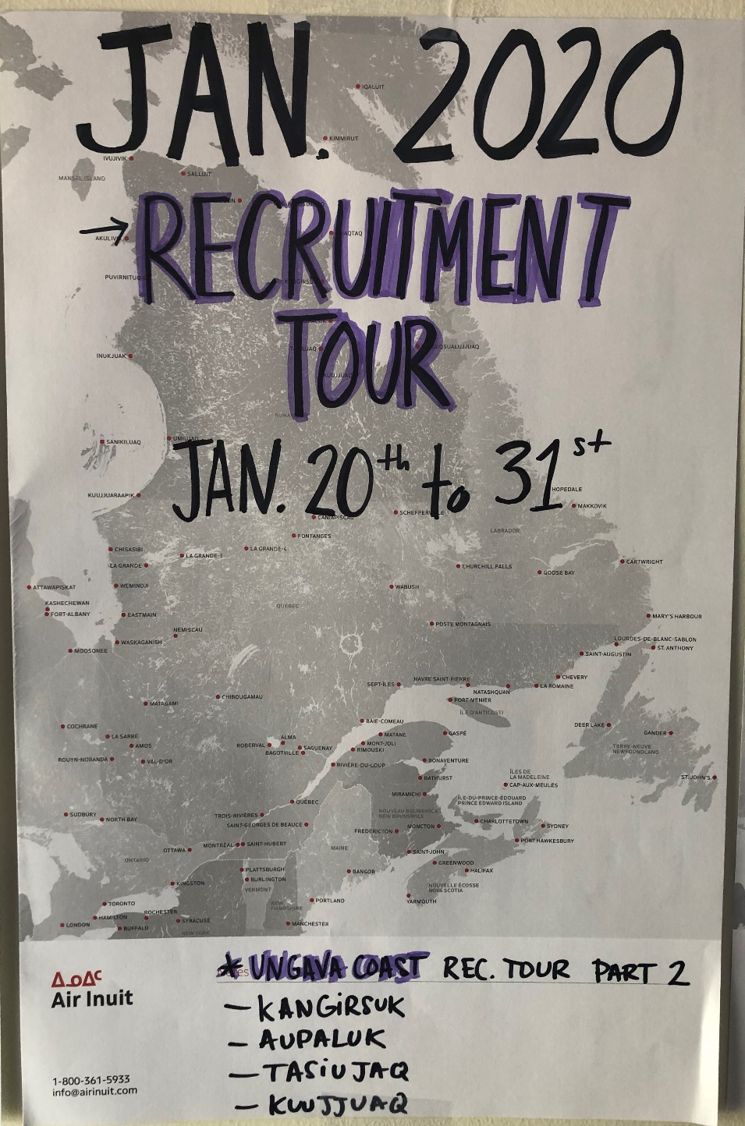
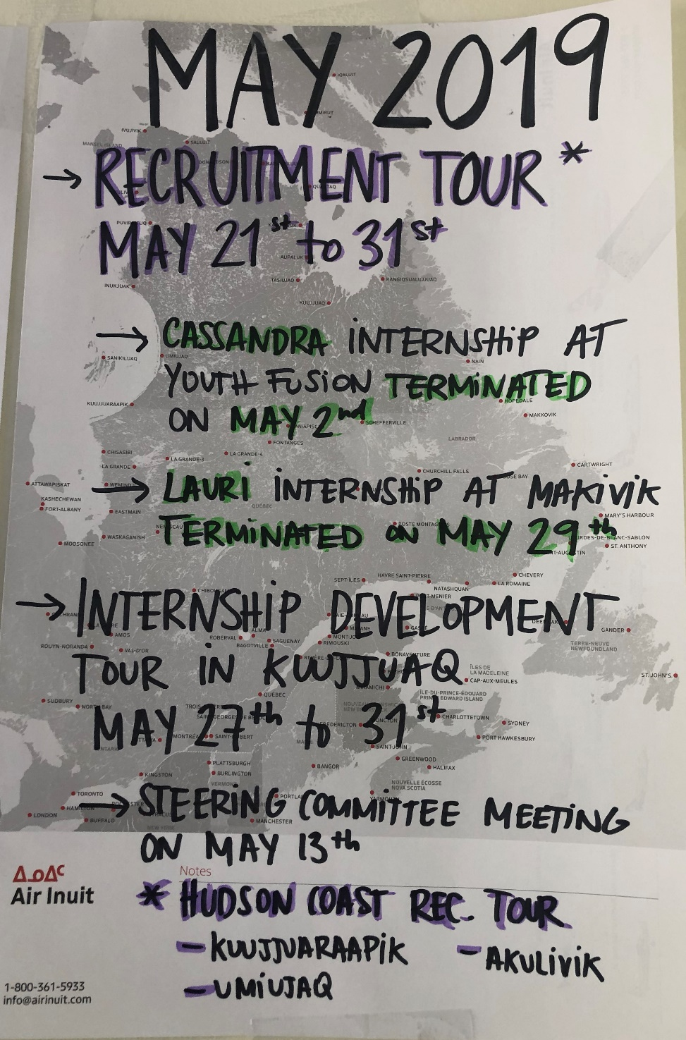
2.1 ᐃᓂᓪᓚᑎᕐᓯᒪᓂᖏᑦ
ᖃᓂᒻᒪᓇᐅᑉ ᓯᓚᕐᔪᐊᒥ ᐃᑉᐸᑎᓐᓂᖓ ᐱᒋᐊᕐᓱᒍ..
ᔪᓓ 2020
ᐱᓇᓱᑫᓐᓇᓂᖅ ᖃᕐᖃᓕᒃ ᓄᓇᒥ ᑎᒍᒥᐊᕐᑎᑯᑦ ᓴᓪᓗᓂ
ᓅᕕᒻᐱᕆ 2020
ᐱᒋᐅᕐᓴᑎᑦᓯᓃᑦ ᐃᓗᓕᖓ 6
ᓯᕗᓪᓕᐹᖅ ᐱᒋᐅᕐᓴᑎᑦᓯᓂᖅ ᒪᓐᑐᔨᐊᓪᒥ

Slide 16
2.2 ᐋᕐᕿᓯᒪᒍᓰᑦ 2017-2021
ᐱᒋᐅᕐᓱᒍ ᐊᐅᒡᒎᓯ 21st 2017 ᒫᑦᔨ 31st 2021-ᒧᑦ:
160 ᐃᓚᐅᔪᐃᑦ ᐃᓕᒐᓱᐊᕐᑐᕕᓃᑦ ᐱᔪᓐᓇᖁᖔᒧᑦ
54 ᐱᒋᐅᕐᓴᑎᑕᐅᓂᕐᒧᑦ ᐃᓚᐅᔪᕕᓃᑦ 6-ᓂᒃ ᐱᔪᓐᓇᖁᖔᒥ 2-ᓂᒃ ᐱᓇᓱᐊᕈᓰᓐᓂᒃ ᐱᒋᐅᕐᓴᑎᑕᐅᓂᒃᑯᑦ ᓄᓇᓕᓐᓂᒃ 5-ᓂᒃ ᐊᑦᔨᒌᖕᖏᑐᓂᒃ
12 ᐱᓇᓱᑫᓐᓇᑐᐃᑦ ᐱᓇᓱᑫᓐᓇᓂᕐᒥᒃ ᐱᕕᑦᓴᑖᕐᑎᑕᐅᔪᕕᓃᑦ 4-ᓂᒃ ᐊᑦᔨᒌᖕᖏᑐᓂᒃ ᐃᓂᐅᔪᓂᒃ
22 ᐱᓇᓱᑫᓐᓇᑐᐃᑦ ᐱᕙᓪᓕᐊᔪᕕᓃᑦ 13-ᓂᒃ ᐊᑦᔨᒌᖕᖏᑐᓂᒃ ᑎᒥᐅᔪᓂᒃ ᐱᓇᓱᐊᖃᑎᒌᑦᑐᓂᒃ

Slide 17


2.2 ᐋᕐᕿᓯᒪᒍᓰᑦ ᐊᒻᒪᓗ ᓱᕐᕋᑕᐅᓂᖏᑦ ᑰᕕᑦᒧᑦ
ᐁᕆᓕ 2020 ᐱᒋᐊᕐᓱᒍ...
ᐋᕐᕿᓯᒪᒍᓰᑦ
23 ᐃᓚᐅᔪᐃᑦ ᐃᓕᒐᓱᐊᕐᑐᕕᓃᑦ ᐱᔪᓐᓇᖁᖔᒧᑦ
6 ᐱᒋᐅᕐᓴᑎᑕᐅᓂᕐᒧᑦ ᐃᓚᐅᔪᕕᓃᑦ 6-ᖓᓄᑦ ᐱᔪᓐᓇᖁᖔ ᐱᒋᐅᕐᓴᑎᑕᐅᓂᖏᓐᓄᑦ *ᓯᕗᓪᓕᐹᒥ ᐱᒋᐅᕐᓴᑎᑕᐅᔪᕕᓃᑦ ᒪᓐᑐᔨᐊᓪᒥᒃ*
1 ᐱᓇᓱᑫᓐᓇᑐᖅ ᐱᔭᕇᕐᑐᕕᓂᖅ ᐱᓇᓱᑫᓐᓇᓂᕐᒥᒃ
4 ᓄᑖᑦ ᐱᓇᓱᑫᓐᓇᑐᕕᓃᑦ ᐱᕙᓪᓕᐊᔪᕕᓃᑦ 4-ᓂᒃ ᐊᑦᔨᒌᖕᖏᑐᓂᒃ ᐃᓂᐅᔪᓂ (ᖃᕐᖃᓕᒃ, ᑲᑎᕕᒃ ᐃᓕᓴᕐᓂᓕᕆᓂᖅ, ᓄᓇᕕᒻᒥ ᐃᓗᓯᓕᕆᕕᒃᑯᓂ, ᓄᓇᒥ ᑎᒍᒥᐊᕐᑎᑯᓐᓂ)
ᓱᕐᕋᑕᐅᓂᖏᑦ ᑰᕕᑦᒧᑦ
ᐱᓇᓱᑦᑐᓴᕐᓯᐅᓂᖃᕐᓯᒪᖕᖏᓚᒍᑦ ᐊᒻᒪᓗ ᓯᕗᓂᕐᒥᒃ ᐱᓇᓱᒐᑦᓴᓂᒃ ᑕᑯᑦᓴᐅᑎᑦᓯᓂᕐᒥᒃ ᕕᕗᐊᕆ 2020 ᐱᒋᐊᕐᓱᒍ VS 3 ᐊᕐᕕᑕᕐᓃᑦ ᐃᓂᓪᓚᑎᕐᑕᐅᓯᒪᔪᑦ ᑰᕕᑦᖃᓚᐅᕐᑎᓇᒍ
ᐱᒋᐅᕐᓴᑎᑦᓯᓂᖃᕐᓯᒪᖕᖏᓚᒍᑦ ᑕᕐᕋᒥ ᒫᑦᔨ 2020 ᐱᒋᐊᕐᓱᒍ VS 3 ᐱᒋᐅᕐᓴᑎᑦᓯᓃᑦ ᐃᓂᓪᓚᑎᕐᑕᐅᓯᒪᔪᑦ ᑰᕕᑦᖃᓚᐅᕐᑎᓇᒍ
7 ᐱᓇᓱᑫᓐᓇᓂᑦᓭᑦ ᐊᕗᖓᐅᓕᕆᐊᕐᑕᐅᒪᔪᑦ (5 ᓄᓇᕕᒃ, 2 ᒪᓐᑐᔨᐊᓪ)
Notes:
Postponing of our entire calendar

Slide 18

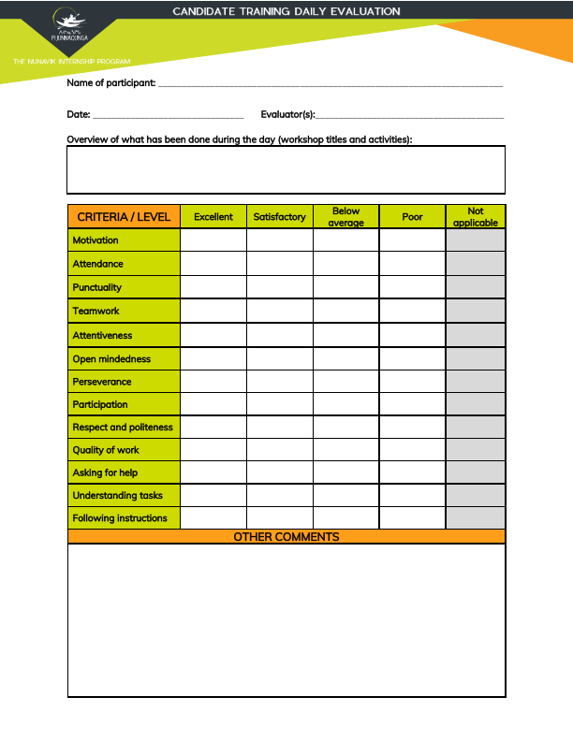

2.3 ᐃᑲᔪᕐᓯᐅᑏᑦ ᐊᒻᒪᓗ ᐱᔭᑦᓴᕆᐊᔭᐅᔪᑦ
ᐱᓇᓱᑦᑎᑖᕐᓂᖅ
ᐃᓕᒐᓱᐊᕈᑏᑦ ᑕᑕᕐᓴᕋᑦᓭᑦ
ᐃᑲᔪᕐᓯᐅᑎ ᑕᑕᕐᓴᕋᑦᓴᖅ
ᖃᕆᑕᐅᔭᒃᑯᑦ ᑐᓴᐅᒪᔭᐅᔪᐃᑦ
ᐅᖄᓚᐅᑎᒃᑯᑦ ᐊᐱᕐᓲᔭᕐᑕᐅᓂᒃᒧᑦ ᑕᑕᕐᓴᕋᑦᓴᖅ
ᐃᓄᑦᑎᒍᑦ ᐊᐱᕐᓲᔭᕐᑕᐅᓂᕐᒧᑦ ᑕᑕᕐᓴᕋᑦᓴᖅ
ᐃᑲᔪᕐᓯᔭᐅᓂᖅ ᖃᓄᖅ ᐱᓇᓱᑦᑎᕈᑫᓐᓇᑐᑦᓴᐅᓂᕐᒧᑦ
ᑕᑯᑦᓴᐅᑎᑦᓯᓂᖅ ᐃᓕᓐᓂᐊᕕᓐᓄᑦ
ᐃᑲᔪᕐᓯᐅᑏᑦ ᐱᓇᓱᑦᑎᑖᕋᓱᐊᕐᓂᒧᑦ ᐊᒻᒪᓗ ᑭᖑᓂᐊᒍᑦ ᐱᐅᓯᒋᔭᐅᔪᑦᓭᑦ
ᐱᒋᐅᕐᓴᑎᑦᓯᓃᑦ
11 ᐱᒋᐅᕐᓴᑎᑦᓯᓃᑦ (PPT-ᓂᒃ ᑕᑯᑦᓴᐅᑎᑦᓯᓃᑦ ᐊᒻᒪᓗ ᓱᖃᑦᓯᓃᑦ)
ᐱᒋᐅᕐᓴᓂᕐᒧᑦ ᐅᓪᓗᑕᒫᕐᓯᐅᑏᑦ
ᐱᒋᐅᕐᓴᑎᑦᓯᓂᕐᒧᑦ ᖃᐅᔨᓴᐅᑏᑦ
ᐃᓚᐅᔪᑦᓭᑦ ᒪᓕᒐᕆᒋᐊᓕᖏᑦ
ᐱᒋᐅᕐᓴᑐᐃᑦ ᐅᓪᓗᑕᒫᑦ ᖃᐅᔨᓴᕐᑕᐅᓂᖏᑦ
ᐃᓚᐅᔪᑦᓭᑦ ᓇᒻᒥᓂᒃ ᖃᐅᔨᓴᕐᓂᖏᑦ
ᐃᓚᐅᔪᑦᓭᑦ ᐅᓪᓗᑕᒫᑦ ᖃᐅᔨᓴᕐᑕᐅᓂᖏᑦ
ᐃᓚᐅᔪᑦᓭᑦ ᐱᒋᐅᕐᓴᑎᑕᐅᓂᕐᒧᑦ ᖃᐅᔨᓴᕐᑕᐅᓂᖏᑦ
ᐱᒋᐅᕐᓴᑎᑕᐅᓂᕐᒧᑦ ᐃᓕᓐᓂᐊᑎᑕᐅᓃᑦ ᑕᑕᕐᓴᒐᑦᓴᖓ
ᐱᓇᓱᑫᓐᓇᓃᑦ
ᐱᓇᓱᑫᓐᓇᓂᕐᒧᑦ ᓇᓗᓀᒃᑯᑕᖓ
ᐱᓇᓱᑫᓐᓇᓂᕐᒧᑦ ᐊᖏᖃᑎᒌᒍᑎ
ᐃᓚᐅᔪᑦᓴᐅᑉ ᑭᓇᐅᓂᖓ
ᕿᑎᕐᖃᖓ ᐱᓇᓱᑫᓐᓇᓂᖓᓄᑦ ᐊᒻᒪᓗ ᓈᓂᖓᓂ ᖃᐅᔨᓴᐅᑏᑦ (ᐃᑲᔪᕐᑏᑦ & ᐱᓇᓱᑫᓐᓇᑐᐃᑦ)
ᕿᑎᕐᖃᖓ ᓈᓂᖓᓂᓪᓗ ᐃᒻᒥᓂᒃ ᖃᐅᔨᓴᕐᓃᑦ (ᐃᑲᔪᕐᑏᑦ & ᐱᓇᓱᑫᓐᓇᑐᐃᑦ)
ᐸᕐᓇᓯᒪᐅᑏᑦ
ᐃᑲᔪᕐᑎᐅᑉ ᒪᓕᒐᖏᑦ
ᐱᓇᓱᑫᓐᓇᑐᒧᑦ ᒪᓕᒉᑦ
ᐱᓇᓱᑫᓐᓇᑑᑉ ᐱᓇᓱᐊᕈᓯᑕᒫᑦ ᖃᐅᔨᓴᕐᑕᐅᓂᖓ
ᐱᓇᓱᐊᕈᓯᑕᒫᑦ ᐃᓕᑦᓯᕙᓪᓕᐊᓂᕐᒧᑦ ᑐᕌᒐᖏᑦᑕ ᐋᕐᕿᓯᒪᒍᓯᖏᑦ
ᐱᓇᓱᑫᓐᓇᑑᑉ ᖃᐅᔨᓴᕐᑕᐅᒍᑎᖓᓄᑦ ᑕᑕᕐᓴᕋᑦᓴᖅ (ᑲᒫᔩᑦ & ᐱᓇᓱᑫᓐᓇᑐᑦ)
ᐱᔪᓐᓇᐅᑎᑖᕐᐸᓕᐊᓂᕐᒧᑦ ᐸᕐᓀᒍᑎ

Slide 19
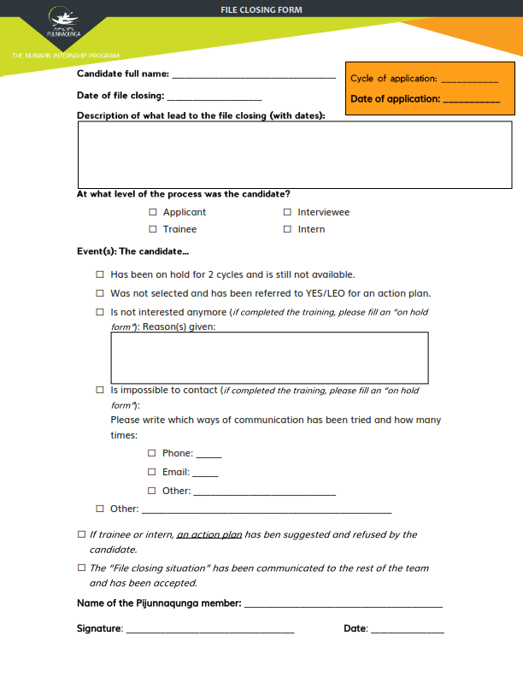

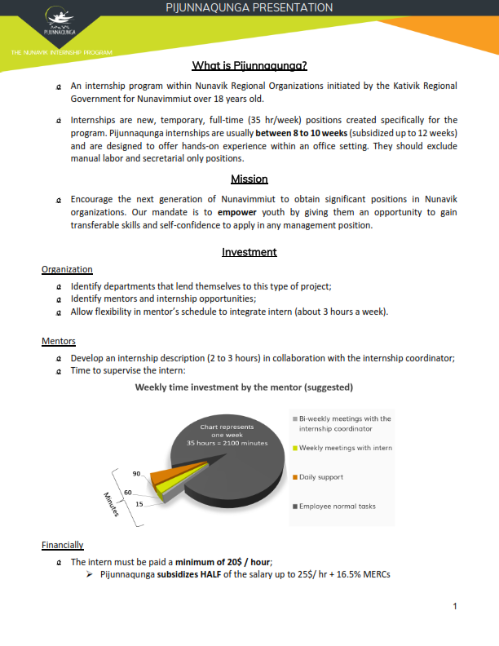
2.3 ᐃᑲᔪᕐᓯᐅᑏᑦ ᐊᒻᒪᓗ ᐱᔭᑦᓴᕆᐊᔭᐅᔪᑦ
ᐸᕐᓇᑕᐅᒪᔪᑦ & ᒪᓕᑦᑕᐅᒋᐊᓖᑦ
ᐱᓇᓱᑫᓐᓇᑐᐃᑦ ᐱᒋᐅᕐᓴᑐᐃᓪᓗ ᒥᑦᓵᓄᑦ ᑐᕐᖁᑐᐃᕕᖓ
ᐊᓂᕐᕋᖃᕐᑎᓯᑫᓐᓇᓂᕐᒧᑦ ᐊᑭᓕᕐᑐᐃᓂᕐᒧᑦ ᐊᖏᕐᓯᒪᐅᑏᑦ
ᐃᓚᐅᔪᐃᑦ ᖃᓄᐃᑦᑑᓂᖏᑦᑕ ᑕᑕᕐᓴᕋᑦᓭᑦ: ᕿᑲᑫᓐᓇᑐᖅ, ᕿᑲᑫᓐᓇᑐᖅ ᐱᒋᐅᕐᓴᑎᑕᐅᓂᕐᒥᑦ, ᕿᑲᑫᓐᓇᑐᖅ ᐱᒋᐅᕐᓴᑎᑕᐅᓂᕐᒥᒃ ᐅᑎᕆᐊᓪᓚᖁᔭᐅᓂᖓ, ᐅᒃᑯᐊᓯᒪᔪᖅ, ᓄᕐᖃᑎᑕᐅᔪᕕᓂᖅ, ᐱᔭᕇᕐᓯᒪᔪᖅd
ᐊᓪᓚᖁᑏᑦ ᐅᒃᑯᐃᑕᐅᓂᖏᓐᓄᑦ ᑲᒪᒍᑏᑦ
ᐊᓪᓚᑕᐅᒪᔪᐃᑦ ᖃᐅᔨᑎᑦᓯᒍᑏᑦ
ᐱᒋᐅᕐᓴᑎᑦᓯᓂᕐᒧᑦ ᖃᐅᔨᑎᑦᓯᒍᑏᑦ
ᐱᔪᒪᓕᕐᑕᐅᑎᑦᓯᒐᓱᐊᕐᓂᖅ
ᖃᕆᑕᐅᔭᐅᑉ ᐱᑐᕝᕕᖓᒍᑦ
ᕓᔅᐳᒃᑯᑦ
ᐊᑐᐊᕌᐱᑦᑎᒍᑦ
ᐊᑭᓐᓇᒥᐅᑕᑎᒍᑦ
ᐱᔪᒪᓕᕐᑕᐅᑎᑦᓯᒐᓱᐊᕈᑏᑦ ᐱᐅᒃᑯᑏᑦ
ᐱᓇᓱᐊᖃᑎᒋᔭᐅᔪᑦ
ᐃᑲᔪᕐᑐᐃᑦ & ᓀᓪᓕᑎᕐᓯᒪᔪᐃᓪᓗ ᑎᒥᐅᔪᓄᑦ
ᐃᑲᔪᕐᑐᐃᑦ YES-ᑯᓄᑦ ᐊᒻᒪᓗ LEO-ᓄᑦ

Slide 20
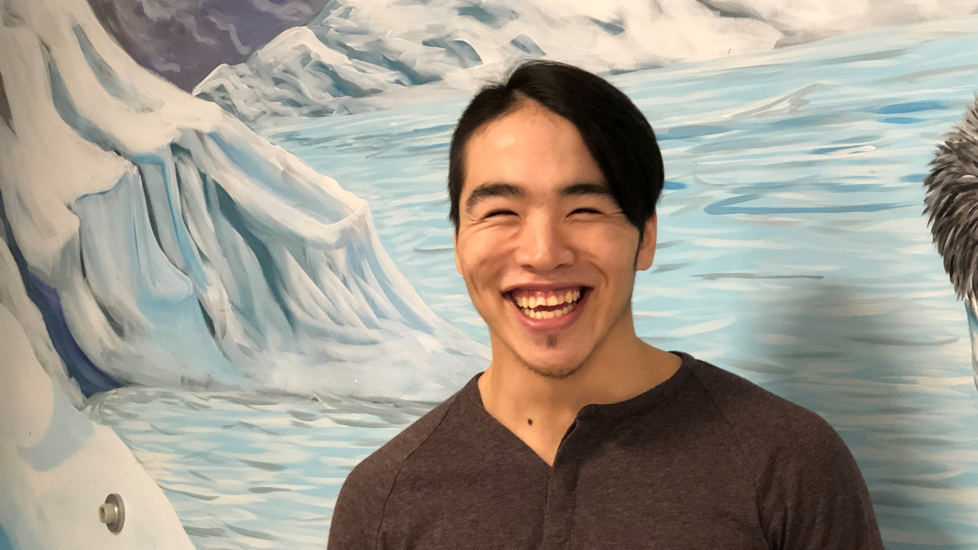
2.4 ᐅᖃᐅᓯᑦᓴᕆᔭᐅᔪᑦ
“ ᐱᔭᕇᕐᓯᒪᕗᖓ ᐱᓇᓱᑫᓐᓇᓂᕐᒥᒃ ᐊᒻᒪᓗ ᖁᕕᐊᓱᓐᓂᔪᐊᖃᕐᖁᖓ ᑕᒪᑦᓱᒪ ᒥᑦᓵᓄᑦ ᐱᓇᓱᐊᕐᓯᒪᒐᒪ ᐊᑑᑎᒍᒪᓯᒪᔭᕋᓂᒃ ᐃᓅᓱᑦᑐᐃᑦ ᐱᕙᓪᓕᐊᓂᖏᓐᓄᑦ ᐃᓅᓯᕐᒥᒃ ᑐᕌᒐᕆᑦᓱᒍᓗ, ᐱᓇᓱᒐᕐᒥᒃ ᒪᓂᔨᓯᒪᔪᑦ […] ᐱᐅᔪᕐᔪᐊᖅ ᑕᒪᓐᓇ ᐊᕐᕌᒍᒥ ᐱᒋᐊᖕᖓᐅᑎᒋᑦᓱᒍ.’’
- ᒫᒃ ᐋᑕᒻᔅ, 25-ᓂᒃ ᐅᑭᐅᓕᒃ ᑲᖏᕐᓱᔪᐊᖅ

Slide 21

2.4 ᐅᖃᐅᓯᑦᓴᕆᔭᐅᔪᑦ
“ ᓇᑯᕐᓴᓚᕆᒃᑯᖓ ᐱᕕᑦᓴᖃᕐᑎᑕᐅᓂᕐᒧᑦ ᐃᑲᔪᕐᓯᓚᕆᑦᓯᒪᒻᒪᑦ ᐅᕙᓐᓂᒃ ᐱᔪᒪᓂᕐᑖᑎᑦᓯᓱᓂ ᐱᔪᓐᓇᕋᓂᓪᓗ ᐅᑉᐱᒋᔭᖃᕐᑎᓯᑦᓱᓂ ᐅᕙᓐᓂᒃ. ᐱᓇᓱᑫᓐᓇᓚᐅᕐᓇᖓ, ᐱᕕᑦᓴᖃᑦᓯᐊᖏᑦᑑᔭᕐᓯᒪᕗᖓ ᐅᕕᒃᑲᐅᓱᖓ ᐊᓈᓇᐅᓂᑯᒐᓄᑦ. ᒫᓐᓇ, ᖃᐅᔨᒪᓕᕐᖁᖓ ᓱᓇᑐᐃᓐᓇᒥᒃ ᐱᕕᑦᓴᖃᕐᓂᕋᓂᒃ. “
ᐃᐊᒥ ᓇᔪᒻᒥᐊᓗᒃ, 20-ᒃ ᐅᑭᐅᓕᒃ ᐃᓄᑦᔪᐊᒃ

Slide 22

2.4 ᐅᖃᐅᓯᑦᓴᕆᔭᐅᔪᑦ
“ᐱᔪᓐᓇᖁᖔ ᐃᑲᔪᕐᓯᓯᒪᔪᖅ ᐅᕙᓐᓂᒃ ᐊᑦᔨᒌᖕᖏᑐᕐᑎᒍᑦ, ᐊᓪᓚᕕᐅᑉ ᐃᓗᐊᓂ ᓯᓚᑖᓂᓪᓗ. ᖃᐅᔨᒪᓕᕐᖁᖓ ᐱᔪᓐᓇᓂᖃᕐᓂᕋᓂᒃ ᓱᓇᑐᐃᓐᓇᒥᒃ ᐱᔪᒪᓂᖃᑐᐊᕈᒪ. ᐊᑑᑎᖁᔨᓪᓚᕆᒃᑯᖓ ᐱᔪᓐᓇᖁᖔᒥᒃ ᐃᓅᓱᑦᑐᓂᒃ.“
- ᐄᒪ ᖃᓴᓪᓗᐊᒃ, 19-ᓂᒃ ᐅᑭᐅᓕᒃ ᐃᓄᑦᔪᐊᒃ

Slide 23


ᐊᐱᕐᓲᑏᑦ ᖃᓄᐃᑦᑐᑐᐃᓐᓀᓗ
ᐅᖃᐅᓯᑦᓴᖃᕐᕿᓰ ᐊᐱᕐᓲᑎᑦᓴᖃᕐᕿᓯᓪᓘᓃᑦ?

