Slide 1
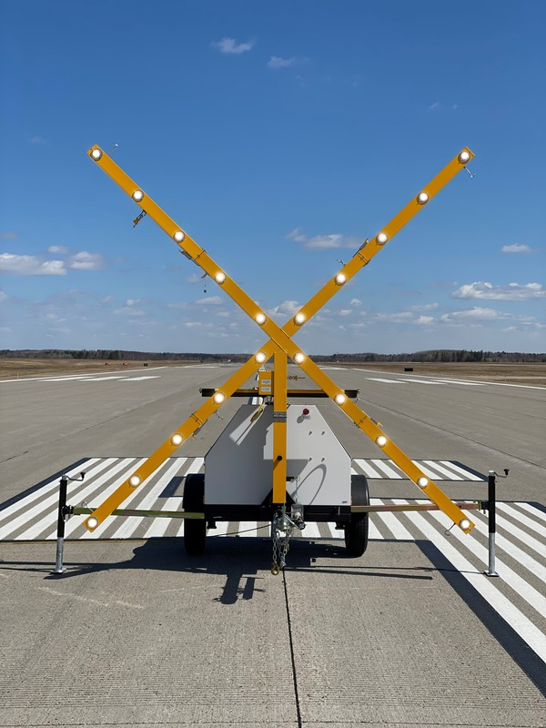
2021 Airport Construction Projects

Slide 2
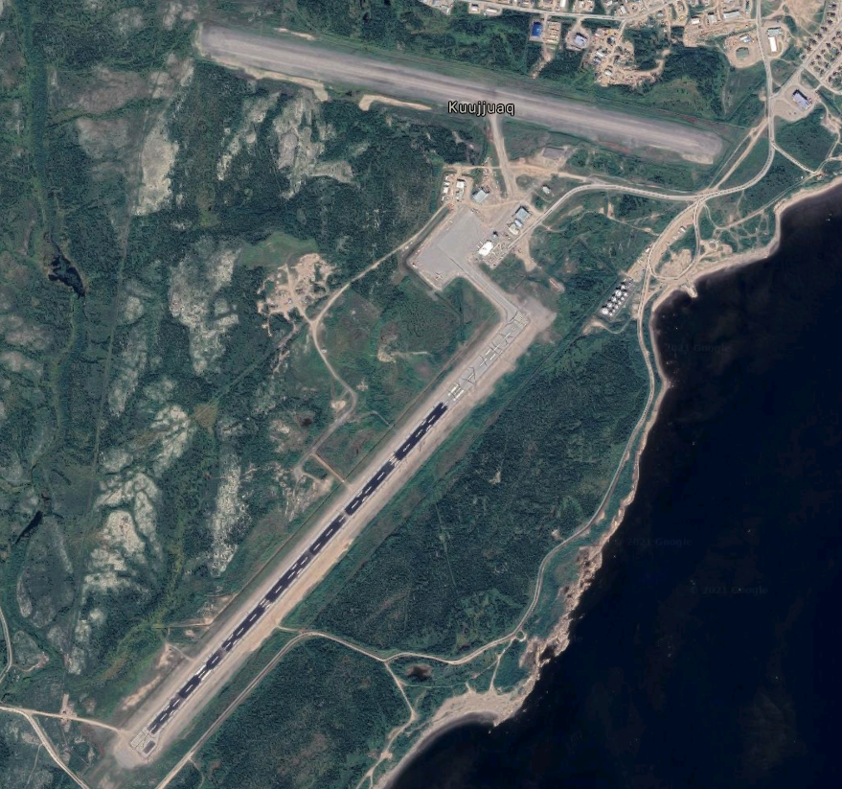
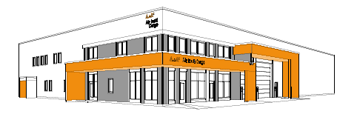
Kuujjuaq Airport
Construction of new Air Inuit warehouse
-
May 2021 to Aug 2022
x
Rehabilitation of Runway 07/25
-
Jun 2021 to Sep 2021
Construction of new private aircraft hangar
-
July 2021 to Sept 2021

Slide 3
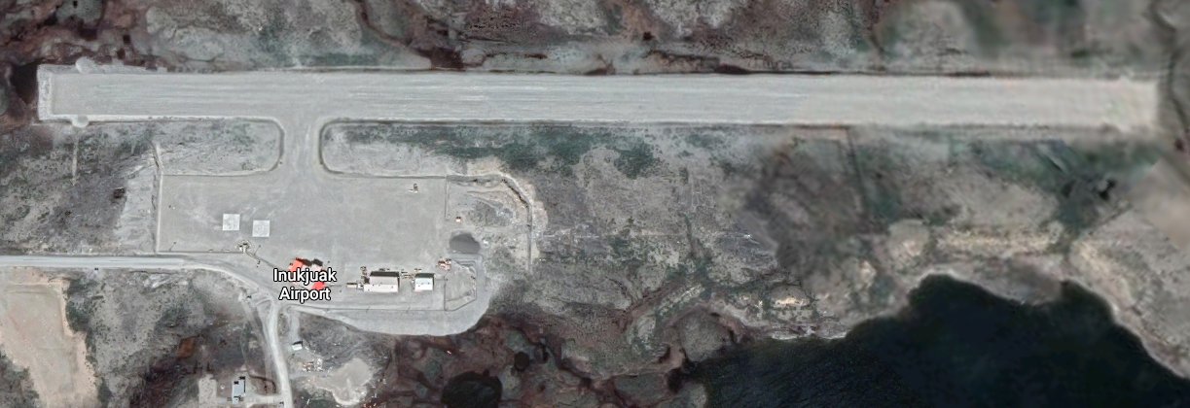
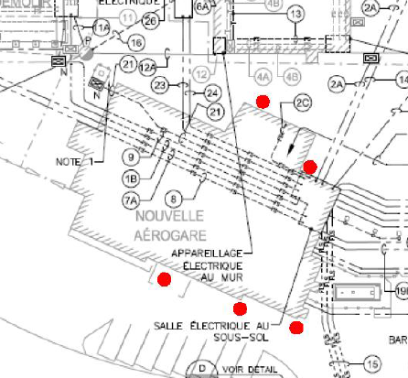
Inukjuak Airport
Drilling to understand infiltration issue
-
Jun 2021
Resurfacing of runway and upgrading visual aids
-
Completing Sep 2021
Notes:
Drilling – to understand water infiltration problem at Inukjuak airport tterminal

Slide 4
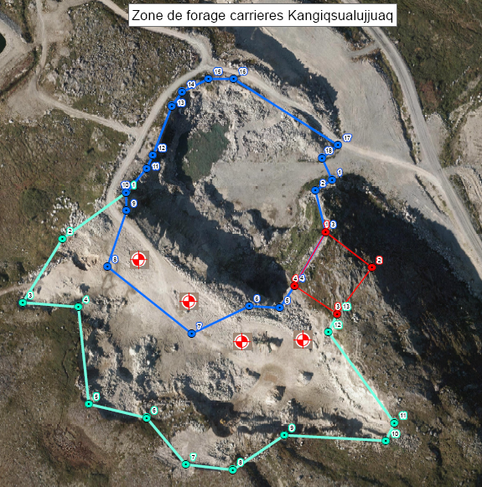
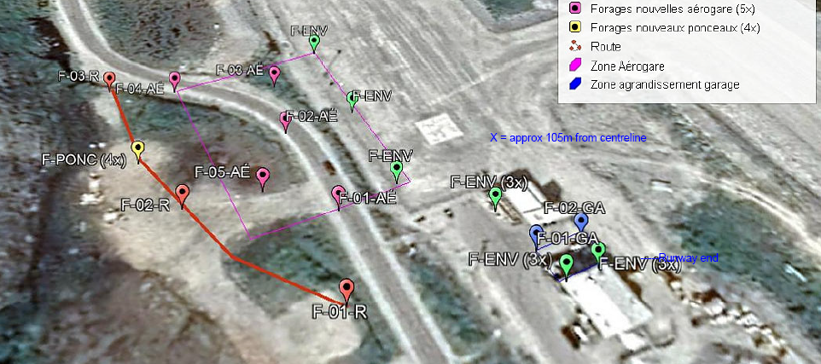
Kangiqsualujjuaq
Drilling for geotechnical analysis
-
Jun 2021 to Jul 2021

Slide 5
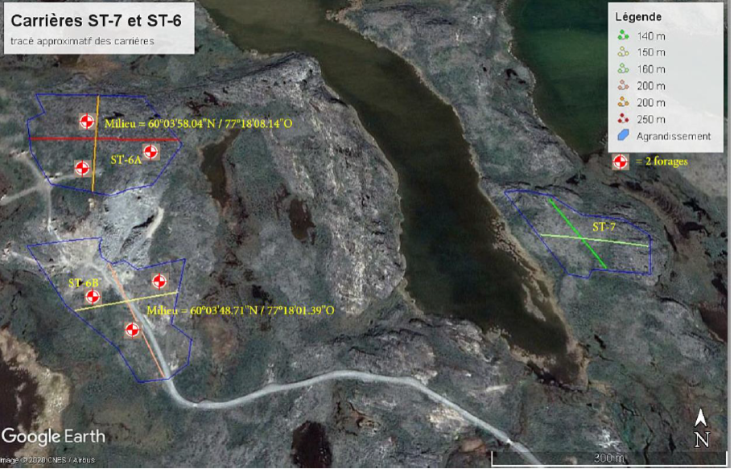
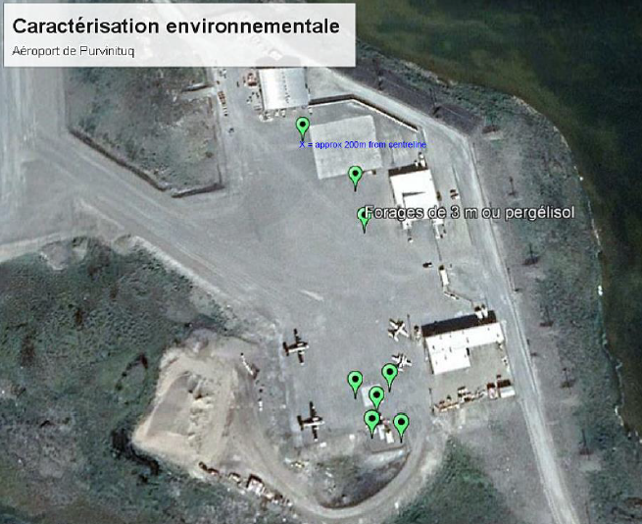
Puvirnituq
Drilling for geotechnical analysis
-
Jul to Aug 2021

Slide 6
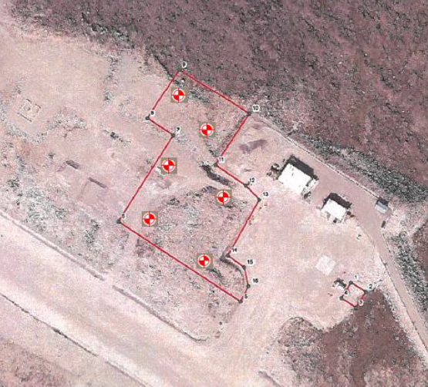
Kangiqsujuaq Airport
Drilling for geotechnical analysis
-
Jul to Aug 2021
Notes:
The drillings will help identify the suitable material to regenerate the gravel stockpile, contamination below fuel tanks, and a suitable location for AWOS.

Slide 7
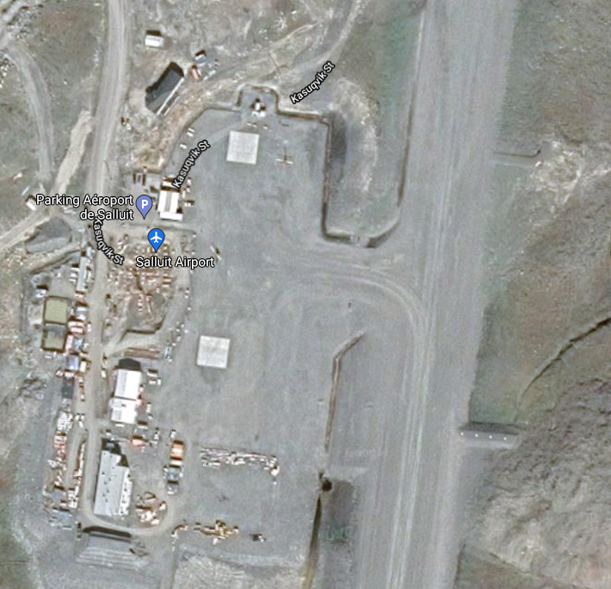
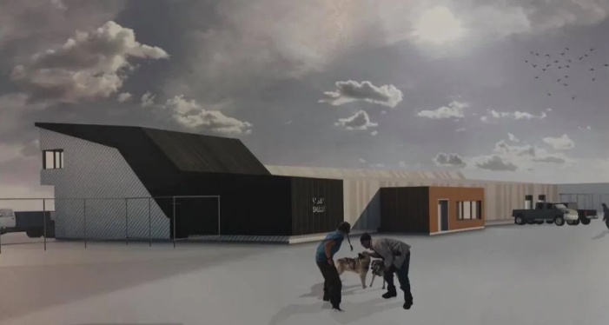
Salluit Airport
Construction of new Airport Terminal
-
Completing Jul 2021
Notes:
https://www.cbc.ca/news/canada/north/salluit-airport-makeover-1.4411074

Slide 8
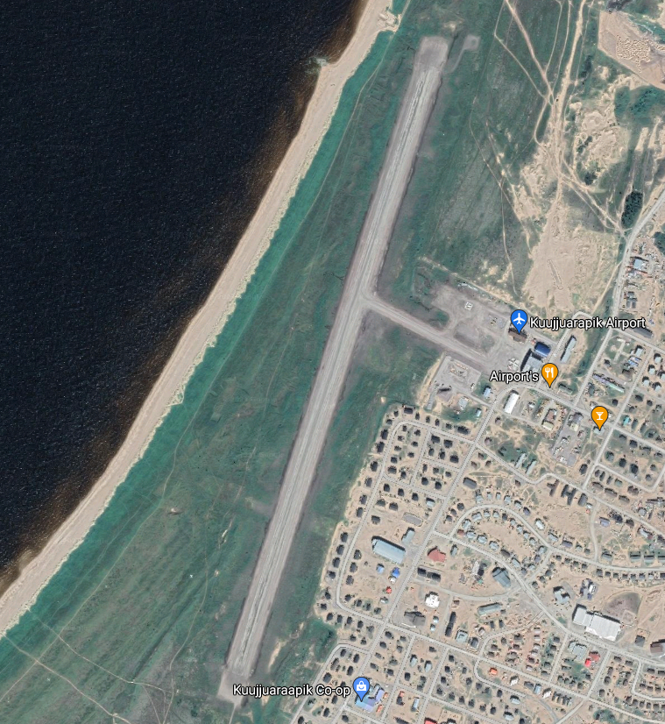
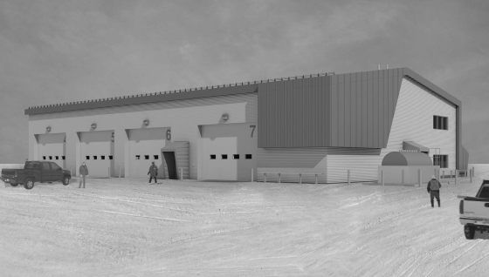
Kuujjuaraapik Airport
Construction of new Airport Garage
-
Completing Sep 2021

Slide 9
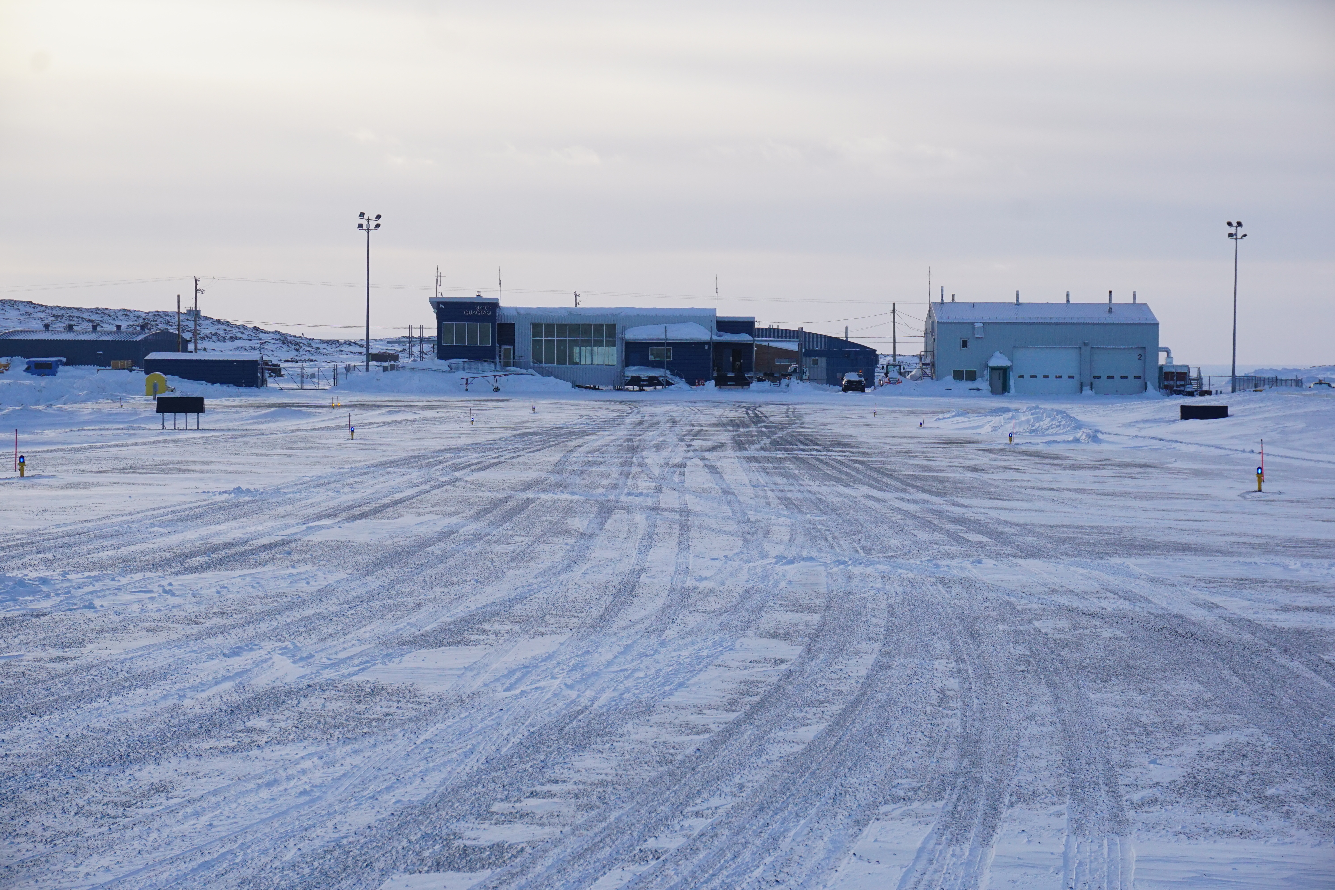
Nakurmiik

