Slide 1



Entrepreneur Local Learning Centers

Slide 2



SEMINAR 20: WHAT ARE JOINT VENTURES?
Business is all about people, and sometimes, you can’t do it all by yourself.
Have you ever heard of the expressions :
If you can't beat them, join them
Two heads are better than one
United we stand, divided we fall This is what a joint venture is all about!

Slide 3
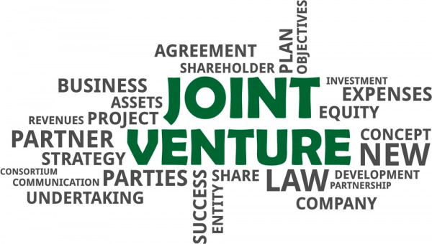

Why Call it a Venture?
A venture is defined as a risky or daring journey or undertaking. This may sound just about right when undertaking new markets or projects.

Slide 4
Differences Between Partnership and Joint Venture
A joint venture is a cooperative arrangement between two or more business entities, often to take on new business activity. Each entity contributes assets to the joint venture and agrees on dividing income and expenses. An example is Nuqsana-Pinnacle, which is based in Baker Lake, Nunavut.
Partnerships and joint ventures are different.
A partnership's purpose is not limited to a single project; rather, it is oriented towards partners/ owners running a business or long-term enterprise and making a profit.
Remember…
In a Joint venture, each party/business entity keeps its separate legal status.
A joint venture is also different from a merger because there is no transfer of ownership in the deal.

Slide 5


Types of Joint Ventures
Incorporated: As a newly incorporated co-owned company.
Unincorporated: such as a partnership, cooperation agreement, or strategic alliance.

Slide 6
The Advantages:
A joint venture can help your business grow faster, increase productivity and generate greater profits, enable growth without borrowing funds, or look for outside investors, including access to new markets and distribution networks.
Advantages include:
● Increased capacity.
● Sharing of risks, costs, and liability with a partner.
● Access to new knowledge and expertise, including specialized staff.
● Access to greater resources, for example, technology and financing.
● Joined forces in purchasing, research, and development.

Slide 7

The Risks:
- Lack of trust: Since alliances are built on trust, one of the main risks you can face may occur if the partners are from different cultures and management styles. They may not trust working in a certain "way.” When joint venturing, be prepared to give and take.
- Divergent Goals/Interests: Many potential joint ventures failed before the ink on the contract was dry because of divergent goals and ambitions or the venture's objectives were unclear.

Slide 8

Problems are also likely to come up if:
The communication between partners is not great.
The level of expertise and investment isn't equally matched.
The work and resources aren't distributed equally.
There is not a good fit between the participating partners.
The alliance hurts the core business reputation or poses a risk to a partner's primary business operations.

Slide 9


Dividing the “Who’s" and "What’s”:
Once again, success depends on good communication, a carefully planned joint venture relationship, and a clear joint venture agreement.
The "who’s" and "what’s" should be covered in a legal agreement that carefully lists which party brings which assets to the joint venture.
A contract should outline the resources, such as money, properties, and other assets each entity will bring to the venture. The agreement also establishes how the venture will be managed, and how its profits and losses will be divided.

Slide 10
Furthermore, the agreement should detail:
The purpose of the joint venture and specific goals for the venture.
Whether the venture is for a specific period or indefinite.
The specific responsibilities of the participants
How you will handle the money and personal guarantees if required, etc.
Who will own any new intellectual property, products, or services created through the joint venture.
The terms of termination or modification of the contract.
Some Advice…
Although joint venture legal agreement templates can be found on the Internet, we suggest you seek the appropriate legal advice when entering such a business relationship.

Slide 11

Questions for Review
Name two of the five components that need to be stated in your venture agreement:
1. Purpose and objectives of the partnership and venture
2. The timeline
3. Investment, revenues administration, and guarantees
4. Intellectual properties
5. Terms of termination of the venture
What or the reasons why a joint venture is not successful or can be terminated?
- Lack of trust and not a good business fit
- Divergent goals/interests

Slide 12
Glossary
Click on the word to go back to that slide.
- Legal Status: Refers to the legal identity by which a person, entity, association or company is recognised, with sufficient capacity for taking on obligations and carrying out activities that incur full legal responsibility, regarding themselves and third parties.
- Merger: A merger is an agreement that unites two existing companies into one new company. There are several types of mergers and also several reasons why companies complete mergers. Mergers and acquisitions (M&A) are commonly done to expand a company’s reach, expand into new segments, or gain market share. All of these are done to increase shareholder value. Often, during a merger, companies have a no-shop clause to prevent purchases or mergers by additional companies.
- Joint venture: A joint venture is a business entity created by two or more parties, generally characterized by shared ownership, shared returns and risks, and shared governance.
Continued

Slide 13
Glossary, Pt.2
Click on the word to go back to that slide.
- Undertaking : an effort to do something, especially to do a large or difficult job, often as a primary objective.
- Entity :An entity refers to a person or organization possessing separate and distinct legal rights, such as an individual, partnership, or corporation. An entity can, among other things, own property, engage in business, enter into contracts, pay taxes, sue and be sued.
- Capacity : The maximum amount that something can contain, or produce. An arena would have a seating capacity, whereas a business making and selling scarves would have a production capacity showing how many scarves they can produce in a certain time.
- Divergent : To diverge means to move away from what is expected – partners with divergent goals have a hard time seeing eye-to-eye.
- Terminated : Terminated means to be finished, cancelled, or otherwise stopped.

Slide 14
Congratulations, you have completed this module!
The next Module will be: When Should I Think About Expansion?

