Slide 1



Entrepreneur
Local Learning Centers

Slide 2



SEMINAR 27:
UNDERSTANDING SALES TAXES
Learn about the A,B,C’s to better understand Quebec's technical, operational, and legal aspects of sales tax.

Slide 3
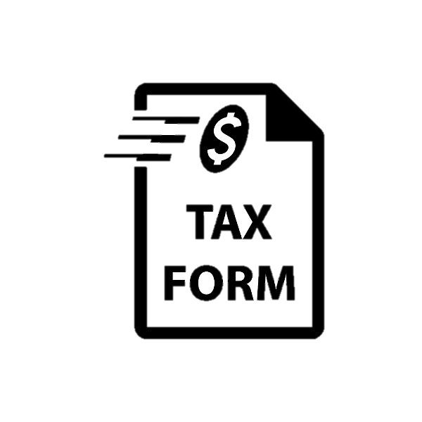
When do I Need to do my GST and QST Reports?
As mentioned previously in seminar 7, titled What About Sales Taxes ​(GST and QST)? You must, as a good corporate citizen, register for and collect the goods and services tax (GST) and the Québec sales tax QST if:
Your total sales exceed 30,000 $ in a given calendar quarter or the four preceding calendar quarters;
You operate a taxi or limousine business.
The good news is throughout Quebec, Revenu Québec is responsible for administering the GST on behalf of the Canadian Revenue Agency (CRA). Therefore, you do not have to register with the federal government to obtain your GST number.
Continued

Slide 4
When do I Need to do my GST and QST Reports, Cont’d.
Once registered, the GST and the QST reports are submitted periodically: these periods are annually, quarterly, or monthly, depending on your business situation.
Annually, one declaration per year, which must be paid three months after the last day of your statement period. This method is simple, but it can have a considerable impact on liquidity if it is poorly planned and money isn’t set aside during the year.
Quarterly, four declarations a year (every three months), which must be paid one month after the last day of your statement period. This is an excellent option if you’re well organized.
Monthly, twelve yearly declarations must be paid one month after the last day of your statement period, which can be time-consuming for a multitasking entrepreneur.
Remember:
Whether you choose the monthly or quarterly declaration, you will realize that the deadlines come back quickly! Make sure you put aside your contributions and watch your calendar.
Continued

Slide 5

When do I Need to do my GST and QST Reports, Cont’d.
As time passes and your business evolves, you might realize that the option you initially selected may no longer be the most optimal. You might choose the annual reporting option to make the year-end reporting requirements as simple as possible.
How often you file your sales tax returns depends on your or your accountant’s availability. New business owners prefer filing reports and paying the balance owing more regularly. Including that task in workflow and monthly or quarterly activities is also wise.

Slide 6
Why do I Need to do my GST and QST Reports?
You must register for GST and QST if you carry on commercial activities in Québec. Under the GST system, a penalty for failure to file is charged where a return is filed late. The penalty is equal to the sum of:
1% of the unpaid amount; and 0.25% of the overdue amount multiplied by the number of months (up to 12 months) for which the return is late.
Remember, government agencies have the authority to take legal action to:
Seize your bank account if you forget or make errors on your remittances.
Close your GST and QST, which can put you out of business until the liability is paid.
Under the QST system, anyone who neglects to file a return is liable to a penalty of 25$ per day until the return is filed, to a maximum of 2,500 $.

Slide 7
How to Do it Right, Step by Step
- It is essential to keep track of all transactions and calculate GST and QST. Most POS and cash registers can produce a simple report automatically for you. As a Quebec company and in agreement with the current self-assessment tax system, you are responsible for keeping up-to-date accounting records.
- Keep traces of all your accounting transactions in a spreadsheet, software, or other documents when you want to make your report. In addition, you must keep all supporting documents for your transactions.
In Quebec, you must complete form FPZ-500 to report your GST and QST. There are three ways to find this form:
Create a "My Account" account with Revenu Québec. The form will be in your file;
Request a paper form from Revenu Québec to receive one by mail;
Check with your financial institution if it is possible to declare your taxes online using the FPZ-500 form.
Continued

Slide 8
How to Do it Right, Cont’d
Don’t forget to keep a copy of your FPZ-500 form in your records and proof of payment with the date in case of a late payment penalty.
There are five critical pieces of information that you should extract from your sales and expense journals:
The total revenue, before taxes, for the period analyzed;
The total GST for which you received an invoice;
The total QST which you paid for business purchases;
The total GST for which you received an invoice;
The total QST you paid for business purchases.
*Do not forget to file your personal and business expenses separately.
Continued

Slide 9
After collecting these pieces of information, you then need to do the following three calculations:
Take the total GST on your sales minus the GST on your expenses to get the total GST payable;
Take the total QST on your sales minus the QST on your expenses to get the total QST payable;
Add the totals of calculations 1 and 2. The result represents the amount you will need to be paid, or that will be reimbursed.
Sample of an annual GST and the QST report:
Total Revenue | $55 930,00
Expenses paid | $30 849,00
 |  | QST 5 % | GST 9,975 % | Total to pay
Received on goods or services sold |  | $2 797 | $5 579 | $8 376
Expenses paid | Minus (-) | $1 542 | $3 077 | $4 620
Balance QST-GST |  | $1 254 | $2 502 | $3 756

Slide 10
SELF EVALUATION
Q. I am a multitasking solo entrepreneur and I often have difficulty organizing myself and setting aside funds for taxes and duties. Which tax reporting method is most appropriate?
A.
Quarterly and/or monthly.
B.
Annually, meaning once a year.
C.
None of the above; as a multitasking entrepreneur, all of these options are too high-maintenance; hiring an accountant will solve this issue.

Slide 11
Congratulations, you have completed this module!
The next Module will be: How to Read Financial Statements

Slide 12
Glossary
Click on the word to go back to that slide.
GST: The goods and services tax (GST) is a value-added tax (VAT) levied on most goods and services sold for domestic consumption. The GST is paid by consumers, but it is remitted to the government by the businesses selling the goods and services.
QST: In Québec, the provincial sales tax is called the Québec Sales Tax (QST). Just like the GST, QST is charged and collected on most goods and services and when QST is paid it can be claimed back on your QST return. Businesses in Quebec are required to register for QST when their total worldwide taxable supply of goods and services exceeds $30,000 in a given calendar quarter or in the four previous consecutive calendar quarters.
Calendar Quarter: A quarter is a three-month period on a company's financial calendar that acts as a basis for periodic financial reports and the paying of dividends. A quarter refers to one-fourth of a year and is typically expressed as Q1 for the first quarter, Q2 for the second quarter, and so forth. For example, a quarter is often shown with its relevant year, as in Q1 2021 or Q121, which represents the first quarter of the year 2021.

Slide 13
Sorry. Please try again.
Click here to try again.

Slide 14
Congratulations, you are correct!
New business owners prefer filing reports and paying the balance owing more regularly. Including that task in your workflow of monthly or quarterly activities is also wise. Make sure you put aside appropriate funds, and to watch your calendar.
Click here to continue.

