Slide 1



Entrepreneur Local Learning Centers

Slide 2



SEMINAR 28: HOW TO READ FINANCIAL STATEMENTS
We discussed bookkeeping and accounting in the previous SEMINAR 25: Budgeting as tools that provide critical information to build a financial report that supports managers in decision-making to ensure their businesses stay afloat. In other words, knowing how to read your financial statement provides information that can help you find ways to make more profit or catch financial matters before they become problematic!

Slide 3
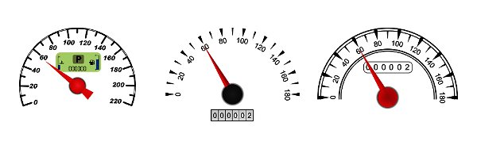
Financial Statements
Financial statements are like your car’s dashboard; they show your performance (profits), fuel levels (resources and expenses), and signal challenges and failures. They help you keep your hands on the wheel!
- They tell you where your money is going,
- Where it’s coming from,
- And how much you’ve got to work with (Working capital).
Additionally,
They’re very helpful for making the right business decisions.
And they’re essential if you want to get a loan or bring on investors.
Continued

Slide 4
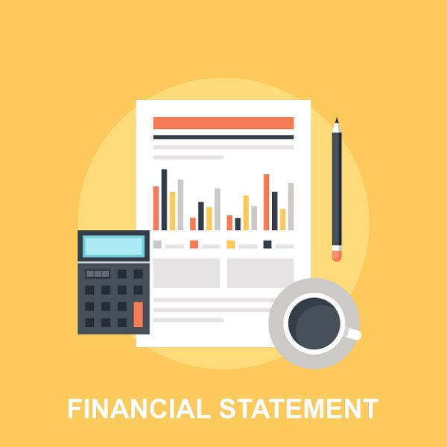
Financial Statements, Cont’d.
How do I Present a Financial Statement?
Financial statements usually include a heading with the company's name, the statement’s title, and the period.
All financial statements must be accurate and conform.
- Don’t forget to separate your personal expenses from your business statement.
You can prepare them in-house or seek help from an accountant.
Here are the three basic statements you need to be able to read and comprehend:
Income statement
Cash flow statement
Balance sheet

Slide 5
Income Statements, Part 1
The income statement, also called a profit and loss (P&L) statement, shows income and expenses for a specific period. This could be monthly, quarterly, semi-annually, or annually.
The purpose of the income statement may differ somewhat, depending on the user.
For example:
A potential partner or investor will want to see a consistent profit that proves the viability of the business.
A lender is most interested in a company generating a sufficient profit to pay for interest expenses and a return on the loaned amount.
As a business owner, you need this statement to prepare your income taxes declaration.
The information provided in this statement is valuable; Income statements show how profitable and sustainable a company is and how efficient its management is. Comparing different consecutive periods helps to identify trends in performance related to revenue and expense.

Slide 6

Income Statements, Part 2
For this section and the following ones, we suggest you follow the excel tables to fully understand the provenance of the data/information.
The income statement contains three main categories: revenues, expenses, and net income or loss. In the following slides, we will give you a real-world example of an income statement.
For context: Kuujjuaq colorful scarves is a start-up artisan who makes accessory scarves that sells its products in a local shop and through its website.

Slide 7
What is Found on an Income Statement
Revenue : How much did you earn from selling scarves during the year?
Cost of goods sold: The total amount it costs you to produce scarves which includes the fabrics, threads, labels, packaging, and labor; all direct costs associated with manufacturing a product.
Gross Profit = Revenue – the cost of goods sold
Operating Expenses = The cost of running your business.
EBITDA: Earnings Before Interest, Taxes, Depreciation, and Amortization = Gross profit - Operating Expenses
Interest paid on the debt: This amount represents the interest paid during the years on your loan.
Depreciation: Assets such as equipment or cars are typically less valuable year after year. Depreciation measures the amount of value an asset loses over time.
Pre-taxes profits = EBITDA- debt – depreciation
Pre-Tax Profit Taxes: 18 % of pre-tax, see SEMINAR 24: Understanding income taxes for business owners
Net Profit = Gross Profit - Pre-taxes profits – Taxes
Continued

Slide 8
INCOME STATEMENT, KUUJJUAQ COLORFUL SCARVES, YEAR ENDED DECEMBER 31st, 2022
Income
Sales revenue | $ 55 930,00
2. Cost of goods sold | $ 18 317,50
3. Gross Profit | $ 37 612,50
4. Operating Expenses
Salary | $ 23 000,00
Sales fees | $ 2 796,50
Administration Fees | $ 2 940,00
Total Operating Expenses: | $ 28 736,50
Conclusion: After paying all its obligations and the owner's salary, the company has generated a net profit of $ 6522, which can be reinvested as working capital or savings.
5. Earnings Before Interest, Taxes, Depreciation, and Amortization (EBITDA) (Gross profit - Operating Expenses) | $ 8 876,00
6. Interest of the Lt Debt (see tab) | $ 712,00
7. Depreciation ( see tab) | $ 210,00
8. Pre-Tax Profit | $ 7 954,00
9. Pre-Tax Profit Taxes (18 % of pre-tax) | $ 1 431,72
10. Net Profit | $6 522,28

Slide 9

Cash Flow Statement
A cash flow statement tells you how much cash is entering and leaving your business at a given period. This report is essential in helping you effectively manage your working capital.
The cash flow statement has three parts:
- Cash Flows from activities. This is what you make (sales) and spend in the normal course of doing business.
- Cash Flow from Investing Activities. This is money you invest—in this case, by purchasing new equipment for your business.
- Cash Flow from Financing Activities. This includes money the owner invested in the business and taking out and repaying loans. In this case, the company got additional financing of 8000 $ as a bank loan.

Slide 10
Cash Flow Statement, Pt. 2
To illustrate these concepts, here is an example of a simplified cash flow statement:
CASH FLOW STATEMENT, KUUJJUAQ COLORFUL SCARVES, YEAR ENDED DECEMBER 31st, 2022
Cash on hands, Jan. 1, 2022 | $2 500
Cash flow from activities
Net income (sales + sales taxes-/see budget tab) ) (+) | $64 308
Cash paid for activities (adm, wages, inventory, etc...) (-) | -$63 000
Net cash from activities = | $3 808
Cash Flow from investing activities
Purchase of equipment (-) | -$2 800
Cash Flow from financing activities
Bank loans (+) | $8 000
Ending cash on December 31 th, 2022 | $9 008

Slide 11
What is Meant by Positive Ending Cash/Positive Cash Flow?
Positive cash flow shows that a company has more money flowing into (cash-in) the business than out of it (cash-out) over a specified period. This is an ideal situation because having excess cash allows you to settle debt payments or put money aside for drier times.
What is Meant by Negative Ending Cash/Negative Cash Flow?
Having negative cash flow means your cash outflow is higher than your cash inflow during the period covered by the statement. It doesn’t necessarily mean profit is lost!
Negative cash flow may be caused by factors such as expenditure and income mismatch, especially when combined with a slower season; these issues should be addressed when noticed.

Slide 12
Balance Sheet
A balance sheet is a snapshot of your business finances as it currently stands. It tells you about the assets you own and liabilities (i.e., debts) you owe at a particular time.
Balance sheets are divided into three general categories: assets, liabilities, and equity. Here are some definitions:
Assets: a resource, property owned by a person or company (cash in the bank, furniture, inventory).
- Current Assets: are accessible assets you can convert into cash within one year.
- Long-term Assets: assets such as property and machinery used for more than a year in the business to generate revenue. They appear in the financial records at their net book value (purchase value - depreciation).
2. Liabilities or Passive Assets: Debt and financial obligation.
- Current liabilities: Debts that must pay within a normal operating cycle, usually less than 12 months.
- Taxes to pay (receivable): current years paid and received taxes, due to pay the next month
Continued

Slide 13
Balance Sheet, Cont’d.
- Income taxes to pay (receivable): Taxes for current years are to be paid next year by June 15th
- Long-term liabilities: are debts a company owes third-party creditors that are payable beyond 12 months.
3. Shareholders’ Equity
- Shareholders’ equity (or business net worth): shows how much the owners (shareholders) of the company have invested in the business, either by investing money in it right from the start (personal investment) or all the reinvested earnings over time.
- Retained earnings: profit generated during the years directly reinvested in the business.

Slide 14
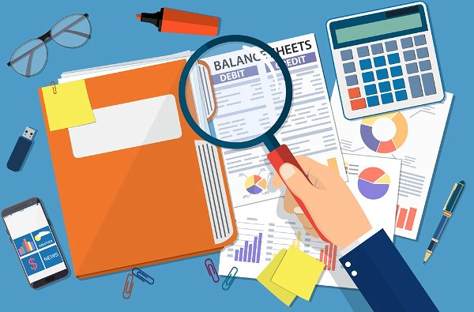
The balance sheet’s core is based on the following central formula:
Assets = Liabilities + Shareholder’s Equity.
In simple terms: The assets you own are either financed by the money invested in the business (reinvested profit /retained earnings or initial investment) or by your debts owed to third parties (liabilities). By contrast, the financial balance sheet reports personal assets and liabilities to estimate your net worth.

Slide 15
Here is an example of a simplified balance sheet:
1. Assets
Cash/ bank account (see monthly budget tab) | $9 009
Accounts receivable
Inventory (see the cost of goods tab) | $3 995
Pre-paid expenses
Current assets | $13 004
Long-term Assets:
Equipment depreciated value (see depreciation tab) | $2 590
Total long-term Assets: | $2 590
Total Assets | $15 594
2. Liabilities
Line of credit
Due accounts
Taxes to pay (receivable) | $570
Income taxes to pay (receivable) | $1 432
CT portion of the LT debt | $4 197
Short Term Passive Assets Total | $6 198
Long Term Passive Assets
LT borrowed | $373
Other LT passive assets
Long Term Passive Assets Total | $373
Retained earnings (net profit reinvested) | $6 522
Total Shareholders' equity | $9 022
Total liabilities and shareholders' equity | $15 594

Slide 16
Conclusion
After one year of operation, Kuujjuaq Colorful Scarves’ Total Assets came out at $ 15 594. By comparing the balance sheets from year to year, we can see if the company is creating value.
To learn more about interpreting financial information, see the following seminars:
- SEMINAR 29: Understanding cash flow (the working capital)
- SEMINAR 30: How to read financial ratios
- SEMINAR 31: Sources of equity financing

Slide 17

How To Read And Understand Financial Statements
Click here to watch an instructional video on how to read and understand financial statements as a small business!
For this section, it is a good idea to take down notes as the video goes along. You can pause and resume play at any time.

Slide 18


Once you are done watching, click here to proceed to the next short video on Cost of Goods Sold. This will refresh you on some topics we have already covered like LIFO and FIFO.
If you haven’t finished the video on financial statements yet, or want to re-watch parts of it, hover your mouse over the icon in the top right, and hit play!

Slide 19
When you’re ready, proceed to the next slide.

Slide 20
TRUE OR FALSE
A personal financial balance sheet presents the same information and analysis you would find in a business balance sheet.
True
False

Slide 21
TRUE OR FALSE
An income statement is used to estimate profits and income taxes.
True
False

Slide 22
Congratulations, you have completed this module!
The next Module will be: Understanding Cash Flow

Slide 23
Congratulations, you are correct!
A personal financial balance sheet reports personal assets and liabilities to estimate your net worth, while the business balance sheet allows you to know whether the assets are mainly financed by debt or by shareholders' equity.
Click here to continue.

Slide 24
Congratulations, you are correct!
Click here to continue.

Slide 25
Sorry. Please try again.
Click here to try again.

Slide 26
Sorry. Please try again.
Click here to try again.

