Slide 1



Entrepreneur Local Learning Centers

Slide 2



SEMINAR 30: How to read financial ratios
Financial ratios offer entrepreneurs a way to evaluate their business performance. They are created using numerical values taken from financial statements to gain meaningful information about a company.

Slide 3

Financial Ratios: Starting Info
Financial ratios are commonly used by lenders such as a bank or organizations like KRG to determine the stability and health of your business just by looking at your balance sheet. They can also make stable financial ratios a part of your business loan agreement.
Ratios should not be evaluated only when visiting your banker.
Ideally, you should review your ratios every month as you do your bookkeeping and budgeting.
This will keep you on top of changing trends in your financial performance to help you make the best decisions.

Slide 4
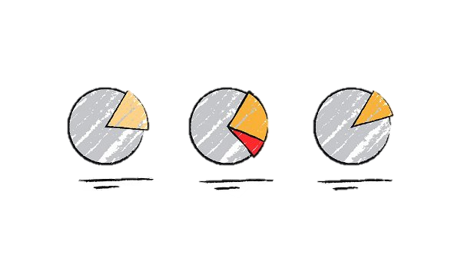
The Advantage of Using Ratios
Here are the two basic categories for start-ups.
The profitability ratios: provides indicators such as gross margin and net profit margin.
The liquidity ratio: is an indicator of your ability to turn assets into cash quickly.
What are the advantages of ratio analysis?
It simplifies the financial statements.
It highlights valuable information in a simple form rather than performing an analysis of a financial statement.

Slide 5
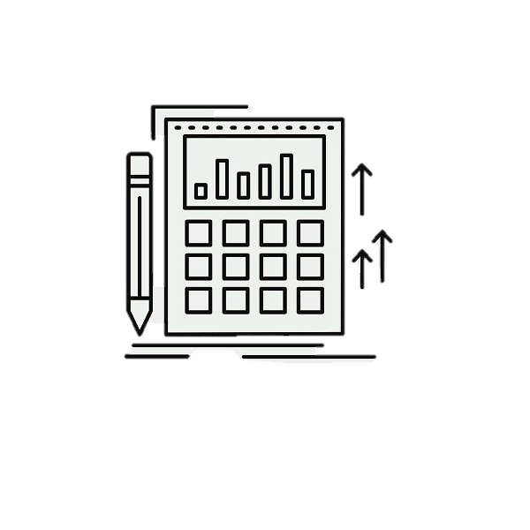
Profitability Ratios
How well does your business generate profits?
Here are the two profitability ratios that you need to know:
Gross profit margin
2. Net profit margin

Slide 6
Gross Profit Margin
Gross profit margin:
The gross profit margin tells you what your business made after paying for the direct cost, including labor, materials, and other direct production costs. Without a high enough gross profit margin, you won’t have a viable business, at least not for long.
Formula and Calculation for Gross Profit Margin:
*Remember: Multiplying the figure by 100 will convert it to a percentage.
Gross profit margin = Gross Profit / revenue x 100*

Slide 7
Net Profit Margin
Net profit margin:
The net profit margin illustrates how much each revenue dollar translates into profit. This ratio is considered one of the most important indicators of a company's overall financial health.
You can assess whether current practices are working and forecast profits based on revenues by tracking increases and decreases in your net profit margin.
In practice, since the net profit margin is expressed as a percentage rather than a dollar, it becomes easy to compare the profitability of two or more businesses regardless of size.
Formula and Calculation for Net Profit Margin:
Net profit margin = Net Profit / revenue x 100
The following slides will contain tables to demonstrate these concepts in action. We suggest you follow the excel tables to fully understand the info!

Slide 8
INCOME STATEMENT, KUUJJUAQ COLORFUL SCARVES, YEAR ENDED DECEMBER 31, 2022
Income
Sales revenue | $ 55 930,00
Cost of goods sold | $ 18 317,50
Gross Profit | $ 37 612,50
Total Operating Expenses: | $ 28 736,50
Earnings Before Interest, Taxes, Depreciation, and Amortization (EBITDA) (Gross profit - Operating Expenses) | $ 8 876,00
Pre-Tax Profit and Other Income (EBITDA- debt - depreciation) | $ 7 954,00
Pre-Tax Profit Taxes (18 % of pre-tax) | $ 1 431,72
Net Profit | $ 6 522,28
RATIOS:
Gross Profit Margin (Gross profit / Sales revenue X 100) | 67%
Net Profit Margin (Net profit / Sales revenue X 100) | 12%

Slide 9

Let’s put this table into words:
For instance, a 67 % gross margin means that for every $100 in revenue, the company pays $33 in costs directly connected to producing the product or service, leaving $67 as gross profit.
In relation to the Net Profit Margin, the business managed to generate profits worth 12 cents for every dollar worth of sales.
A good net profit ratio can vary depending on the industry:
For example, a good net profit ratio might be between 0.5% and 3.5% in the retail and restaurant industry.
Businesses should aim for profit ratios between 10% and 20% while paying attention to their industry's average.

Slide 10
Liquidity Ratios
Does your business have enough cash to pay the bill?
Even if your business is currently profitable, bankruptcy is a constant danger. All it needs is a few missed payments due to accounts receivables and payables not lining up well. To keep track of your capacity to pay your debt, you can use the two following indicators. The financial information needed to estimate this ratio is found in the balance sheet.
The following slides will offer in-depth explantations of these two indicators, called Quick Ratio and Current Ratio.

Slide 11
Quick ratio: (also called cash ratio or acid test ratio) indicates if your company can immediately pay its debts using its most liquid assets (cash or assets that are easily converted into money), also called quick assets.
Your quick assets are cash, money in the bank, account receivable, and pre-paid account short-term investments that are easy to convert (marketable).
Your current liabilities are any short-term debt such as credit card debt, accounts payable, bank operating credit, accrued expenses, and taxes payable.
To estimate your quick ratio, you need to divide your current liabilities by your quick assets:
Quick ratio = Current liabilities / Quick assets
A quick ratio of less than 1 is a low score and means that your company has no liquid assets to pay its current liabilities and should be treated cautiously.
A low ratio means that you might have difficulty meeting your obligations and may not be able to take advantage of opportunities that require quick cash.
A quick ratio of 1 and + indicates that your company could pay off its current liabilities without selling any long-term assets. For example, a quick asset of 2 shows that the company has twice as many quick assets as current liabilities.
Continued

Slide 12
Current ratio: measures your business’s ability to meet its short-term liabilities (within the year) when they come due.
Current assets are quick assets + inventory.
To estimate your current ratio, you need to divide your current liabilities by your current assets:
Current ratio = Current liabilities / Current assets
A ratio value lower than 1 may indicate a liquidity problem and the need to secure other forms of financing.
Recommendations:
Paying off your debts can improve this ratio;
Delay purchases or consider long‑term borrowing to repay short-term debt.
Review your credit sales policies with clients and possibly adjust them to collect outstanding payments quickly.
Let’s go back to the Kuujjuaq Colorful Scarves balance sheet to evaluate these two liquidity ratios.

Slide 13
These next two slides represent a balance sheet from Kuujjuaq Colourful Scarves – the first represents Assets, with the next slide showing Liabilities. You are encouraged to switch between them to compare and contrast figures.
Assets
Cash/ bank account | $9 008
Accounts receivable
Inventory | $3 995
Pre-paid expenses
Current assets | $13 003
Long-term Assets:
Equipment (see depreciation tab) | $2 590
Total long-term Assets: | $2 590
Total Assets | $15 593
Quick Cash | $9 008
Current assets (Quick cash+ inventory) | $13 003

Slide 14
Liabilities
Line of credit
Due accounts
Taxes to pay (receivable) | $570
Income taxes to pay (receivable) | $1 432
CT portion of the LT debt | $4 197
Short Term Passive Assets Total | $6 199
Long Term Passive Assets
LT borrowed | $373
Other LT passive assets
Long Term Passive Assets Total | $373
Total Liabilities
Quick assets ratio (Quick cash/Current liabilities): | 1,45
Current Asset Ratio (Current assets/Current Liabilities): | 2,10
A ratio of 2.10 means current assets are twice as large as current liabilities. A current ratio of less than one indicates the company might have problems meeting short-term financial obligations.
In some cases, the liquidity ratio is over 6, which indicates that some of your money is not being put to work. This money could be used to settle some debts. In the case of a start-up, a high liquidity ratio can also protect your business from the newcomers’ challenges.
Long Term Passive Assets Total
Total Liabilities | $6 572
Shareholders' equity
Owner/ shareholders' equity | $2 500
Retained earnings (net profit reinvested) | $6 522
Total Shareholders' equity | $9 022
Total liabilities and shareholders' equity | $15 595
Current liabilities | $6 199

Slide 15
SELF-EVALUATION
For this exercise, you are asked to calculate the Gross Profit Margin (GPM) and Net Profit Margin (NPM).
Income
Sales revenue | $ 125 987,00
Cost of goods sold | $ 36 952,00
Gross Profit | $ 89 035,00
Net Profit | $ 12 056,00
Select the correct answer to continue.
GPM: 81% NPM: 24%
GPM: 68%
NPM: 71%
GPM: 71%
NPM: 10%
GPM: 57%
NPM: 10%

Slide 16
Congratulations, you have completed this module!
The Next Module will Be: Sources of Equity Financing

Slide 17
Congratulations, you are correct!
Click here to continue.

Slide 18
Sorry. Please try again.
Click here to try again.

Slide 19
TRUE OR FALSE
The financial information needed to estimate liquidity ratios is found in the balance sheet.
True
False

Slide 20
Congratulations, you are correct!
Click here to continue.

Slide 21
Sorry. Please try again.
Click here to try again.

Slide 22
GLOSSARY
Current Assets: Current assets include cash, short-term investments, prepaid expenses, accounts receivables, and inventories.
Current Liabilities: Current liabilities include credit card debt, accounts payable, bank operating credit, the portion of long-term debt expected to be repaid within one year, accrued expenses, and taxes payable.

