Slide 1



Entrepreneur
Local Learning Centers

Slide 2

SEMINAR 0: introduction to the modules
This presentation will provide instructions on how to navigate the features you will find as you progress throughout the program.

Slide 3
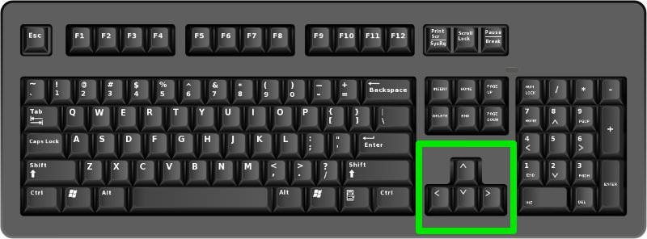
Lesson 1: Navigating the Presentation
Clicking the mouse will proceed to the next slide, along with hitting the Right (or forward) arrow key – hitting the Left key will send you backwards.
Some text will only appear after being prompted by a click or hitting the forward arrow key.
Remember to go through slides at a steady pace so you don’t miss any information or skip ahead prematurely!

Slide 4
Lesson 2: The Mouseover Glossary
The mouseover glossary functions like an interactive dictionary to help you become familiar with certain words and terms.
These terms will often be related to the field of entrepreneurship, such as a line of credit.
Terms will be highlighted with a pop-up definition and, if clicked, will lead you to the full glossary page.

Slide 5
GLOSSARY
Click on the word to go back to that slide.
Budget A budget is a cash flow road map where you predict the sources of cash as well as the ways in which you will use cash. This can be for your business on a monthly, yearly or longer basis. It can also be for a specific project such as building a new store. The important feature of a budget is to see if money coming in to the business coupled with cash reserves is able to cover expenses.
Line of Credit Banks as well as other lending institutions can offer a type of debt which allows you to take out funds up to your credit limit without having to make a request each time. You will have to make a minimum monthly payment, though. The interest rate on lines of credit is usually much lower than a credit card.
Budget Variance With budgeting, things never go exactly as planned. It is important to compare your predictions against the actual performance of your business as shown in your bookkeeping. It can point to dangers in the future if cash in flow is less than anticipated, or if your expenses are higher than you thought. You must then make some adjustments to make sure your business is healthy.

Slide 6
Lesson 2: The Mouseover Glossary
The mouseover glossary functions like an interactive dictionary to help you become familiar with certain words and terms.
These terms will often be related to the field of entrepreneurship, such as a line of credit.
Terms will be highlighted with a pop-up definition and, if clicked, will lead you to the full glossary page.
Now click (or hit the forward key) to advance!

Slide 7

Lesson 3: Instructional Videos
At a point in the presentation, a slide will appear with a link to a video with information relevant to the topic of the module.
These links will be highlighted and will appear as any other text in the presentation!

Slide 8

Instructional Videos
If, for whatever reason, you exited the video prematurely or want to re-watch it, it can be replayed by hovering your mouse on the video box in the top right hand corner, and clicking play on the bar that appears.
Once finished, there will be a short re-cap given of what the video was about to prepare you for the upcoming quizzes.
But in this case, since there are no real quizzes and we can all count backwards from 10, we’ll just continue with the presentation!

Slide 9
Lesson 4: Quizzes
Quizzes will be given in each module to test your knowledge of the subjects being taught.
They will be given in either True/False or multiple choice formats.
It is important to only navigate these sections by clicking the respective buttons –
skipping past them will result in a failure to complete the module and will likely make
you lost in the slides!
Examples of Buttons (do not click):
A. Answer A
B. Answer B
True
Click here to try again.

Slide 10
TRUE OR FALSE
The “True” button is coloured green.
True
False

Slide 11
Congratulations, you are correct!
Click here to continue.

Slide 12
Sorry. Please try again.
Click here to try again.

Slide 13
MULTIPLE CHOICE
What is the best way to deal with a difficult customer?
A. Call the police
B. Ask them to leave
C. Patience, friendliness, and good customer service
D. Distract them by telling the story of how your cousin fought off a polar bear with his hands
Remember to click specifically on the letter for these!

Slide 14
Congratulations, you are correct!
Click here to continue.

Slide 15
Sorry. Please try again.
Click here to try again.

Slide 16
Sorry. Please try again.
Click here to try again.

Slide 17
Sorry. Please try again.
Click here to try again.

Slide 18



Congratulations, you have completed this introduction module!

