Slide 1



Entrepreneur
Local Learning Centers

Slide 2



Seminar 4:
BUSINESS ENVIRONMENT
You can compare this next step to the eagle flying over its territory and viewing his surroundings from a broader angle. You analyze information to see what is coming ahead so you can properly prepare your strategies. The business environment breakdown will help you to identify openings and requirements and also verify and validate your business opportunity.

Slide 3

Who Are My Clients?
First thing first, you need to determine who are your customers and if you have a sufficient number of potential customers on the targeted market.
• Who are my clients: Consumers, Business or the Government?
• Where do they live or are located? How many are there in the territory targeted?
• Can the targeted client afford my products/services?

Slide 4

Who is My Competition?
You also need to be able to describe your competition.
How many other companies provide the same solutions?
Who are my primary competitors?
How I am different or better than my competition?

Slide 5

Who are my Suppliers?
And now, who will help you?
Who will provide me with resources such as tools, raw materials and inventory I need?
Who will help me with storage, delivery, handling that I need to reach/serve my clients?
Are they affordable? Are they available and easily accessible?

Slide 6

What Are The Rules And Policies In My Territory?
These will be outlined in a future info-sheet. In this segment we intend to identify the different levels of government and local administration that legislate and regulate the business community in your territory.
What are the regulations and laws (federal, provincial or municipal) that apply to my sector of activity?
Is there Small Business Support Program?
And am I eligible for these programs?

Slide 7

Who Are My Partners/Network?
Do you have potential allies? Anyone starting their own business needs to know where to get help. By creating a list of contacts, you set up a support network. Surround yourself with people you can ask for advice on the responsibilities and challenges you will face in your business.
Are there any business networks in my area? Who are they? What are their assignments and role in my project?
  How can they help me to reach my goal?
  Is there anyone who can mentor you and your business?

Slide 8


What Are The Available Technologies?
There are a large number of technologies that small businesses need such as the internet, a computer, a scanner, etc. Even if you cannot afford the latest technology, you still need to ask yourself:
What are the latest technologies used in my sector?
Is it easy to access theses resources and technologies locally?

Slide 9

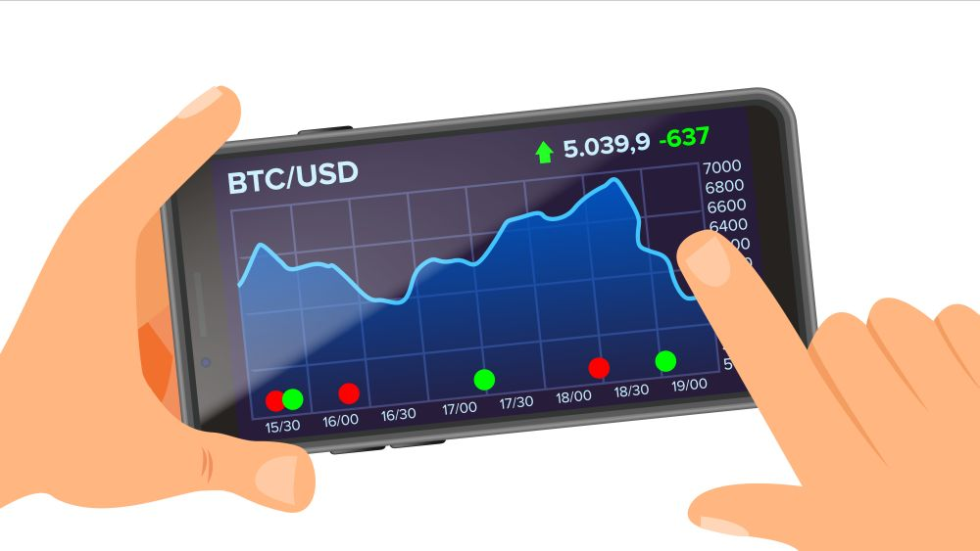
What Are The Market Or Industry Trends?
You also need to examine the past, present and future growth of your industry.
Was my sector growing in the last past years?
How will it be in 5 years?
How is it doing now?
Is there a high seasonality of demand?
To help you, sector studies are available on government websites.

Slide 10


Are There Any Social And Cultural Factors I Need To Consider?
It is key to have a good understanding of the potential customers who may buy the products or services. This will help you build the best marketing and communication strategies.
You can use surveys in person or online to gather information on your client profile, It’s also a good way to introduce your business project and promote your goods and services.
Continued on next slide…

Slide 11
Are There Any Social And Cultural Factors I Need To Consider?
How old are they? If a business, how long they have been active?
What is their average income? Can they afford my products?
What is their occupation/work?
What is their cultural heritage/ethnicity?
What language do they use at work or at home?
What is the average household revenue or business size?
Do they have access to the internet? Do they use social media, and if they do which are the most popular?
Do they buy from my competition on the internet, in local stores or elsewhere?
What are their foremost motivations, challenges or fears? For example: Family, safety, subsistence, health, spirituality, welfare, social standing or time management, food safety, product quality, products, and services accessibility or the cost of living.

Slide 12

What Is A Client?
Both customers and clients can buy goods and services from you. But did you know you build different kinds of relationships with customers and clients?
Here you will learn some of the differences.

Slide 13

Defining A Client
Client: Someone who buys goods or pays for services.
A client is similar, but not the same as a customer. A client can also be a company or other organization.
Example:
The Difference:
A customer buys a cup of coffee from a café. The café itself is a client of the coffee supplier, as there is an arrangement for the supplier to deliver coffee in bulk to the café at a set rate.
Clients have an arrangement with the seller, whereas customers don’t.

Slide 14
SELF-EVALUATION
Which of the following is a NOT a customer of your business?
Click the correct letter to continue.
A. You have a corner store – the people who buy milk from you
B. You sell office supplies – the companies who buy regularly from you
C. You have a restaurant – the people who eat often at your business
D. You have a hotel – guests who stay there once and a while

Slide 15
Congratulations, you are correct!
Click here to continue.

Slide 16
Sorry. Please try again.
Click here to try again.

Slide 17
Sorry. Please try again.
Click here to try again.

Slide 18
Sorry. Please try again.
Click here to try again.

Slide 19

What is Business Networking?
We all network in our lives, whether with friends, family, people having the same interests, etc. The following video will help you learn what business networking is, and what it is not.

Slide 20

The Many Faces of Business Networking
It’s easy to get overwhelmed by the many potential definitions of business networking.
When considering networking, it’s helpful to keep in mind:
- That when we give first things will happen to us
- It’s how we approach business networking that makes it work for us
Business relationships are a two-way street. When we think of networking and building these relationships, we should think of making them mutually-beneficial.

Slide 21

Successful business marketing is when I . .
A. Hand out lots of business cards
B. Get what I want and then move on
C. Establish a mutually-helpful relationship
D. Pick up lots of product catalogs

Slide 22
Congratulations, you are correct!
Click here to continue.

Slide 23
Sorry. Please try again.
Click here to try again.

Slide 24
Sorry. Please try again.
Click here to try again.

Slide 25
Sorry. Please try again.
Click here to try again.

Slide 26

How to Network in Business – 5 Networking Tips
Business seminars, trade shows and other get-togethers are rich opportunities to introduce yourself, your business and learn what prospective clients may need.
This short video will explain some of the techniques to make the most of these opportunities.

Slide 27
The 5 Ups of Networking
1.
Show Up
Be fully present during an interaction - give the person you’re speaking with your full attention.
2.
Listen Up
Don’t wait for the other person to finish talking just so you can start.
3.
Network Up
4.
Speak Up
It’s important to be personable and a conversationalist. For topics to start a conversation with, remember FORD: Family, Occupation, Recreation, and Dreams.
5.
Link Up
Consider getting on LinkedIn. Everyone’s on for the same reason – to network professionally. Staying connected is an important aspect of today’s business environment.
Look for possible mentors in your field and build a relationship with them.

Slide 28
SELF-EVALUATION
When networking at a trade show, it is important to :
A. Pitch your product or service right at the beginning
B. When talking to someone uninteresting, look around for better people to talk to
C. Tell lots of jokes – people like funny people
D. Listen closely to what the other person is saying

Slide 29
Congratulations, you are correct!
Click here to continue.

Slide 30
Sorry. Please try again.
Click here to try again.

Slide 31
Sorry. Please try again.
Click here to try again.

Slide 32
Sorry. Please try again.
Click here to try again.

Slide 33
GLOSSARY
Click on the word to go back to that slide.
Client Your clients are the people or businesses you will be selling to on a regular organized basis. Customers, on the other hand, are people who purchase your goods or services, but not in an organized basis. For example, someone who comes in your store to buy an apple is a customer, but someone who buys a case of apples a week on a regular basis is a client.
Competition Your competition are those businesses which, potentially, can sell to the same clients as you. For this reason, it is important to make your business offerings different from them – either product selection, price, better service, etc. Please note that with the Internet and e-commerce, your competition could be anywhere in the world.
Consumers These are people or businesses which could purchase your products or service. They are potential clients.
Mentor Every business needs advice both when starting out or planning an expansion. Mentors are individuals who are willing to give you the benefit of their experience, to help and advise you to make the right decisions. Typically, mentors aren’t paid for their help – they do this out of generosity to help other businesses. Don’t be shy to ask other business owners for help and advice – most would be flattered by this.

Slide 34



Congratulations, you have completed this module!
The next Module will be: Legal Aspects

