Slide 1


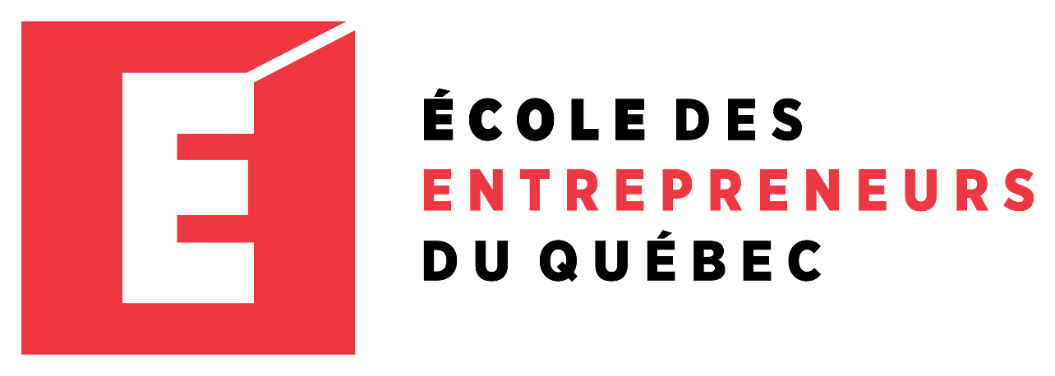
Entrepreneur Local Learning Centers

Slide 2



SEMINAR 5: LEGAL ASPECTS
There are a lot of legal obligations to be aware of when starting or managing a business. Some matters will need a lawyer or accountant, but the more you know, the more self-sufficient you are.
Carefully read these legal essentials and start exploring their impacts

Slide 3
Forms Of Organization Ownership
These are the most common forms of business organizations in Nunavik.
Sole Proprietorship is the simplest and cheapest of all. You can operate your business under your personal name or register a business name at REQ*. You will be personally responsible for any debt. As well, any profit or loss has to be reported on your personal income tax form.
General Partnership needs a verbal or written contract between the partners (2 or +) and be registered at REQ¹. The partners are both liable for the enterprise’s obligations. Any profit or loss must also be reported on each partner’s income tax form in proportion of their partnership share.
Business Corporation is a separate legal ”person.” It is more complicated and costs more but it has advantages for larger businesses. You can incorporate with the Provincial or Federal government. As owners you will have shares of the company and your responsibility is limited by the money injected in the business.
Cooperative is also a legal person. The members share common economic, social and cultural values and operate the business accordingly. The liability is limited to the value of the shares.

Slide 4
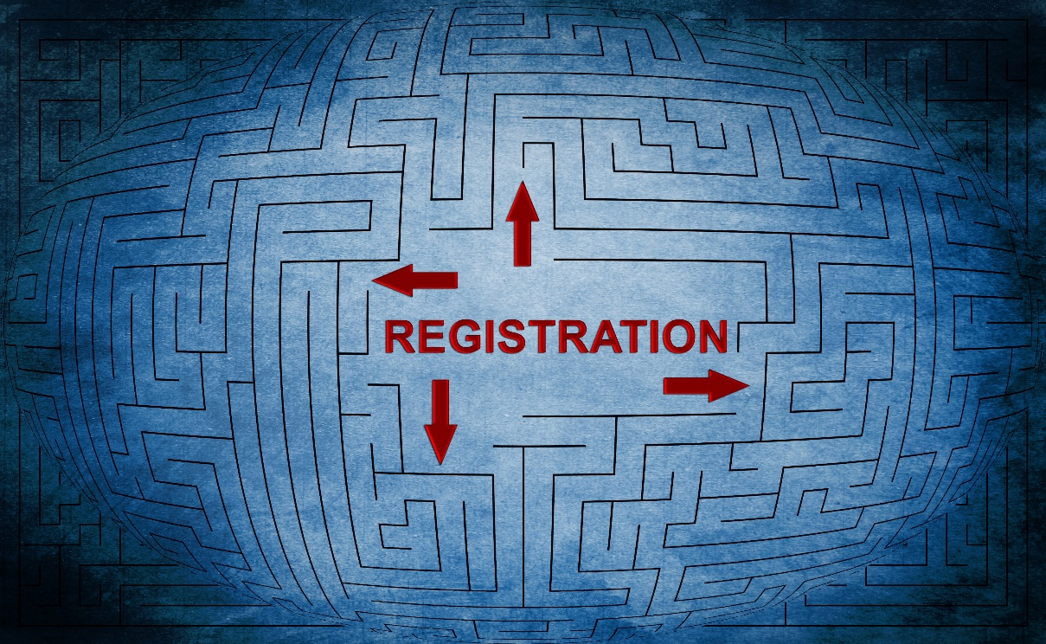
How Do I Register My Business?
It is done at the REQ¹ by filling a declaration of registration. The fees in 2019 are $35 for a Sole Proprietorship, $53 for General Partnership and $35 for a Cooperative. The Quebec incorporation fees are $337 and the federal² fees are $250. Cooperatives incorporated in Quebec must first apply to the Minister of Economy, Innovation and Export.

Slide 5
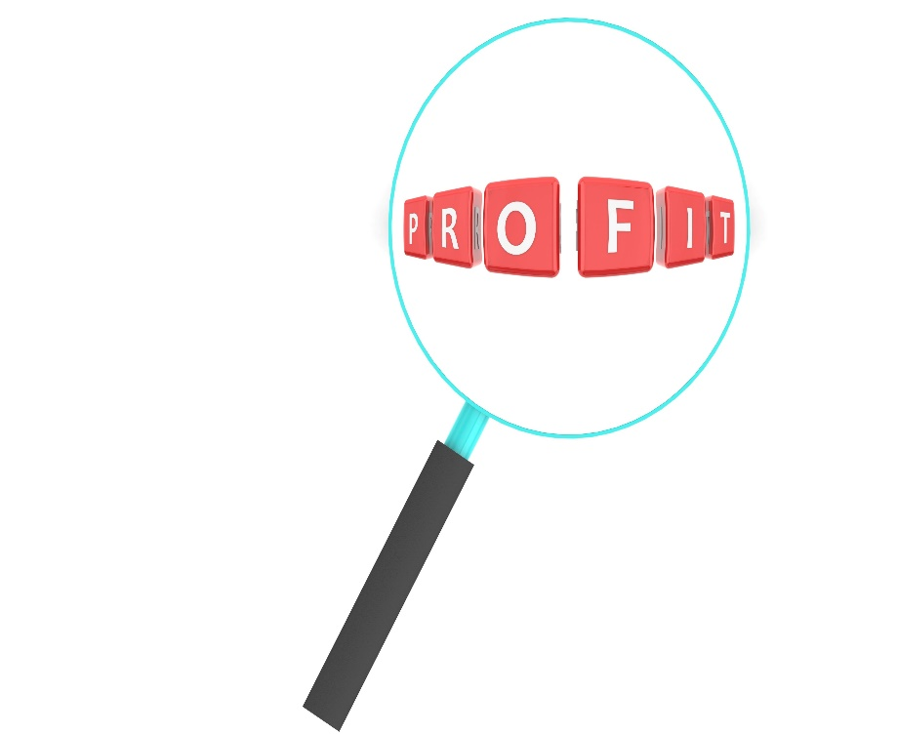
When Do I Need To Incorporate My Business?
Consider incorporation if your business has net profits of over $100,000 per year. There are more things to consider but think of this is as a tipping point.

Slide 6

What Permits, Licenses Or Certifications Do I Need?
Depending on what you do, some permits, licenses and certifications might be required. For example, if you sell tobacco, alcohol, firearms, ammunition, tires, etc. you will require a special permit.
Tools to Succeed:
Search on the internet for general and specific government information about your activities³.

Slide 7

Why Do I Need Insurance?
Insurance could cover you in the event of liability claims or other damages. Without insurance, you would have to pay yourself if recognized responsible.

Slide 8

What Is Intellectual Property?
Also known as IP, it can protect your business inventions and ideas.
Patent protects an invention for 20 years but costs a lot of money.
Industrial design protects distinctive design characteristics.
Copyright protects automatically an original artistic creation.
Trademark protects a name, a logo associated with a product or a service. You need to register it to the CIPO⁴.

Slide 9

Which Laws Apply To Me?
Every municipal, provincial and federal laws apply to you. Contact your local northern village concerning things like zoning, hours of operation, business permits, etc. Also, if you operate from a building which you own, you will have to sign a land lease agreement with your local Landholding Corporation.
Tools to Succeed:
Your business has the same laws to respect in addition to the agreements and contracts you agree to.

Slide 10

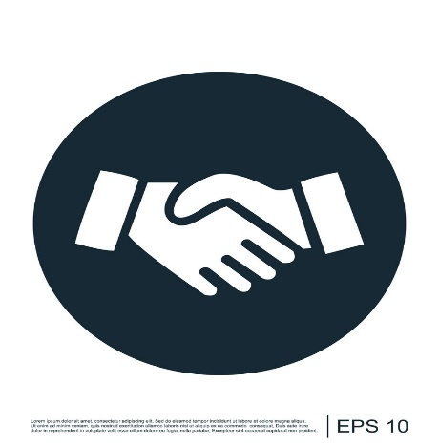
What Is A Contract?
It is a legal obligation between two parties to achieve specific acts such as pay the agreed price, provide a service or pay the employee’s salary.
Tools to Succeed:
There are different types of contracts: Express, Implied, Under Seal and simple contract. Most contracts are under seal, meaning: formal, written, signed before a witness and marked with a seal. You can use a template to be sure to cover the basics5.

Slide 11
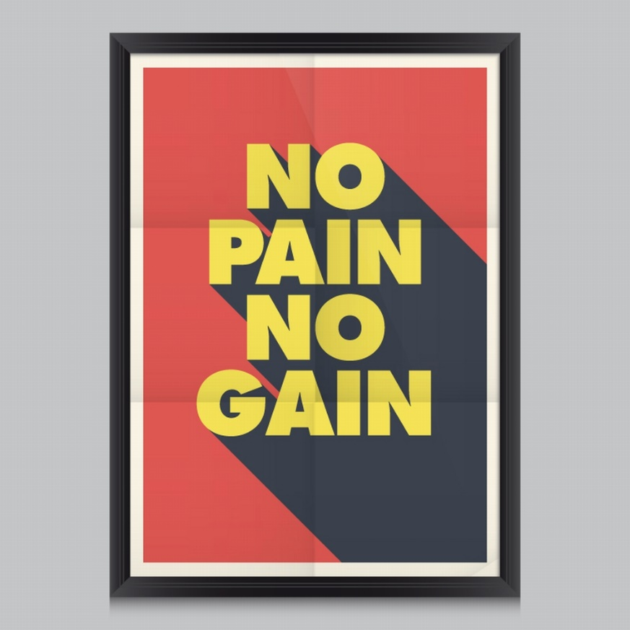
Forms Of Business Ownership
This video examines the four types of business using pretend entrepreneurs for each one. Pros and cons of each business type are also discussed.

Slide 12

Pros and Cons
Sole Proprietorship Advantages
Ease of starting and ending a business
You’re the boss
Retention of company profits
No Special taxes
Disadvantages
Unlimited liability
Limited financial resources
Management difficulties
Limited growth and life span
Corporation
Advantages
Limited liability
Ability to raise more money
Perpetual life
Separation of ownership from management
Disadvantages
Initial cost
Extensive paperwork
Double taxation
Conflict with stockholders and board of directors
Partnership
Advantages
Financial resources
Greater chance of survival
Profits taxed as personal income
Disadvantages
Unlimited liability
Division of profits
Disagreements with partners

Slide 13
SELF-EVALUATION
Which form of business has shareholders?
Click the correct letter to continue.
A. Sole Proprietorship
B. Partnership
C. Cooperative
D. Corporation

Slide 14
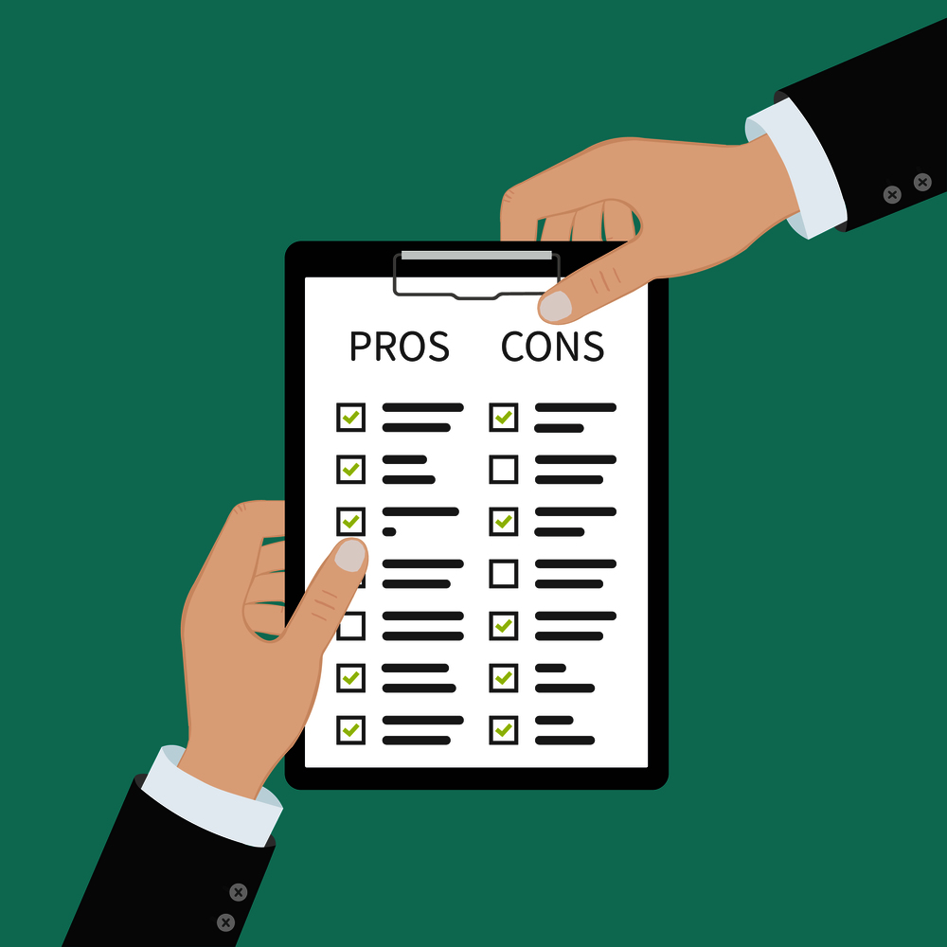
Types of Businesses
This segment also covers much of the same ground as the previous one. It gives real examples of each form, as well as listing the advantages and disadvantages of each.

Slide 15
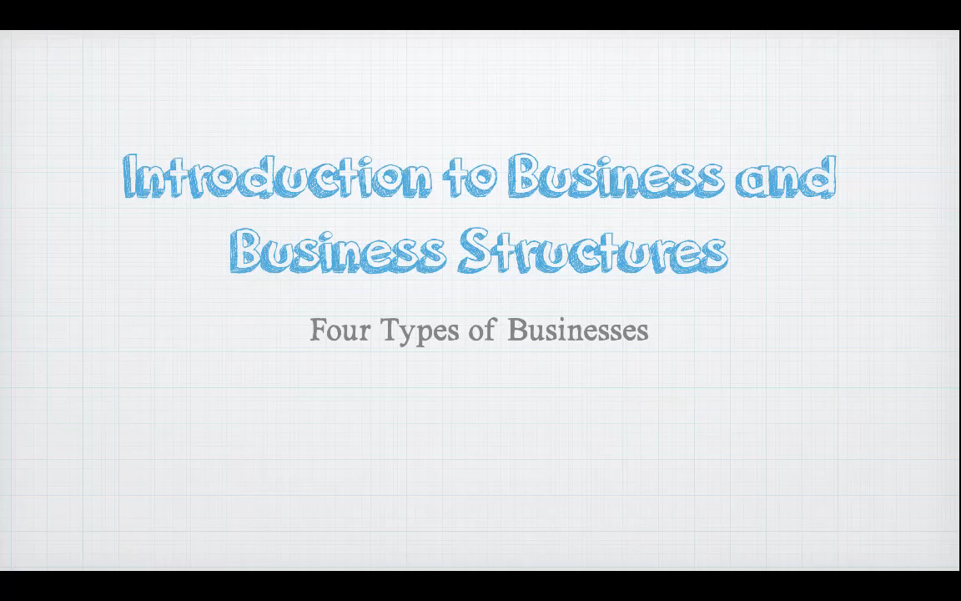
What’s The Difference?
Corporation
A company or group of people authorized to act as a single entity (legally a person) and recognized as such in law.
Partnership
An arrangement where parties agree to cooperate to advance their mutual interests.
Cooperation
A business or organization owned and operated for the benefit of those using the services.
Sole Proprietorship
Unincorporated and run by one individual with no distinction between the individual and the business.

Slide 16
SELF-EVALUATION
Which form provides the best protection against loosing personal assets?
A. Sole Proprietorship
B. Partnership
C. Cooperative
D. Corporation

Slide 17

What Is A Contract?
We tend to think of contracts as huge documents full of fine print and strange words.
However, this video breaks a contract down into its simple basic elements.

Slide 18
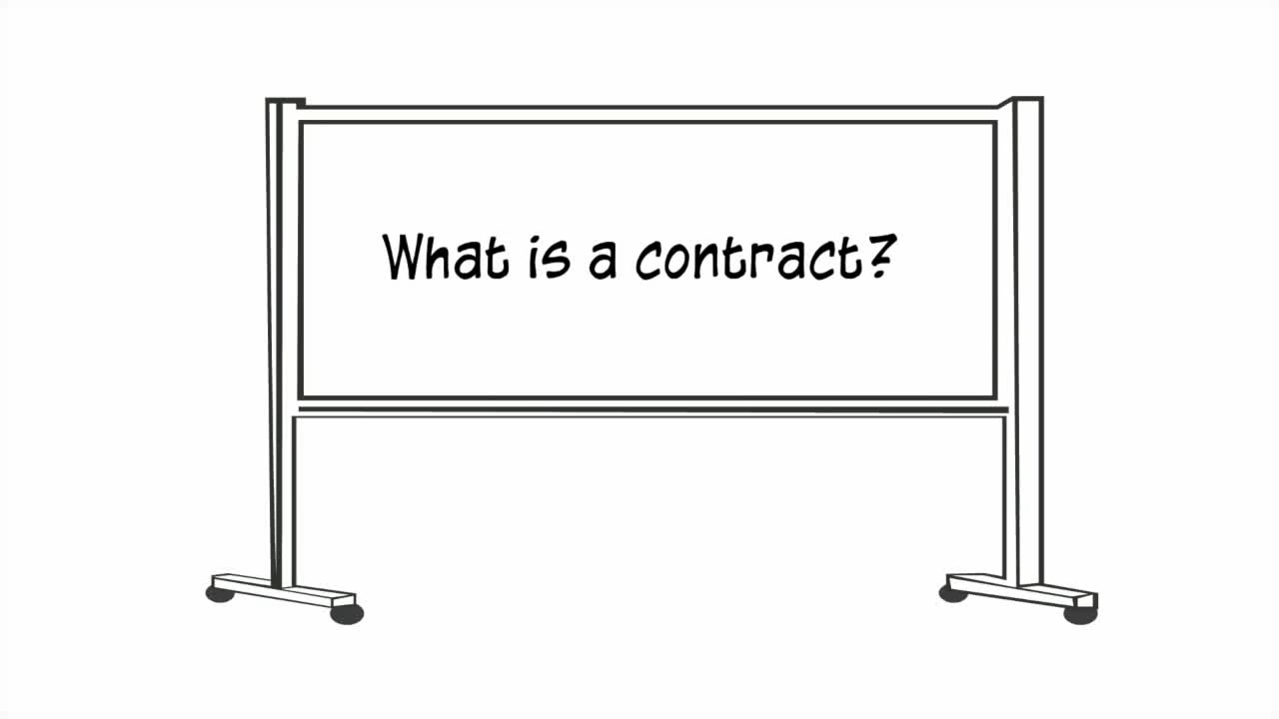

Slide 19
The Ins and Outs of Contracts
Contracts are like promises, but in the business world, liability enters the process if a contract is broken – at which point an agreement can be forced in a court of law.
Three Elements of a Contract
Offer
Acceptance
Consideration
Offer and acceptance is the mutual agreement to enter into a deal
Consideration means that the exchanging parties are giving and getting something.

Slide 20
SELF-EVALUATION
In a contract, what does “Consideration” mean:
A. The parties will act nice towards each other
B. What the parties will be giving and getting
C. The consequences if one party does not live up to their side of the deal
D. How much you will pay a lawyer for drawing up the contract

Slide 21
TRUE OR FALSE
I’m selling prepared meals from my home, I don’t need to register my business?
True
False

Slide 22
TRUE OR FALSE
All my client pays cash, I don’t need a contract or an invoice?
True
False

Slide 23
GLOSSARY
Click on the word to go back to that slide.
Partnership Share A partnership is when two or more people (or companies) enter into an agreement to operate a business together. The percentage of that business which is owned by each partner is called the partnership share. Often, when two people are involved, there is a 50/50 split of the business; however, there can be many other scenarios such as 51/49 or 67/33. It is important to get expert advice as the the partnership share when drawing up the partnership agreement.
Intellectual Property Things like designs, inventions, slogans, etc. are not physical things, but they do have a value. They are known as intellectual property. For example, if you design a widget and allow a company to manufacture or market them, they will have to pay you a royalty on each item produced. Alternatively, you can sell your widget design for a fixed price to that company, in which case you agree to give up any future royalties for a lump sum. This is a very complicated area of business law, so seek expert advice.

Slide 24
Congratulations, you have completed this module!
The next Module will be: How to Sell

Slide 25
Congratulations, you are correct!
Click here to continue.

Slide 26
Sorry. Please try again.
Click here to try again.

Slide 27
Congratulations, you are correct!
Click here to continue.

Slide 28
Sorry. Please try again.
Click here to try again.

Slide 29
Congratulations, you are correct!
Click here to continue.

Slide 30
Sorry. Please try again.
Click here to try again.

Slide 31
Sorry. Please try again.
Click here to try again.

Slide 32
Sorry. Please try again.
Click here to try again.

Slide 33
Congratulations, you are correct!
Click here to continue.

Slide 34
Sorry. Please try again.
Click here to try again.

Slide 35
Sorry. Please try again.
Click here to try again.

Slide 36
Sorry. Please try again.
Click here to try again.

Slide 37
Congratulations, you are correct!
Click here to continue.

Slide 38
Sorry. Please try again.
Click here to try again.

Slide 39
Sorry. Please try again.
Click here to try again.

Slide 40
Sorry. Please try again.
Click here to try again.

