Slide 1



Entrepreneur Local Learning Centers

Slide 2



SEMINAR 7: WHAT ABOUT SALES TAXES (GST AND QST)?
If you are selling goods or services, you become an important player in the economic system.
“As a vendor of taxable goods or services, you are required to bill and collect the GST and QST and remit any amount of tax collected to Revenue Québec. In Québec, the goods and services tax (GST) and the Québec sales tax (QST) are collected on supplies of most property and services”*

Slide 3
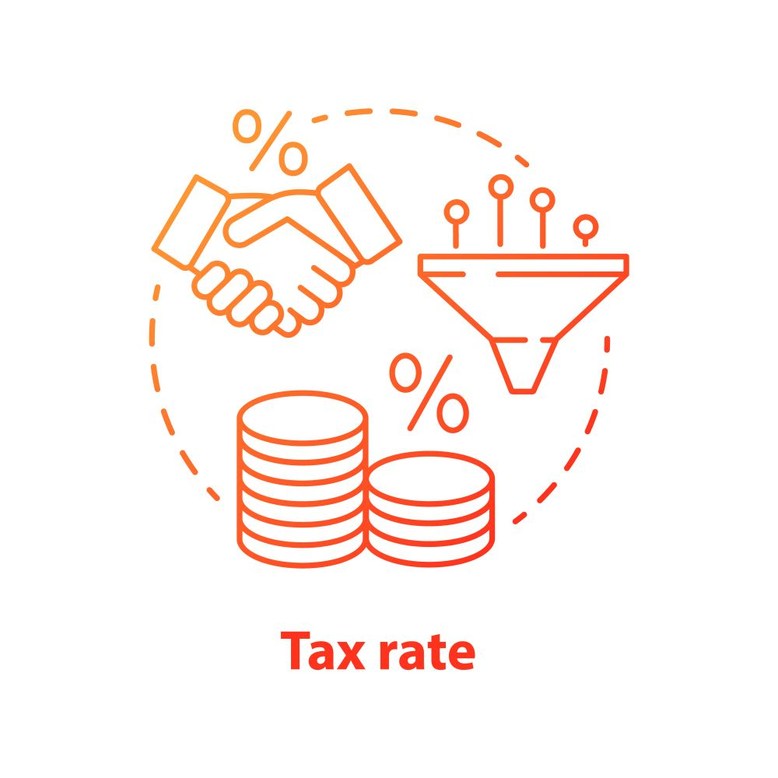
GST / QST Rates
The goods and services tax (GST), which is calculated at a rate of 5% on the selling price.
The Québec sales tax (QST), which is calculated at a rate of 9.975% on the selling price excluding the GST.

Slide 4
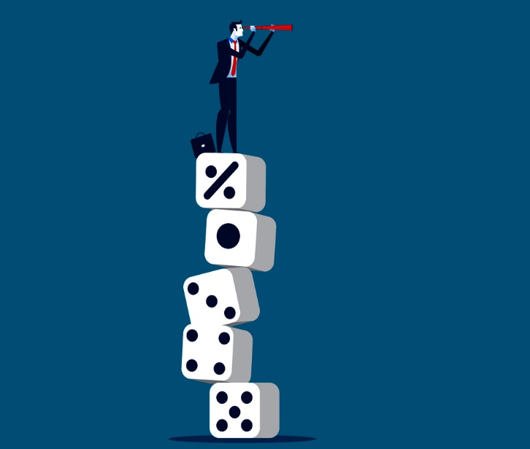
Register For And Collect The GST And The QST
“As a rule, you must register for the GST and QST if you carry on commercial activities in Québec”.
Specifically, you must register for and collect the GST and the QST if:
Your total sales exceed $30,000 in a calendar quarter in the four preceding calendar quarters;
You operate a taxi or limousine business.

Slide 5
Zero Rated Supplies
You do not have to collect sales taxes on certain goods and services you sell. Some of these are called zero-rated supplies, in other words, the tax rate is 0%. Here are some examples:
sales of certain prescription drugs;
sales of certain medical devices;
sales of basic groceries;
sales of certain properties used in the farming and fishing sectors;
sales of certain goods that are marketed exclusively for feminine hygiene purposes;
sales of certain goods or services exported outside Canada, or outside Québec, for QST purposes (for more information, refer to Exports);
the provision of certain passengers or freight transportation services;

Slide 6

Exempt Supplies
Some other goods and services are exempt from sales taxes. These include:
the lease of a dwelling for one or more months;
the provision of most health, education, childcare and legal-aid services;
the provision of certain services by public sector bodies (that is, governments and public service bodies);
the provision of most financial services.

Slide 7


How To Do It Right?
A cash register, or a computer with a Point of Sale (POS) software or web service, will keep track of all transactions and calculate GST and QST automatically for you.
It is very important that you maintain a good bookkeeping and accounting to pay what is due to RQ and CRA in time. The government agencies have to authority to seize your bank account if you forget or make errors on your remittances.
To help you in this task, consider using the agency’s online services and refer to Info-Sheet 5.6 Bookkeeping and accounting for more information.

Slide 8

Plus De Temps Pour Vos Affaires!
This very short video reveals some of the time-saving measures through dealing with Revenu Quebec at its on-line portal “Mon Dossier pour les Affaires”. You can report and make payments for sales taxes, as well as many other reports.

Slide 9
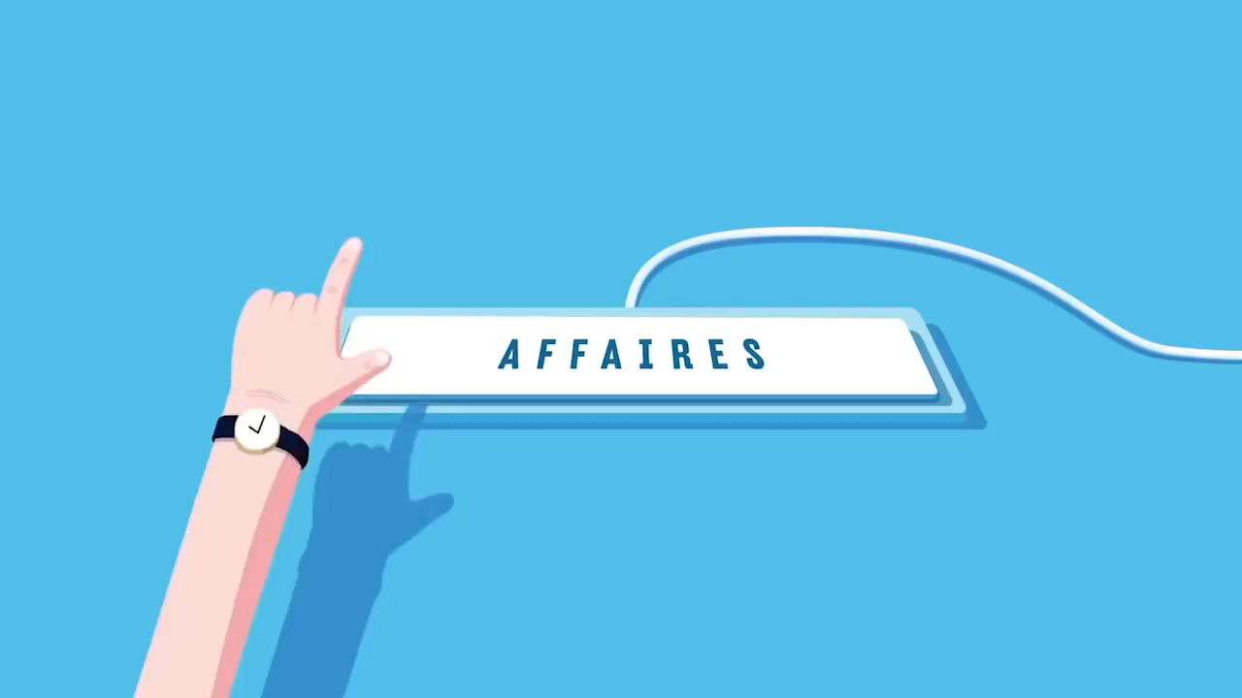

Online Tools To Help Your Business
“Mon Dossier Pour les Entreprises” helps you save time by performing certain actions. These include:
Tax returns
Online payments
Access to your fiscal profile
Creating notices

Slide 10
SELF-EVALUATION
What can you do on “Mon Dossier Pour les Affaires”?
Click the correct letter to continue.
A. Report a Record of Employment (ROE) for Employment Insurance claims
B. Make a sales tax payment
C. Apply for personal GST credits
D. All of the above

Slide 11
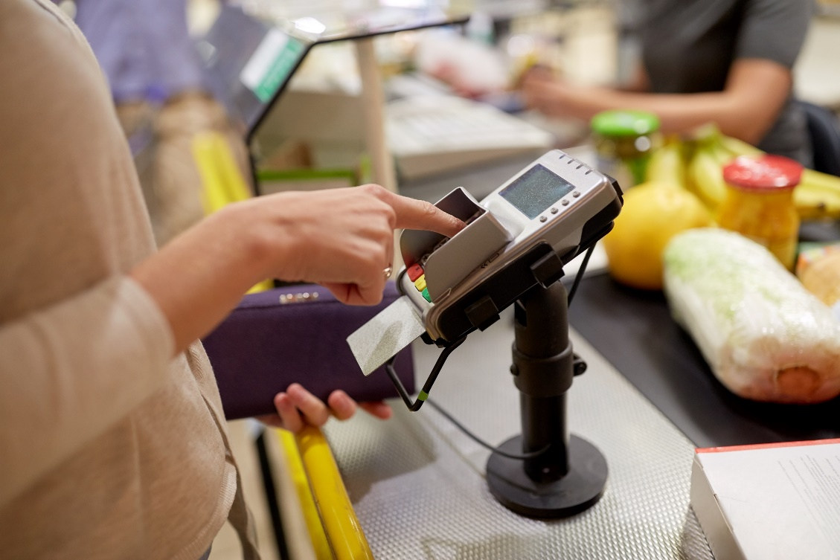
What Is POS? Definition Of POS Systems
This Info-sheet makes reference to Point of Sales systems.
Here we learn what makes up these digital systems and how powerful they could be in your enterprise. We apologize for the annoying soundtrack.

Slide 12

What Is POS?
POS = Point of Sales; i.e. the spot where transactions take place. POS System = the tool to do the transactions.
Hardware
Software
Additional Functions
- Screen - Barcode reader - Credit card reader - Receipt Printer - Cash Drawer
- Web POS - PWA POS
- Real time synchronization - Sales Management - Customer Management - Inventory Management
A POS system = Hardware + Software + Additional Functions

Slide 13

Point of Sales Systems can . . .
A. Calculate the amount of sales tax payable on an item
B. Alert you if someone is shoplifting
C. Automatically count the cash in the cash drawer
D. None of the above

Slide 14
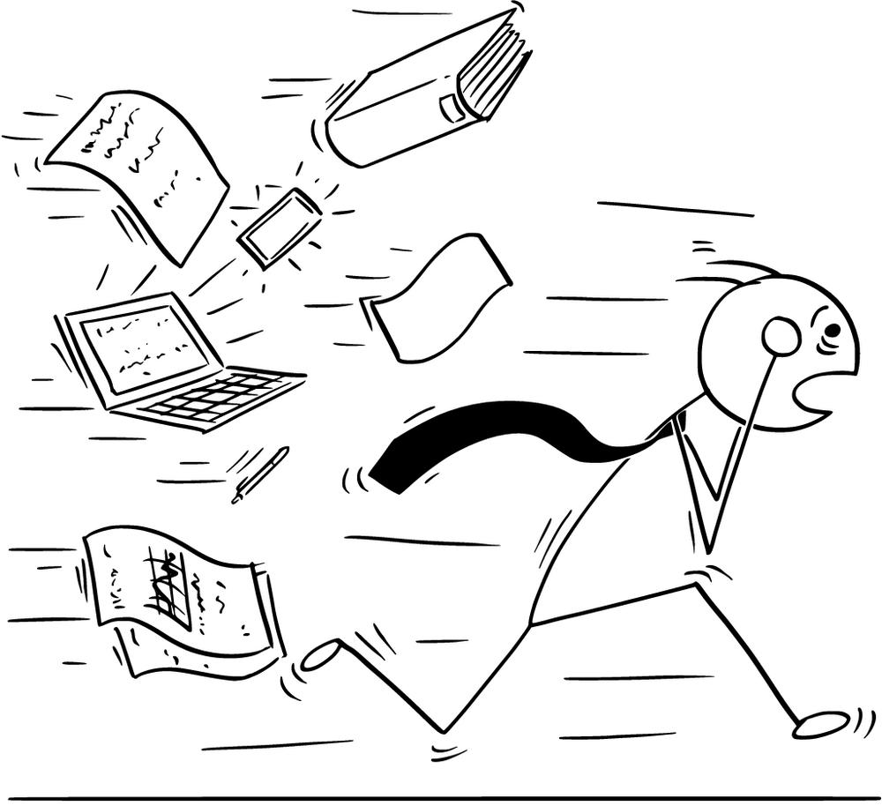
Keeping Your Business On Track
This video makes a very important point : you can’t run away from your sales tax and other business obligations.
They suggest making payment arrangements on line, or with a representative of the CRA. But once you do, you have to stick to your repayment schedule, as well as paying interest on your debt.

Slide 15

Advice To Stay On Track
Over time, unpaid debt accumulates interest. To avoid having debts grow larger, it is important to:
Maintain a regular payment plan
Always file on time
Stay up-to-date with tax obligations
This formula makes it less likely for the Canadian Revenue Agency to have to take take firmer steps, such as seizure of income or assets, or legal fees.

Slide 16
SELF-EVALUATION
Why should sales tax remittances be paid on time and in full?
A. The government really needs the money for its day-to-day operations
B. It is not your money anyways; you are holding it in trust for the government
C. It messes up the government’s computer accounting system if not paid on time
D. CRA employees are paid a commission on late sales taxes collected

Slide 17
TRUE OR FALSE?
Since I’m selling services and not goods, I don’t need to charge QST and GST.
True
False

Slide 18
TRUE OR FALSE?
I’ve sold for 15 000 $ of goods in the month of may 2019, then in June and also July 2019 I sold 20 000 $;therefore I don’t need to register for QST and GST.
True
False

Slide 19
GLOSSARY
Click on the word to go back to that slide.
Vendor The word “vendor” literally means “seller”, so the company which sells you goods or services is a vendor. Vendors are also known as suppliers.
Calendar Quarter It is common practice to divide the business year into four 3-month periods. These 3-month periods are called quarters (ex: January, February and March)..
Taxable Goods When you sell, not all products and services are charged sales taxes. There is a long list of products exempt from sales taxes, such as many groceries, medical services, etc. Taxabie products or services are those you must charge federal goods and services tax and Quebec sales tax.
Point of Sale For retail businesses and many service businesses the point of sale is where the customer pays, usually before leaving the store. There are machines such as cash registers where you can add up the purchase items, and have sales taxes added automatically. Some businesses have a computer which does the same function. The important thing is that all transactions are recorded (this is a legal requirement). The point of sale devices also provide sales and sales tax summaries.
Remit To remit means to send money in payment. This term is most often used with moneys sent to the Canadian Revenue Agency and Revenue Quebec for sales taxes and employee deductions. These are also called “remittances”.

Slide 20
Congratulations, you have completed this module!
The next Module will be: Considerations in Setting Your Prices

Slide 21
Congratulations, you are correct!
Click here to continue.

Slide 22
Sorry. Please try again.
Click here to try again.

Slide 23
Sorry. Please try again.
Click here to try again.

Slide 24
Sorry. Please try again.
Click here to try again.

Slide 25
Congratulations, you are correct!
Click here to continue.

Slide 26
Sorry. Please try again.
Click here to try again.

Slide 27
Sorry. Please try again.
Click here to try again.

Slide 28
Sorry. Please try again.
Click here to try again.

Slide 29
Congratulations, you are correct!
Click here to continue.

Slide 30
Sorry. Please try again.
Click here to try again.

Slide 31
Sorry. Please try again.
Click here to try again.

Slide 32
Sorry. Please try again.
Click here to try again.

Slide 33
Congratulations, you are correct!
Click here to continue.

Slide 34
Sorry. Please try again.
Click here to try again.

Slide 35
Congratulations, you are correct!
Click here to continue.

Slide 36
Sorry. Please try again.
Click here to try again.

