Slide 1



Entrepreneur Local Learning Centers

Slide 2



Seminar 11: HOW TO OPEN A BANK ACCOUNT
As a businessperson, opening a bank account is important because it will allow you to grow your business, as well as pay for goods and services, and give your customer options of payment.
Are you thinking about opening a bank account?
You can consider the following:

Slide 3
What Do You Need?
Go in person to a financial institution if at all possible. This may be difficult for many businesses in Nunavik outside of Kuujjuaq: here you should phone the manager of the bank with which you want to do business to have the forms mailed to you.
Provide 2 forms of identification (original ID, not photocopies) such as:
Valid Canadian driver’s license (as permitted by provincial law)
Birth certificate issued in Canada
Old Age Security card issued by the Government of Canada
Certificate of Indian Status
Provincial or territorial health insurance card that can be used as ID under provincial or territorial law
Social Insurance Number (SIN) card issued by the Government of Canada
Passport
Continued

Slide 4
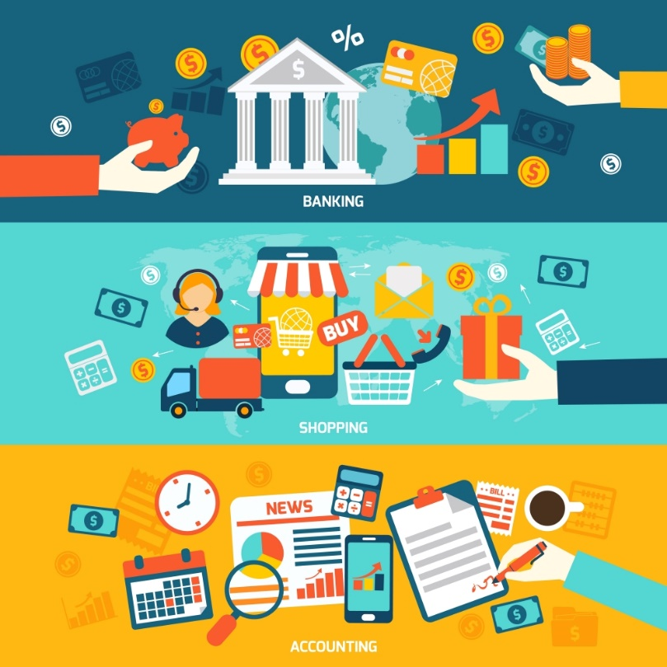
What Do You Need?
If you are opening an account for a corporation, you will need to provide a resolution from your board of directors stating who has signing authority and how many signatures are needed. You will also have to provide a copy of the corporation’s Lettre Patente issued by the government confirming the incorporation of your organization. The letters patent contains information about the corporation, such as its official name, purposes, the names of its first directors and its official address.
If you are opening an account for a sole proprietorship which has been registered with the Quebec government, you must provide a copy of your official Registration with your NEQ, (ten-digit numerical identifier assigned to each company that registers in the enterprise register)

Slide 5


Before Opening A Bank Account
Before opening an account ask yourself:
How will you use the account?
Charges or fees on the account
Interest you will earn on the money in your account
Make sure you understand all the terms, conditions and fees of the account before you sign up. Ask questions about anything that you don’t understand. Keep a copy of your account agreement for your records.

Slide 6

Where You Can Open A Bank Account
You can open an account at any financial institution, such as a bank, credit union, Caisse Populaire, or a trust company.
Pro Tip:
Choose your financial institution according to your needs and location.

Slide 7
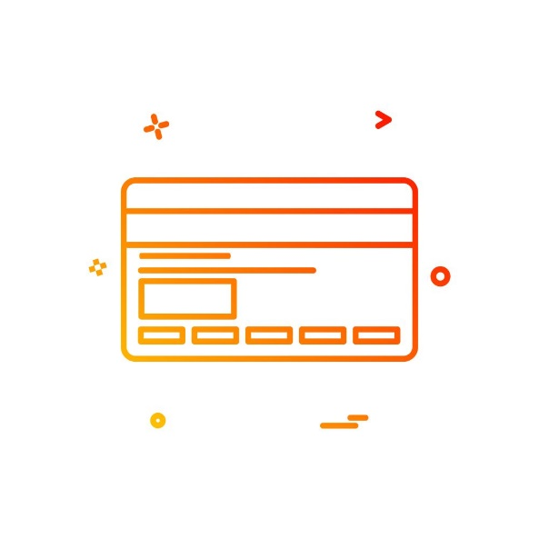
Acquire A Credit Card
Credit cards come with numerous benefits. First and perhaps most important, a wisely-used credit card will help you build your credit.
Beyond convenience, a credit card also gets you an interest-free loan for a grace period of 21 to 25 days.¹ In other words, any new purchases made within the period can be made interest-free until the payment due date. However, if you don’t pay your balance in full within the grace period, you’ll owe interest on your average daily balance. Canadian credit cards most often have a purchase interest rate of 19.99%. Therefore, make every effort to pay your entire balance each month.

Slide 8
Opening A Paypal Account
PayPal is an online financial service that allows your customers to pay with a credit card, e-check or their PayPal balance. Therefore, your clients/customers don't need to register aPayPal account to pay you.
What do I need to open a PayPal business account?
Valid email address
Customer service information
Business address and phone number
Bank name
Business or personal bank account number
Bank routing number
Pro Tip:
It normally takes 3 to 5 days to complete the verification process and to finalize the account set up. PayPal's fees are less than many merchant accounts (currently 2.9% + $0.30 USD for debit and credit card purchases).

Slide 9
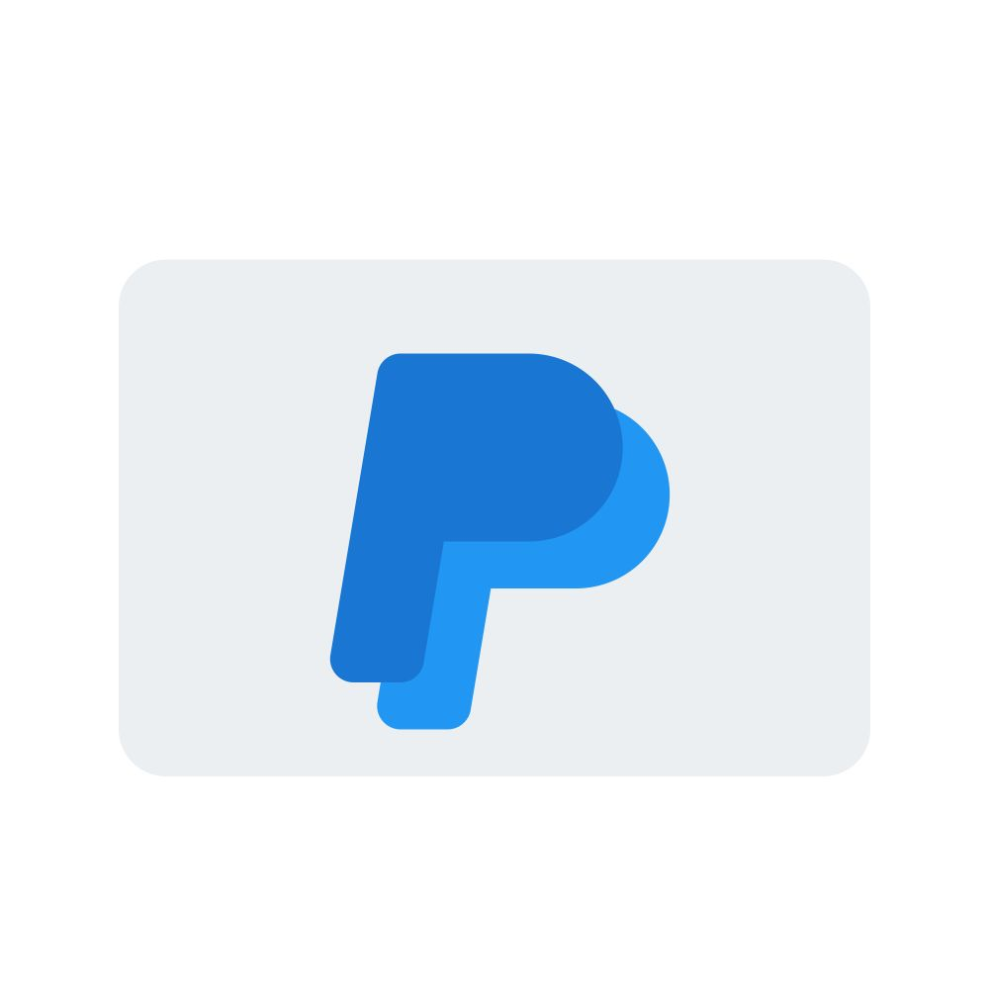
What is PayPal and How Does it Work?
If your business is considering e-commerce, that is, selling and receiving payments on-line, you may want to consider using Paypal.
This video gives an overview of how Paypal works from both the buyer’s and seller’s point of view.
Other examples of payment include google pay, E-transfers and EMT

Slide 10

Introduction To Paypal
What is Paypal, and how does it work?
But there’s more to it…
Simply put, Paypal is a way to send and receive payments.
Seller’s Side
Buyer’s Side
There are many different formats Paypal offers to integrate onto your website to receive payments as a seller. It’s a simple and fast method that can be accomplished through a variety of ways. All payments drop into a single account – your Paypal account – and the money is typically available instantly. Including Paypal as an payment option is important, as many buyers appreciate the choice.
Treat it like a digital wallet by connecting your debit and credit cards, and multiple bank accounts from online institutions. With Paypal, payments are protected from inside this digital wallet – when you make a payment, a seller only gets your name, email, and shipping address if required. All sensitive banking information is kept private.

Slide 11
SELF EVALUATION
Which of the following is true?
A. Paypal does not pass any account number, access code or password to the seller
B. Paypal charges the buyer a fee on each transaction
C. You can only associate one bank account or credit card with your Paypal account
D. Paypal pays the seller at the end of each month

Slide 12
Congratulations, you are correct!
Click here to continue.

Slide 13
Sorry. Please try again.
Click here to try again.

Slide 14
Sorry. Please try again.
Click here to try again.

Slide 15
Sorry. Please try again.
Click here to try again.

Slide 16

QUESTIONS TO THINK ABOUT
I work from home; I don’t need a bank account?
I only sell online; my clients are required to have access at PayPal.

Slide 17
GLOSSARY
Click on the word to go back to that slide.
Resolution A resolution is a corporate document where the directors, shareholders or members make a formal decision. It usually contains the reasons behind the decision (the “Whereases”) and the terms of the decision (the “That’s”). It also shows the results of the vote on the decision, and the date. Banks require signing resolutions authorizing certain individuals to sign cheques, make payments, etc.
NEQ You can find this number on your Letters Patent or registration document. It is very important – it is very important to include your NEQ in all dealings with the government.
Credit Union A credit union is a bank owned by its members (those having accounts), rather than shareholders. It is in the form of a cooperative. The Caisses Populaires of Desjardins are credit unions. If your credit union makes a surplus, you may get a dividend from that surplus.
Trust Company This is a smaller type of bank which concentrates on holding funds on behalf of an individual or company. Many trust companies do offer commercial banking services, such as chequing accounts, deposit accounts, etc. Examples are the Manulife Bank and Canada Trust.
On-line financial service This allows an individual or business to do many banking transactions using the internet. This includes paying bills, money transfers, account reconciliation, etc. Almost all financial institutions offer on-line financial services. It is also possible to apply for a loan, credit card and guaranteed investment certificates (GICs) on-line.

Slide 18
Congratulations, you have completed this module!
The next module will be: Cash Flow Management

