Slide 1



Entrepreneur Local Learning Centers

Slide 2



SEMINAR 12: HOW TO HANDLE LOONIES & TOONIES
In business, there are many different forms of cash. However, here we are talking about paper and coins.
Here are some good practices on how to manage cash:

Slide 3

Deposit Money At Coop Store Or Northern Store
Have a local merchant convert your cash into a cheque. Most banks allow you to deposit your cheques on-line which your smartphone or tablet.
You can also send the cheque by mail to your bank, but it will take longer to get it in your account and there is a risk of losing it in mail transfer.

Slide 4

WE Cards
Northern Stores throughout Canada can transfer your money on a WE prepaid credit card.
You can then use the card to pay suppliers.

Slide 5

Bank Account
Systematically return cash to the bank when the funds reach a predetermined amount. It can be every few days or once every two weeks. This, however, only works if you will be near your bank.

Slide 6
Protect Cash
Use a safe or lockable cashbox
Ensure that the amount of cash held in cash does not exceed the amount insured
Make payments by cash only on presentation of an invoice. Keep the receipts.
Print out a daily cash register receipt of your sales.
Balance your cash daily: opening balance + cash sales – cash paid out = closing balance.
Limit the number of people that handle cash
Count in private,away from the public or employees

Slide 7
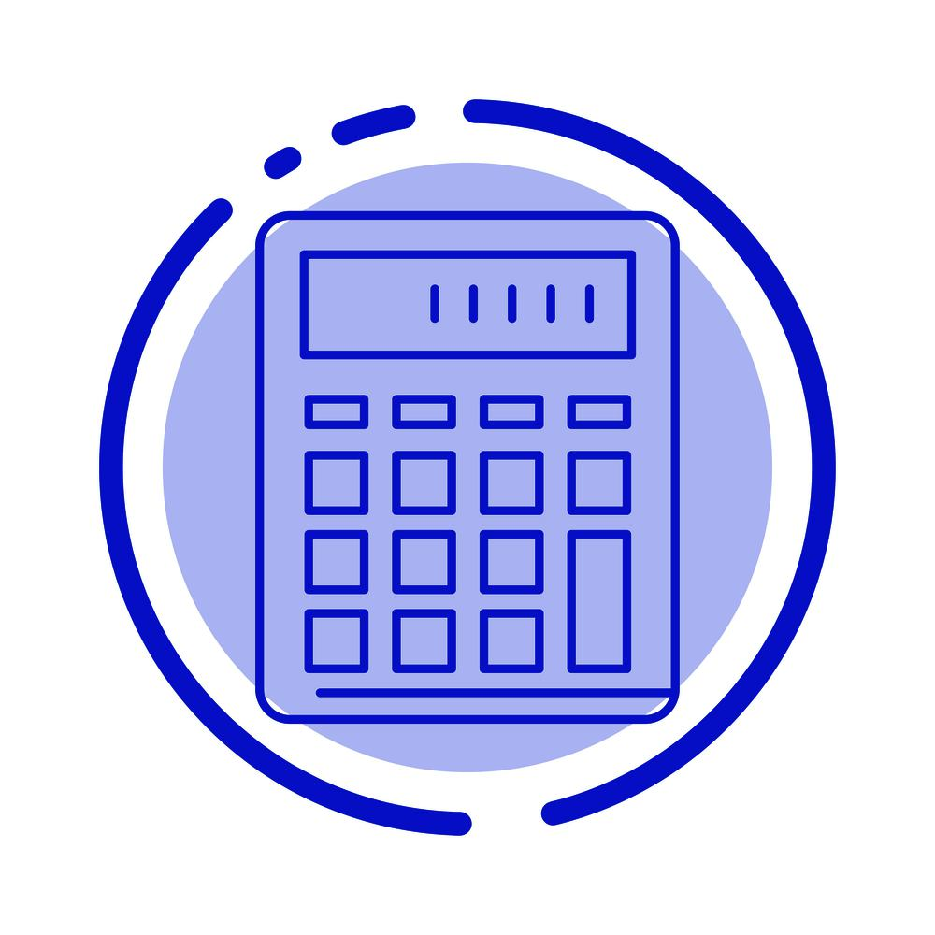
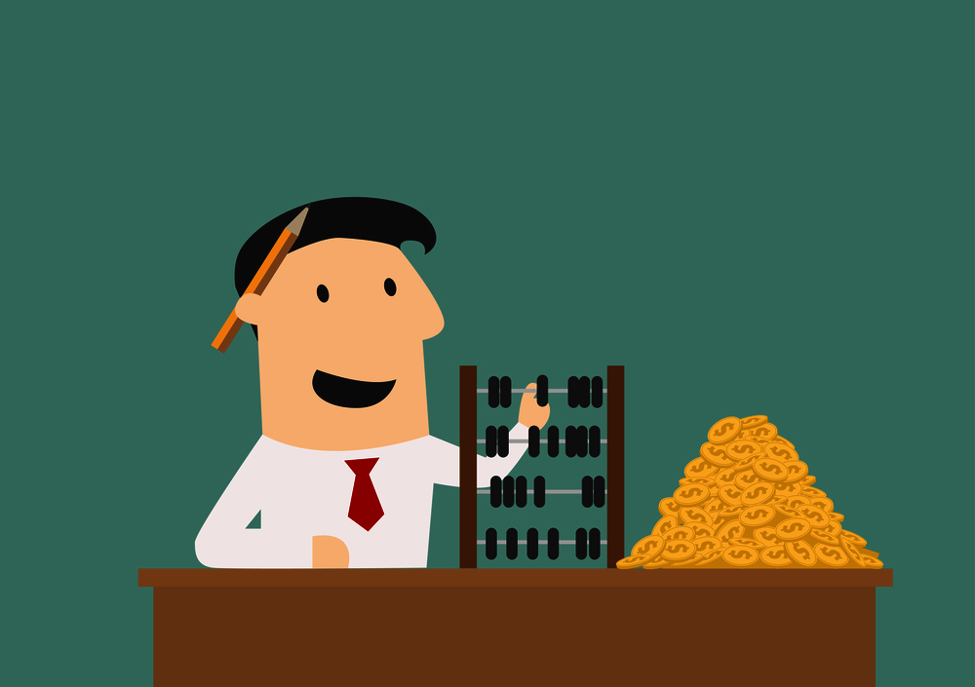
Use Technology
You can use software to help you count your money, even a spread sheet program such as Excel will do.
In the case that you handle a lot of money, you can use a counting machine to minimize errors.

Slide 8
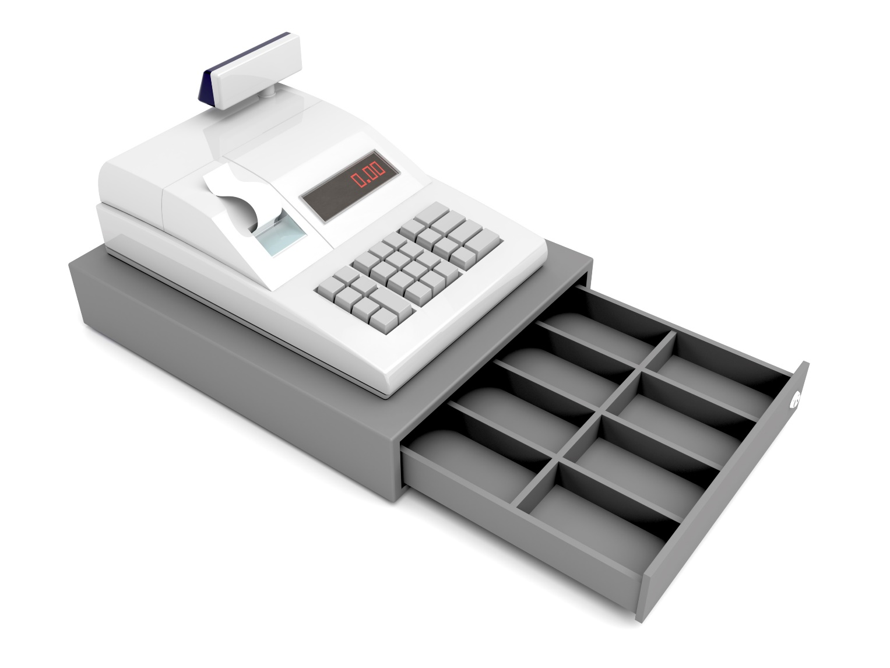
How to Balance a Cash Register
This video is a bit behind the times, as it still talks about the old-fashioned credit card receipts. However, the procedure for counting out your cash drawer and balancing it with your cash register receipts is very important.
As well, it doesn’t discuss cash paid out (CPOs), money you’ve taken from your cash register to pay casual labour, local purchases, etc. But the final bit of advice – depositing the cash into the safe – is crucial.

Slide 9

Tutorial on Balancing a Cash Register
Make sure to follow drop safe procedures
Add up your check totals. Do they match the number in your computer system?
Add up the number of credit card slips. Does it match the total on the computer?
Voids-Do they match the computer total?
Cash – leave your starting balance in the drawer. Do your excess totals match what is on the computer screen?
Add up all refunds. Do the totals match those on the computer? Fill out bank deposit slip for cash and checks.
To close out your register:
Remember: Always lock up your cash in a safe!

Slide 10
SELF EVALUATION
The cash sales on your cash register tape should equal:
A. The money in your cash drawer
B. The money in your cash drawer minus the amount of cash you started the day with (float)
C. The money in your cash drawer plus cash paid out
D. The money in your cash drawer minus cash paid out

Slide 11

Coin Counting and Sorting Machine
This short video shows one of the many kinds of automatic coin counters/sorters. This one in particular uses British coins, but the same idea works for Canadian coins or any other currency. Consider this if you handle a lot of coins.

Slide 12
Coin Counting Machine in Action
Please proceed to the next slide when finished watching.

Slide 13
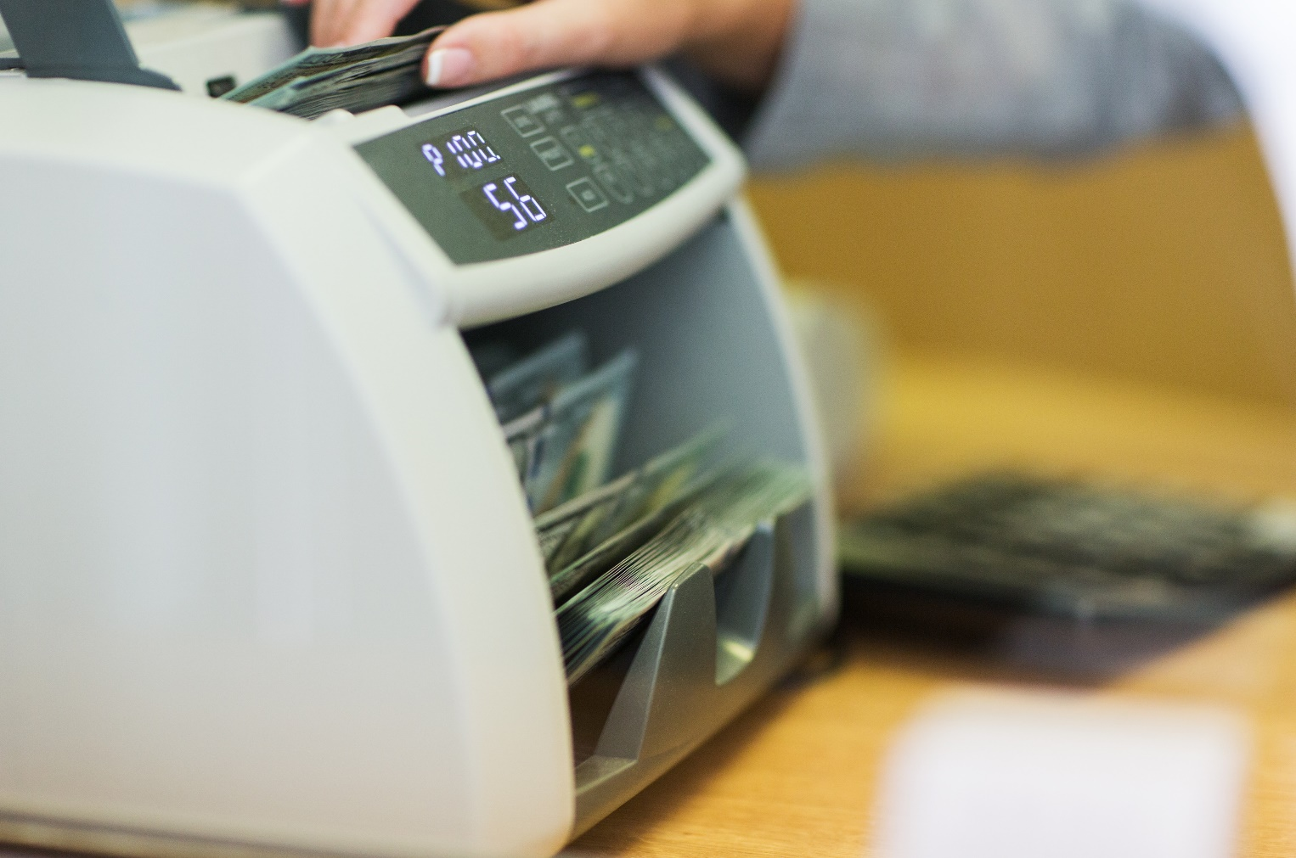
How To Use A Professional Bill Counter
This is another tool which comes in hand if you are dealing with a large amount of paper currency. Note that it doesn’t sort, but your money should be sorted already in your cash drawer.
Also, if you want, say, your $20 bills in batches of 10, this machine can handle it.

Slide 14
Using a Bill Counter
Please proceed to the next slide when finished watching.

Slide 15
TRUE OR FALSE
It is safe to keep cash in small boxes under my counter after business hours
True
False

Slide 16
TRUE OR FALSE
Sending a cheque by mail to a supplier is the most efficient way of payment.
True
False

Slide 17
GLOSSARY
Click on the definition to return to its slide.
Daily Cash Register Receipt At the end of the day, the cash register must be balanced. This is often called “closing the cash”. The cash (and cheques) in the till are counted, then a summary is run on the cash register, which will give you the total amount of sales for the day, sales taxes collected, money used for cash purchases, etc. The amount of cash in the till must equal your sales less cash purchases from the till. This is a very important process – it can identify employee theft, poor money handling skills, employee problems with using the cash register, etc. Also, information on sales, sales taxes, purchases, etc. must be entered into your bookkeeping system. Finally, the cash register summary must be stored for five years.
Counting Machine When handling large amounts of cash, the counting procedure can be done by a machine. There are some types for coins, while others count bills.
Cash Paid Out Sometimes, it is necessary to pay a supplier directly from the cash register. The amount is entered onto the register and the CPO (Cash Paid Out) button is punched. The vendor’s invoice is kept, and used when closing off the register at the end of the day. It is also entered into the bookkeeping system and filed.

Slide 18
GLOSSARY
Click on the definition to return to its slide.
Voids – Voids are when a transaction entered into the cash register is cancelled. These are monitored because it is also a way that a dishonest cashier can take money from a customer, put it in their own pocket, and the transaction will not be recorded on the cash register and the cash drawer will balance. If there are a lot of voids, it may be an indication of employee theft.

Slide 19
Congratulations, you have completed this module!
The next Module will be: Bookkeeping and Accounting

Slide 20
Congratulations, you are correct!
Click here to continue.

Slide 21
Sorry. Please try again.
Click here to try again.

Slide 22
Sorry. Please try again.
Click here to try again.

Slide 23
Sorry. Please try again.
Click here to try again.

Slide 24
Congratulations, you are correct!
Click here to continue.

Slide 25
Sorry. Please try again.
Click here to try again.

Slide 26
Congratulations, you are correct!
Click here to continue.

Slide 27
Sorry. Please try again.
Click here to try again.

