Slide 1



Entrepreneur
Local Learning Centers

Slide 2



SEMINAR 14:
MAINTAINING A GOOD CREDIT REPORT
Your personal credit report will play an important part in the financing of a new business. KRG, banks and other suppliers from the south will evaluate the financial risk of doing business with you based on your credit report.
The following questions will help you better understand what it is and what rules to follow:

Slide 3
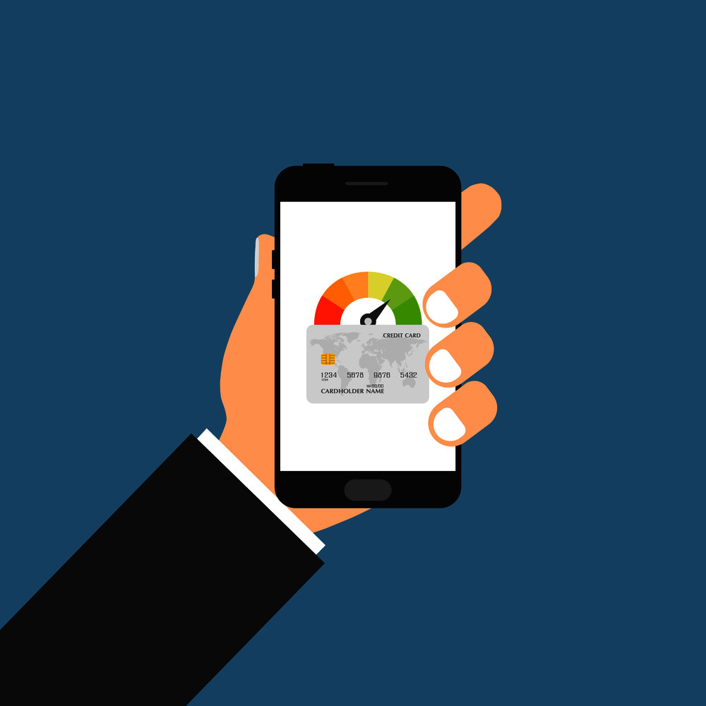
What Is It?
Your credit report is a record of your financial history and your reputation with credit providers.
It’s created the first time you borrow money from a bank or ask for a credit in a store, telephone company, house rental, etc.

Slide 4

What Does It Do?
It gives information about how you deal with payments.
Are you paying normally in time or always late?
Do you only pay the minimum or skip payments?
Have you ever declared bankruptcy?

Slide 5

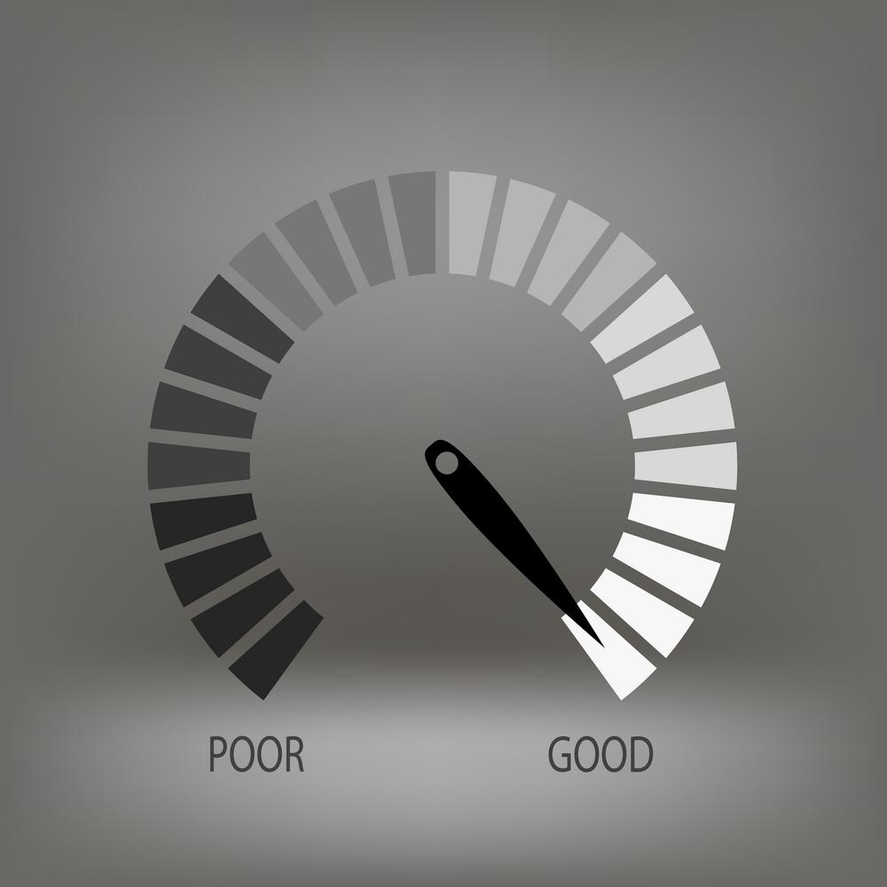
Why Is It Important?
Your credit report is what helps financial providers to decide if they will lend you money or not and at what conditions.

Slide 6

Who Looks At Your Credit Report?
KRG, banks, suppliers are among the ones who can ask to look at your credit report.
Pro tip:
You have to give your authorization in order for someone to get your credit report.

Slide 7

Who Will Check on My Credit Report?
Some suppliers might use these to check your credit score, They will usually use:
TransUnion (www.transunion.ca)
Equifax (www.equifax.ca)

Slide 8
Credit in Nunavik
The major money lenders in Nunavik are KRG, Nunavik Investment Corporation (NIC), the CIBC bank and other institutions like the Northern or COOP

Slide 9

What Is My Credit Limit?
Your credit limit is calculated with your repayment capacity, your guarantees and your credit score.

Slide 10

How Is It Calculated?
A credit score is calculated from variables contained in your report of credit with various weights: payment history, balances, types of accounts, the age of the accounts, the number of investigations, etc.
Credit scores are generally between 300 and 900.

Slide 11
How Can I Improve It?
Pay your bills on time. Try to pay your bills in full before the due date. If not, pay at least the minimum amount. You can set up automatic payments for your credit cards with most banks.
Make sure that your monthly statement contains no errors.
Limit the amount of credit applications and the number of credit cards

Slide 12
What Information Is In A Credit Report?
This is an introduction to credit reports, produced by a major credit agency, Equifax. It discusses what information is contained in your report and how to get a free copy. Although it discusses personal credit evaluations, corporate credit reports are similar.
NOTE: This is an American video – to find out how you can order your personal credit report in Canada, visit this Government of Canada website: https://www.canada.ca/en/financial-consumer-agency/services/credit-reports-score/order-credit-report.html

Slide 13

Information on a Credit
Report
At A Glance: A credit report is a summary of your financial history
This includes:
- Credit cards in your name
- Mortgages
- Student Loans
- Vehicle Loans
- Public Record Information
- Debts
Your Credit History helps potential lenders gauge your credit worthiness. Lenders use it to decide whether to give you a loan, and also what interest rate to give you based on the risk they think they’re taking.
Remember:
Negative information may indicate accounts that haven’t been paid on time. Positive information usually refers to commitments met under the original terms.

Slide 14
SELF-EVALUATION
Which of the following is usually found in a personal credit report?
A. The number of credit cards you have
B. The amount of money in your savings account
C. The financial status of your marital partner
D. Your bank manager’s personal evaluation

Slide 15
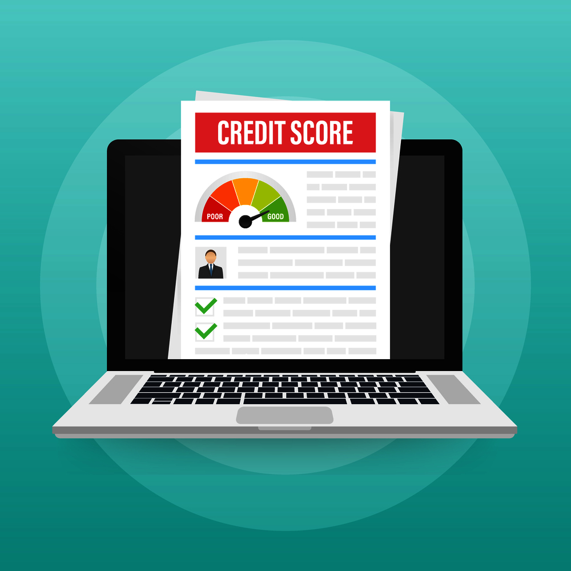
How To Build A Good Credit Score? | How To Improve My Credit?
There are some key factors which go into your credit score’s calculation. These are discussed in this video, as well as ways of improving your credit score. All in all, very sound advice both for the consumer and the business entrepreneur.

Slide 16
Tips to Build a Better Credit Score
Instead of using a credit card to spend money you don’t have yet, it is a better idea to use them to build your credit.
5 Main Factors That Impact Your Credit Score
Tips
1. Your Payment History
This category alone is worth 35% of your overall credit score
2. How Much you Owe Compared to your Total Available Credit
This is the second largest impact on your credit.
3. Types of Credit Used
Creditors like to see that you are able to manage various types of credit.
4. New Credit Inquiries
Composes 10-12% of your overall credit score
5. Length of your Credit History
Creditors like to see that you can handle credit accounts over a prolonged period.
1. Do not spend more than you can afford
2. Keep your credit utilization to a minimum
3. Have multiple, but not too many, lines of credit open
4. Do not pay interest

Slide 17
SELF-EVALUATION
Which is the most important factor in calculating your credit score?
A. Your total amount of debt
B. Your repayment history
C. How much interest you pay each month
D. Whether you have ever declared bankruptcy

Slide 18
The Benefits Of A Good Business Credit Score
The previous two presentations have dealt with personal credit ratings. This one outlines the benefits to getting and maintaining a good business credit score.

Slide 19
The Benefits Of A Good Business Credit Score
1.
Better Credit Can Save You Money
Lenders offer better interest rates to businesses with good credit.
2.
Helps you obtain Business Credit without the Need for a Personal Guarantee
This reduces your personal liability and reduces your personal assets.
3.
A Strong Credit Profile Helps You Stay Ahead Of Your Competition
As you’re in a better position to pass on your interest savings to your customers, or keep a larger profit margin for yourself, you can make business growth decisions with confidence.

Slide 20
SELF-EVALUATION
Which is NOT a benefit of having a good business credit rating :
A. Banks will charge you less interest since you are credit worthy
B. It is easier to get financing
C. Banks will be more likely to forgive your debts
D. You may not have to give a personal guarantee for a loan

Slide 21
TRUE OR FALSE
Paying my personal rent and my hydro bills late won’t affect my chance to get a business loan.
True
False

Slide 22
TRUE OR FALSE
My suppliers have no reason to do a credit check even if a want credit on a significant big order since I am bringing them good business.
True
False

Slide 23
GLOSSARY
Click on the word to go back to that slide.
Credit Limit This is the maximum amount you can charge to your credit card or business account.
Guarantees Very often, you will have to provide something which will show that you will repay your loan. This can be as simple as a promissory note (as kind of IOU), or a mortgage if it is a building. You may be asked to deposit something like a GIC as security. Just be prepared to provide some kind of guarantee if you take out a loan.

Slide 24
Congratulations, you have completed this module!
The next Module will be: Who Do I Need to Pay

Slide 25
Congratulations, you are correct!
Click here to continue.

Slide 26
Sorry. Please try again.
Click here to try again.

Slide 27
Sorry. Please try again.
Click here to try again.

Slide 28
Sorry. Please try again.
Click here to try again.

Slide 29
Congratulations, you are correct!
Click here to continue.

Slide 30
Sorry. Please try again.
Click here to try again.

Slide 31
Sorry. Please try again.
Click here to try again.

Slide 32
Sorry. Please try again.
Click here to try again.

Slide 33
Congratulations, you are correct!
Click here to continue.

Slide 34
Sorry. Please try again.
Click here to try again.

Slide 35
Sorry. Please try again.
Click here to try again.

Slide 36
Sorry. Please try again.
Click here to try again.

Slide 37
Congratulations, you are correct!
Click here to continue.

Slide 38
Sorry. Please try again.
Click here to try again.

Slide 39
Congratulations, you are correct!
Click here to continue.

Slide 40
Sorry. Please try again.
Click here to try again.

