Slide 1



Entrepreneur Local Learning Centers

Slide 2



SEMINAR 16: CASH FLOW MANAGEMENT
You can compare this as doing a weather forecast. You analyze information to see what is coming ahead so you can properly prepare. A good cash flow management will help you get ready for slow periods and plan your financing for the busy ones.
The following will contribute to your peace of mind:

Slide 3
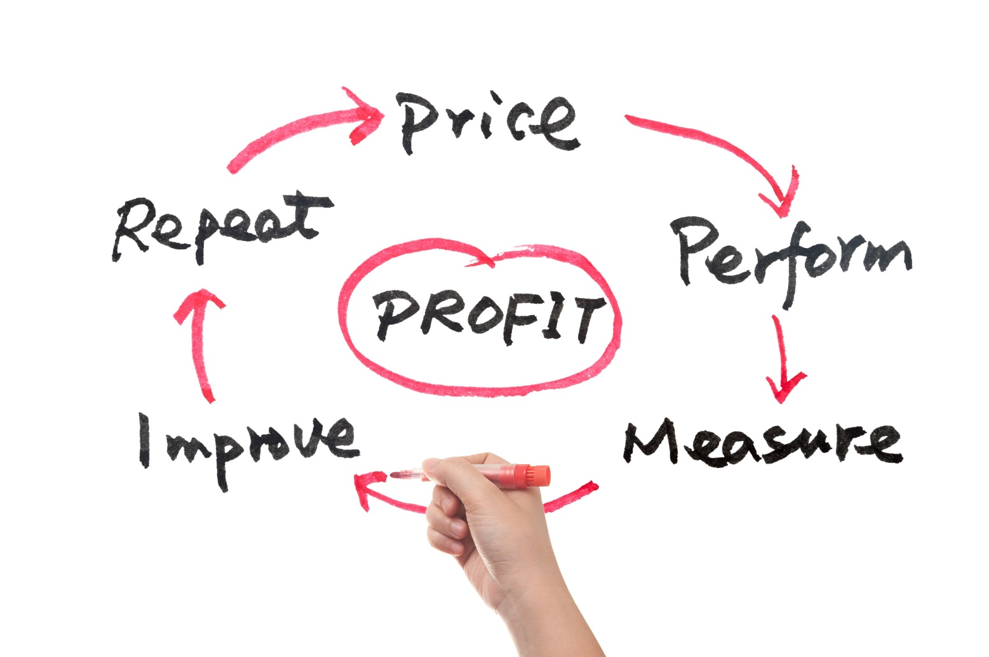
Do You Make Profit?
First thing first, be sure that your business makes profits.
You have to look each products and/or services you sell, and analyze the profitability. Do you pay a fair price for it and is it sold at a price which will give you some profit?

Slide 4

Budget - Planning Ahead
A budget helps you understand how your business is doing. It allows you to know when to borrow or to use your line of credit.
It is best is to do a one-year forecast to give you proper warnings.

Slide 5


When Do I Spend And Stop Spending?
A good budget will end the guesswork and you will know when to stop spending and when you can spend.
Track your progress by monitoring your real cash flow and compare it to your projections. This is called a budget variance report.
Online bank services can help you save time.

Slide 6
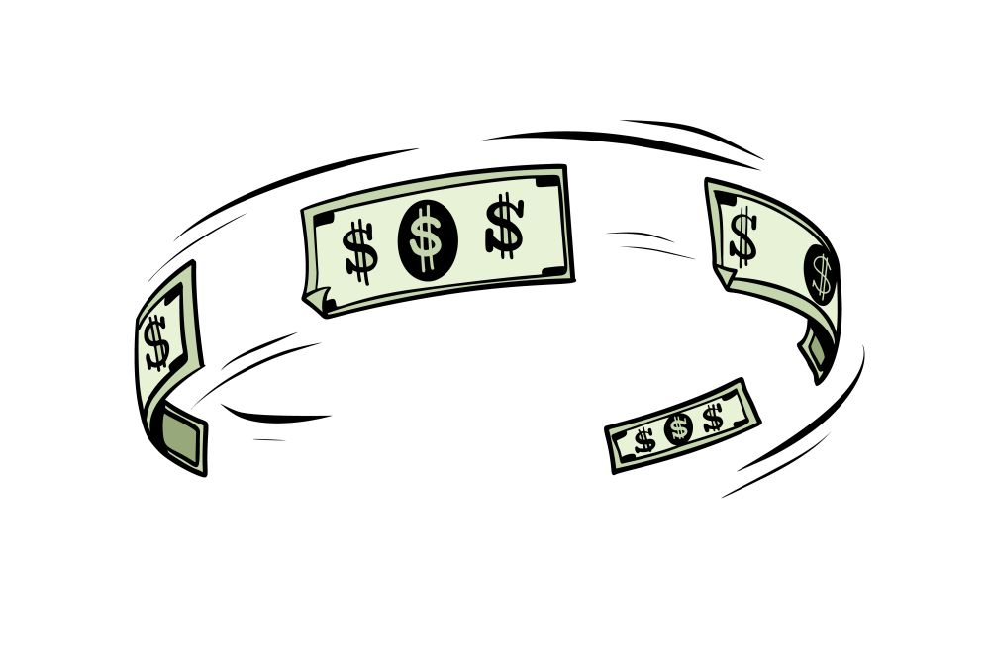
How Do I Control My Cash?
Prioritize cash sales than credit sales.
Minimize unnecessary expenses.
Rule of thumb: finance big purchases instead of paying with cash.
Pay cash for small short term buys.
Use credit for medium mid term buys.
Finance big long-term buys.

Slide 7

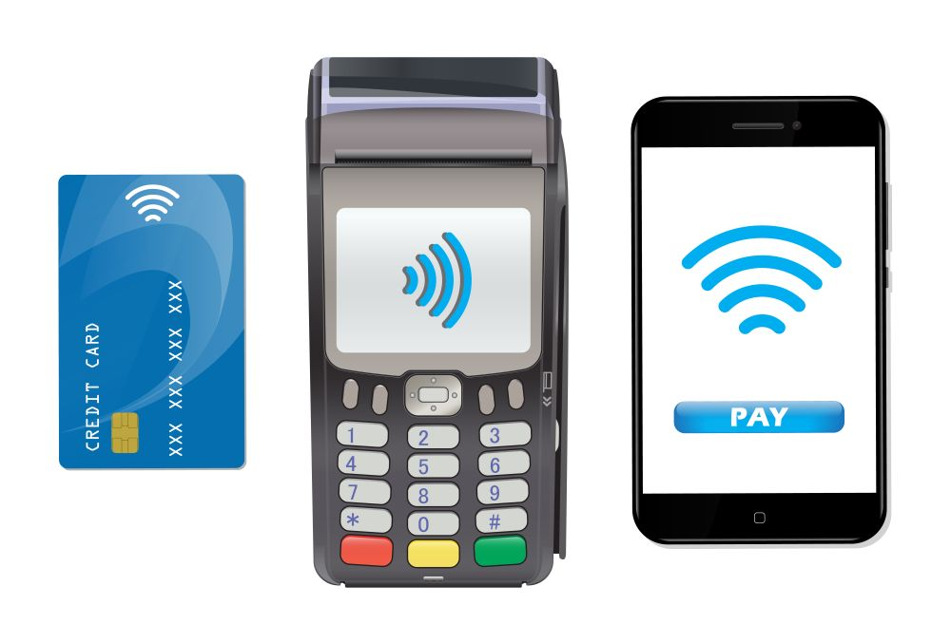
Cash Sales
Cash sales are sales paid in full at once by paper money, cheques or credit cards.

Slide 8
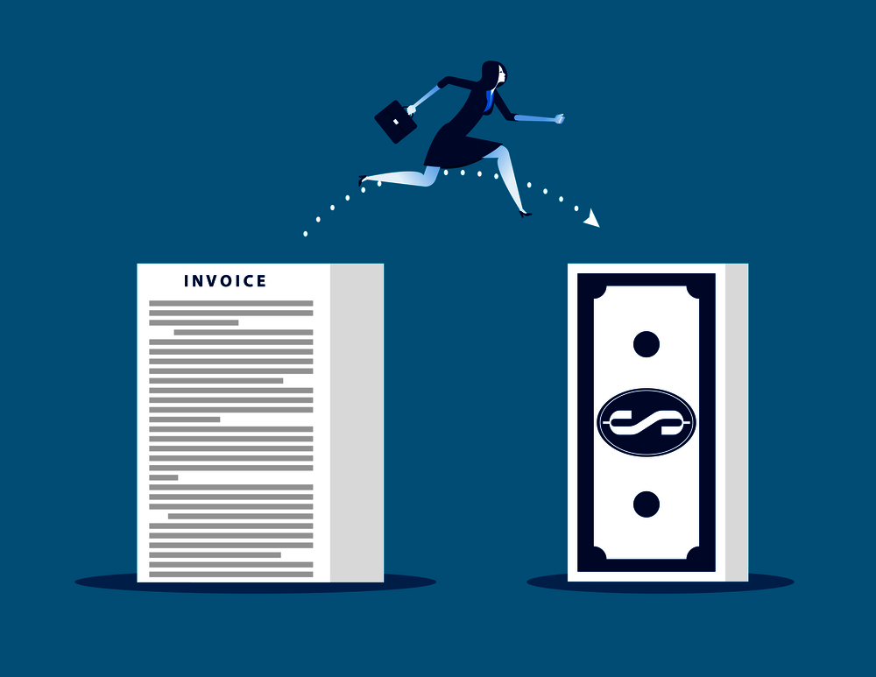
Credit Sales
Credit sales are when you agree with your client to sell him something now but the payment will be received later. You are in fact financing his purchase so it delays your cash receipt.
Be sure to send invoices quickly to your clients and indicate terms of interest to slow payers.

Slide 9
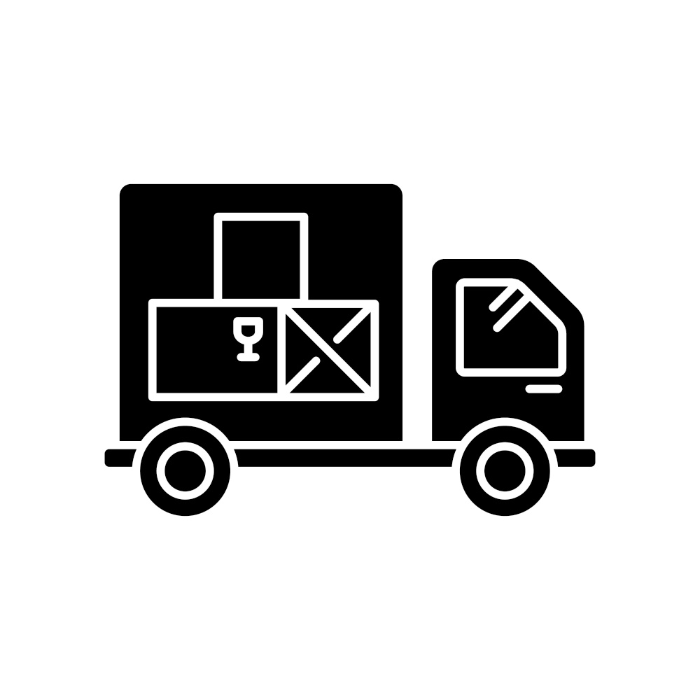
Suppliers
Suppliers can ask you to pay for their product or service in full at the time of the sale or can offer you credit sales.

Slide 10

KRG Loan
KRG Loan must be paid according to terms.

Slide 11
What To Do If I Don’t Have Money To Pay Invoices?
Talk to KRG for advice
Talk to your financial institution for .
Try selling some products or services at a discount (on sale) for quick cash.
Ask suppliers for extra time to pay your bills.
Set a target cash reserve for unexpected spending and emergencies.

Slide 12
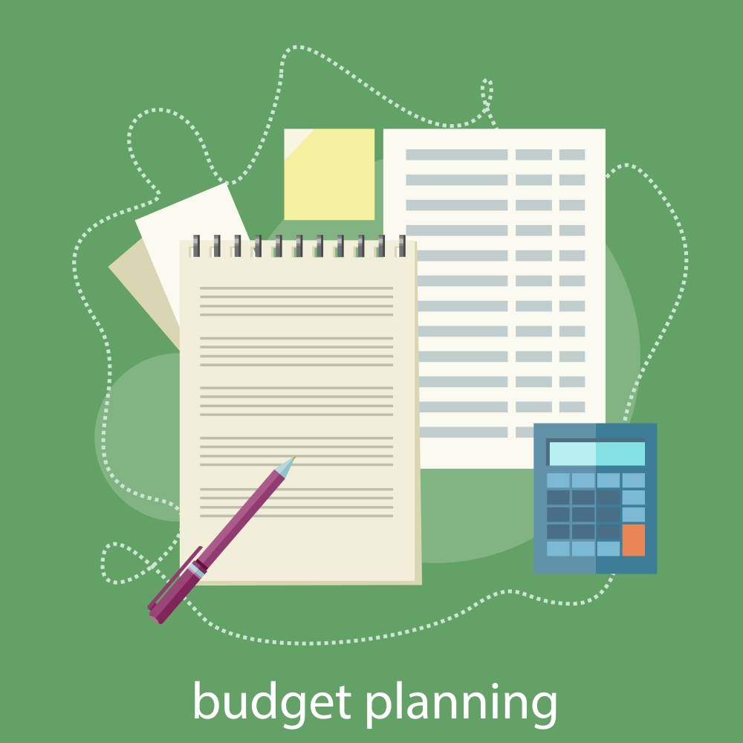
Creating A Business Budget
This short video explains the concept behind making a budget, which the presenter also calls a plan . . . for your money.

Slide 13

Budgeting for Small Businesses
Think of running your business without a budget like driving blind. You can’t see where you’re headed, your speed, or any indications your car might be telling you. Having a budget is like a plan that helps you keep track of where you are with your business.
How to Create a Budget:
Track expenses for two months
Decide where you’d rather spend that money
Look to where to cut back

Slide 14
SELF EVALUATION
A budget is . . .
A. Very difficult to do for small businesses
B. A plan how to spend your money
C. Not necessary for small businesses
D. Very useful for banks and accountants only

Slide 15
Making a Budget: How to Make a Company Budget Plan
This short video goes a little further into what the elements of a budget are. Note, although he is talking about business, the flip chart in the background seems to be a personal budget – pay more attention to his words.

Slide 16
Company Budget Planning
What are you looking to accomplish with you budget?
Simply put, a budget is the list of expenses and income.
Simple rule: if the income is comes out higher than the expenses, you’re doing OK. But expenses are something you should look at on a monthly basis.
Understand the difference between your wants and needs.
Every budget should consist of 50% towards your basic needs, 30% to your wants, and 20% towards reducing costs or investing in your company’s future.

Slide 17
SELF EVALUATION
According to the presenter, what is the most important aspect of budgeting?
A. A monthly review of your expenses to make sure they follow the plan
B. A big profit
C. Tweak your income to meet your expenses
D. It meets all your wants rather than your needs

Slide 18

How To Set Up A Business Budget
We now examine some of the basic elements used in making a budget. Revenues and expenses are considered.

Slide 19
Budgeting a Business
What is a Budget?
How do we Create a Budget?
- A budget is a set limit of monies set aside for recurring expenses as well as non-recurring expenses – as stated before, it’s a plan that you stick with to keep on track.
1.Take account of all sources of income 2. Take account of all sources of expenditures 3. Figure out the cost of recurring and non recurring expenses 4. Enter this data into a format that you can look at on a regular basis
Remember:
Recurring costs refer to any expense that is known, anticipated, and occurs at regular intervals. Nonrecurring costs are one-of-a-kind expenses that occur at irregular intervals and thus are sometimes difficult to plan for or anticipate from a budgeting perspective.

Slide 20
SELF EVALUATION
Which is not a recurrent business expense?
A. Rent paid for your office or shop
B. Payroll for your regular employees
C. Money paid for an advertisement in Nunatsiaq News
D. Bank fees for your account

Slide 21
Variance Analysis
The previous three videos deal with why budgeting is important, and how to set one up. But budgeting is not a once-a-year activity; you must also compare it to your actual monthly or weekly sales.
By doing this you can react quickly to address budget shortfalls or take advantage of profit opportunities.
By the way, this is a British video, so mentally replace the Pound symbol (£) with a Dollar sign($).

Slide 22
Defining Variance Analysis
What is it?
…variance analysis compares actual costs with budgeted costs and analyses the difference.
Two Types of Variants
Favourable: Costs are lower
Adverse: Costs are higher
Remember: For a sales revenue or profit budget, favourable means revenue or profit is higher; adverse means sales or revenue is lower
For example: Say your budgeted (or planned) sales revenue is $500, but when you look at your income you see you’ve actually made $600. This gives a variance of 100 favourable. Conversely, if your budgeted material costs were $250 and the actual costs ended up at $300, then this gives a variance of 50 adverse.

Slide 23
SELF EVALUATION
What is a favourable budget variance?
A. When sales are less than predicted
B. When expenses are less than predicted

Slide 24

Questions To Think About
What should I do to avoid being out of money?
I want to buy a new truck for my deliveries, which is the best way to pay for this type of purchase?

Slide 25
GLOSSARY
Click on the word to go back to that slide.
Budget A budget is a cash flow road map where you predict the sources of cash as well as the ways in which you will use cash. This can be for your business on a monthly, yearly or longer basis. It can also be for a specific project such as building a new store. The important feature of a budget is to see if money coming in to the business coupled with cash reserves is able to cover expenses.
Line of Credit Banks as well as other lending institutions can offer a type of debt which allows you to take out funds up to your credit limit without having to make a request each time. You will have to make a minimum monthly payment, though. The interest rate on lines of credit is usually much lower than a credit card.
Budget Variance With budgeting, things never go exactly as planned. It is important to compare your predictions against the actual performance of your business as shown in your bookkeeping. It can point to dangers in the future if cash in flow is less than anticipated, or if your expenses are higher than you thought. You must then make some adjustments to make sure your business is healthy.
Continued

Slide 26
GLOSSARY
Cash Sales When speaking of cash sales, this normally means the payment is made in coins or bills. But when we talk of cash in bookkeeping, we also include money on deposit in a bank, cheques and credit card receipts.
Invoice Terms When you receive an invoice from a supplier, it will show a lot of information. What you ordered, the cost of these items and where you should send your payment are all shown clearly. But in addition to this, there are invoice terms. If you see “Net 30”, this means you have 30 days to pay the invoice (or you may start paying interest as well). Also, some companies give discounts for speedy payments – for example, if you pay in less than 15 days you may receive a 2% discount on that invoice.
Cash Reserve Cash is the lifeblood of your business, and you should always make sure that you have enough cash in the form savings or reserve to cover any downturns in your business, or for your next sealift inventory, or for an expansion.

Slide 27
Congratulations, you have completed this module!
The next Module will be: How To Handle Loonies & Toonies

Slide 28
Congratulations, you are correct!
Click here to continue.

Slide 29
Sorry. Please try again.
Click here to try again.

Slide 30
Sorry. Please try again.
Click here to try again.

Slide 31
Sorry. Please try again.
Click here to try again.

Slide 32
Congratulations, you are correct!
Click here to continue.

Slide 33
Sorry. Please try again.
Click here to try again.

Slide 34
Sorry. Please try again.
Click here to try again.

Slide 35
Sorry. Please try again.
Click here to try again.

Slide 36
Congratulations, you are correct!
Click here to continue.

Slide 37
Sorry. Please try again.
Click here to try again.

Slide 38
Sorry. Please try again.
Click here to try again.

Slide 39
Sorry. Please try again.
Click here to try again.

Slide 40
Congratulations, you are correct!
Click here to continue.

Slide 41
Sorry. Please try again.
Click here to try again.

