Slide 1

ᓄᓇᕕᒻᒥ ᓄᓇᓖᑦ ᑎᒥᐅᔪᖁᑎᖓ
ᑲᑎᕕᒃ ᓄᓇᓕᓕᒫᑦ ᑲᕙᒪᖓᑕ ᑲᑎᒪᓂᖓ, ᓅᕕᒻᐱᕆ 2024

Slide 2
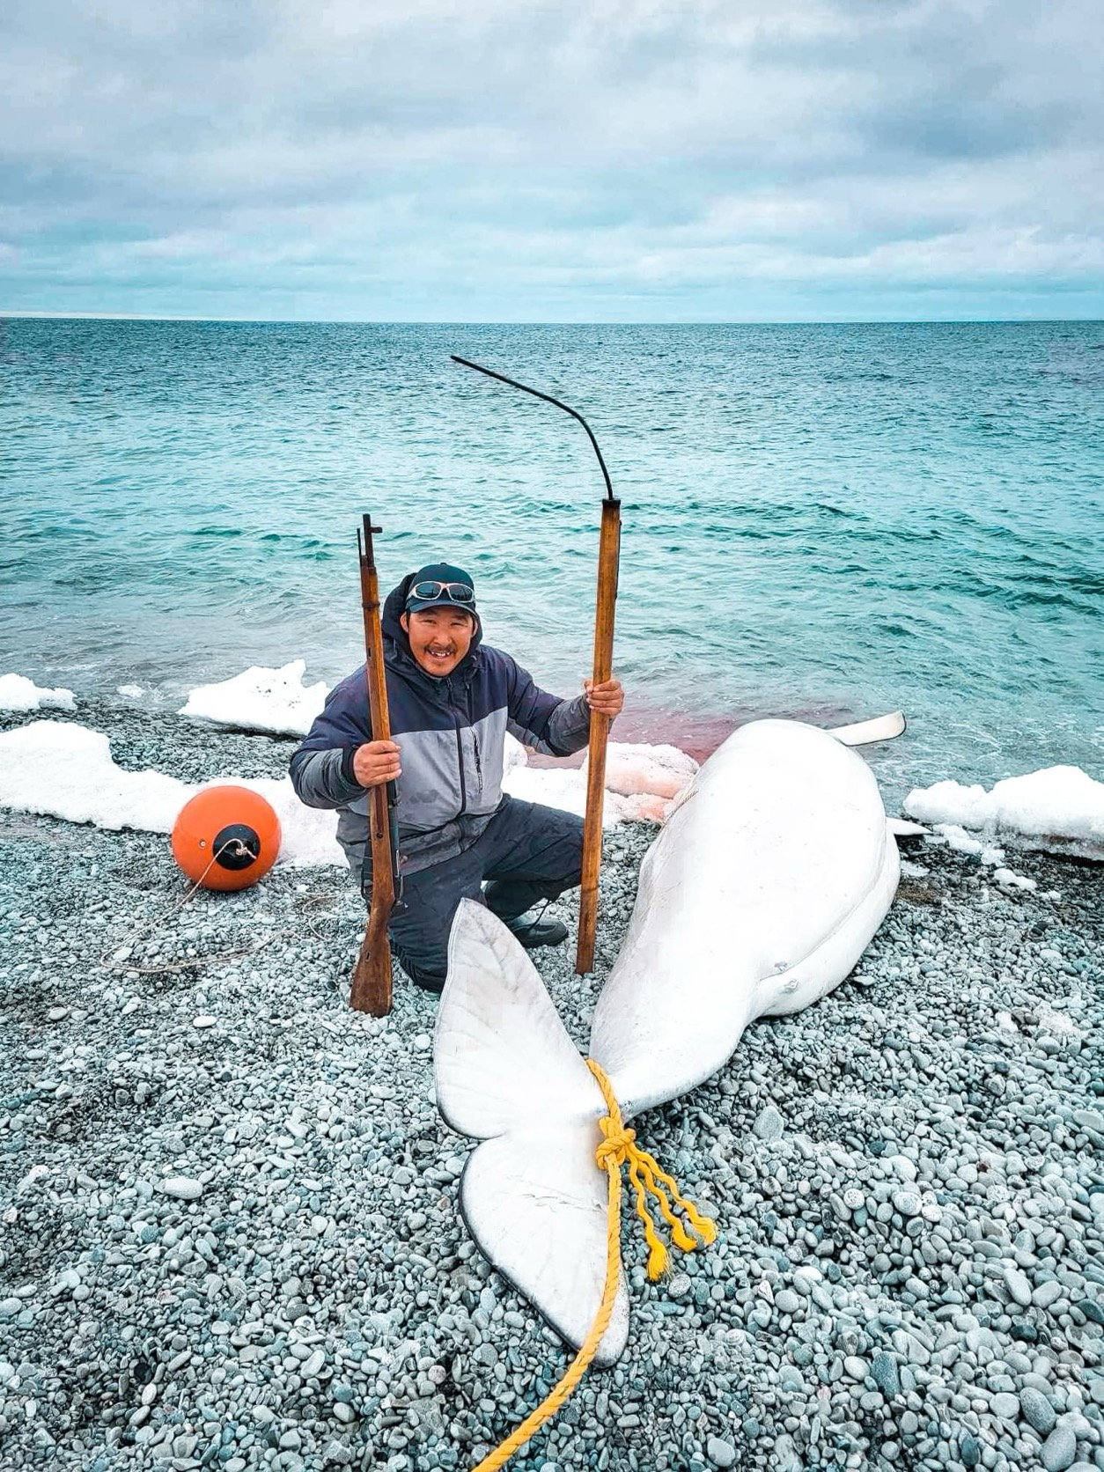
ᐱᔭᕆᒐᓱᑦᑕᖓ
ᑫᓪᓗᑐᐃᓂᖅ ᐃᓗᕐᖁᓯᒃᑯᑦ ᒪᒥᓴᕐᓂᒥᒃ ᓄᓇᕕᒻᒥ ᓄᓇᓕᓐᓂ ᐱᓂᐊᕐᓂᖃᕐᓂᑯᑦ ᐱᕙᓪᓕᐊᑎᑕᐅᓯᒪᔪᒥᒃ ᐃᓄᐃᑦ ᐃᓕᕐᕈᓯᖓᑎᒍᑦ ᐱᐅᓯᑐᖃᖏᑎᒍᓪᓗ

Slide 3
ᐃᓪᓕᕆᔭᕗᑦ
ᐃᓄᐃᑦ ᐃᓗᕐᖁᓯᒃᑯᑦ ᐊᑦᑕᓇᕐᑐᒦᑦᑌᓕᓂᖓ
ᐃᓄᑐᐃᓐᓀᑦ ᓯᕗᓕᕐᓂᖓ
ᓲᓱᑦᓴᓂᖅ
ᒪᒥᓴᕐᓂᖅ
ᐃᓕᓐᓂᐊᑎᑦᓯᓂᖅ
ᐃᓚᑦᔪᒍᓱᒍᑎᖃᕐᓂᖅ ᐃᓄᑐᐃᓐᓀᑦ ᐊᑑᑎᔭᖏᓐᓂᒃ ᐃᓅᒍᓯᖏᓐᓂᓗ
ᑲᑐᑦᔨᖃᑎᒌᓐᓂᖅ

Slide 4
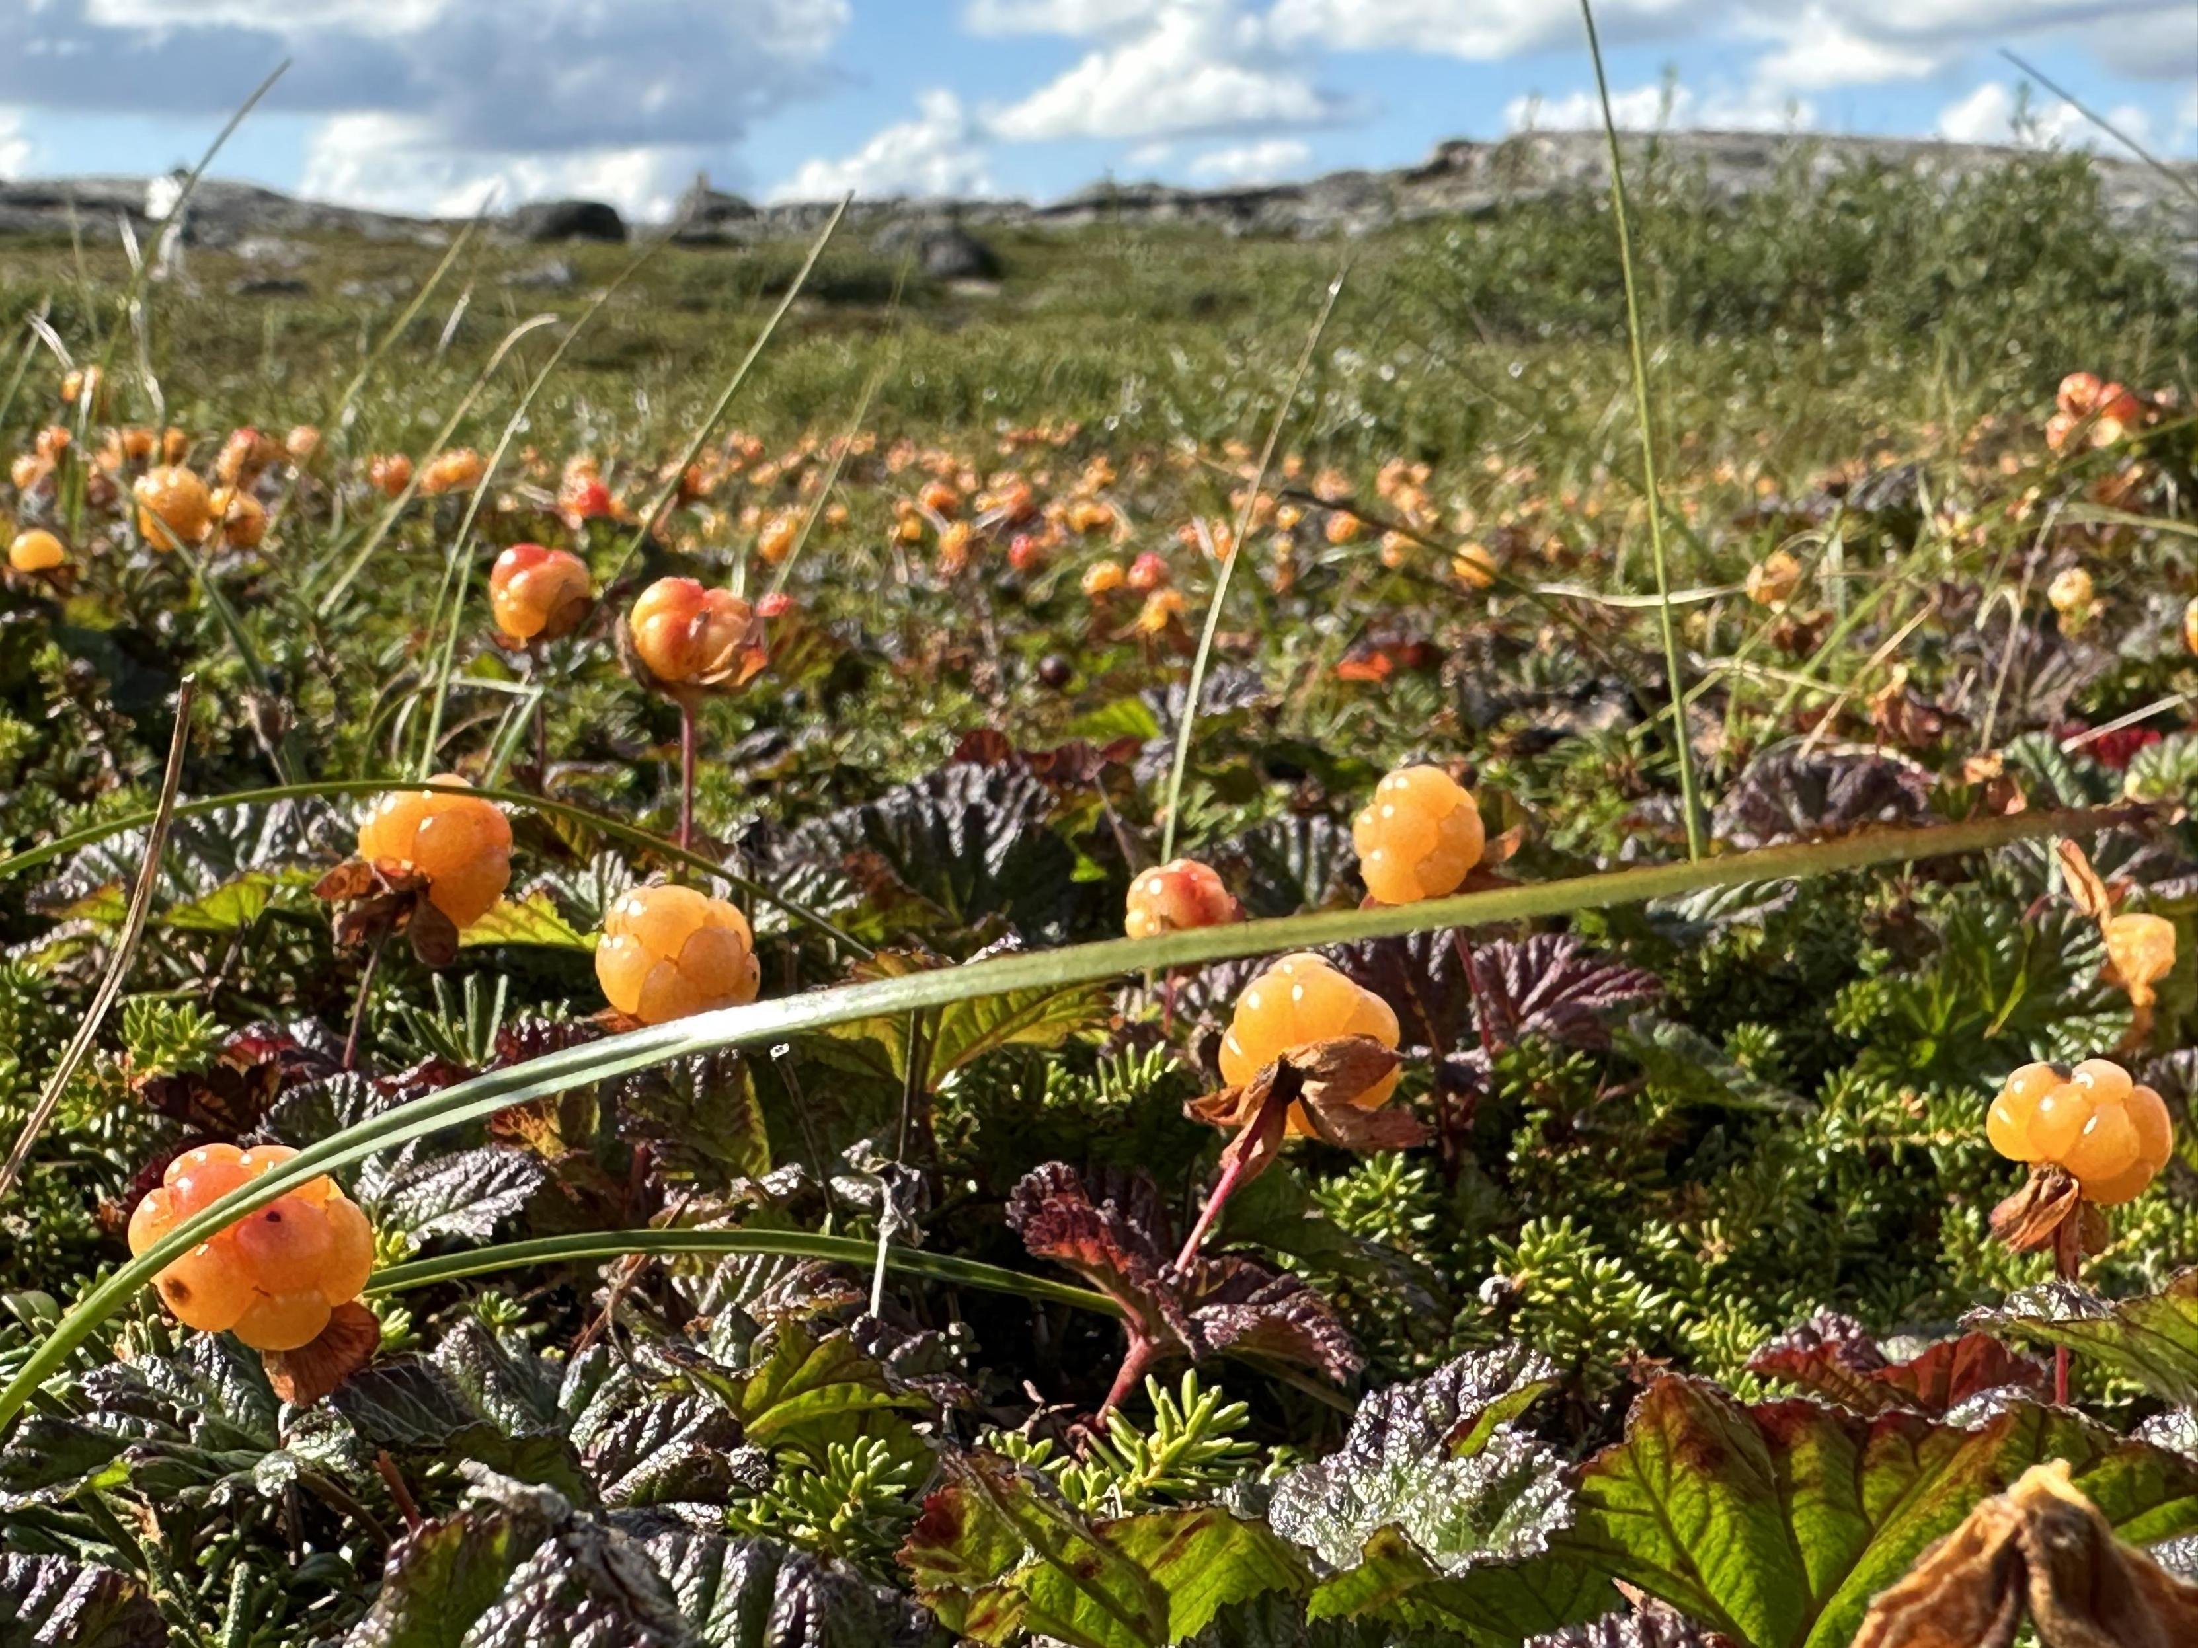
ᑐᕌᒐᕗᑦ
ᓄᕐᖃᖓᑎᑦᓯᒐᓱᐊᕐᓂᖅ
  -ᑫᓪᓗᑐᐃᓂᖅ ᐱᐅᔪᓂᒃ ᐃᓅᒍᓯᖃᕐᓂᒥᒃ
  -ᐊᑐᐃᓐᓇᖃᕐᓂᖅ ᓱᖃᑦᓯᓂᕐᓂᒃ ᐃᒻᒥᓂᒃ ᓈᒻᒪᒋᕙᓪᓕᐊᖁᓗᒋᑦ ᐅᕕᒃᑫᑦ
  -ᐃᓕᓐᓂᐊᑎᑦᓯᓂᖅ ᐃᓄᑐᐃᓐᓀᑦ ᐃᓗᕐᖁᓯᒃᑯᑦ-ᓄᓇᓕᒃᑯᑦ ᐃᓪᓕᕆᔭᖏᓐᓂᒃ
ᐊᑯᓐᓂᖁᑦᓯᐅᑎᓂᖅ
  ᐊᑐᐃᓐᓇᖃᕐᓂᖅ ᓄᓇᓕᓐᓃᑐᓂᒃ ᐱᒍᑦᔨᓂᕐᓂᒃ ᐃᑯᓪᓚᒋᐊᕐᑎᓯᒐᓱᓪᓗᓂ ᐅᑯᓂᖓ :
    -ᐱᖁᔭᒥᒃ ᓯᖁᑦᑎᕆᓂᕈᕐᑎᓯᓂᖅ ᐃᓅᖃᑎᒌᑎᒍᑦ ᐱᓀᓗᑕᕐᓂᒃ
    -ᐋᓐᓂᐊᕕᓕᐊᓚᕿᓂᖅ
    -ᐋᖓᔮᓐᓇᑐᕐᑐᓗᐊᕐᓂᖅ
    -ᐃᓄᐃᑦ ᐃᓱᒪᖃᑎᒌᖕᖏᓂᖏᓐᓄᑦ ᐊᑦᓱᕈᕐᓇᑐᒃᑰᓂᖅ
    -ᐃᒻᒥᓂᐊᕐᓂᖅ

Slide 5
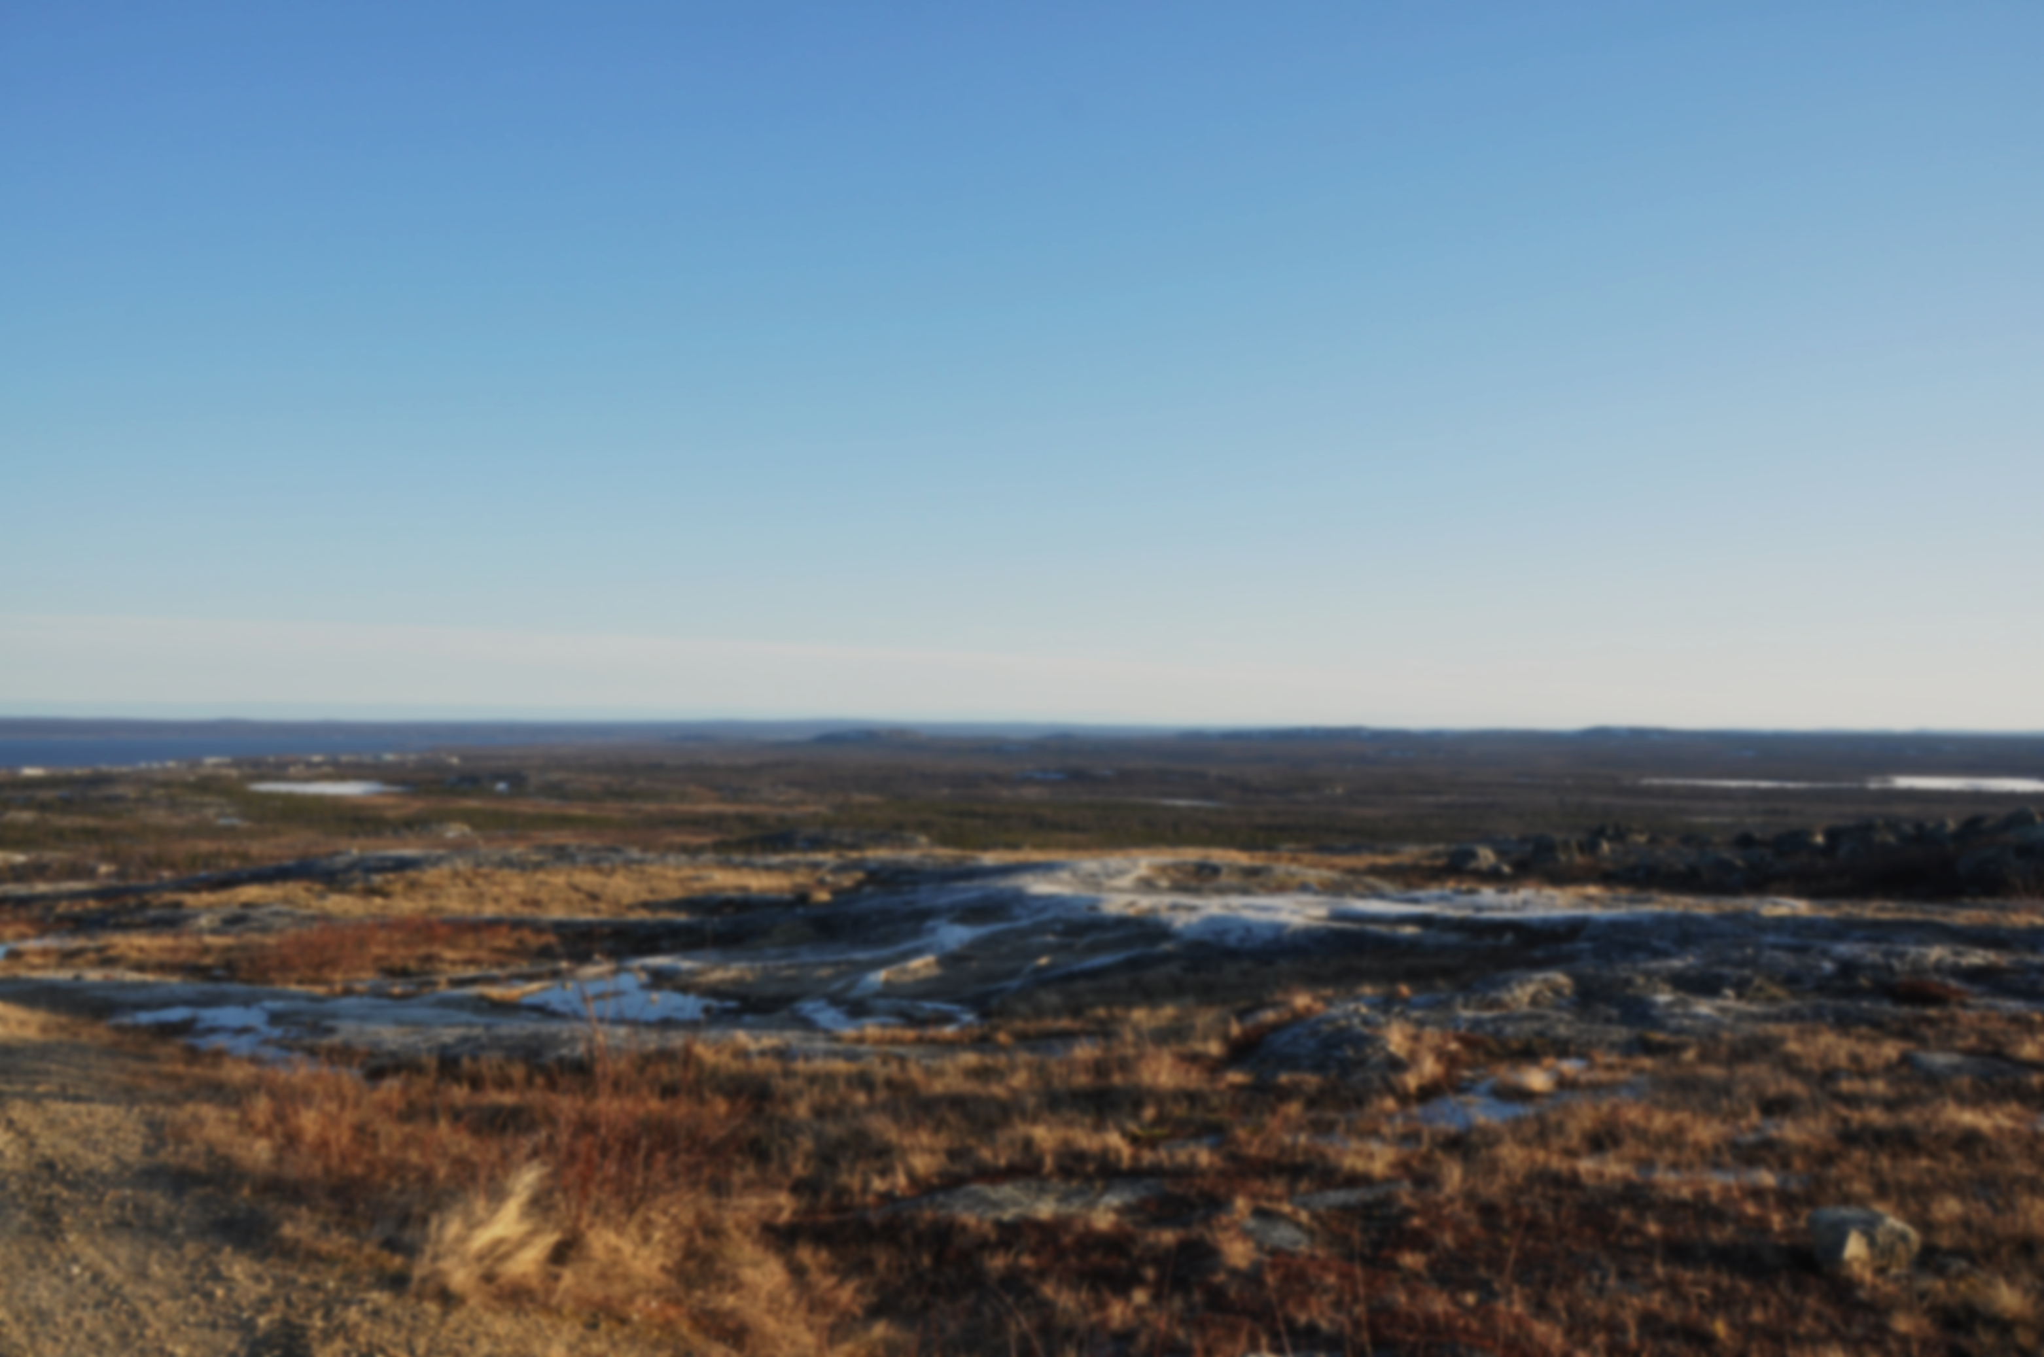
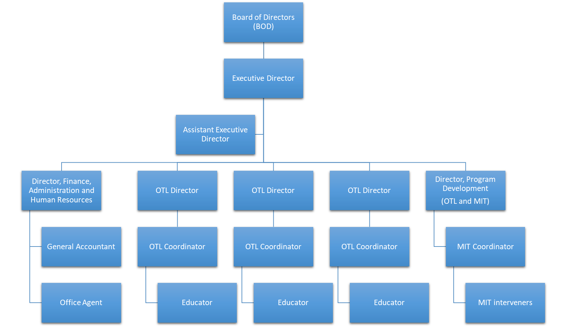
ᑎᒥᐅᔫᑉ ᖃᓄᐃᓕᖓᓂᖓᓂᒃ ᓄᐃᑕᑎᑦᓯᒍᑎ
Executive Director
Assistant Executive Director
Director, Finance, Administration and Human Resources
OTL Director
Director, Program Development
(OTL and MIT)
OTL Director
OTL Director
OTL Coordinator
OTL Coordinator
OTL Coordinator
Educator
Educator
Educator
General Accountant
Office Agent
Board of Directors (BOD)
MIT Coordinator
MIT interveners
91%-ᖏᑦ ᐱᓇᓱᒐᓕᒫᑦ ᓴᕿᔪᕐᒥ ᑎᒍᒥᐊᕐᑕᐅᔪᑦ ᐃᓄᑐᐃᓐᓇᓄᑦ
Notes:
We are 34 positions

Slide 6

Notes:
Luke – since June 27th

Slide 7
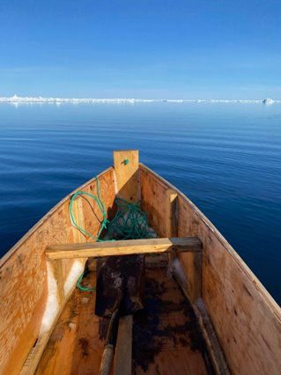
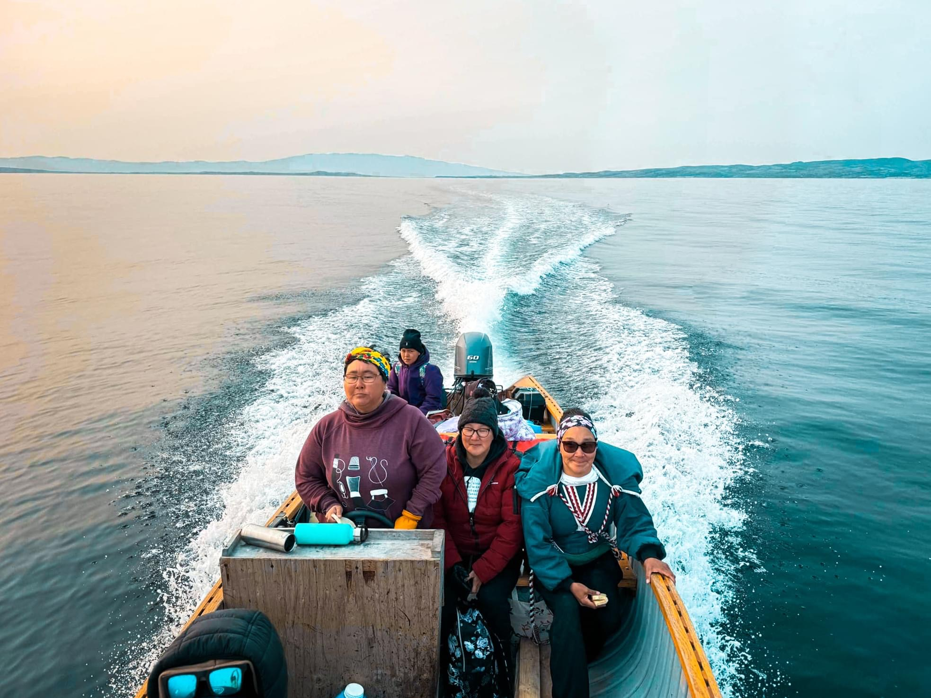
On-The-Land
ᓄᓇᒥ
ᓴᕿᔫᑉ ᓄᓇᒥ ᐃᓚᓕᒃ ᐊᖑᑎᓂᒃ ᐊᕐᓇᓂᓪᓗ ᐃᓕᓐᓂᐊᑎᑦᓯᔨᓂᒃ ᐊᑐᐃᓐᓇᖃᕐᓱᑎᒃ ᐊᒥᓱᓂᒃ ᐊᑦᔨᒌᖕᖏᑐᓂᒃ ᐃᓗᕐᖁᓯᒃᑯᑦ ᐱᓇᓱᐊᕐᓂᒥᒃ ᐊᒻᒪᓗ ᐃᓕᓐᓂᐊᓂᕐᓂᒃ ᐱᒍᑦᔭᐅᔪᑦ ᐃᓚᐅᕕᒋᓚᖓᔭᖏᓐᓂᒃ.
ᐃᓗᕐᖁᓯᒃᑯᑦ ᐃᓪᓕᕆᔭᐅᔪᑦ ᐃᓕᓐᓂᐊᑎᑦᓯᒍᑎᐅᔪᑦ ᐊᑦᑕᓇᕐᑐᒨᑐᐃᓐᓇᕆᐊᖃᕐᓂᐹᓂᒃ ᐃᓄᑑᓈᕐᑎᑐᓂᒃ ᓄᓇᓕᒻᒥ ᐃᑲᔪᕐᓂᑯᑦ ᑖᒃᑯᓂᖓ ᐱᑐᒋᐊᓪᓚᓂᕐᒧᑦ ᓇᑭᖕᖔᕕᒋᓯᒪᔭᒥᓄᑦ
ᐱᑐᒋᐊᓪᓚᑎᑦᓯᓂᒃᑯᑦ ᐱᒍᑦᔨᔭᑦᑎᓂᒃ ᐃᓗᕐᖁᓯᕐᒥᓄᑦ, ᐃᓕᓐᓂᐊᑎᓲᕗᑦ ᐊᓯᐅᒍᑦ ᐊᐅᒡᒉᒍᑎᑦᓴᖏᓐᓂᒃ ᓴᖑᑐᐃᓐᓇᕆᐊᖃᖕᖏᖔᕐᓗᑎᒃ ᐋᖓᔮᓐᓇᑐᓄᑦ ᐃᒥᐊᓗᒻᒧᓘᓐᓃᑦ.
ᓄᓇᒥᐅᑉ ᐱᓇᓱᑦᑎᖏᑦ ᐊᑐᐃᓐᓇᖃᕐᑐᑦ ᓄᓇᓕᒻᒦᑐᓂᒃ ᐊᑯᓐᓂᖁᑦᓯᐅᑎᒍᓯᕐᓂᒃ ᐱᒍᑦᔭᐅᔪᓂᒃ ᐅᑎᕐᑎᓯᓂᒃᑯᑦ ᐃᓗᕐᖁᓯᒃᑯᑦ ᑭᓇᐅᓂᕐᒥᓄᑦ.

Slide 8
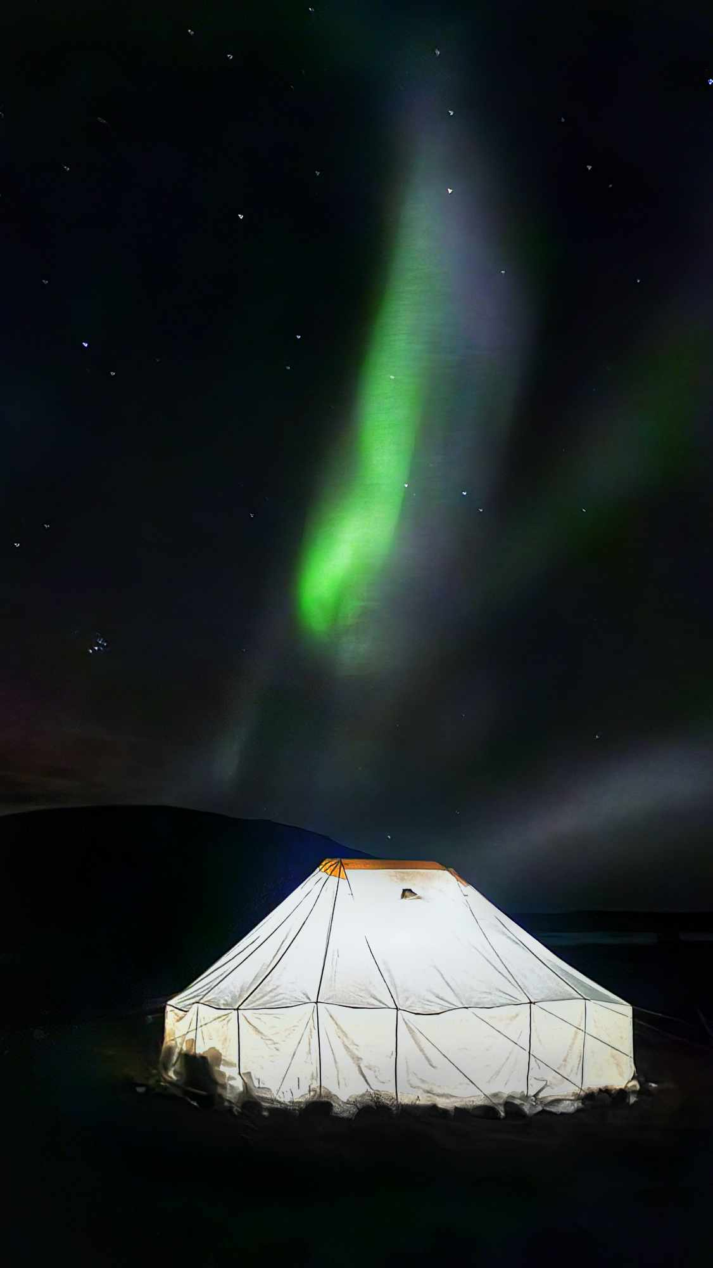
ᓄᓇᒥ
ᐊᓐᓂᑐᕐᑕᐅᔪᓕᒫᑦ ᐊᑐᐃᓐᓇᐅᑎᑕᐅᓲᑦ ᓄᓇᓕᒻᒧᑦ ᐃᓄᑐᖃᕐᓅᓕᖓᑦᓱᑎᒃ, ᐊᑦᑕᓇᕐᑐᒨᑐᐃᓐᓇᕆᐊᓕᓐᓄᑦ ᐃᓚᒌᓄᑦ, ᓄᓇᓕᒻᒥ ᓱᒐᓚᓐᓂᓄᑦ ᐊᒻᒪᓗ ᐱᒍᑦᔭᐅᔪᓄᑦ.
ᒫᓐᓇ 6-ᓂ ᓄᓇᓕᓐᓂ: ᐃᓄᑦᔪᐊᖅ, ᐳᕕᕐᓂᑐᖅ, ᐊᑯᓕᕕᒃ, ᑰᑦᔪᐊᖅ, ᑲᖏᕐᓱᖅ ᐊᒻᒪᓗ ᑲᖏᕐᓱᐊᓗᑦᔪᐊᖅ
2024 ᐱᒋᐊᕐᓂᖓᓂᓂᑦ
1950-ᓂᒃ ᐊᒥᓲᓂᕐᓭᑦ ᐃᓚᐅᖃᑕᐅᓯᒪᔪᑦ
1500-ᓂ ᓄᓇᒦᓐᓂᓂ/ᐱᓇᓱᐊᕐᓂᓂ

Slide 9
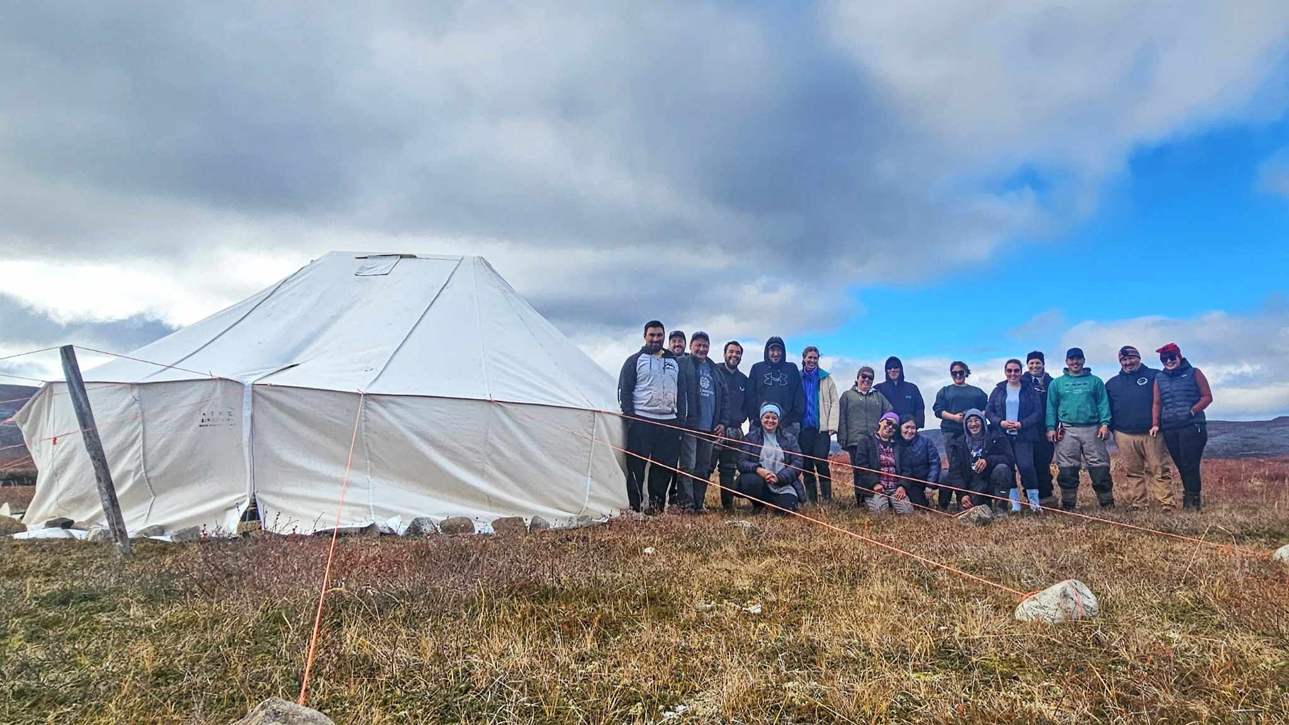
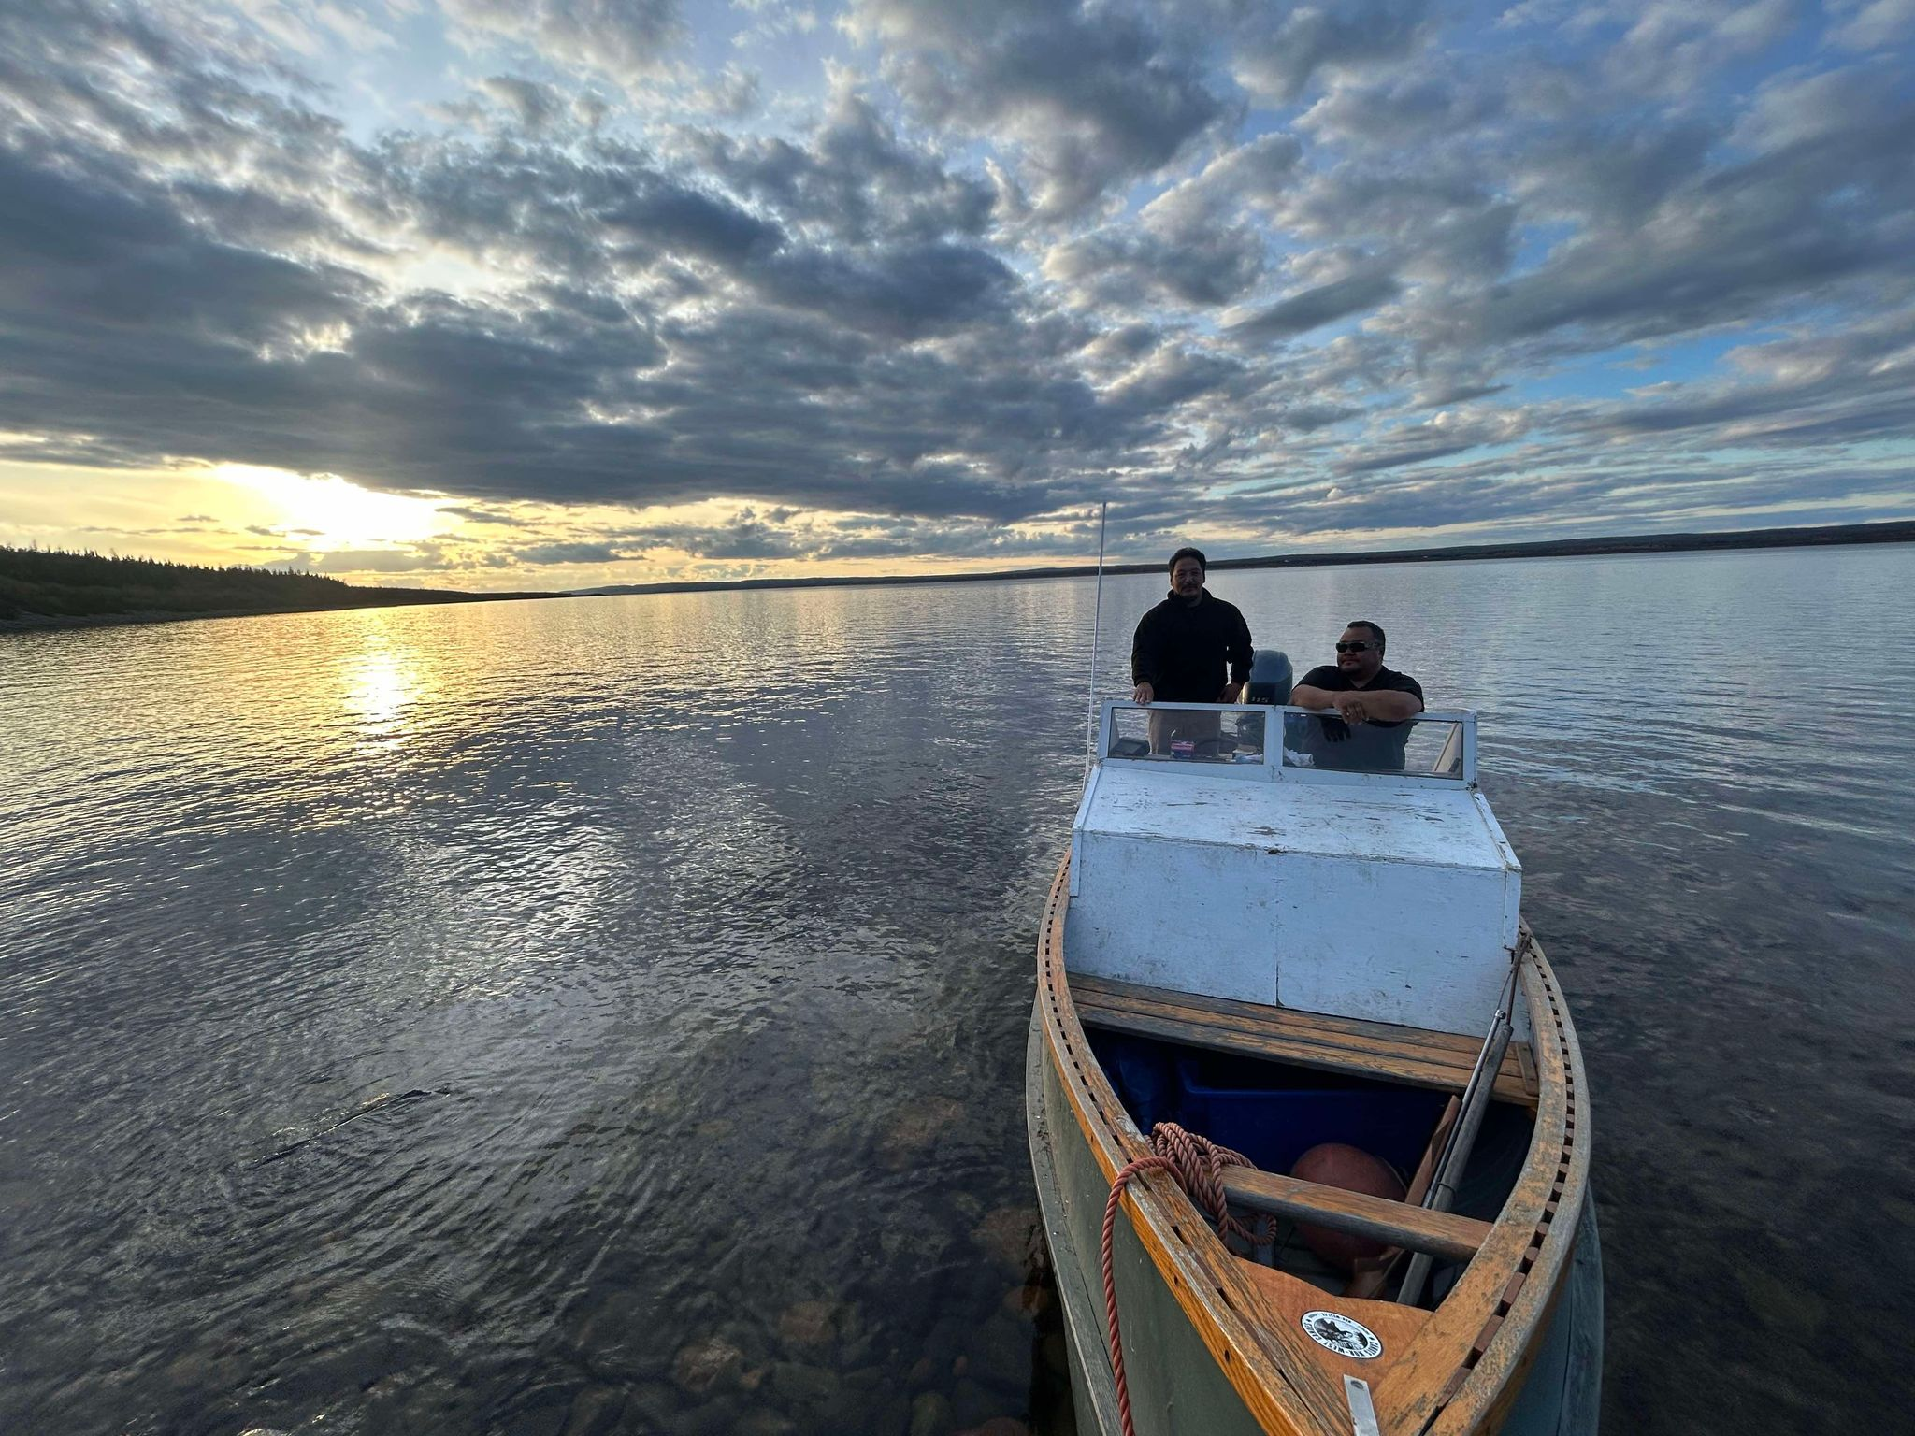
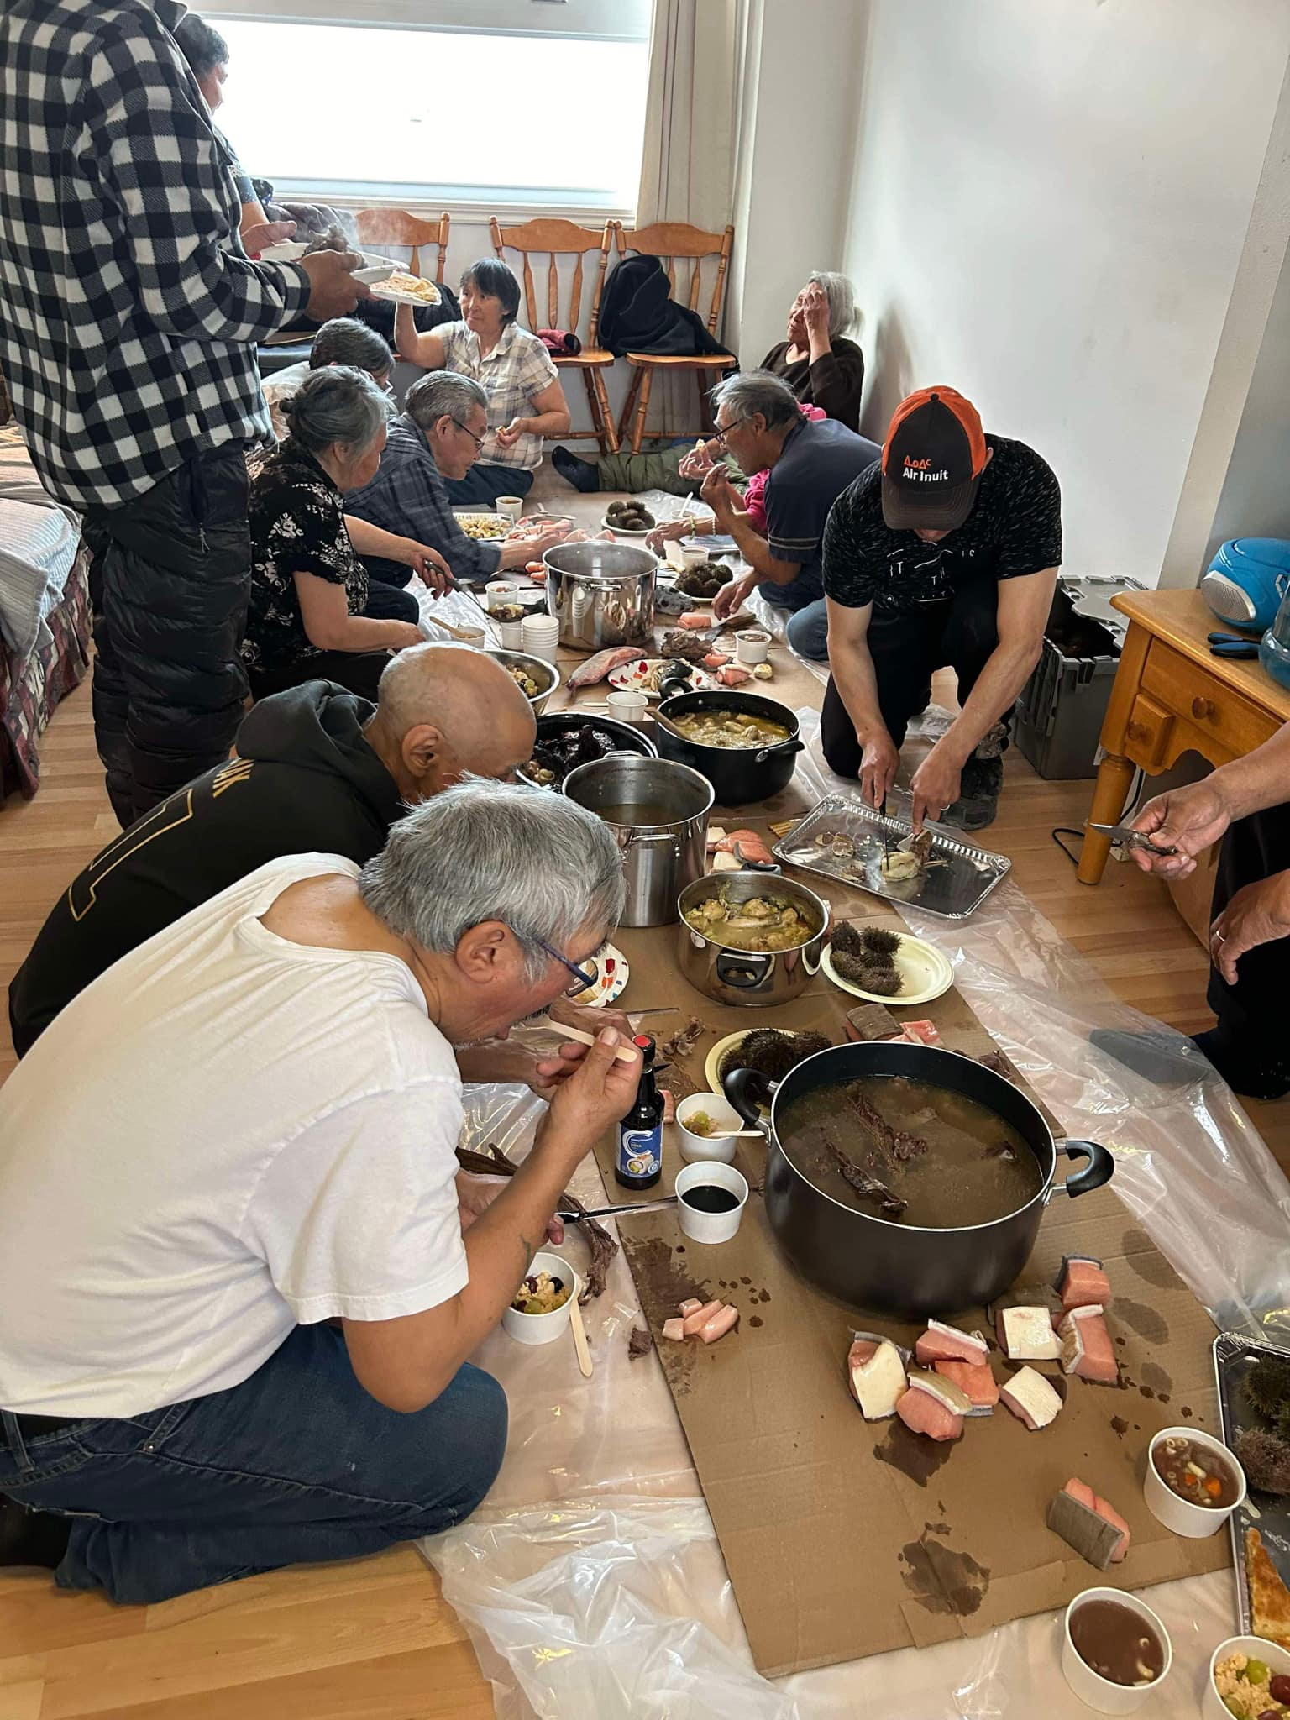
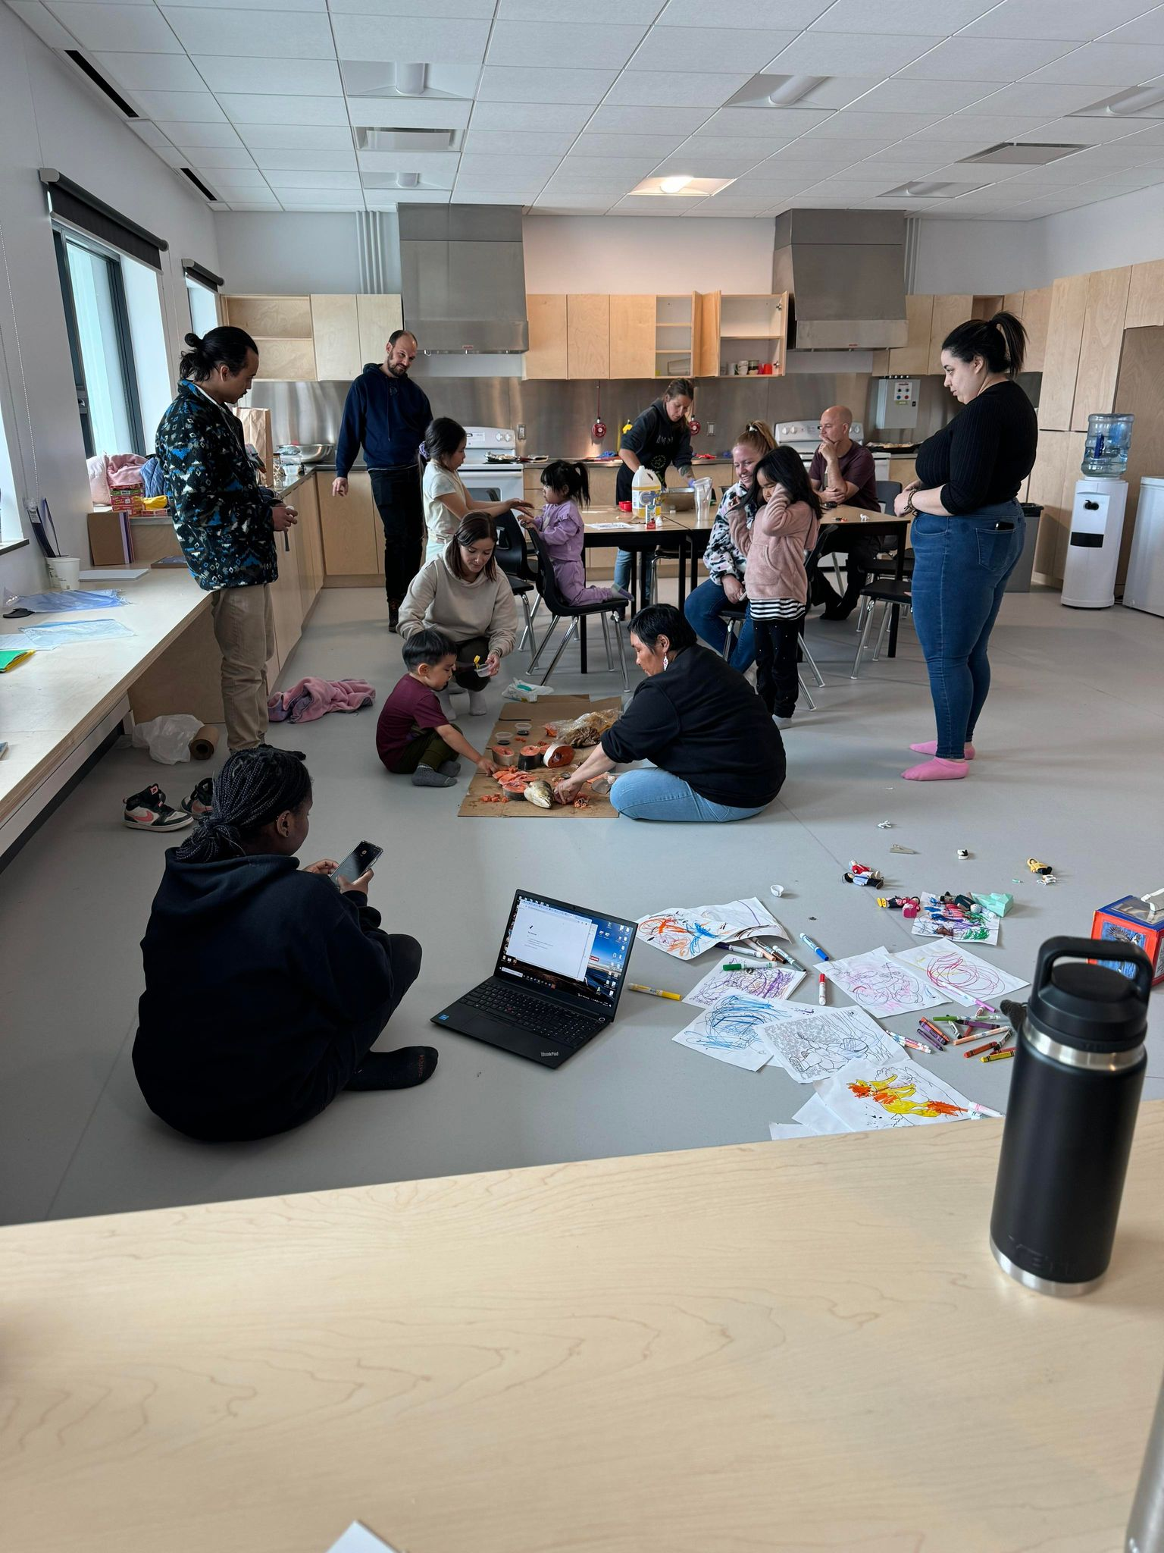
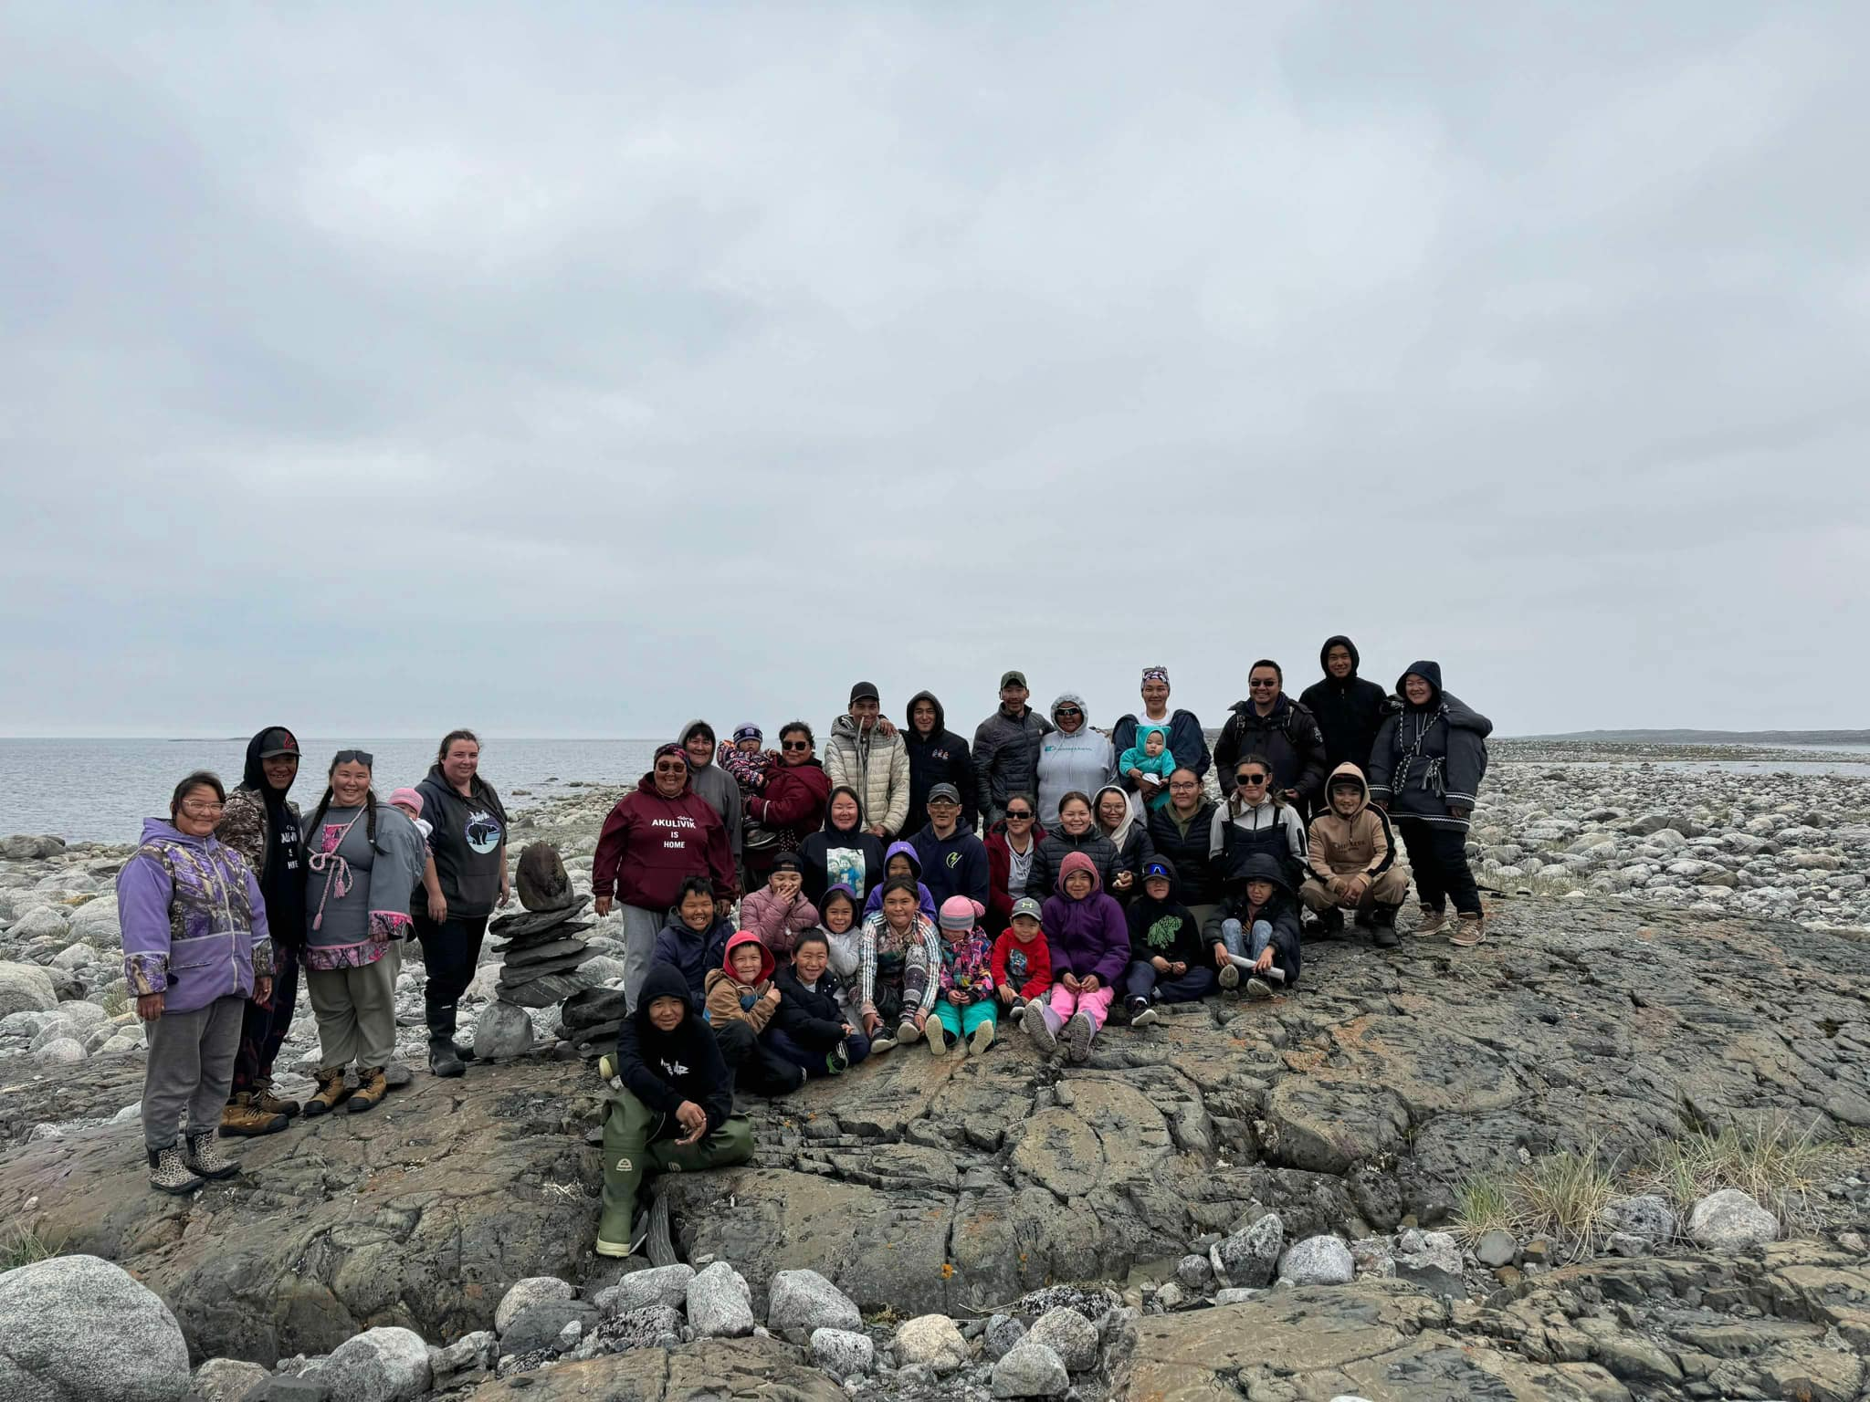

Slide 10
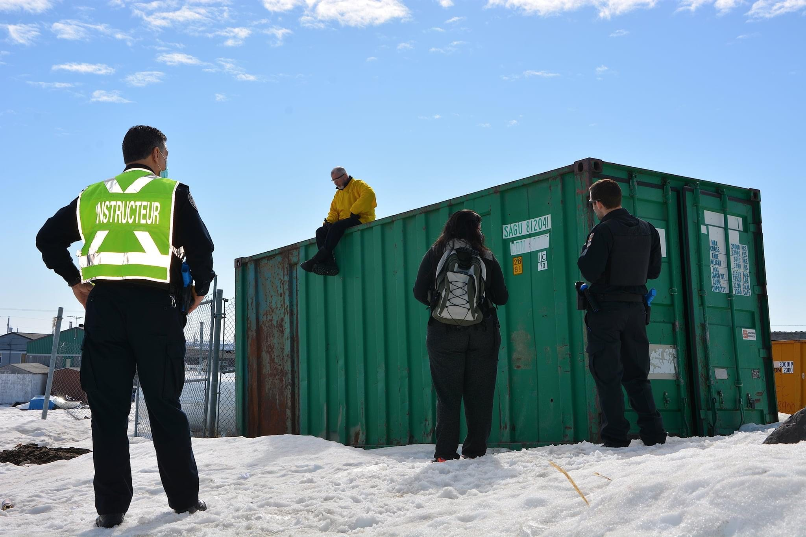
ᓇᒧᑐᐃᓐᓈᕈᓐᓇᑐᑦ ᐊᑯᓐᓂᖁᑦᓯᐅᑎᔩᑦ (MIT)
ᓇᒧᑐᐃᓐᓈᕈᓐᓇᑐᑦ ᐊᑯᓐᓂᖁᑦᓯᐅᑎᔩᑦ ᑲᒪᓇᓱᑦᑏᑦ ᐃᓚᓖᑦ ᐃᓄᓕᕆᔨᒥᒃ ᐳᓖᓯᒥᓪᓗ ᑲᒪᓇᓱᓲᓐᓂᒃ ᓄᓇᓕᒻᒥᒃ ᐊᒻᒪᓗ ᑲᒪᖃᑦᑕᓱᑎᒃ ᑲᑉᐱᐊᓈᕿᔪᓂᒃ ᐆᑦᑑᑎᒋᓗᒋᑦ : ᐃᒻᒥᓂᐊᕐᑐᒧᑦ ᑲᑉᐱᐊᓈᕿᔪᑦ, ᐁᑉᐸᕇᑦ ᐋᓐᓂᑎᕆᐅᑎᔪᑦ, ᐃᓱᒪᒃᑯᑦ ᖃᓄᐃᖕᖏᓯᐊᕐᓂᖅ ᐊᒻᒪᓗ ᐱᐊᕃᑦ ᐊᑦᑕᓇᕐᑐᒨᑐᐃᓐᓇᕆᐊᓖᑦ ᐅᖄᓚᒍᑕᐅᔪᑦ
ᐊᑐᓲᑦ ᓄᓪᓚᑎᑦᓯᒐᓱᐊᕈᑎᓂᒃ ᐊᒻᒪᓗ ᓭᒻᒪᑎᑦᓯᒐᓱᐊᕈᑎᓂᒃ ᐋᕐᖀᒐᓱᑦᓱᑎᒃ ᑲᑉᐊᓈᕿᓂᕐᒥᒃ ᓄᓇᓕᒻᒥ ᐃᓚᖃᕐᓱᑎᒃ ᐃᓚᖏᓐᓂᒃ ᐱᖃᑎᖏᓐᓂᓗ
ᐃᖏᕐᕋᔪᖅ ᐳᕕᕐᓂᑐᒥ

Slide 11
ᓇᒧᑐᐃᓐᓈᕈᓐᓇᑐᑦ ᐊᑯᓐᓂᖁᑦᓯᐅᑎᔩᑦ (MIT)
ᔭᓄᐊᕆᒥᑦ ᓅᕕᒻᐱᕆᒧᑦ 2024:
  595 ᐊᑯᓐᓂᖁᑦᓯᐅᑎᓃᑦ ᐊᑑᑎᔪᕕᓃᑦ
  85%-ᖏᑦ ᐊᑯᓐᓂᖁᑦᓯᐅᑎᓃᑦ ᐋᕐᕿᑕᕕᓃᑦ ᓄᓇᓕᒻᒥ
  70%-ᖏᑦ ᐊᑯᓐᓂᖁᑦᓯᐅᑎᓃᑦ ᐊᕐᓇᓂᒃ ᑲᒪᔪᕕᓃᑦ
  97%-ᖏᑦ ᐊᑯᓐᓂᖁᑦᓯᐅᑎᓃᑦ ᐃᕐᖃᑐᐃᕕᒃᑰᕆᐊᑐᕐᓂᖏᑦᑐᑦ (ᑎᒍᔭᐅᔪᑦ, ᒪᑉᐱᒐᖅ-38)
  74%-ᖏᑦ ᐱᒍᑦᔭᐅᔪᑦ ᐱᓇᓱᐊᖃᑕᐅᑦᓯᐊᑐᕕᓃᑦ ᓇᒧᑐᐃᓐᓈᕈᓐᓇᑐᓄᑦ ᐊᑯᓐᓂᖁᑦᓯᐅᑎᔨᓄᑦ

Slide 12
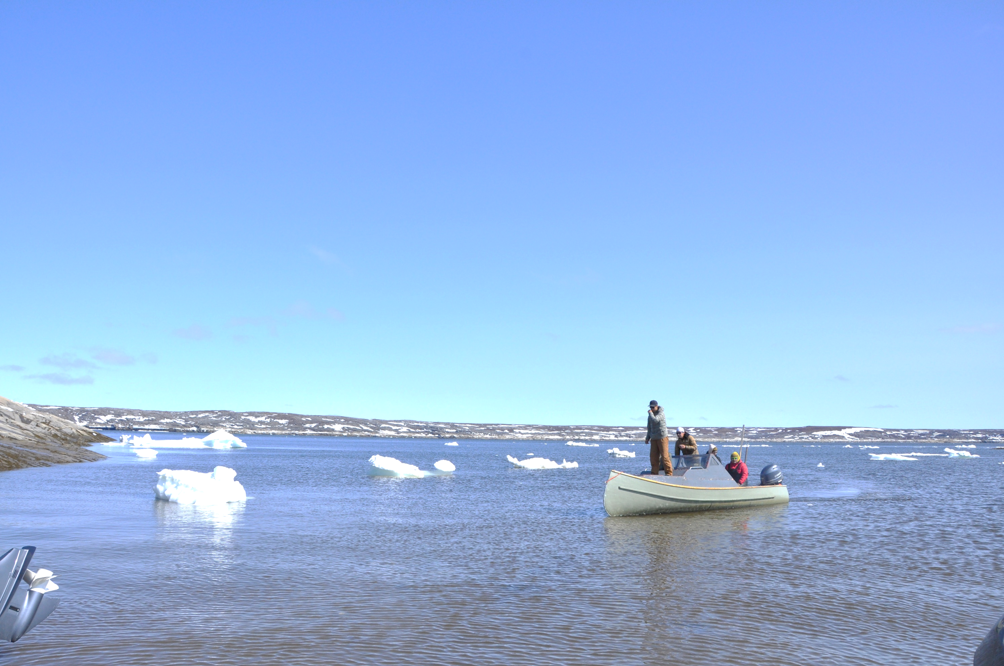
ᑮᓇᐅᔭᓕᕆᓂᖅ
ᑮᓇᐅᔭᖃᕐᑎᓯᓪᓚᕆᑦᑐᖅ
  ᐅᖓᓗᒃ 3.4 ᒥᓕᐊᓐ ᐊᕐᕌᒍᑕᒫᑦ (ᑲᑎᕕᒃ ᓄᓇᓕᓕᒫᑦ ᑲᕙᒪᖓ ᐊᒻᒪᓗ ᒪᑭᕝᕕᒃ)
ᐊᓯᖏᑦ ᑮᓇᐅᔭᖃᕐᑎᓯᔪᑦ
ᑯᐯᒃ ᑐᕐᖃᑕᕐᕕᖓ ᐃᕐᖃᑐᐃᓂᓕᕆᓂᕐᒧᑦ
ᐅᑭᐅᕐᑕᑐᒥ ᐊᒻᒪᓗ ᓄᓇᖃᕐᖄᓯᒪᔪᓂᒃ ᐱᓂᕐᓗᑌᓕᑎᑦᓯᓂᕐᒧᑦ ᑮᓇᐅᔭᖃᕐᑎᓯᒍᑎ
ᓄᓇᕕᒻᒥ ᐃᓗᓯᓕᕆᓂᕐᒧᑦ ᑲᑎᒪᔩᑦ
ᓇᐅᓕᒫᓂᒃ ᐊᑦᑕᓇᕐᑐᒦᑦᑎᓯᑦᑌᓕᓂᕐᒧᑦ ᑐᕐᖃᑕᕐᕕᒃ (ᑲᕙᒪᑐᖃᒃᑯᑦ ᐊᒻᒪᓗ ᑯᐯᒃ)
SRPNI (secrétariat aux relations avec les Premières Nations et les Inuit)
Secrétariat à la condition féminine
ᑲᑎᑦᓱᑎᒃ ᒥᑦᓵᓃᑦᑐᑦ $8 ᒥᓕᐊᓐ 2024-ᒧᑦ

Slide 13
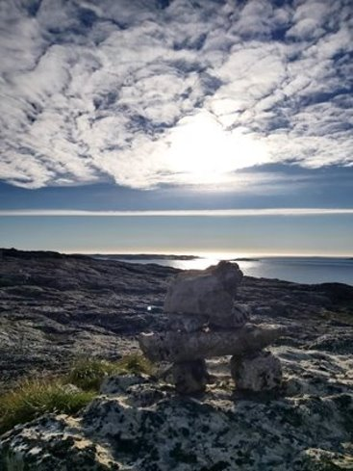
ᐊᓪᓗᕆᐊᕐᓂᐅᓛᓕᕐᒥᔪᑦ
ᐱᕙᓪᓕᐊᑎᑦᓯᓂᖅ ᓇᒧᑐᐃᓐᓈᕈᓐᓇᑐᓂᒃ ᐊᑯᓐᓂᖁᑦᓯᐅᑎᔨᓂᒃ ᑰᑦᔪᐊᒥ
ᐃᕐᐸᐸᓪᓕᐊᑎᑦᓯᓂᖅ ᓴᕿᔪᕐᒥᒃ ᓄᓇᕕᓕᒫᒧᑦ
ᓄᓇᒥᐅᑉ ᐃᓕᓐᓂᐊᑎᑦᓯᓂᖏᑦ ᑲᑐᑦᔨᖃᑎᖃᕐᓗᑕ ᐱᓇᓱᐊᖃᑎᑦᑎᓂᒃ
ᐊᓪᓚᕕᑦᑖᓃᑦ
ᐊᑐᐃᓐᓇᖃᕐᓂᖅ ᐱᒍᑦᔨᓂᒋᐊᓪᓚᓂᒃ ᓄᓇᓕᒻᒥᐅᓕᒫᓄᑦ ᓴᕿᔫᑉ ᑲᔪᓯᑎᑕᐅᕕᖏᓐᓂ

Slide 14
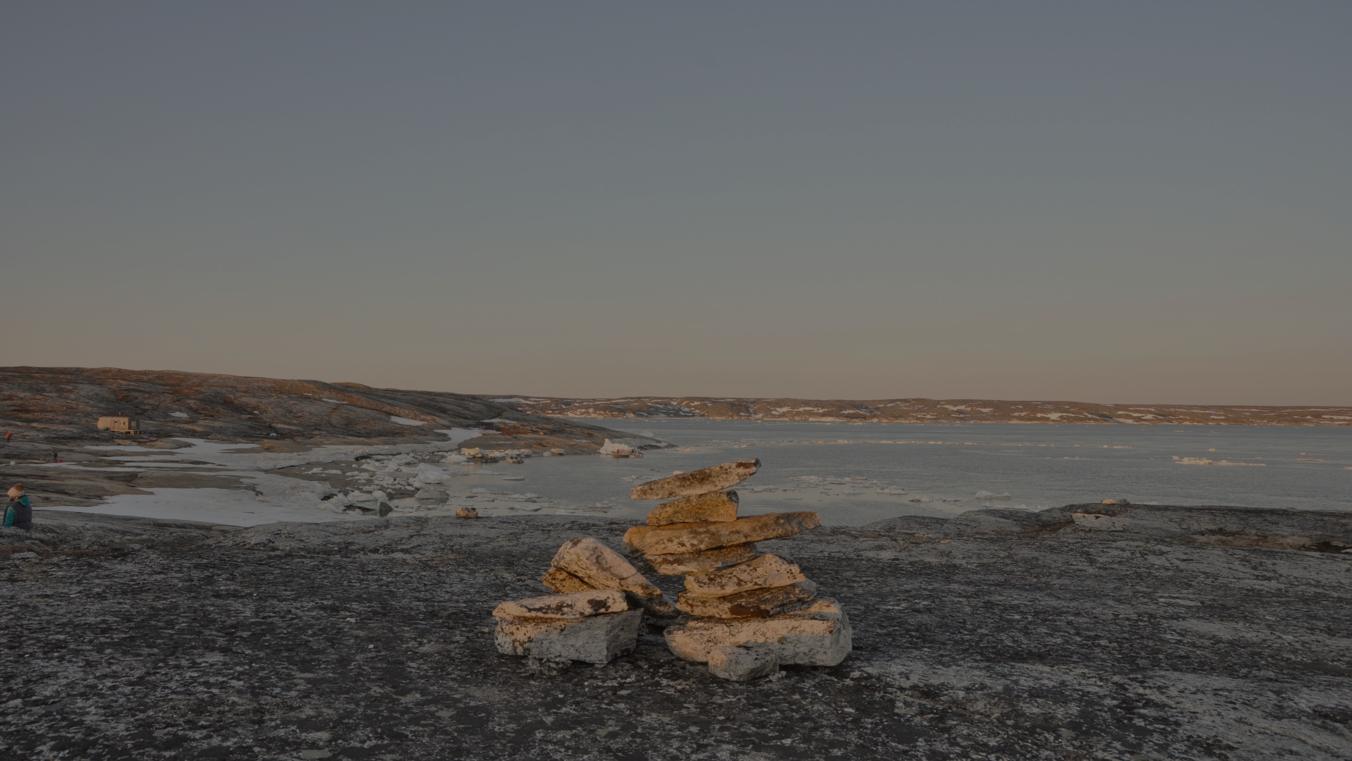
ᓇᑯᕐᒦᒃ!
ᐊᐱᕐᓲᑎᑦᓴᓖᒃ?

