Slide 1

ᑎᓕᔭᐅᒪᒍᑎᕗᑦ ᓯᕗᓂᑦᑎᓂᓗ ᑕᐅᑐᑦᑕᕗᑦ
ᑐᓵᔪᐃᑦ ᑲᓱᕐᑎᓯᓱᖑᕗᑦ ᐊᑯᓐᓂᖃᕈᑎᖏᓐᓂᒃ ᐃᓕᓐᓂᐊᓂᕐᒥᓗ ᐃᓗᓯᓕᕆᓂᕐᒥᓗ ᐱᑦᔪᔨᒍᑎᓂᒃ ᐱᔭᐅᑎᓲᒥᓐᓂᒃ ᓄᓇᕐᖃᑎᒌᓄᑦ ᐱᕕᖃᕐᑎᓯᒍᑎᒋᑦᓱᒋᑦ ᐃᓕᓐᓂᐊᑎᑕᐅᒍᑎᑦᓴᓂᒃ ᐃᓕᖓᔪᓂᒃ ᑐᓯᓚᓐᓂᓄᑦ ᐃᑲᔪᕐᓯᒍᑎᒋᑦᓱᒋᓪᓗ ᐱᒐᓱᒍᑎᒋᒍᓐᓇᑕᖏᓐᓂᒃ ᑐᓵᓂᖃᑦᓯᐊᕆᐊᖃᕐᓂᒥᒃ. ᑐᓵᔪᐃᑦ ᑲᒪᕙᓐᓂᐊᑐᑦ ᖃᐅᔨᓴᕐᓗᑎᒃ ᓱᓇᒧᑦ ᖃᓄᕐᓗ ᑐᓵᑦᓯᐊᖏᑦᑐᓂᖃᕐᒪᖔᑕ ᑐᓵᑦᓯᐊᖏᑦᑐᕈᕐᑎᓯᑦᑌᓕᒍᑎᓂᒃᓗ. ᓯᕗᓂᖃᕈᑎᐅᔪᑦ ᐊᑯᓂ-ᑐᓯᓚᓐᓂᖃᕐᓂᐅᑉ ᓱᕐᕃᓯᒪᒍᑎᒋᓲᖏᓐᓂᒃ ᐱᔪᖃᕐᑎᓯᓪᓗᐊᑌᓕᓇᓱᓪᓗᑎᒃ ᐱᐅᓯᒋᐊᕐᓗᒋᓪᓗ ᖃᓄᐃᖕᖏᓯᐊᕐᓂᓴᖏᓪᓗ ᐃᓅᖃᑎᒥᓄᓪᓗ ᐃᓚᐅᑦᓯᐊᖏᓐᓇᕈᓐᓇᖁᓪᓗᒋᑦ ᑐᓯᓚᑦᑐᑦ ᐃᓄᐃᑦ

Slide 2
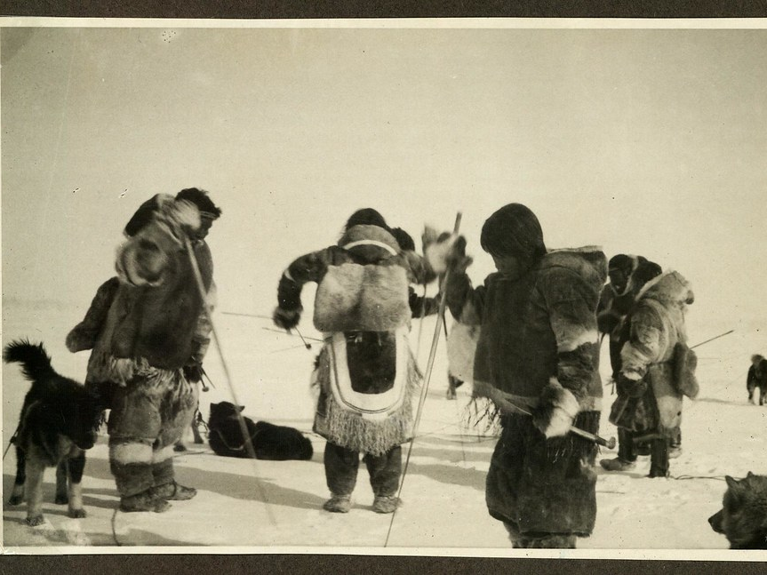
ᑐᓵᓂᒃᑯᑦ ᖃᓄᐃᖕᖏᓯᐊᕐᓂᓗ ᐃᑦᓅᑦᔪᓯᐅᓪᓗ ᓱᕐᕋᑕᐅᒪᓂᖏᑦ ᓄᓇᓕᑐᙯᑦ ᓄᓇᓕᖏᓐᓂ
ᑕᐅᑐᑦᑕᖃᕐᓂᖅ ᐃᓄᑐᐃᓐᓀᑦ ᐱᐅᓯᑐᖃᖏᓐᓂᒃ ᑐᓵᑦᓯᐊᕆᐊᖃᕐᓂᓗ
15—20 ᒥᓇᑦᓯᓂ ᑐᓴᕐᑎᓯᒍᑎᐅᓂᖏᑦ
This Photo by Unknown Author is licensed under CC BY-SA

Slide 3

ᑐᑭᓯᑎᑦᓯᒍᑎᖃᕐᓃᑦ ᑐᓵᓂᒃᑯᑦ ᖃᓄᐃᖕᖏᓯᐊᕐᓂᓴᓂᒃ
ᑐᓵᓂᒃᑯᑦ ᖃᓄᐃᖕᖏᓯᐊᕐᓂᖅ ᑐᑭᖃᕐᐳᖅ ᑲᔪᓯᓂᖃᑦᓯᐊᑐᒥᒃ ᑐᓵᓂᖃᑦᓯᐊᓂᕐᒥᒃ ᐊᑐᕐᓗᒋᑦ ᑐᓯᓚᑦᓯᑌᓕᑎᑦᓯᒍᑏᑦ, ᐱᔪᖃᕐᑎᓯᑌᓕᓃᑦ ᓴᐳᑦᔨᓯᒪᓃᓪᓗ
ᓱᕐᕃᓂᖃᓲᖑᒻᒪᑦ ᑐᓴᖃᑦᑕᐅᑎᓂᕐᒥᒃ, ᐃᓕᑦᓯᓂᕐᒥᒃ, ᐱᓂᕐᓗᑌᓕᓂᕐᒥᒃ ᐃᓅᑦᔪᓯᑎᒍᓪᓗ ᐱᑐᑦᓯᒪᐅᑎᓂᒃ
ᓄᓇᓕᑐᙯᑦ ᓄᓇᓕᖏᓐᓂ, ᑐᓯᓚᖕᖏᓂᖅ ᐱᑐᑦᓯᒪᒻᒪᑦ ᐃᓗᓐᓈᒍᑦ ᖃᓄᐃᖕᖏᓯᐊᕐᓂᓴᖏᓐᓄᑦ ᐃᓗᕐᖁᓯᕐᒥᓗ ᑲᔪᓯᑎᑦᓯᓂᖃᑦᓯᐊᓂᕐᓄᑦ.

Slide 4
ᑐᓯᓚᑦᓯᒍᑎᐅᓲᓪᓗ ᖃᓄᐃᑦᑐᒥᓪᓗ ᑐᓯᓚᓐᓂᖃᕐᓃᑦ
• ᑐᓯᓚᑦᓯᒍᑎᐅᓲᑦ: ᓯᐅᑎᐅᑉ ᐃᓗᐊᓂᓗ ᓯᓚᑖᓂᓐᓂᓭᓪᓗ
ᑐᓯᓚᑦᓯᓚᕆᓐᓇᑐᑦ: ᓯᐅᑎᐅᑉ ᐃᓗᐊᓂᓗᓐᓃᑦ ᐃᑉᐱᒍᓱᑎᐅᓪᓗᓃᑦ ᐱᐅᒍᓐᓀᓂᖓ (ᑐᓵᑦᓯᐊᖏᓕᕈᑎᐅᓲᖅᐋᕐᕿᓂᐊᕈᓐᓀᑐᒥᒃ)
• ᐅᐊᕈᑎᒌᒃ: ᑕᒪᖏᓐᓂᒃ ᐊᑑᑎᔭᖃᓕᕐᓂᖅ
• ᑐᓯᓚᑦᓯᒍᑎᐅᖏᓐᓇᓂᕐᓴᐅᓲᑦ: ᓂᐱᕆᑦᑐᓂᒃ ᑐᓵᖃᑦᑕᓂᖅ, ᖃᓂᒻᒪᓯᒧᑦ ᓱᕐᕋᑕᐅᓂᖅ, ᐃᓄᑐᖃᖕᖑᐸᓪᓕᐊᓂᖅ, ᐃᓅᓕᕐᓱᓂ ᐊᐅᖓᓃᑦᑐᑦ ᓯᐅᓯᕆᑦᓱᓂᓗ ᐋᓐᓂᐊᓯᐅᕐᑕᐅᓯᒪᖕᖏᓃᑦ

Slide 5
ᓄᓇᓕᑐᙯᑦ ᑕᐅᑐᒍᓯᖏᑦ ᑐᓵᓂᐅᑉ ᐃᓗᓯᖏᓐᓂᒃ
• ᑐᓵᓂᖅ ᐱᑐᑦᓯᒪᓪᓚᕆᑉᐳᖅ ᐅᓂᒃᑲᑐᓂᒃ ᓈᓚᓐᓂᓄᑦ, ᐅᖃᐅᓯᑐᐃᓐᓇᑯᑦ ᐱᕙᓪᓕᐊᓯᒪᓂᕐᒥᒃ ᐅᓂᒃᑲᐅᓯᕐᓄᑦ ᐱᐅᓯᑐᖃᒃᑯᓗ ᖃᐅᔨᒪᔭᐅᔪᑐᖃᕐᓄᑦ
• ᑐᓯᓚᓐᓂᖅ ᑐᓵᑦᓯᐊᕈᓐᓀᓂᕐᓗ ᓱᕐᕃᓯᒪᒍᓐᓇᐴᒃ ᐃᓚᐅᖃᑦᑕᓂᑦᓴᓂᒃ ᐃᓗᕐᖁᓯᕐᒥᒃ ᐱᒐᓱᒍᑎᖃᓕᕐᑐᓄᓪᓗ ᐃᓅᖃᑎᒌᓐᓂᑯᓪᓗ ᓄᓇᕐᖃᑎᒌᓂ.
•ᓄᓇᓕᑐᙯᑦ ᖃᓄᐃᓘᕈᑎᒋᓲᖏᑦ ᐱᔭᖃᕐᓂᓴᐅᕗᑦ ᓇᓪᓕᖁᐊᕇᓐᓂᓂᒃ, ᐱᑐᑦᓯᒪᐅᑎᓂᕐᓂᓗ ᐃᓗᓐᓈᒍᓪᓗ ᖃᓄᐃᖕᖏᓯᐊᕆᐊᖃᕐᓂᓂᒃ.

Slide 6
ᐃᓅᑦᔪᓯᓂᒃᓗ ᐃᑉᐱᓂᐊᕐᓂᓂᒃᓗ ᓱᕐᕃᓯᒪᓂᕆᓲᖏᑦ ᑐᓯᓚᑦᓯᓂᐅᑉ
•. ᑐᓴᖃᑦᑕᐅᑎᓃᑦ ᐊᕐᖁᑌᓐᓕᑕᕈᑎᖏᑦ ᓯᕗᓪᓕᐅᒍᓐᓇᐳᑦ ᐃᓄᑑᑎᓕᓂᕐᓂᑦ ᐃᓚᐅᖃᑦᑕᕈᓐᓀᓂᕐᓄᓗ ᓄᓇᓖᑦ ᖃᓄᐃᓘᕐᓂᕆᓕᕐᑕᖏᓐᓄᑦ
• ᐃᑉᐱᓂᐊᕐᓃᑦ ᐃᓱᒪᑦᓯᐊᕈᓐᓀᓂᕐᒥᒃ, ᑲᖕᖑᓱᓐᓂᒥᒃ ᐅᕝᕙᓘᓐᓃᑦ ᐃᒣᑦᑐᕆᓐᓈᓂᕐᒥᒃ ᐱᑕᓕᐹᓗᕙᑉᐳᑦ
•ᓄᓇᓕᐊᕈᕐᓂ ᐃᓄᓕᓐᓂ ᐃᓚᒌᑦᓯᐊᑐᓂᒃ ᑐᓯᓚᓐᓂᖅ ᓱᕐᕃᒪᒍᓐᓇᖁᖅ ᐃᓅᖃᑎᒌᓐᓂᓂᓪᓗ ᑭᓇᐅᑎᓐᓂᓂᓪᓗ

Slide 7
ᑐᓯᓚᓐᓂᓗ ᐱᐅᓯᕐᓱᓯᐊᕈᓐᓀᓂᕐᓗ
ᑕᑯᑦᓴᕈᕐᑕᐅᓯᒪᔪᑦ ᖃᐅᔨᓴᕐᓂᓄᑦ
ᐃᓄᐃᑦ ᑐᓯᓚᒐᓚᑦᑐᑦ ᒪᕈᕕᓪᓗᐊᑐᒥᒃ ᐱᐅᓯᕐᓱᓯᐊᖕᖏᓕᑐᐃᓐᓇᕆᐊᖃᕐᓂᓴᐅᕗᑦ
ᐊᓯᖏᑦ ᑐᓯᓚᓐᓂᓭᑦ ᐱᖓᓱᕕᓪᓗᐊᑐᒥ ᐱᒍᓇᐅᓂᕐᓴᐅᑎᓪᓗᒋᑦ, ᑐᓯᓚᑦᓯᓚᕆᓪᓗᑎᒃ ᐱᐅᑦᓯᐊᖏᓕᕐᓂᖃᕈᓇᐅᓂᕐᓴᐅᕗᓪᓗ 5-ᕕᓪᓗᐊᑐᒥᒃ
ᖃᐅᔨᓴᕐᓂᐅᓯᒪᔪᑦ (ᓲᕐᓗ Johns Hopkins ᐋᓐᓂᐊᕕᒻᒥ, WHO/ᓯᓚᕐᔪᐊᒥᐅᑦ ᐃᓗᓯᓕᕆᔭᐅᓂᖏᓐᓄᑦ ᐱᓇᓱᒐᖃᕐᕕᒧᑦ, Lancet Commission-ᑯᓐᓄᓗ) c

Slide 8
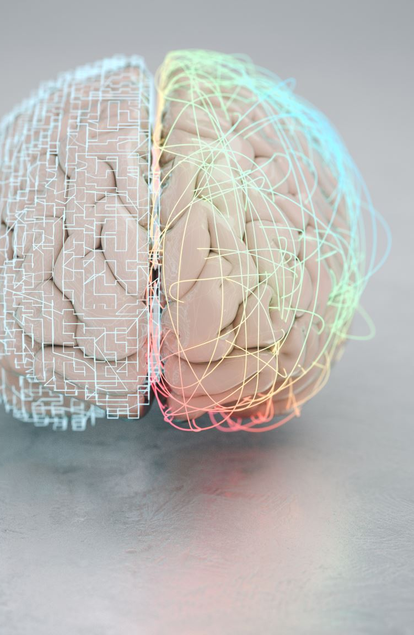
ᑐᓯᓚᓐᓂᖅ ᖃᓄᖅ ᖃᕆᑕᕐᒥᒃ ᓱᕐᕃᓂᖃᓲᖑᒻᒪᖔᑦ
ᐃᓱᒪᒥᐅᑌᑦ: ᖃᕆᑕᖅ ᐊᑦᓱᕈᕐᓂᓴᐅᓱᖑᕗᖅ ᐃᓄᒃ ᑐᓵᑦᓯᐊᖏᒧᑦ ᑐᑭᓯᐊᑦᓯᐊᕈᓐᓀᑐᐊᕐᒪᑦ, ᐊᐅᓚᔨᔭᑦᓴᓂᒃᓗ ᐃᓱᒪᒋᒋᐊᓕᓐᓂᓗ ᐱᑕᖃᖕᖏᓂᕐᓴᐅᓕᕐᓱᓂ
ᐃᓅᖃᑎᐅᒍᓐᓇᓂᕐᒥᑦ ᐃᓄᑐᐊᕈᕐᓂᖅ: ᑐᓯᓚᓐᓂᑯᒥᓄᑦ ᐃᓄᒃ ᐃᓄᐊᖑᖃᑦᑕᓯᒍᓐᓇᐳᖅ ᓂᑦᔭᖃᑎᒌᓄᑦ ᐃᓚᐅᒍᓐᓇᕈᓐᓀᓱᓂᓗ ᓱᒐᓚᑦᑐᓄᓪᓗ ᐃᓚᐅᔪᓐᓇᕈᓐᓃᓱᓂ, ᐃᓄᑐᐊᖑᖏᓐᓇᐸᓪᓕᐊᓂᕐᑖᓱᓂ—ᑕᒪᓐᓇ ᐱᐅᓯᕐᓱᓯᐊᕈᓐᓀᓕᕈᑎᐅᓱᖑᒋᐊᖓ ᖃᐅᔨᒪᔭᐅᔪᖅ
ᖃᕆᑕᐅᑉ ᐃᓂᓪᓚᖓᓂᖓᑕ ᐊᓯᑦᔨᓂᖏᑦ: ᐊᑯᓂᓗᐊᖅ ᑐᓯᓚᓕᕋᒥ ᐃᓅᑉ ᖃᕆᑕᖓᑕ ᐃᓚᖓ ᐊᑐᑦᓯᐊᕈᓐᓀᕈᓐᓇᐳᖅ ᐃᓕᖓᓂᓗᐊᖕᖑᐊᒥᒍᑦ ᑐᓴᕐᓴᓄᑦ ᐅᖃᐅᓯᕐᒧᑦ, ᑕᒪᒃᑯᐊ ᐃᓱᒪᒥᐅᑕᓄᑦ ᓄᖑᑉᐸᓕᐊᒍᑎᐅᒍᓐᓇᖁᑦ.

Slide 9
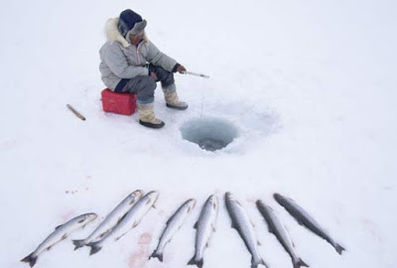
ᑐᓵᑦᓯᐊᖏᓕᕐᓂᓗ/ᑐᓯᓚᑦᓯᓂᕐᓗ ᐃᓄᑐᐃᓐᓀᓓᓗ ᐱᐅᓯᑐᖃᕐᒥᒍᑦ ᒪᙯᒍᓯᖏᑦ
ᑐᓵᓂᖅ ᐊᑑᑎᖃᓪᓚᕆᑉᐳᖅ ᐱᐅᓯᑐᖃᕐᒥᒍᑦ ᐃᓄᑐᐃᓐᓀᑦ ᒪᙯᒍᓯᖏᑎᒍᑦ—ᐆᒪᔪᓂᒃ ᑐᓵᔭᖃᕐᓂᑯᑦ, ᑐᕓᑦ ᐊᐅᓚᓂᖏᑎᒍᑦ, ᓯᓚᐅᓪᓗ ᐊᑑᑎᓕᕐᑕᖏᒍᑦ
ᐃᓄᒃ ᑐᓯᓚᑦᓯᓯᒪᔪᖅ ᑲᑉᐱᐊᓇᕐᑐᑯᕐᓂᖃᑐᐃᓐᓇᕆᐊᖃᕐᓂᓴᐅᕗᖅ ᒪᕐᑦᑐᓄᓪᓗ ᐃᓚᐅᕙᓐᓂᖓ ᐊᑯᑦᑐᔪᕈᕐᓗᓂ.
ᒪᙯᒍᓯᕐᓂᒃ ᖃᐅᔨᒪᔭᓂᒃ ᐊᓯᒥᓅᔦᓂᖅ (ᑐᓴᕐᓴᑎᒍᓪᓗ ᐃᓕᓐᓂᐊᑎᑦᓯᓂᒃᑯᓗ) ᓱᕐᕋᑕᐅᓂᖃᕈᓐᓇᐳᑦ
ᓴᐳᑦᔭᐅᒪᒍᑏᑦ ᓲᕐᓗ ᑐᓵᒍᑎᓄᑦ ᐅᕝᕙᓘᓐᓃᑦ ᓯᐅᑎᒃᑯᑦ ᐱᓚᑦᑐᑕᐅᑦᓱᑎᒃ ᐃᓕᑦᔨᕕᐅᓂᒃᑯᑦ ᐃᑲᔪᕐᓯᔭᐅᒍᓐᓇᐳᑦ ᐱᐅᓯᑐᖃᕐᓄᑦ ᐱᑐᑦᓯᒪᒍᑎᖏᑦ.
This Photo by Unknown Author is licensed under CC BY-NC-ND

Slide 10
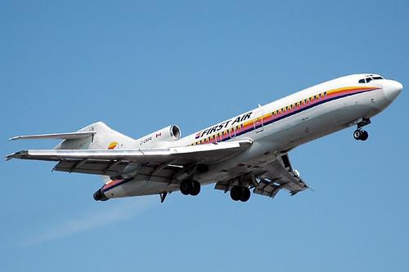
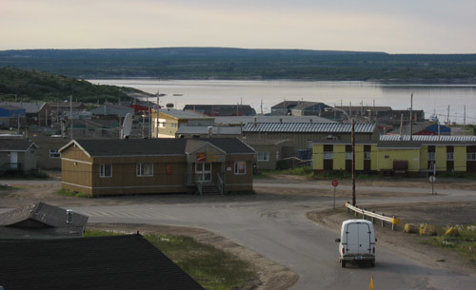
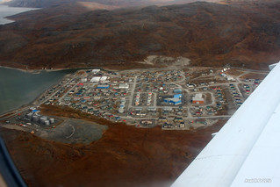
ᐱᔭᖃᕈᓐᓇᓂᖅ ᑐᓵᓂᒃᑯᑦ ᖃᓄᐃᖕᖏᓯᐊᕈᑎᑦᓴᓂᒃ ᓄᓇᓕᓐᓂ ᐅᖓᓯᑦᑐᓂ ᐋᓐᓂᐊᕕᒻᒪᕆᓕᓐᓄᑦ
ᐱᑕᖃᖕᖏᓗᐊᕐᑐᑦ ᑐᓵᓂᕐᒥᒃ ᐋᓐᓂᐊᓯᐅᕆᒍᑏᑦ ᑕᕐᕋᒥᓗ ᓄᓇᓂᓪᓗ ᐋᓐᓂᐊᕕᒻᒪᕆᓐᓄᑦ ᐅᖓᓯᑦᑐᒥ.
ᐊᑭᑐᓗᐊᕐᑐᑦ ᐊᐅᓪᓚᕈᑏᑦ ᐱᓇᓱᒍᑏᓪᓗ.
ᐅᖃᐅᓯᐅᓪᓗ ᐃᓗᕐᖁᓯᐅᓪᓗ ᐊᐳᕐᑕᓂᖏᑦ ᐃᓗᓯᓕᕆᔭᐅᒍᑎᐅᒋᐊᓕᑎᒍᑦ
ᓅᑦᑕᑐᑦ ᐋᓐᓂᐊᓯᐅᕐᕖᖅ, ᑲᑉᐳᑎᑦᑕᑐᑎᒍᑦ-ᑐᓵᒍᑎᖃᕐᓃᑦ ᓄᓇᓕᓐᓂᓗ-ᑐᖕᖓᕕᓖᑦ ᐱᒋᐅᓴᔭᐅᒍᑏᑦ ᐱᐅᓯᒋᐊᕆᓯᒪᓕᕐᑐᑦ ᐱᔭᖃᕈᑎᐅᒍᓐᓇᑐᓂᒃ
This Photo by Unknown Author is licensed under CC BY-NC
This Photo by Unknown Author is licensed under CC BY-NC-ND
This Photo by Unknown Author is licensed under CC BY-SA-NC

Slide 11
ᓴᐳᒻᒥᓂᕐᒥᒃ ᐱᓇᓱᒍᑏᓪᓗ ᓄᓇᕐᖃᑎᐅᔪᓪᓗ ᐃᑲᔪᕐᓯᒪᓇᓱᒍᑎᖏᑦ
ᐃᓚᓖᓪᓗ ᓄᓇᕐᖃᑎᐅᔪᓪᓗ ᓴᐳᑦᔨᓯᒪᒍᑎᖏᑦ ᐱᑕᖃᓪᓚᕆᒋᐊᖃᕐᐳᑦ ᑐᓯᓚᑦᑐᓂᒃ ᑐᓯᓚᓐᓂᖏᑎᒍᑦ ᑲᒪᒋᑦᓯᐊᓗᒋᑦ
ᓄᓇᓕᑐᙯᑦ-ᓯᕗᓕᕐᑕᖏᑦ ᐃᓗᓯᓕᕆᓂᕐᒥᒃ ᐱᓇᓱᒍᑏᑦ ᓄᐃᑕᑎᑦᓯᓂᖃᑦᓯᐊᑐᑦ ᐃᓗᕐᖁᓯᑎᒍᑦ ᐱᓂᕐᓗᒌᒃᑯᑎᓂᓪᓗ ᐃᓚᐅᑎᑦᓯᓂᕐᓂᓗ
ᓴᐳᒻᒥᓂᕐᒥᒃ ᐱᔭᖃᕋᓱᑉᐸᑐᑦ ᐃᓄᑐᑲᓪᓚᒋᒃᑯᑎᐅᕗᑦ ᖁᕝᕙᑎᕆᓂᖃᕐᓱᑎᒃᓗ ᐃᑉᐱᒋᔭᖃᑦᓯᐊᓂᑦᓴᓂᒃ

Slide 12

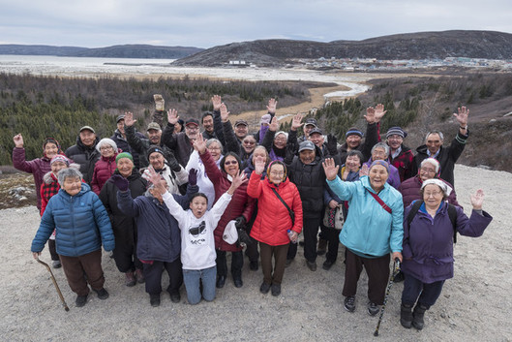
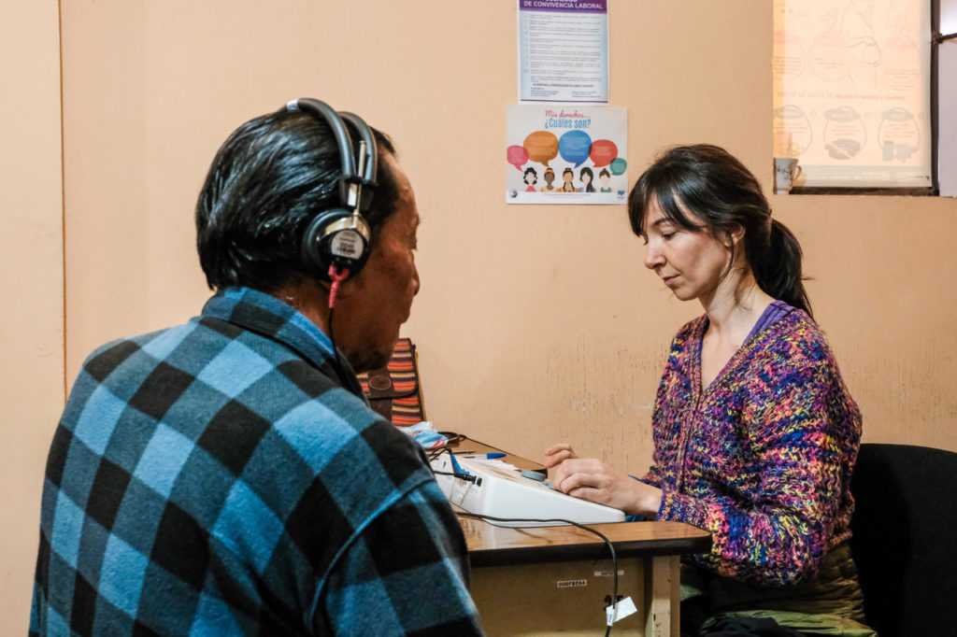
ᐱᔪᖃᕐᑎᓯᑦᑌᓕᒍᑏᓪᓗ ᐃᑉᐱᒋᔭᖃᕐᓂᓂᒃᓗ ᐱᓇᓱᒍᑏᑦ
ᓂᐱᕆᑦᑐᐊᓗᓐᓂᒃ ᐊᑯᓂᓗᐊᖅ ᑐᓵᓂᖃᕐᑌᓕᓗᓂ
ᖃᐅᔨᓴᕐᑕᐅᓴᐅᑎᒋᕙᓪᓗᓂ ᑐᓵᓂᖓ, ᐱᓗᐊᕐᑐᒥ ᒥᑭᔪᖑᐊᓂᓗ ᐃᓄᑐᖃᕐᓂᓗ
ᖁᕝᕙᑎᕆᒍᑎᒋᓗᒋᑦ ᐃᓗᕐᖁᓯᑎᒍᑦ ᓈᒻᒪᓯᐊᕐᑐᑦ ᐃᓕᓐᓂᐊᑎᑦᓯᒍᑎᐅᑦᓱᑎᒃ ᑐᓯᓚᑦᓯᑌᓕᒍᑎᓂᒃ
ᐃᓄᐃᑦ ᐅᖃᖃᑎᒌᒍᑎᖃᕐᓂᓴᖓᓐᓂᒃ ᑫᓪᓚᑐᖃᑦᑕᓗᒋᑦ ᐱᑦᔪᑎᖃᕐᓗᑎᒃ ᑐᓯᓚᑦᓯᓂᐅᓲᓂᒃ ᓄᓇᓕᓐᓂ.
This Photo by Unknown Author is licensed under CC BY-NC-ND

Slide 13
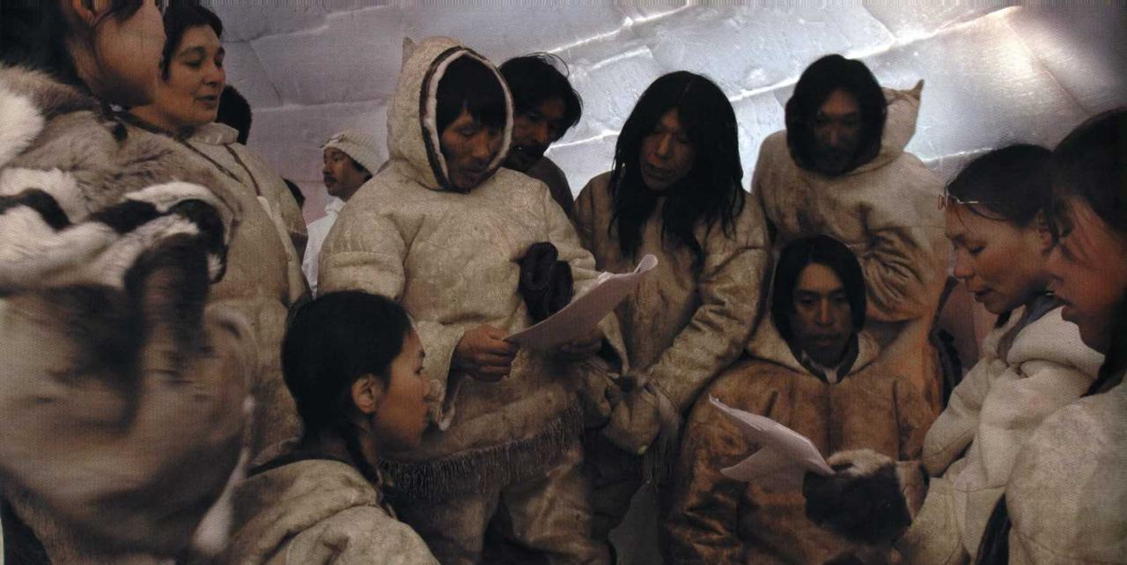
ᐱᔭᖃᑦᓯᐊᓯᒪᓂᕐᓂᒃ ᐅᓂᒃᑲᐅᓰᓪᓗ ᑲᔪᓯᔪᒥᓪᓗ ᐱᔭᖃᕋᓱᖏᓐᓇᕈᑏᑦ
• ᐃᓄᑐᐃᓐᓀᑦ ᐱᓇᓱᒐᖃᑉᕕᖁᑎᖏᑦ ᐱᓇᓱᖃᑎᓖᑦ ᑐᓵᓂᕐᓅᓕᖓᔪᓂᒃ ᐱᓇᓱᑦᑐᓂᒃ ᓄᓇᓕᒻᒥᓂ ᐱᑦᔪᔨᒍᑎᓂᒃ ᒪᓂᔨᒍᑎᑦᓴᓂᒃ
• ᑐᓵᒍᑎᓂᒃ ᑐᓂᕐᕈᓯᖃᑦᑕᓂᕐᒥᒃ ᐱᓇᓱᒍᑎᐅᔪᓪᓗ ᑐᓴᐅᒪᔭᐅᓂᑦᓴᖏᓐᓂᓗ ᐱᓇᓱᒍᑎᖃᕐᓃᑦ
•. ᐅᕕᒃᑲᓂᒃ ᐃᓕᓐᓂᐊᑎᑦᓯᒍᑎᖃᕐᓂᖅ ᑐᓵᓂᐅᑉ ᑲᓄᐃᖕᖏᓯᐊᕆᐊᖃᕐᓂᖓᓂᓗ ᐱᐅᓯᑐᖃᒃᑯᓗ ᖃᐅᔨᒪᔭᐅᔪᓂᒃ

Slide 14
ᐃᓱᓕᒍᑎᐅᔪᓪᓗ ᐱᔭᐅᒪᓪᓚᕆᑦᑐᓗ
ᑐᓵᓂᒃᑯᑦ ᖃᓄᐃᖕᖏᓯᐊᕐᓂᖅ ᓴᐳᑦᔨᓯᒪᓂᖃᕐᐳᖅ ᑐᓴᖃᑦᑕᐅᑎᒍᑎᓂᒃ, ᐃᓗᕐᖁᓯᕐᒥᓗ ᓄᓇᓕᐅᓪᓗ ᖃᓄᐃᖕᖏᓯᐊᕐᓂᓴᖓᓂᒃ.
ᑐᓯᓚᑦᓯᓂᖅ ᓱᕐᕃᓯᒪᒍᓐᓇᐳᖅ ᐃᓄᑐᐃᓐᓀᑦ ᐱᐅᓯᑐᖃᖏᓐᓂᓗ ᐃᓄᑦᑎᒍᓪᓗ ᐃᓅᑦᔪᓯᖏᓐᓂᒃ.
ᑲᑐᑦᔨᖃᑎᒌᒍᑎᖃᕐᓃᑦ, ᐃᓗᕐᖁᓯᒃᑯᑦ ᑐᖕᖓᕕᖃᑦᓯᐊᑐᓂᒃ ᐱᒐᓱᒍᑎᖃᕐᓂᒥᒃ ᐱᒻᒪᕆᐅᓂᖃᕐᐳᑦ ᐊᑐᕐᓂᖃᑦᓯᐊᑐᒥᒃ ᑐᓵᓂᕐᒥᒃ ᑲᒪᒋᔭᖃᕈᑎᑎᒍᑦ.

