Slide 1
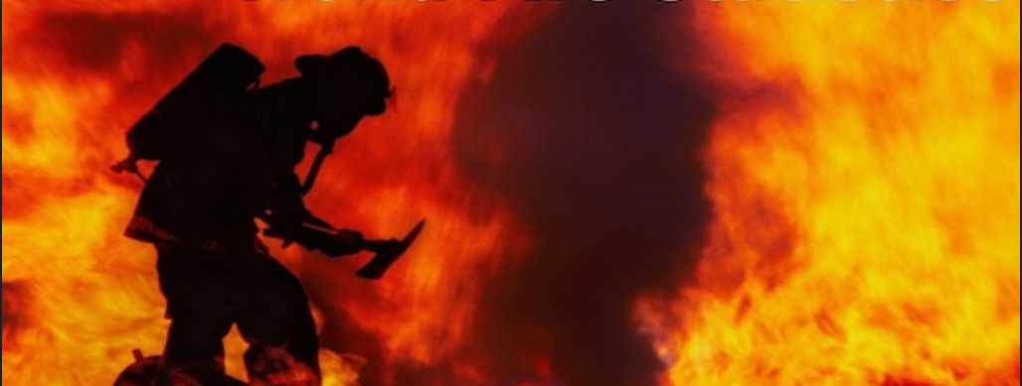

ᓄᓇᕕᒻᒥ ᐃᑯᐊᓪᓚᑐᓄᑦ ᑭᓪᓕᓯᓂᐊᕐᑕᐅᓯᒪᔪᑦ 2025
Notes:
UPDATED SLIDE

Slide 2

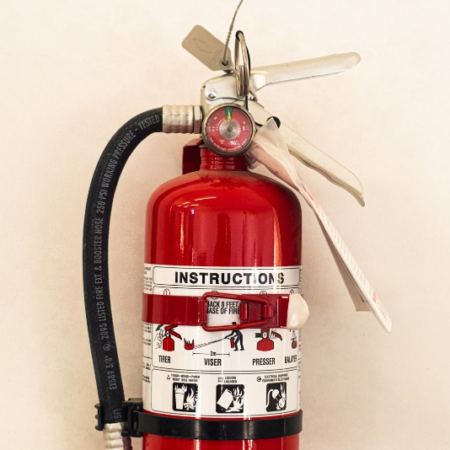
ᓄᓇᕕᒻᒥ ᐃᑯᐊᓪᓚᑕᓄᑦ ᑭᓪᓕᓯᓂᐊᕐᑕᐅᒪᔪᑦ 2025
ᖃᐅᔨᓴᕈᓰᑦ*
ᑲᕙᒫᐱᒃᑯᓂ ᐃᑯᐊᓪᓚᑐᕐᓂᐊᑏᑦ ᑲᒪᒋᔭᓖᑦ ᐊᐅᓪᓚᑎᑦᓯᓂᕐᒥᒃ ᐃᑯᐊᓪᓚᑐᓄᑦ ᑐᓴᕐᑎᓯᒍᑎᓂᒃ KRG-ᒥ ᐃᓄᓐᓂᒃ ᐊᑦᑕᓇᖕᖏᑐᒦᑦᑎᓯᓂᕐᒧᑦ ᐱᓇᓱᕝᕕᖓᓄᑦ,
ᐊᕐᕌᒍᑕᒫᑦ ᑭᓯᑕᐅᒪᔪᑦ ᖃᐅᔨᓴᕐᑕᐅᒍᑎᖏᑦ ᐱᓇᓱᐊᕐᑕᐅᓲᑦ ᐃᓄᓐᓂᒃ ᐊᑦᑕᓇᖕᖏᑐᒦᑦᑎᓯᓂᕐᒧᑦ ᐃᓄᓕᒫᓂᒃ ᐊᑦᑕᓇᕐᑌᓕᒪᑎᑦᓯᓂᕐᒧᑦ ᐊᒻᒪᓗ ᐃᑯᐊᓪᓚᑎᑦᓯᑏᓕᓂᕐᒧᑦ ᐱᓪᓗᑯᒋᐊᓕᓕᕆᔨ,
ᐅᓄᕐᓯᒋᐊᕐᑎᓯᓂᖅ ᑐᓴᕐᑎᓯᒍᑎᓂᒃ ᐱᐅᓂᕐᓴᒥᒃ ᐊᓪᓚᑕᐅᓯᒪᔪᓂᒃ ᖃᐅᔨᓴᕈᑎᕕᓂᕐᓂᒃ ᐱᐅᓂᕐᓴᕈᕐᑎᓯᓲᖅ, ᓄᐃᑦᓯᓱᓂ ᓱᓕᓂᕐᓴᓂᒃ ᑕᑎᒋᔭᐅᒍᓐᓇᐅᑐᓂᒃ ᑭᓯᑕᐅᒪᔪᓄᑦ ᖃᐅᔨᓴᕈᑎᓂᒃ.
*ᑭᓪᓕᓯᓂᐊᕐᑕᐅᓯᒪᔪᑦ ᐋᕐᕿᒋᐊᕐᑕᐅᑐᐃᓐᓇᕆᐊᖃᕐᖁᑦ ᐃᓱᒪᒋᔭᐅᒋᐊᖃᕐᓱᑎᓪᓗ ᓇᓚᐅᑦᓵᑕᐅᓯᒪᑐᐃᓐᓇᓂᖏᓐᓂᒃ.
Notes:
UPDATED SLIDE

Slide 3

ᓄᓇᕕᒻᒥ ᐃᑯᐊᓪᓚᑕᓄᑦ ᑭᓪᓕᓯᓂᐊᕐᑕᐅᒪᔪᑦ 2025
2021: ᓄᓇᓖᑦ ᑐᓂᓯᓯᒪᔪᑦ 213-ᓂᒃ ᑐᓴᕐᑎᓯᒍᑎᓂᒃ.
2022: 417 ᑐᓴᕐᑎᓯᒍᑏᑦ ᑎᑭᑎᑕᐅᓯᒪᔪᑦ; 319 ᐊᑐᕐᑕᐅᔪᑦ ᑭᓪᓕᓯᓂᐊᕐᑕᓯᒪᔪᓄᑦ.
2023: 384 ᑐᓴᕐᑎᓯᒍᑏᑦ ᑎᑭᑎᑕᐅᓯᒪᔪᑦ; 250 ᐊᑐᕐᑕᐅᔪᑦ ᑭᓪᓕᓯᓂᐊᕐᑕᓯᒪᔪᓄᑦ.
2024: 821 ᑐᓴᕐᑎᓯᒍᑏᑦ ᑎᑭᑎᑕᐅᓯᒪᔪᑦ; 271 ᐊᑐᕐᑕᐅᔪᑦ ᑭᓪᓕᓯᓂᐊᕐᑕᓯᒪᔪᓄᑦ.
2025: 578 ᑐᓴᕐᑎᓯᒍᑏᑦ ᑎᑭᑎᑕᐅᓯᒪᔪᑦ; 212 ᐊᑐᕐᑕᐅᔪᑦ ᑭᓪᓕᓯᓂᐊᕐᑕᓯᒪᔪᓄᑦ.
ᐱᓇᓱᐊᕐᑕᐅᔪᓄᑦ ᑐᓴᕐᑎᓯᒍᑎ ᐃᓚᐅᑎᑦᓯᔪᖅ ᐊᓪᓚᑕᐅᓯᒪᔪᓂᒃ ᑲᑎᒪᓂᕐᓂᒃ, ᐃᓕᓐᓂᐊᑎᑦᓯᓂᕐᓂᒃ, ᖃᐅᔨᓴᕐᓂᓂᒃ ᐊᒻᒪᓗ ᐅᐃᒪᓇᕐᑐᓯᐅᕐᓂᕕᓂᕐᓂᒃ ᐊᑐᕐᑕᐅᓲᓂᒃ ᓄᓇᕕᒻᒥ ᐃᑯᐊᓪᓚᑐᓄᑦ ᐊᑦᑕᓇᕐᑐᒦᑦᑎᓯᑦᑌᓕᓂᕐᒧᑦ ᓯᓚᑉᐱᖓᓄᑦ ᐸᕐᓇᓯᒪᐅᑎᓄᑦ (NFSCP) ᑭᓪᓗᓯᓂᐊᕐᑕᐅᒪᔪᓄᑦ.
ᐃᓘᓐᓇᑎᒃ 95 ᓄᓇᓕᓐᓂ ᐃᑯᐊᓪᓚᑐᓄᑦ ᑐᓴᕐᑎᓯᒍᑏᑦ 2025-ᒥ ᐃᓚᐅᑎᑕᐅᔪᕕᓃᑦ ᑭᓪᓕᓯᓂᐊᕐᑕᐅᒪᔪᓄᑦ.
Notes:
UPDATED SLIDE

Slide 4

ᓄᓇᕕᒻᒥ ᐃᑯᐊᓪᓚᑕᓄᑦ ᑭᓪᓕᓯᓂᐊᕐᑕᐅᒪᔪᑦ 2025
Number of reports sent by community*
ᐅᓄᕐᓂᖏᑦ ᑐᓴᕐᑎᓯᒍᑏᑦ ᐊᐅᓪᓚᓯᑕᐅᓯᒪᔪᑦ ᓄᓇᓕᓐᓄᑦ
ᐊᑯᓕᕕᒃ
ᐃᓄᑦᔪᐊᖅ
ᑲᖏᕐᓱᒃ
ᑰᑦᔪᐊᕌᐱᒃ
*ᑲᑎᑦᓱᑎᒃ 578 ᑐᓴᕐᑎᓯᒍᑏᑦ
Notes:
UPDATED SLIDE

Slide 5
ᓄᓇᕕᒻᒥ ᐃᑯᐊᓪᓚᑕᓄᑦ ᑭᓪᓕᓯᓂᐊᕐᑕᐅᒪᔪᑦ 2025
ᐅᓄᕐᓂᖏᑦ ᐱᓇᓱᐊᕐᓂᕕᓃᑦ ᐅᐃᒪᓇᕐᑐᓯᐅᕐᓂᕕᓃᓪᓗ per community*
ᐊᑯᓕᕕᒃ
ᐊᐅᐸᓗᒃ
ᐃᓄᑦᔪᐊᖅ
ᐃᕗᔨᕕᒃ
*366 ᐱᓇᓱᐊᕐᓂᓄᑦ ᑐᓴᕐᑎᓯᒍᑏᑦ, 117 ᐅᐃᒪᓇᕐᑐᓯᐅᕐᓂᕕᓃᑦ = 483 (ᐃᓚᐅᑎᓐᓇᒋᑦ ᐃᑯᐊᓪᓚᑐᒧᑦ ᑐᓴᐃᑎᓯᒍᑏᑦ)
Notes:
UPDATED SLIDE

Slide 6

ᓄᓇᕕᒻᒥ ᐃᑯᐊᓪᓚᑕᓄᑦ ᑭᓪᓕᓯᓂᐊᕐᑕᐅᒪᔪᑦ 2025
NUMBER OF FIRES PER COMMUNITY*
ᐊᑯᓕᕕᒃ
*95 ᑲᑎᑦᓱᑎᒃ ᐃᑯᐊᓪᓚᑐᒧᑦ ᑐᓴᕐᑎᓯᒍᑏᑦ
Notes:
SLIDE UPDATED

Slide 7

ᓄᓇᕕᒻᒥ ᐃᑯᐊᓪᓚᑕᓄᑦ ᑭᓪᓕᓯᓂᐊᕐᑕᐅᒪᔪᑦ 2025
ᐅᓄᕐᓂᖏᑦ ᐃᑯᐊᓪᓚᑐᑦ ᐊᕐᕌᒍᓂ ᑕᓪᓕᒪᓂ ᐊᓂᒍᕐᑐᓂ*
*ᐃᓚᖏᑦ ᑐᓴᕐᑎᓯᒍᑏᑦ ᐱᔭᕇᕐᓯᒪᖕᖏᑐᑦ ᐅᕝᕙᓗᓘᓐᓃᑦ ᖃᓄᐃᑦᑑᓂᖏᑦ ᐃᑯᐊᓪᓚᑐᓄᑦ ᑐᓴᕐᑎᓯᒍᑎᓕᐊᖑᓯᒪᑐᐃᓐᓇᕆᐊᓖᑦ ᖃᓄᐃᓕᓂᕕᓂᐅᖕᖏᖔᕐᓱᑎᒃ.
Notes:
UPDATED SLIDE

Slide 8

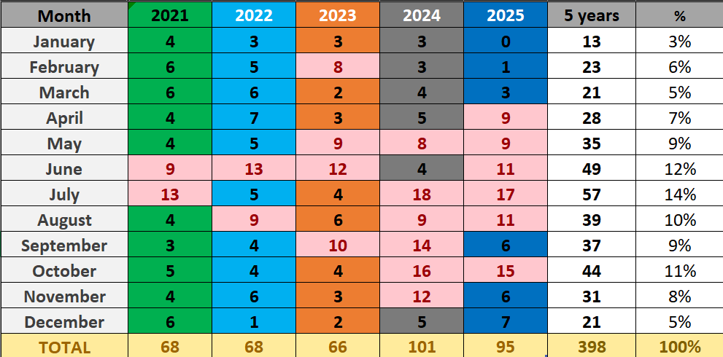
ᓄᓇᕕᒻᒥ ᐃᑯᐊᓪᓚᑕᓄᑦ ᑭᓪᓕᓯᓂᐊᕐᑕᐅᒪᔪᑦ 2025
ᐅᓄᕐᓂᖏᑦ ᐃᑯᐊᓪᓚᑐᑦ ᑕᕐᕿᑕᒫᑦ *
ᑕᕐᕿᖓ
ᐊᕐᕌᒍᐃᑦ
ᔭᓄᐊᕆ
ᕕᕈᐊᕆ
ᒫᑦᔨ
ᐁᕆᓕ
ᒣ
ᔫᓂ
ᔪᓓ
ᐊᐅᒡᒍᓯ
ᓯᑦᑎᒻᐱᕆ
ᐆᑦᑐᐱᕆ
ᓅᕕᒻᐱᕆ
ᑏᓯᒻᐱᕆ
ᑲᑎᑦᓱᑎᒃ
* ᑕᐅᑦᑐᖏᑦ ᑯᑦᓲᔦᑦ ᑕᑯᑦᓴᐅᑎᑦᓯᔪᑦ 8 ᐅᖓᑖᓄᑦ ᐃᑭᐊᓪᓚᑐᓂᒃ / ᑕᕐᕿᑕᒫᑦ
Notes:
UPDATED SLIDE

Slide 9

ᓄᓇᕕᒻᒥ ᐃᑯᐊᓪᓚᑕᓄᑦ ᑭᓪᓕᓯᓂᐊᕐᑕᐅᒪᔪᑦ 2025
ᐃᓪᓗᔪᐊᖅ ᖃᑦᓯᕌᓱᖏᓂᖏᑦ ᓄᑕᐅᓯᓕᕐᑕᐅᒍᑏᑦ ᖃᐅᔨᓴᕐᑕᐅᓚᐅᕐᓱᑎᒃ*
ᖃᓄᐃᑦᑑᓂᖓ ᐃᓪᓘᑉ | ᖃᑦᓯᕌᕐᓂᖓ 2024-ᒥ | ᖃᑦᓯᕌᕐᓂᖓ ᖃᐅᔨᓴᕐᑕᐅᓚᐅᕐᓱᓂ 2025
ᐃᓪᓗᐊᐱᒃ | 25,000 $ | 40,000 $
ᑖᓐᓇᑑᑦᓱᓂ ᐃᓪᓗᖅ(3 ᖃᕆᐊᓕᒃ) | 1,360,000 $ | 1,745,685 $
ᑖᓐᓇᑑᑦᓱᓂ ᐃᓪᓗᖅ( 5 ᖃᕆᐊᓕᒃ | 1,776,000 $ | 2,532,570 $
ᐃᑦᓯᒥᑦᑕᑕᕇᒃ (2 ᖃᕆᐊᓕᒃ) | 2,344,500 $ | 3,751,200$
ᓯᑕᒪᑕᓕᒃ (2 ᖃᕆᐊᓕᒃ) | 2,564,688 $ | 4,103,500 $
*ᖃᑦᓯᕌᓱᖑᓂᖏᑦ ᐃᓪᓗᐃᑦ NHB-ᑯᓐᓄᑦ ᐊᑭᖏᑦ ᐱᑖᕆᔭᐅᓯᒪᔪᑦ
Notes:
UPDATED SLIDE

Slide 10
ᓄᓇᕕᒻᒥ ᐃᑯᐊᓪᓚᑕᓄᑦ ᑭᓪᓕᓯᓂᐊᕐᑕᐅᒪᔪᑦ 2025
TOTAL ESTIMATED BUILDING AND MATERIAL LOSS*
ᑲᑎᑦᓱᑎᒃ ᖃᑦᓯᐅᓂᖏᑦ ᐃᓪᓗᐃᑦ ᐱᐅᓕᓂᐊᒉᓪᓗ ᐊᓯᐅᔨᔭᐅᔪᑦ
*ᑕᒃᑲᓂ ᐊᕐᕌᒍᒥ ᐊᑦᔨᒌᖕᖏᓂᖏᑦ ᐱᑦᔪᑎᖃᕐᖁᑦ 2025-ᒥ ᐊᓪᓚᑕᐅᓯᒪᓂᖏᑦ ᖃᐅᔨᓴᕐᑕᐅᓯᒪᔪᑦ ᓱᓕᓂᕐᓴᐅᓂᖏᓐᓄᑦ, ᑭᖑᓂᖓᓂ ᐊᕐᕌᒍᒥ ᑐᖕᖓᕕᖃᕐᓂᓴᐅᔪᕕᓂᐅᑎᓪᓗᒋᑦ ᓇᓚᐅᕐᓵᑕᐅᔪᓂᒃ
Notes:
UPDATED SLIDE

Slide 11

ᓄᓇᕕᒻᒥ ᐃᑯᐊᓪᓚᑕᓄᑦ ᑭᓪᓕᓯᓂᐊᕐᑕᐅᒪᔪᑦ 2025
AVERAGE BUILDING AND MATERIAL LOSSES PER FIRE*
ᑲᑎᑦᓱᑎᒃ ᖃᑦᓯᐅᓂᖏᑦ ᐃᓪᓗᐃᑦ ᐱᐅᓕᓂᐊᒉᓪᓗ ᐊᓯᐅᔨᔭᐅᔪᑦ ᐃᑯᐊᓪᓚᑐᒧᑦ ᐊᑕᐅᓯᕐᒧᑦ
* ᑕᒃᑲᓂ ᐊᕐᕌᒍᒥ ᐊᑦᔨᒌᖕᖏᓂᖏᑦ ᐱᑦᔪᑎᖃᕐᖁᑦ 2025-ᒥ ᐊᓪᓚᑕᐅᓯᒪᓂᖏᑦ ᖃᐅᔨᓴᕐᑕᐅᓯᒪᔪᑦ ᓱᓕᓂᕐᓴᐅᓂᖏᓐᓄᑦ, ᑭᖑᓂᖓᓂ ᐊᕐᕌᒍᒥ ᑐᖕᖓᕕᖃᕐᓂᓴᐅᔪᕕᓂᐅᑎᓪᓗᒋᑦ ᓇᓚᐅᕐᓵᑕᐅᔪᓂᒃ
Notes:
UPDATED SLIDE

Slide 12

ᓄᓇᕕᒻᒥ ᐃᑯᐊᓪᓚᑕᓄᑦ ᑭᓪᓕᓯᓂᐊᕐᑕᐅᒪᔪᑦ 2025
ᓄᕐᖃᑎᑦᓯᒐᓱᐊᕐᑐᑦ
ᓄᕐᖃᑎᑦᓯᒐᓱᐊᕐᑐᑦ: ᐅᓄᕐᓂᖏᑦ ᐃᑯᐊᓪᓚᑐᕐᓂᐊᑏᑦ ᑭᐅᖃᑦᑕᑐᑦ ᐅᖄᓚᒍᑕᐅᔪᒧᑦ ᐊᑐᐃᓐᓇᐅᔪᑦ ᐱᒋᐊᖕᖓᐅᑎᒥ ᐃᑯᐊᓪᓚᑐᒥᒃ.
NFSCP-ᑯᑦ ᐃᒣᓗᖁᔨᔪᑦ ᐱᒋᐊᕐᑎᓯᓂᕐᒥᒃ ᐱᒋᐊᖕᖓᐅᑎᐅᒥᒃ ᓄᕐᖃᑎᑦᓯᒐᓱᐊᕐᓂᒧᑦ 15 ᒥᓇᑦᓯᓂ. ᓄᓇᕕᒻᒥ, ᐃᒫᒃ ᑐᑭᓕᒃ:
    ᐃᑭᓐᓂᐹᑦ 4 ᐃᑯᐊᓪᓚᑐᕐᓂᐊᑏᑦ 15 ᒥᓇᑦᓯᐅᑎᓪᓗᒍ
    ᑰᑦᔪᐊᖅ: 8 ᐃᑯᐊᓪᓚᑐᕐᓂᐊᑏᑦ 15 ᒥᓇᑦᓯᐅᑎᓪᓗᒍ
ᓈᒻᒪᓈᑦᓯᐊᑐᖅ ᐊᑯᓃᕋᓂᓗ ᑭᐅᓂᐅᔪᖅ ᐊᖏᔪᒻᒪᕆᒻᒥᒃ ᒥᑭᓕᒋᐊᕐᑎᓯᔪᖅ ᐃᑯᐊᓚᒧᑦ ᐊᓯᐅᔨᔭᐅᔪᓂᒃ.
Notes:
UPDATED SLIDE

Slide 13
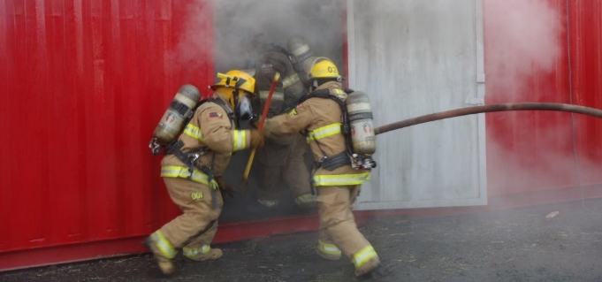
ᓄᓇᕕᒻᒥ ᐃᑯᐊᓪᓚᑕᓄᑦ ᑭᓪᓕᓯᓂᐊᕐᑕᐅᒪᔪᑦ
ᓄᕐᖃᑎᑦᓯᒐᓱᐊᕐᑐᑦ*
ᓄᕐᖃᑎᑦᓯᒐᓱᐊᕈᑏᑦ ᐱᒍᓐᓇᓯᔭᐅᔪᑦ 34 ᕕᑦᓱᑎᒃ ᓄᓇᓕᓐᓂ 8-ᓂ.
8-ᓂ ᐃᓪᓗᓂ ᐃᑯᐊᓪᓚᓂᕐᒧᑦ ᐱᓂᕐᓗᓯᒪᔪᓂ, 5 ᓄᓇᓖᑦ ᑭᐅᑦᓴᑐᒋᒍᓐᓇᑐᕕᓃᑦ ᑭᓯᐊᓂ ᐃᑭᓐᓂᐸᐅᒋᐊᖃᕐᓂᖏᑦ 4 ᐃᑯᐊᓪᓚᑐᕐᓂᐊᑏᑦ ᖏᑦᑎᓗᒋᑦ.
1 ᐃᓪᓗᖅ ᐃᑯᐊᓪᓚᑐᕕᓂᖅ, 1 ᓄᓇᓕᒃ ᑭᐅᑦᓴᐅᑎᒋᓐᓂᖏᑦᑐᖅ ᐊᒻᒪᓗ ᐃᑭᓐᓂᐸᐅᒋᐊᓖᑦ 4 ᐃᑯᐊᓪᓚᑐᕐᓂᐊᑏᑦ ᖏᑦᑎᓗᒋᑦ.
2 ᓄᓇᓖᑦ ᑐᓂᓯᓐᓂᖏᑦᑐᑦ ᐃᑯᐊᓪᓚᓂᕐᒧᑦ ᑐᓴᕐᑎᓯᒍᑎᓂᒃ ᑭᓯᑦᑕᐅᓯᒪᐅᑎᖏᓐᓂᒃ.
ᐱᒐᓱᐊᕐᓂᖅ ᑕᑯᓐᓇᓂᖃᕆᐊᓕᒃ ᐱᐅᓯᐅᒥᑎᑦᓯᓂᕐᒥᒃ ᐃᑯᐊᓪᓚᑐᕐᓂᐊᑏᑦ ᐊᑐᐃᓐᓇᐅᓂᖏᓐᓂᒃ, ᐊᑕᑎᑦᓯᓂᕐᒥᒃ, ᐱᓇᓱᑦᑎᑖᕋᓱᐊᕐᓂᒥᒃ, ᐃᓕᓐᓂᐊᑎᑦᓯᓂᕐᒥᒃ ᐊᒻᒪᓗ ᐱᔭᕇᕐᓯᒪᑦᓯᐊᓂᖏᓐᓂᒃ ᐱᓂᕐᓗᓂᕕᓂᕐᒧᑦ ᑐᓴᕐᑎᓯᒍᑏᑦ.
*ᐊᒥᓱᐃᑦ ᑐᓴᕐᑎᓯᒍᑏᑦ ᐱᑕᖃᑦᓯᐊᖏᑦᑐᑦ ᑐᓴᐅᒪᑎᑦᓯᒍᑎᓂᒃ ᓱᓕᑎᑦᓯᓂᕐᒧᑦ ᓄᕐᖃᑎᑦᓯᒐᓱᐊᕐᓂᖅ ᐊᑐᕐᑕᐅᓂᕐᒪᖔᑦ
Notes:
UPDATED SLIDE

Slide 14

ᓄᓇᕕᒻᒥ ᐃᑯᐊᓪᓚᑕᓄᑦ ᑭᓪᓕᓯᓂᐊᕐᑕᐅᒪᔪᑦ 2025
ᓄᓇᕕᒻᒥ ᐊᑦᑐᑕᐅᔪᑦ ᐃᑯᐊᓪᓚᓂᕐᒧᑦ ᑭᐅᒍᑎᓄᑦ
ᐃᓄᐃᑦ ᐊᓂᑦᑕᐅᔪᑦ | 10
ᐃᓄᐃᑦ ᐱᐅᓕᐊᖑᔪᑦ | 0
ᐃᓄᐃᑦ ᐋᓐᓂᑐᑦ* | 7
ᐃᓄᐃᑦ ᑐᖁᔪᑦ | 0
ᖃᑎᑦᓱᑎᒃ 17 ᐃᓄᐃᑦ ᐃᑯᐊᓪᓚᑐᒦᑦᑐᕕᓃᑦ 95 ᐃᑯᐊᓪᓚᑐᒧᑦ ᑭᐅᓂᐅᔪᑦ 2025-ᒥ
*ᐃᓚᐅᑎᓪᓗᒋᑦ 2 ᐃᑯᐊᓪᓚᑐᕐᓂᐊᑏᒃ ᐋᓐᓂᑕᐅᔫᒃ ᑕᒃᑲᓂᑦᓭᑦᓇᖅ ᐊᕐᕌᒍᖓᓂ.
Notes:
UPDATED SLIDE

Slide 15
ᓄᓇᕕᒻᒥ ᐃᑯᐊᓪᓚᑕᓄᑦ ᑭᓪᓕᓯᓂᐊᕐᑕᐅᒪᔪᑦ 2025
5 ᐊᑐᕐᑕᐅᓗᐊᖕᖑᐊᑐᑦ ᐃᑯᐊᓪᓚᑐᒥ
ᐊᑐᕐᑕᐅᓗᐊᖕᖑᐊᑐᑦ | ᐅᓄᕐᓂᖏᑦ ᑐᓴᕐᑎᓯᒍᑏᑦ | %
ᓯᓚᒥ (ᐃᒋᑕᑦᓭᑦ, ᓴᓂᒃᑯᕕᒃ, ᐃᒋᑦᓯᕕᒃ) | 30 | 45%
ᐊᓂᕐᕋᐅᔪᓂ | 26 | 39%
ᓄᓇᒥ, ᓇᐹᕐᑐᓂ | 5 | 7%
ᑲᑎᕝᕕ ᐃᓪᓗᔪᐊᖅ | 5 | 7%
ᓂᐅᕕᕐᓂᐊᕕᒃ | 1 | 2%
Notes:
SLIDE UPDATED

Slide 16
ᓄᓇᕕᒻᒥ ᐃᑯᐊᓪᓚᑕᓄᑦ ᑭᓪᓕᓯᓂᐊᕐᑕᐅᒪᔪᑦ 2025
10 ᐃᑯᐊᓪᓚᑎᑦᓯᓗᐊᖕᖑᐊᓲᑦ ᓱᓇᐅᓂᖏᑦ
ᐃᑯᐊᓪᓚᑎᑦᓯᔪᖅ | ᐃᑯᐊᓪᓚᑐᒧᑦ ᑐᓴᕐᑎᓯᒍᑎ | %
ᖃᐅᔨᒪᔭᐅᖕᖏᑐᖅ ᐆᕐᖁᒍᑎᐅᑦᓱᓂ(999) | 25 | 40%
ᑭᐊᑦᓴᐅᑎ ᐃᓗᐊᓂᑦᑐᓕᐅᕈᑎ (111) | 9 | 16%
ᒫᑦᓴᓯ, ᐃᑭᑦᑕᐅᑎ (720) | 6 | 10%
ᐊᓯᖏᑦ ᐅᕐᖂᒍᑎᐅᑦᓱᑎᒃ (990) | 6 | 10%
ᓱᐴᕈᓯᔭᕈᑏᑦ(ᓱᐴᕈᑏᑦ, ᐯᑉᐹᑦ, ᓯᑳᑦ) (710) | 3 | 5%
ᐃᑯᐊᓚᑦᓯᒍᑎ ᐃᑯᐊᓚᔪᒧᑦ ᐱᐅᓕᓂᐊᒐᖅ ᖃᐅᔨᒪᔭᐅᖕᖏᑐᖅ (790) | 3 | 5%
ᑭᐊᑦᓴᐅᑎ ᐃᓗᐊᓂᑦᑐᓕᐅᕈᑎᓘᓐᓃᑦ (112) | 3 | 5%
ᐊᓯᖏᑦ ᐃᑯᐊᓚᑦᓯᒍᑏᑦ ᐃᑯᐊᓚᔪᒧᑦ ᐱᐅᓕᓂᐊᒐᖅ (790) | 2 | 3%
ᐃᑯᒪᓕᐅᕈᑎᒨᓕᖓᔪᖅ ᐱᐅᓕᓂᐊᒐᖅ ᖃᐅᔨᒪᔭᐅᖕᖏᑐᖅ (599) | 2 | 3%
ᐸᓂᕐᓰᑎ (331) | 2 | 3%
Notes:
UPDATED SLIDE

Slide 17

ᓄᓇᕕᒻᒥ ᐃᑯᐊᓪᓚᑕᓄᑦ ᑭᓪᓕᓯᓂᐊᕐᑕᐅᒪᔪᑦ 2025
ᓄᓇᕕᒻᒥ ᐊᓯᐅᔨᔭᐅᓂᕐᐹᑦ - ᐊᒥᓲᓂᕐᐹᑦ 10
ᓄᓇᓕᖓ | ᐃᓪᓗᔪᐊᖅ | ᓇᒻᒥᓂᓖᑦ | ᑲᑎᑦᓱᑎᒃ ᐊᓯᐅᔨᔭᐅᔪᑦ
ᐃᓄᑦᔪᐊᖅ | ᐃᓪᓗᖅ | ᐃᓪᓗᓕᕆᔨᒃᑯᑦ | $2,050,000
ᐊᑯᓕᕕᒃ | ᓄᓇᓕᓐᓂ ᓱᖃᑦᓯᕕᒃ | ᑲᕙᒫᐱᖓ ᓄᓇᓕᓐᓂ | $2,000,000 *
ᐊᑯᓕᕕᒃ | ᖄᑭᕐᕕᒃ | ᑲᕙᒫᐱᖓ ᓄᓇᓕᓐᓂ | $2,000,000 *
ᑲᖏᕐᓱᒃ | ᐃᓪᓗᖅ | ᐃᓪᓗᓕᕆᔨᒃᑯᑦ | $1,801,000 *
ᐳᕕᕐᓂᑐᖅ | ᐃᓪᓗᖅ | ᐃᓪᓗᓕᕆᔨᒃᑯᑦ | $1,845,685
ᑲᖏᕐᓱᐊᓗᑦᔪᐊᖅ | ᐃᓪᓗᖅ | ᐃᓪᓗᓕᕆᔨᒃᑯᑦ | $1,202,250 *
ᑰᑦᔪᐊᕌᐱᒃ | ᐃᓪᓗᖅ | ᐃᓪᓗᓕᕆᔨᒃᑯᑦ | $1,137,000
ᑲᖏᕐᓱᐊᓗᑦᔪᐊᖅ | ᐃᓪᓗᖅ | ᐃᓪᓗᓕᕆᔨᒃᑯᑦ | $1,083,000 *
ᑲᖏᕐᓱᐊᓗᑦᔪᐊᖅ | ᐃᓪᓗᖅ | ᐃᓪᓗᓕᕆᔨᒃᑯᑦ | $1,083,000 *
ᐳᕕᕐᓂᑐᖅ | ᐃᓪᓗᖅ | ᐃᓪᓗᓕᕆᔨᒃᑯᑦ | $1,147,000
Notes:
UPDATED SLIDE

Slide 18

ᓄᓇᕕᒻᒥ ᐃᑯᐊᓪᓚᑕᓄᑦ ᑭᓪᓕᓯᓂᐊᕐᑕᐅᒪᔪᑦ
2025
ᐳᓕᓯᒃᑯᑦ ᑲᒪᒋᔭᖏᑦ- 10 ᐊᒥᓲᓂᕐᐹᑦ ᐊᓯᐅᔨᔭᐅᔪᑦ
ᓄᓇᓕᖓ | ᐃᓪᓗᔪᐊᖅ | ᓇᒻᒥᓂᓖᑦ | ᑲᑎᑦᓱᑎᒃ ᐊᓯᐅᔨᔭᐅᔪᑦ
ᐊᑯᓕᕕᒃ | ᓄᓇᓕᓐᓂ ᓱᖃᑦᓯᕕᒃ | ᑲᕙᒫᐱᖓ ᓄᓇᓕᓐᓂ | $2,000,000 *
ᐊᑯᓕᕕᒃ | ᖄᑭᕐᕕᒃ | ᑲᕙᒫᐱᖓ ᓄᓇᓕᓐᓂ | $2,000,000 *
ᑲᖏᕐᓱᒃ | ᐃᓪᓗᖅ | ᐃᓪᓗᓕᕆᔨᒃᑯᑦ | $1,801,000 *
ᑲᖏᕐᓱᐊᓗᑦᔪᐊᖅ | ᐃᓪᓗᖅ | ᐃᓪᓗᓕᕆᔨᒃᑯᑦ | $1,202,250 *
ᑲᖏᕐᓱᐊᓗᑦᔪᐊᖅ | ᐃᓪᓗᖅ | ᐃᓪᓗᓕᕆᔨᒃᑯᑦ | $1,083,000 *
ᑲᖏᕐᓱᐊᓗᑦᔪᐊᖅ | ᐃᓪᓗᖅ | ᐃᓪᓗᓕᕆᔨᒃᑯᑦ | $1,083,000 *
ᑕᓯᐅᔭᖅ | ᐃᓕᓐᓂᐊᕕᑐᖃᖅ/ᐊᓂᕐᕋᕆᔭᐅᔪᖅ | ᑲᕙᒫᐱᖓ ᓄᓇᓕᓐᓂ | $1,250,000 *
ᓴᓪᓗᐃᑦ | ᐃᓪᓗᖅ/ᐊᓂᕐᕋᕆᔭᐅᔪᖅ | ᐃᓪᓗᓕᕆᔨᒃᑯᑦ | $215,000
ᑰᑦᔪᐊᕌᐱᒃ | ᐃᓪᓗᖅ | ᐃᓪᓗᓕᕆᔨᒃᑯᑦ | $55,000
ᐃᓄᑦᔪᐊᖅ | ᐃᓪᓗᖅ | ᐃᓪᓗᓕᕆᔨᒃᑯᑦ | $25,500
Notes:
UPDATED SLIDE

Slide 19
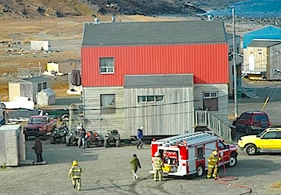

ᓄᓇᕕᒻᒥ ᐃᑯᐊᓪᓚᑕᓄᑦ ᑭᓪᓕᓯᓂᐊᕐᑕᐅᒪᔪᑦ
2025
ᐃᑯᐊᓪᓚᑎᑦᓯᑌᓕᓂᖅ- 2025
ᐃᑯᐊᓪᓚᑎᑦᓯᑌᓕᓂᖅ ᐊᒻᒪᓗ ᐃᓄᓕᒫᓂᒃ ᐊᑦᑕᓇᕐᑌᓕᒪᑎᑦᓯᓂᖅ –
ᐱᒻᒪᕆᐅᓗᐊᖕᖑᐊᑐᑦ (2025)
ᖃᓄᐃᖕᖏᓯᐊᕐᓂᖅ ᐊᒻᒪᓗ ᐊᑦᑕᓇᕐᑌᓕᑎᑦᓯᓂᕐᒧᑦ ᐸᕐᓇᓯᒪᐅᑏᑦ ᐊᒻᒪᓗ ᐱᓂᕐᓗᑐᖃᓚᐅᕐᑎᓇᒍ ᐸᕐᓇᓯᒪᐅᑏᑦ ᐋᕐᕿᓱᕐᑕᐅᒪᔪᑦ ᐃᓘᓐᓇᖏᓐᓄᑦ ᐃᑯᐊᕐᓚᑐᕐᓂᐊᕕᒻᒥ
29 ᐳᕐᑐᔪᑦ ᕿᑎᖓᓃᑦᑐᓗ ᐊᑦᑕᓇᕐᑐᓂᒃ ᖃᐅᔨᓴᕐᓂᖅ ᐱᔭᕇᕐᑕᐅᔪᑦ ᓄᓇᕕᓕᒫᒥ
ICO ᖃᕆᑕᐅᔭᕈᑎ ᐊᑐᓕᕐᑎᑕᐅᓯᒪᑦᓯᐊᑐᑦ (ᐱᓂᕐᓗᓂᕐᒧᑦ ᐊᒻᒪᓗ ᐱᓇᓱᐊᕐᓂᓄᑦ ᑐᓴᕐᑎᓯᒍᑎᓄᑦ ᐊᓪᓚᓯᒪᔪᓂᒃ ᓄᐊᑦᓯᕕᒃ ᖃᕆᑕᐅᔭᒃᑯᑦ)
ᐃᓘᓐᓈᒍᑦ ᕿᒥᕐᕈᓂᖅ ᐃᓕᓐᓂᐊᑎᑦᓯᓂᕐᒥᒃ ᐱᑕᖃᕐᑎᑕᐅᔪᓂᒃ ᐃᓄᓐᓂᒃ ᐊᑦᑕᓇᕐᑐᒦᑦᑎᓯᑦᑌᓕᓂᕐᒧᑦ ᐱᓇᓱᑦᑏᑦ ᐊᒻᒪᓗ ᐃᑯᐊᓪᓚᑐᕐᓂᐊᑎᓄᑦ ᐊᖓᔪᕐᖄᑦ ICO-ᒥ
ᓄᓇᓕᓐᓂ ᑐᓴᐅᒪᑎᑦᓯᓂᖅ: ᐃᓕᓐᓂᐊᕕᓐᓂ ᓱᖃᑦᓯᑎᑦᓯᓂᖅ, ᐱᓇᓱᒐᕐᓄᑦ ᐅᓪᓗᖁᑎᖓᓂ , ᐃᑯᐊᓪᓚᑎᑦᓯᑌᓕᓂᕐᒧᑦ ᐃᓕᓐᓂᐊᑎᑦᓯᓂᖅ
ᓄᑕᐅᓯᒋᐊᕐᓯᒪᔪᑦ ᐱᓇᓱᐊᖃᑎᒌᓐᓃᑦ NHB-ᑯᓪᓗ ᐊᒻᒪᓗ ᓄᓇᓕᓐᓂ ᐃᑯᐊᓪᓚᑐᕐᓂᐊᕕᒃ
Notes:
UPDATED SLIDE

Slide 20
ᓄᓇᕕᒻᒥ ᐃᑯᐊᓪᓚᑕᓄᑦ ᑭᓪᓕᓯᓂᐊᕐᑕᐅᒪᔪᑦ
2025
ᐃᑯᐊᓪᓚᑎᑦᓯᑌᓕᓂᕐᒧᑦ ᓇᓚᐅᑦᓵᑕᐅᓯᒪᔪᑦ- 2026
ᐃᑯᐊᓪᓚᑎᑦᓯᑌᓕᓂᖅ ᐊᒻᒪᓗ ᐃᓄᓕᒫᓂᒃ ᐊᑦᑕᓇᕐᑌᓕᒪᑎᑦᓯᓂᖅ –
ᐱᒻᒪᕆᐅᓗᐊᖕᖑᐊᑐᑦ(2026)
ᐱᓇᓱᐊᕐᓗᑎᒃ ᐃᑯᐊᓪᓚᑎᑦᓯᑌᓕᓂᕐᒧᑦ ᖃᐅᔨᓴᕐᓂᓂᒃ ᐳᕐᑐᔪᒦᑦᑐᓂᒃ ᐊᒻᒪᓗ ᐳᕐᑐᔪᒻᒪᕆᒻᒦᑐᓂᒃ ᐊᑦᑕᓇᕐᑐᒥ ᐃᓪᓗᔪᐊᓂᒃ
ICO ᖃᕆᑕᐅᔭᕈᑎ ᓄᐃᑕᐅᓂᖓ ᐱᐅᓯᒥᑎᑦᓯᓂᖓᓗ (ᐃᓕᓐᓂᐊᑎᑦᓯᓂᖅ ᐊᒻᒪᓗ ᐊᓪᓚᑕᐅᓯᒪᔪᓂᒃ ᖃᐅᔨᓴᕈᑎᕕᓂᕐᓂᒃ ᐊᐅᓚᑦᓯᓂᖅ)
ᑐᕌᕐᑕᐅᔪᑦ ᐃᑯᐊᓪᓚᑎᑦᓯᑌᓕᓂᕐᒧᑦ ᑐᓴᕐᑎᓯᓂᖅ (ᐃᒐᓂᖅ ᐊᒻᒪᓗ ᓱᐴᕈᑎᒨᓕᖓᔪᑦ ᐃᑯᐊᓪᓚᓂᐅᔪᑦ)
ᑲᔪᓯᔪᖅ ᓄᓇᓕᓐᓂ ᓄᓇᓕᓕᒫᒥᓪᓗ ᐱᓇᓱᖃᑎᒌᓐᓃᑦ
ᐱᓂᕐᓗᑐᖃᓚᐅᕐᑎᓇᒍ ᐸᕐᓀᓂᖅ ᐳᕐᑐᔪᒻᒪᕆᒻᒥᒃ ᐊᑦᑕᓇᕐᑐᒦᑦᑐᓄᑦ ᐃᓄᖃᕐᑐᓄᑦ
ᓄᑖᖅ ᐸᕐᓀᓂᕐᒧᑦ ᐱᓇᓱᐊᕈᑏᑦ : 2026 ᐅᖄᖃᑎᒌᓐᓂᒧᑦ ᐸᕐᓇᓯᒪᐅᑎ, ᐃᓕᓐᓂᐊᑎᑦᓯᓂᕐᒧᑦ ᐋᕐᕿᓯᒪᓂᖏᑦ, ICO ᖃᕆᑕᐅᔭᕈᑏᑦ ᐊᓪᓚᓯᒪᔪᓕᐅᕈᑎᐅᑦᓱᓂ ᖃᐅᔨᓴᐅᑎᓂᒃ
Notes:
UPDATED SLIDE

Slide 21
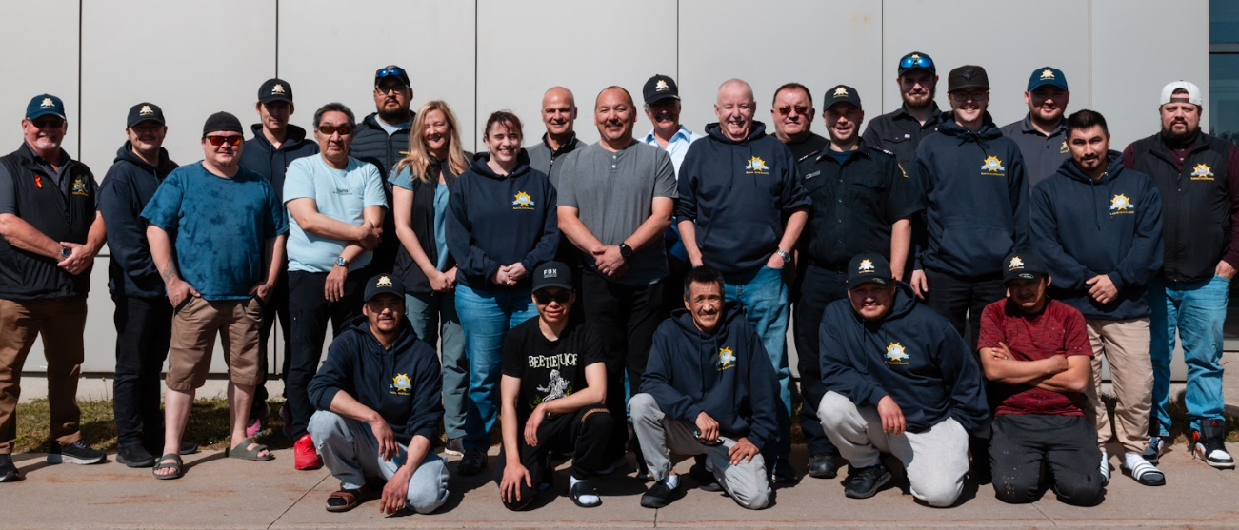
ᓄᓇᕕᒻᒥ ᐃᑯᐊᓪᓚᑕᓄᑦ ᑭᓪᓕᓯᓂᐊᕐᑕᐅᒪᔪᑦ 2025
ᓇᑯᕐᒦᒃ!
Notes:
UPDATED SLIDE

