Slide 1
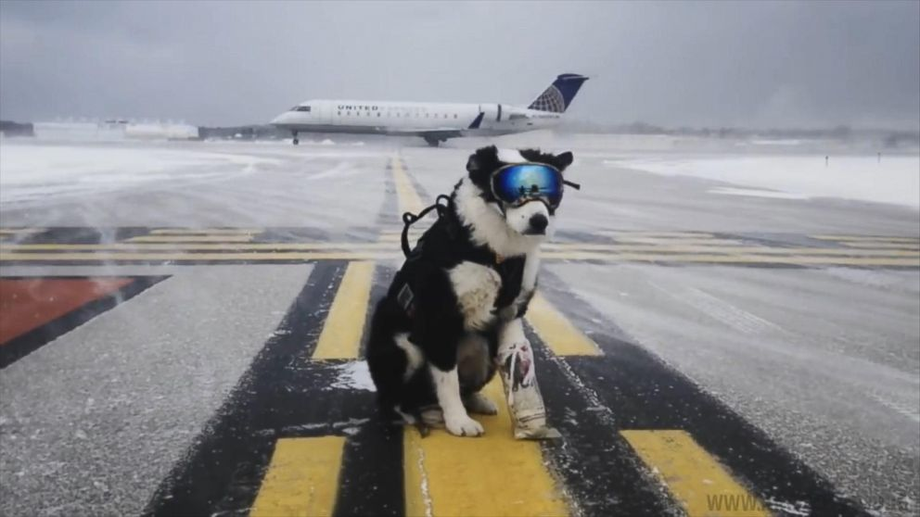

ᕿᒻᒦᑦ ᐃᑖᖃᑦᑕᓂᖏᑦ ᒥᕝᕕᒧᑦ

Slide 2

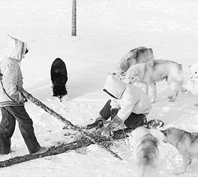
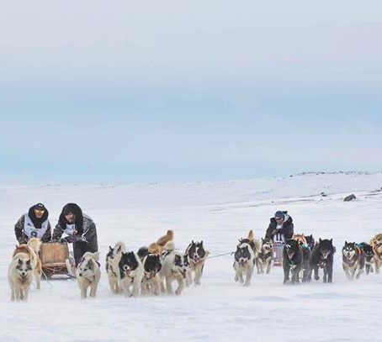
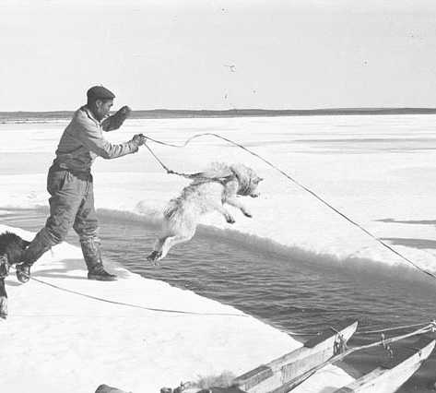
ᓇᓗᓀᕐᓯᓂᖅ ᑌᑦᓱᒪᓂ ᕿᒻᒦᑦ ᐱᒻᒪᕆᐅᓂᕕᓂᖏᓐᓂᒃ ᓄᓇᕕᒻᒥ

Slide 3
ᒪᓕᒋᐊᖃᕐᖁᒍᑦ CAR-ᒃᑯᓂᒃ ᒥᕝᕕᒥ ᐊᐅᓚᑦᓯᓂᕐᒧᑦ ᐃᓕᑕᕆᔭᐅᒍᑎ-ᖃᕈᒪᕈᑦᑕ.
ᑲᓇᑕᒥ ᖃᖓᑦᑕᔫᓐᓂᐊᓂᕐᒧᑦ ᒪᓕᑦᑕᐅᒋᐊᓖᑦ (CARs) ᑭᖕᖒᒪᑦᓯᔪᑦ ᐆᒪᔪᐃᑦ ᒥᑦᓵᓄᑦ ᐊᐅᓚᑦᓯᓂᕐᒥᒃ ᐸᕐᓀᒍᑎᓂᒃ.
ᐊᓂᒎᑎᑦᓯᐊᓯᒪᔪᑦ ᐸᕐᓀᒍᑏᑦ ᐊᑦᑕᓇᕐᑐᓂᒃ ᐳᒃᑭᓕᕆᐊᕆᓯᒪᓲᑦ ᒥᕝᕖᑦ ᐆᒪᔪᓄᑦ ᐊᓕᐊᒋᔭᐅᑎᑦᑌᓕᑦᓱᒋᑦ ᒪᑯᓂᖓ ᐱᓂᐊᕐᓂᖃᕐᓂᑯᑦ:
ᑲᒪᒋᔭᖃᑦᓯᐊᓂᖅ ᐊᕙᑎᖏᓐᓂᒃ
ᐆᒪᔪᖃᕐᑎᓯᑦᑌᓕᓂᖅ ᓭᒍᓕᐅᕐᓯᒪᓂᒃᑯᑦ
ᐲᔦᓂᖅ
ᐋᕐᕿᒋᐊᕐᑕᐅᓯᒪᒐᓗᐊᕐᒪᑕ, ᐊᑦᑕᓇᕐᑐᒦᑦᑌᓕᒪᓂᕐᒧᑦ ᖃᐅᔨᑎᑦᓯᒍᑏᑦ ᓇᓗᓀᕐᓯᓯᒪᔪᑦ ᕿᒻᒦᑦ ᐃᑖᖃᑦᑕᓂᖏᓐᓄᑦ ᒥᕝᕕᐅᑉ ᐃᓗᐊᓄᑦ.
ᐊᕕᑦᑐᐃᓂᖅ

Slide 4
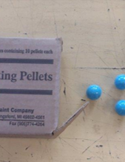
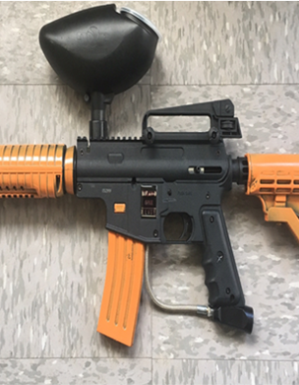
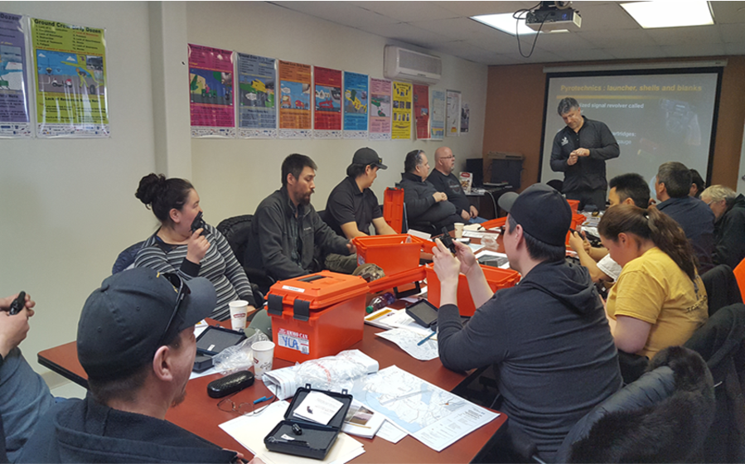
ᐊᑑᑎᑎᑦᓯᑌᓕᓂᕐᒧᑦ ᒪᓕᒉᑦ
ᐆᒪᔪᓂᒃ ᐊᐅᓚᑦᓯᓂᕐᒧᑦ ᐱᒋᐅᕐᓴᑎᑕᐅᓂᖅ
ᒥᕝᕕᒥ ᐊᑦᑕᓇᕐᑐᒦᑦᑌᓕᒪᓂᕐᒧᑦ ᑐᑭᒧᐊᒍᑏᑦ
ᐆᒪᔪᓂᒃ ᐊᐅᓚᑦᓯᓂᕐᒧᑦ ᐱᐅᒃᑯᑏᑦ (ᖁᒻᒧᐊᔫᑦ ᐊᒻᒪᓗ ᐸᑦᑕᓂᒃ ᓴᒃᑯᓖᑦ ᖁᑭᐅᑏᑦ)
ᑲᒪᖃᑦᑕᓂᖅ ᓭᒍᕐᓂᒃ ᐅᒃᑯᐊᓂᓪᓗ

Slide 5

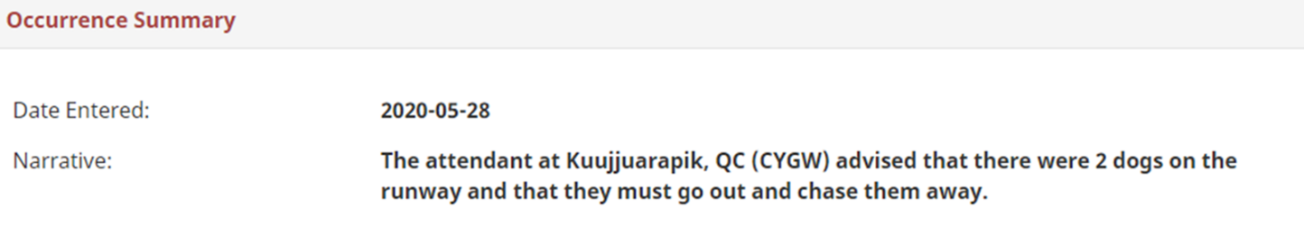
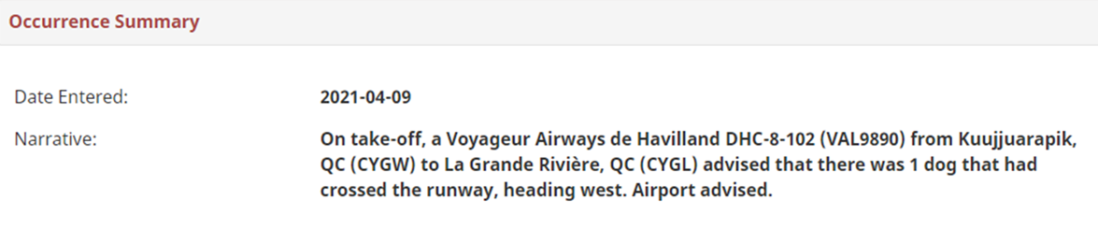
ᑲᓇᑕᒥ ᐃᖏᕐᕋᐅᑎᓕᕆᔩᑦ ᓄᐊᑦᓯᓲᑦ ᑲᒪᒋᔭᖃᓲᖑᑦᓱᑎᓪᓗ ᖃᖓᑦᑕᔫᓐᓂᐊᕕᓐᓂ ᐊᑑᑎᓲᓂᒃ ᖃᕆᑕᐅᔭᒃᑯᑦ ᖃᐅᔨᑎᑦᓯᒍᑎᑎᒍᑦ ᐱᑐᕝᕕᒥ.
ᓱᓀᑦ ᖃᐅᔨᑎᑦᓯᒍᑎᐅᒍᓐᓇᖃᑦ? ᐃᑎᕆᐊᖃᖕᖏᑐᐃᑦ ᐃᑎᖃᑦᑕᓂᖏᓐᓄᑦ ᐅᕝᕙᓘᓐᓃᑦ ᐊᐅᓚᑦᓯᓯᐊᖕᖏᓚᕿᑉᐸᑕ ᐆᒪᔪᐃᑦ ᐱᑦᔪᑎᒋᑦᓱᒋᑦ, ᐃᖏᕐᕋᐅᑏᑦ, ᐃᓄᐃᑦ ᐅᕝᕙᓘᓐᓃᑦ ᖃᖓᑦᑕᔫᑦ.
ᑭᓇᒃᑯᑦ ᖃᐅᔨᑎᑦᓯᒍᓐᓇᖃᑦ? ᖃᖓᑦᑕᔫᓐᓂᐊᑏᑦ, ᐅᕙᖁᑦ, ᐊᓯᖏᓪᓗ ᐱᓇᓱᑦᑏᑦ
ᐆᑦᑑᑎ 1:
ᐆᑦᑑᑎ 2:

Slide 6
ᕿᒻᒥᓂᒃ ᐃᑖᔨᐊᖃᖃᑦᑕᖏᓐᓇᖁᒍᑦ ᒪᓕᑦᑕᐅᒋᐊᓖᑦ ᒪᓕᖃᑦᑕᕋᓗᐊᕐᓱᒋᑦ
2020-ᒥ, 110-ᓂᒃ ᕿᒻᒥᓂᒃ ᑐᓴᕐᑎᓯᐅᑎᓕᐅᕐᓯᒪᔪᐃᑦ ᒥᕝᕕᓂ 14-ᓂᒃ. ᑕᒪᒃᑯᐊ,
9 ᑐᓴᕐᑎᓯᒍᑏᑦ ᕿᒻᒦᑦ ᒥᕝᕕᒦᑦᑐᕕᓂᐅᑎᓪᓗᒋᑦ ᖃᖓᑦᑕᔫᖅ ᐃᖏᕐᕋᑎᓪᓗᒍ
1 ᖃᖓᑦᑕᔫᖅ ᐃᕗᔨᕕᒻᒥᒃ ᖄᖐᓐᓀᓯᒪᔪᖅ ᕿᒻᒥᖃᕐᓂᑯᖓᓄᑦ ᒥᕝᕕᒥ
1 ᐊᐳᕐᑕᐅᔪᕕᓂᖅ ᑐᓴᕐᑎᓯᒍᑎᐅᓐᓂᒥᔪᖅ ᑐᖁᓯᒪᒐᓂ, ᓱᒃᑯᐃᓯᒪᒐᓂ ᓱᕐᕃᓯᒪᒐᓂᓪᓗ ᑰᑦᔪᐊᕌᐱᒻᒥ ᐊᐅᓚᑦᓯᕕᒻᒥ
80% ᑕᒪᒃᑯᐊ ᑐᓴᕐᑎᓯᒍᑏᑦ ᐱᓯᒪᔪᑦ 4-ᓂᒃ ᒥᕝᕕᓂ: ᑰᑦᔪᐊᕌᐱᒃ (25%), ᐳᕕᕐᓂᑐᖅ (23%), ᐊᐅᐸᓗᒃ (18%), ᐊᒻᒪᓗ ᑲᖏᕐᓱᐊᓗᑦᔪᐊᖅ (14%)

Slide 7
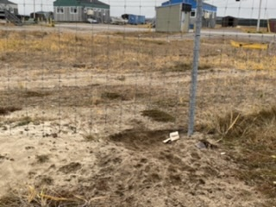
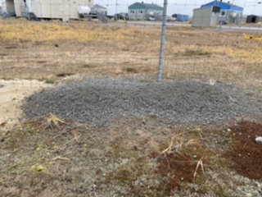
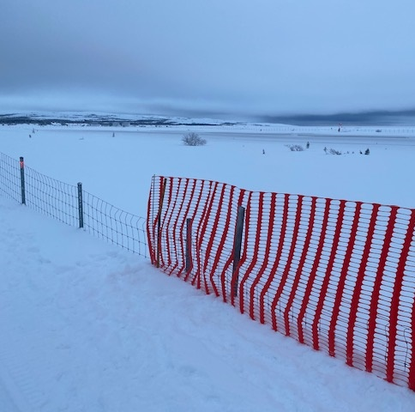
ᓱᔪᖃᓕᕐᖄ ᓱᒐᓱᐊᕐᕿᑖ ᑰᑦᔪᐊᕌᐱᒻᒥ?
ᒥᕝᕕᐅᑉ ᐊᕙᑖ ᓴᓂᖃᐅᑎᐊᓗᒻᒧᑦ ᑎᑭᑦᓱᒍ ᐊᕐᖁᑎᓕᐅᕐᑕᐅᓯᒪᔪᖅ ᕿᒻᒥᓄᑦ.
ᓯᐅᕋᔮᖅ ᓄᓇᖅ ᕿᒻᒥᓄᑦ ᓴᒡᒉᕕᐅᖃᑦᑕᑐᖅ ᒥᕝᕕᐅᑉ ᐃᓗᐊᓄᑦ.
ᐅᔭᕋᓛᓂᒃ ᐃᓕᓯᕕᐅᓲᖅ ᓴᒡᒐᑕᐅᔪᕕᓃᑦ ᕿᒻᒥᓄᑦ.
ᐊᐳᑎᒧᑦ ᓴᐅᔭᐅᓲᑦ ᓭᒍᐃᑦ ᐅᑭᐅᖑᓕᕐᐸᑦ ᑌᒣᑦᓱᒍ ᐆᒪᔪᐃᑦ ᒥᕝᕕᐅᑉ ᐃᓗᐊᓅᓲᑦ

Slide 8
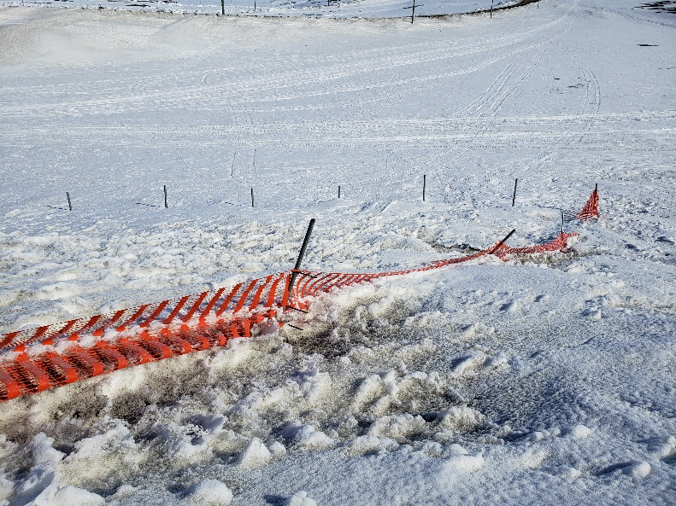
ᓱᔪᖃᓕᕐᖄ ᓱᒐᓱᐊᕐᕿᑖ ᐳᕕᕐᓂᑐᒥ?
ᓭᒍᖅ ᓱᒃᑯᑎᕐᐸᓕᐊᔪᖅ ᓄᓇᐅᑉ ᐋᑖ ᖁᐊᖑᓂᖓ ᐊᐅᑉᐸᓕᐊᓂᑯᖓᓄᑦ ᐊᒻᒪᓗ ᓯᓚ ᐅᕐᖂᓯᕙᓪᓕᐊᓂᑯᖓᓄᑦ (ᐊᓄᕆ ᐊᒻᒪᓗ ᐊᐳᑎ)
ᓄᓇᓕᐅᑉ ᑲᕙᒫᐱᖓᓂᒃ ᐱᓇᓱᐊᖃᑎᖃᓲᖑᓕᕐᖁᒍᑦ ᕿᒻᒦᑦ ᒥᕝᕕᒨᖃᑦᑕᑐᐃᑦ ᑲᒪᒋᔭᐅᖁᑦᓱᒋᑦ
ᒥᕝᕕᒃ ᐊᒻᒪᓗ ᖃᖓᑦᑕᔫᓐᓂᐊᕕᒃ ᑐᓴᐅᒪᔪᐃᑦ ᑲᒪᑦᓯᐊᒐᓱᐊᕐᓱᑎᓪᓗ: ᑲᒪᒋᔭᖃᓲᑦ ᕿᒻᒥᓂᒃ ᒥᕝᕕᓕᐊᓕᕐᒪᖔᑕ
ᐃᓚᖏᑦ ᕿᒻᒦᑦ ᓇᓗᓀᕐᑕᐅᓲᑦ ᒥᖑᐊᕐᑕᐅᒪᑦᓱᑎᒃ ᐸᑦᑕᒧᑦ ᓴᒃᑯᓕᓐᓄᑦ ᖁᑭᕐᑕᐅᓂᕕᓂᖏᑦ ᓇᓗᓀᕐᑕᐅᖁᓪᓗᒋᑦ ᕿᒻᒦᑦ

Slide 9
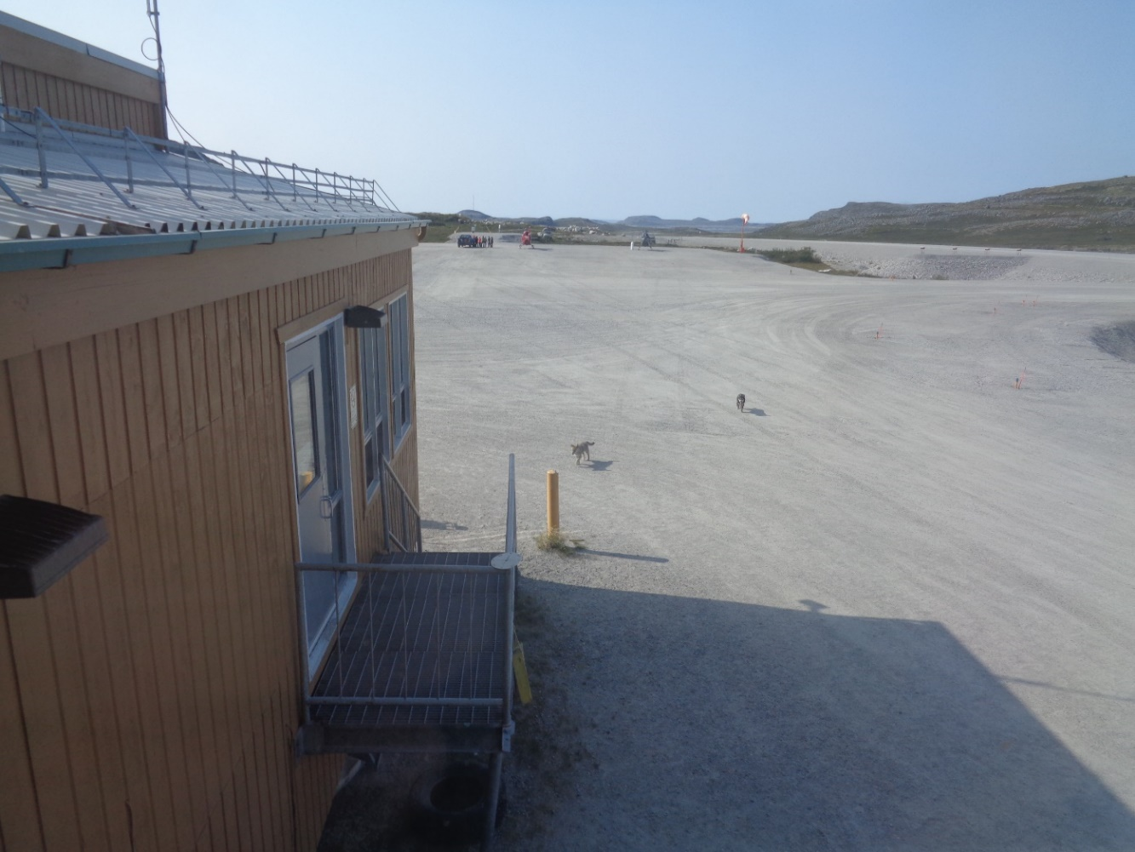
ᓱᔪᖃᓕᕐᖄ ᑲᖏᕐᓱᐊᓗᑦᔪᐊᒥ?
ᕿᒻᒦᑦ ᒥᕝᕕᐅᑉ ᐃᓗᐊᓅᓲᑦ ᒪᑐᐃᖕᖔᔪᑎᒍᑦ ᐃᑎᖃᑦᑕᓱᑎᒃ ᒥᕝᕕᐅᑉ ᐊᑖᒍᑦ ᐊᒻᒪᓗ ᓴᓇᕕᐅᑉ ᓴᓂᐊᒍᑦ
ᕿᒻᒦᑦ ᐊᒥᓱᐃᑦ ᖃᐅᔨᔭᐅᓯᒪᔪᑦ ᖃᓂᑦᑑᓂᖏᓐᓂᒃ ᒥᕝᕕᒧᑦ

Slide 10
ᓱᔪᖃᓕᕐᖄ ᐊᓯᖏᓐᓂᒃ ᒥᕝᕕᓂ?
ᓭᒍᐃᑦ ᓱᒃᑯᑎᕐᐸᓕᐊᔪᑦ ᓄᓇᐅᑉ ᐊᑖᓂ ᖁᐊᖅ ᐊᐅᑉᐸᓕᐊᓂᖓᓄᑦ
ᓱᒃᑯᑎᕐᑕᐅᖃᑦᑕᑐᐃᑦ ᒥᕝᕖᑦ ᓭᒍᖏᑦ
ᓭᒍᐃᑦ ᐊᕙᑎᖏᑦ ᐁᕕᐅᕐᖃᔭᖕᖏᑐᑦ ᓴᓇᔭᐅᖁᓪᓗᒋᑦ
Akulivik
1 m
Ivujivik

Slide 11
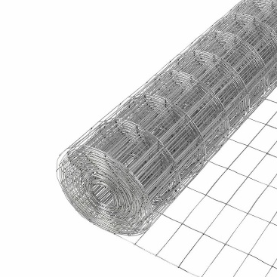

ᓱᒋᐊᖃᕐᕿᑕ ᕿᒻᒦᑦ ᒥᕝᕕᒧᑦ ᐃᑎᖃᑦᑕᖁᓇᒋᑦ?
ᓴᓇᓗᒋᑦ ᓭᒍᐃᑦ ᐅᒃᑯᐃᓯᒪᓂᓖᑦ
ᓴᐅᔨᓗᒋᑦ ᓴᒡᒐᑕᐅᔪᕕᓃᑦ ᓭᒍᐃᑦ ᐊᑖᓂ
ᓭᒍᓕᐅᕐᓂᖅ ᐃᓪᓗᐃᑦ ᐊᑖᓂ
ᕿᒻᒦᑦ ᐅᐸᑦᑐᖃᑦᑕᓗᒋᑦ ᐊᓂᑎᒐᓱᐊᕐᓗᒋᑦ ᒥᕝᕕᐅᑉ ᓴᓂᐊᓂ
ᐊᑐᕐᓗᒋᑦ ᖁᒻᒧᐊᔫᑦ ᐸᑦᑕᓂᓪᓗ ᓴᒃᑯᓖᑦ ᖁᑭᐅᑏᑦ
ᒥᕝᕕᐅᑉ ᐅᕐᖁᑎᖓᓂᒃ ᑲᒪᓕᐅᒥᔮᖃᑦᑕᓂᖅ
ᑐᓴᕐᑎᓯᒍᑎᐅᔪᕕᓃᑦ ᓭᒍᓂᒃ ᐱᓀᓗᑕᖃᖃᑦᑕᓂᕐᒥᓄᑦ MTQ-ᒃᑯᓄᑦ, ᐃᓚᐅᑎᓪᓗᒋᑦ ᓄᓀᑦ ᐊᑖᓂ ᖁᐊᖑᓂᖏᑦ ᐊᐅᑉᐸᓕᐊᓂᖏᓐᓄᑦ ᐱᓀᓗᑕᐅᔪᓂᒃ ᐊᒻᒪᓗ ᓭᒍᐃᑦ ᓯᖁᑦᑎᓯᒪᓂᖏᓐᓄᑦ ᓯᓚ ᐱᑦᔪᑎᒍᑦᓱᒍ
ᐊᔪᐃᓐᓇᕋᓗᐊᕋᑦᑕ, ᕿᒻᒦᑦ ᐊᑦᑕᓇᕐᑐᒦᑦᑎᓯᓲᑦ ᒥᕝᕕᑎᓐᓂ

Slide 12
ᐃᑲᔪᕐᑕᐅᒍᒪᕗᒍᑦ ᐃᓕᑦᓯᓄᑦ!
ᐱᓇᓱᐊᖃᑎᖃᒍᒪᕗᒍᑦ ᓄᓇᓕᑦᓯᓄᑦ, ᕿᒻᒥᓂᐊᕐᑏᑦ ᐊᒻᒪᓗ ᕿᒻᒦᑦ ᐊᐅᓚᑕᐅᓂᖏᓐᓄᑦ ᐱᖁᔦ.
ᕿᒻᒦᓗ ᒥᕝᕖᓗ ᑲᑎᒪᐅᑎᕐᖃᔭᖕᖏᑑᒃ.
ᖃᖓᑦᑕᔫᑦ ᐊᑦᑕᓇᕐᑐᒦᑦᑎᑌᓕᒋᐊᓕᕗᑦ, ᐃᓕᑦᓯᓗ, ᓄᓇᓕᖁᑎᑦᑕᓗ.

Slide 13
ᐃᑲᔪᕐᑕᐅᒍᒪᕗᒍᑦ ᐃᓕᑦᓯᓄᑦ!
ᑲᒪᒋᓗᒋᑦ
ᓄᓇᓖᑦ ᕿᒻᒥᓂᐊᕐᑎᖃᕋᓗᐊᕐᒪᖔᑦ ᖃᐅᔨᓴᕐᓗᑎᑦ
ᑲᑎᓗᒋᑦ
ᓯᕗᓕᕐᑏᑦ ᐅᓐᓂᑑᑦᔨᓗᒋᓪᓗ ᒪᓕᒑᐲᑦ ᒥᑦᓵᒍᑦ
ᐊᑐᓕᕐᑎᓗᒋᑦ
ᒪᓕᒑᐲᑦ (ᐊᑭᓕᕋᑦᓴᓕᐅᕆᓂᖅ ᓱᒋᐊᖁᔨᓃᓪᓗ ᕿᒻᒦᑦ ᓱᒋᐊᕐᑕᐅᖁᓪᓗᒋᑦ)
ᖃᐅᔨᓴᕐᓗᒋᑦ
ᓴᓂᖃᐅᑎᐊᓗᐃᑦ ᐆᒪᔪᓄᑦ ᐅᐸᑦᑕᐅᓲᑦ
ᐊᑑᑎᓗᒋᑦ
ᐃᓄᓐᓂᒃ ᑐᓴᐅᒪᒃᑫᓂᖅ ᓄᓇᓕᐅᑉ ᐃᓗᐊᓂ ᕿᒻᒦᑦ ᐱᓀᓗᑕᐅᓲᖑᓂᖏᓐᓄᑦ ᒥᕝᕕᒥ

Slide 14
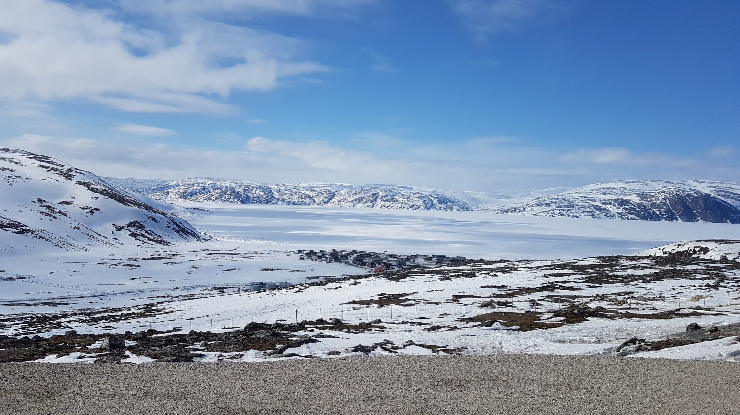
ᓇᑯᕐᒦᒃ!

