Slide 1
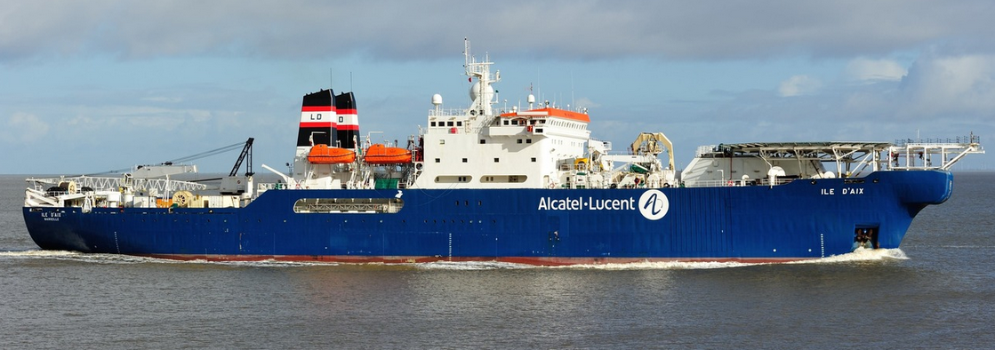
Eastern Arctic Underwater
Fibre Optic Network (EAUFON)
KRG Council Meeting
May 2021

Slide 2
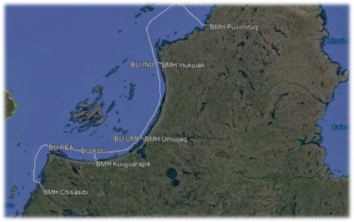
EAUFON Eastern Arctic Undersea Fibre Optic Network
$86 M ( From Chisasibi to Puvirnituq)
1861 KM Submarine Fibre Optic Cable
Expected in Service – December 2021
Engineered Cable Route (surveyed in 2018)
About 25% of the current satellite capacity will be recuperated and redistributed to other communities
Activities 2021 | Cable ship and marine cable install | Electronics install, testing and training | High speed activation (Turned on)
Puvirnituq | 29 July – 12 Aug | Nov – Dec | Dec 31
Inukjuak | 12 Aug – 23 Aug | Nov – Dec | Dec 31
Umiujaq | 23 Aug – 31 Aug | Nov – Dec | Dec 31
Kuujjuaraapik | 31 Aug – 9 Sept | Nov – Dec | Dec 31

Slide 3
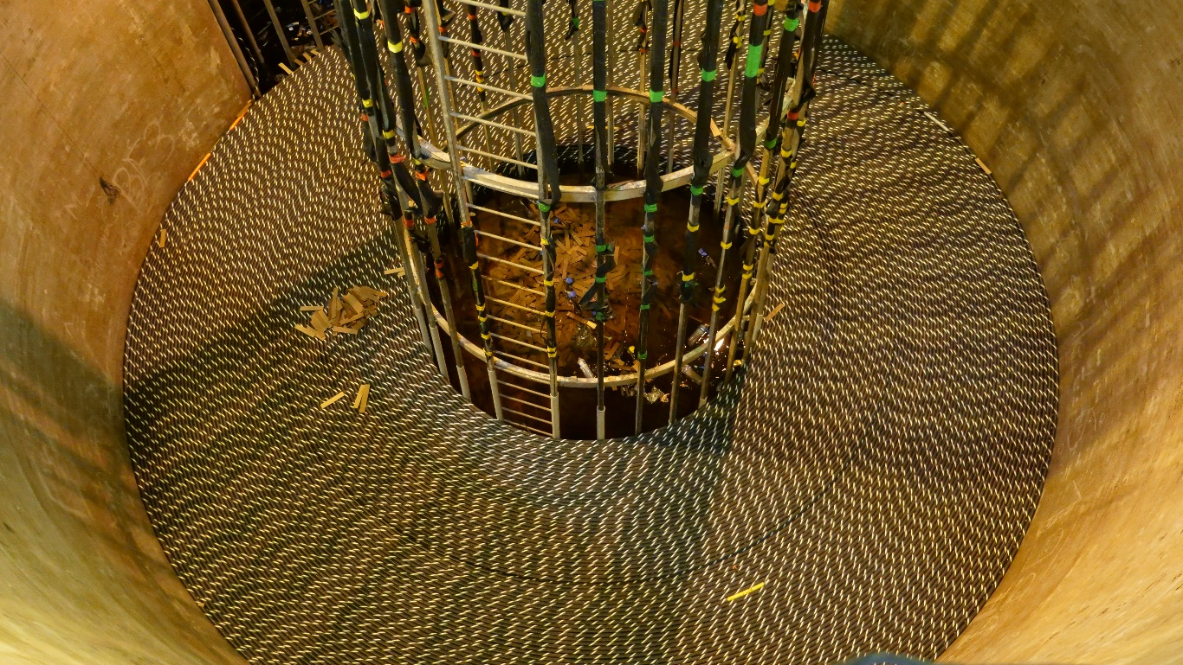
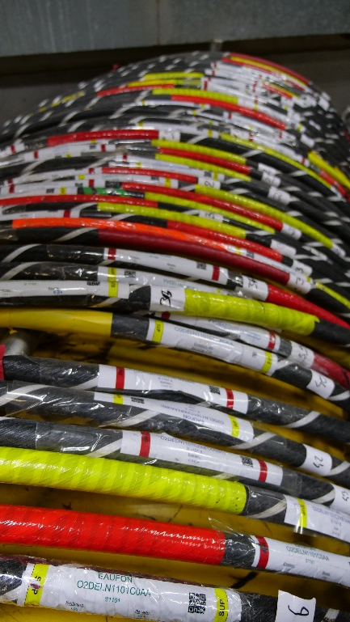
EAUFON Project Update
All materials (cable, repeaters, branching units, beach manholes, electronics) have been manufactured to 90% at present.
The cable ship will be loaded beginning of July and is expected to arrive in Puvirnituq July 29th.

Slide 4
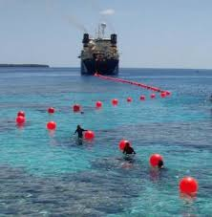
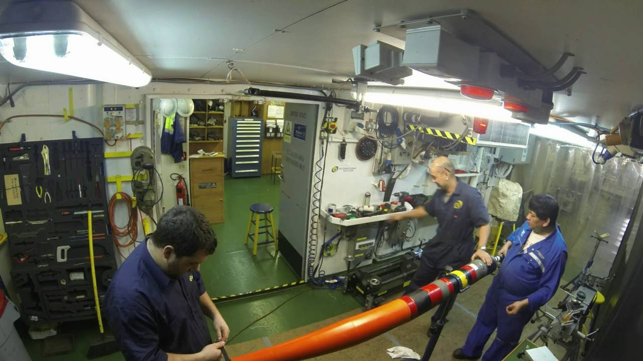
EAUFON Project Update
The cable will be installed at Puvirnituq first and will work south finishing in Chisasibi mid September (weather permitting)
October – December: Configuring the cable/components, testing and ensuring quality compliance.
System is expected to go live December 31, 2021.

Slide 5
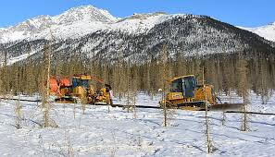
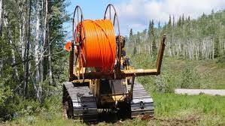
Phase 6 & Kuujjuaq Fibre
Scheduled to be completed before December 2023 …
Kuujjuaq to Kawawachikamach terrestrial fibre optic cable
Puvirnituq to Salluit fibre optic cable
Salluit to Kangiqsujuaq terrestrial fibre optic cable

Slide 6
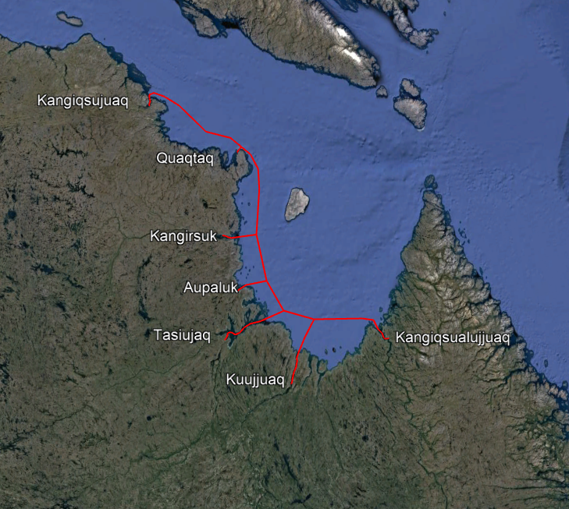
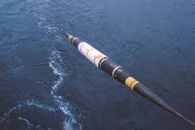
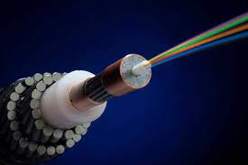
Longer Term Planning Phase 7
***Estimated $120M to connect Kangiqsujuaq to Kuujjuaq and spur lines to all other Ungava communities by submarine Fibre optic cable

Slide 7
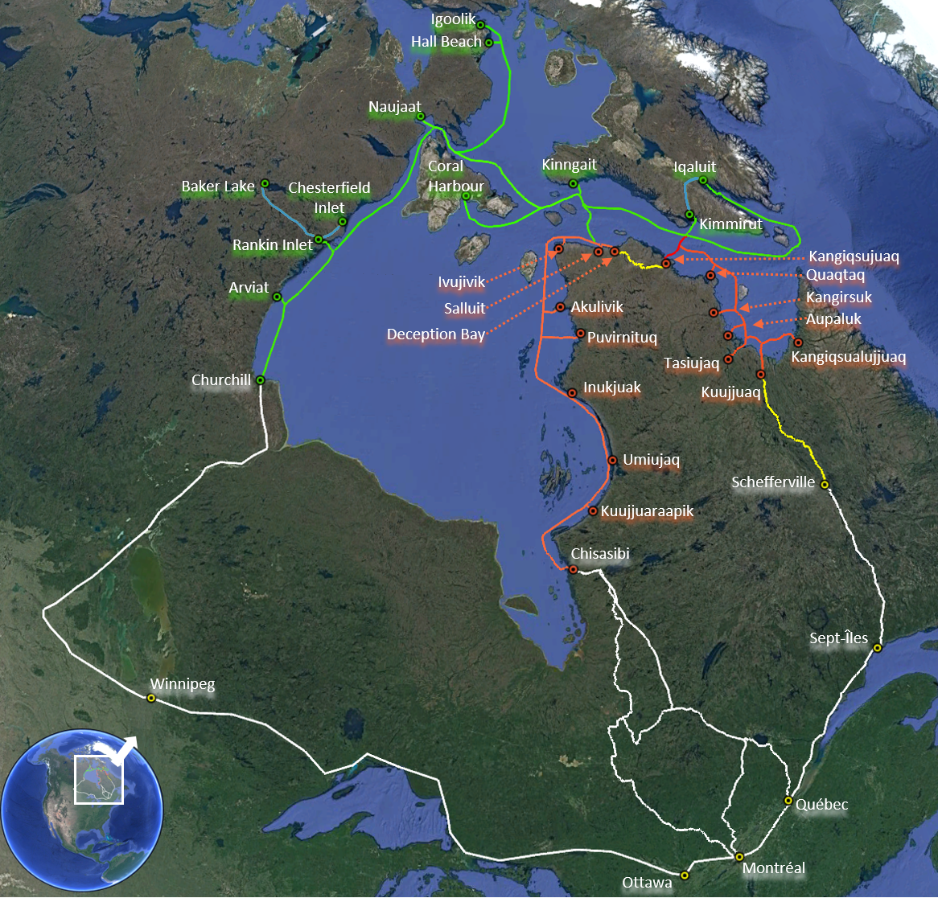
A look to the Future…(10/15 Years)
GN Underwater Network
GN New Terrestrial Network
KRG Underwater Network
KRG New Terrestrial Network
Existing Terrestrial Networks

Slide 8
Thank You!

