Slide 1
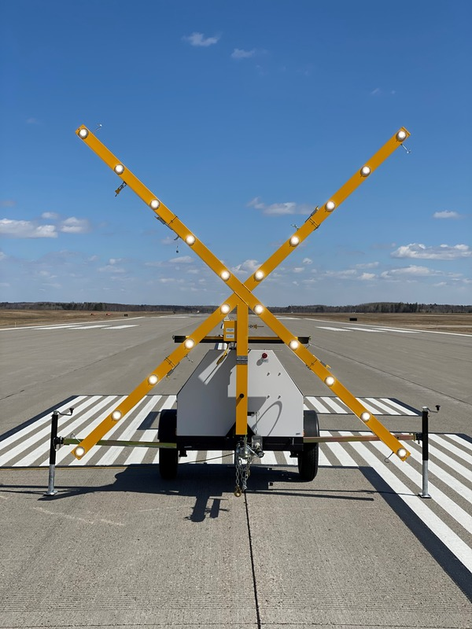
2021 ᐊᕐᕌᒍᖓᓂ ᒥᕝᕕᒥ ᐅᑕᕐᕿᕖᑦ ᐱᓇᓱᐊᕐᑕᐅᓂᖏᑦ

Slide 2
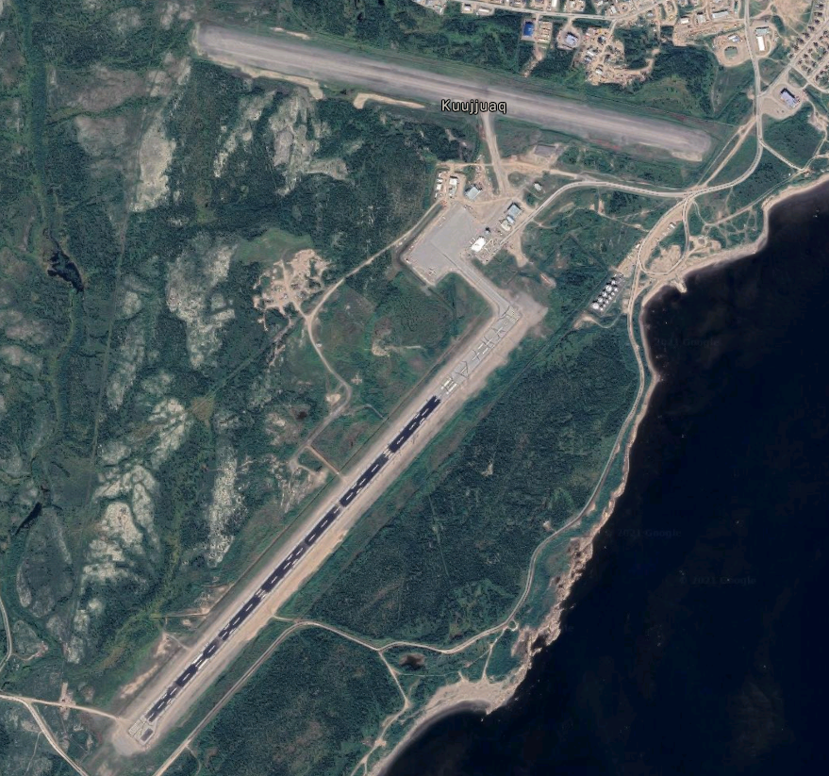
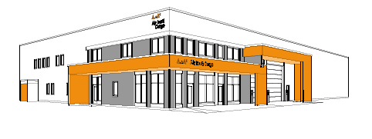
ᑰᑦᔪᐊᑉ ᒥᕝᕕᖓ
ᓴᓇᔭᐅᓂᖓ ᓄᑖᑉ ᐃᓄᐃᑦ ᓱᓇᒐᓚᖃᐅᑎᖓᑕ
-
ᒣ 2021-ᒥᑦ ᐊᐅᒡᒍᓯ 2022-ᒧᑦ
x
ᒥᕝᕕᐅᑉ ᓄᑕᐅᓯᓕᕐᑕᐅᓂᖓ 07/25
-
ᔫᓂ 2021-ᒥᑦ ᓯᑦᑎᒻᐱᕆ 2021-ᒧᑦ
ᖃᖓᑦᑕᔫᓄᑦ ᓇᒻᒥᓂᕆᔭᔪᓄᑦ ᖃᖓᑦᑕᔫᖃᐅᑎᐅᑉ ᓴᓇᔭᐅᓂᖓ
-
ᔪᓓ 2021-ᒥᑦ ᓯᑦᑎᒻᐱᕆ 2021-ᒧᑦ

Slide 3
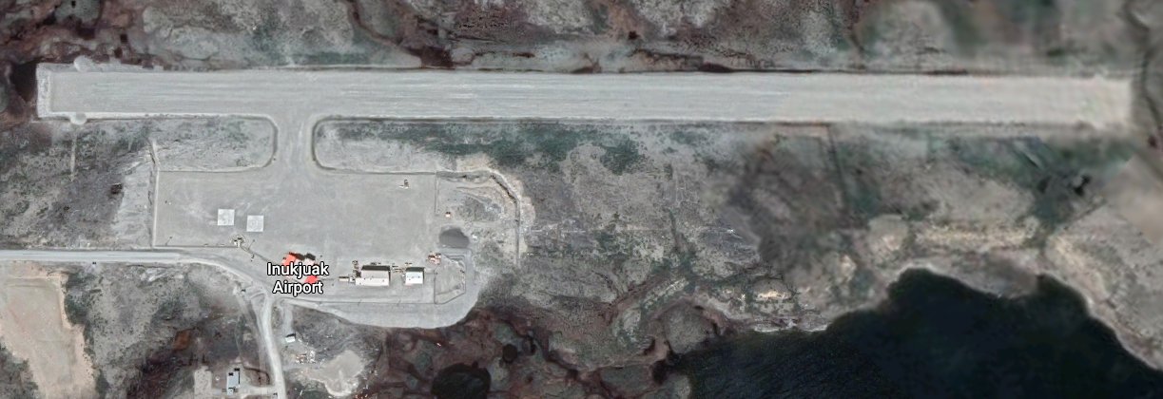
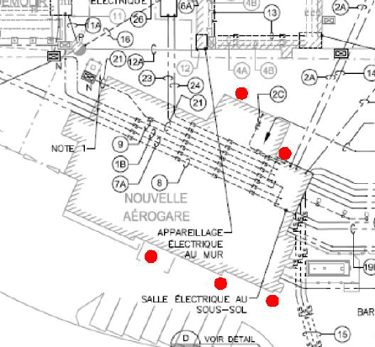
ᐃᓄᒃᔪᐊᑉ ᒥᕝᕕᖓ
ᐃᑰᑕᕐᓱᑎᒃ ᖃᐅᔨᒐᓱᐊᕐᑐᑦ ᐃᒪᕐᒥᒃ ᓴᓗᒣᑦᑐᒥᒃ ᓯᖏᑦᓯᒍᑎᒥᒃ ᑐᑭᓯᒐᓱᐊᕐᓱᒍᓗ
-
ᔫᓂ 2021
ᖄᒥᐅᑦᓯᑐᐃᒋᐊᑦᓯᐊᑐᑦ ᒥᕝᕕᒥᒃ ᓄᑕᐅᓯᓕᕐᑎᕆᑦᓱᑎᓪᓗ ᑕᐅᑐᒍᑎᓂᒃ
-
ᓯᑦᑎᒻᐱᕆ 2021-ᒥ ᐱᔭᕆᕐᑕᐅᓛᕐᑐᖅ
Notes:
Drilling – to understand water infiltration problem at Inukjuak airport tterminal

Slide 4
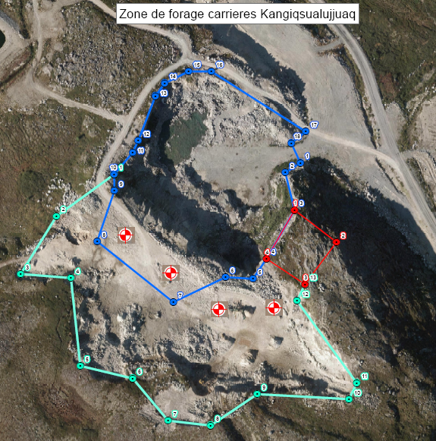
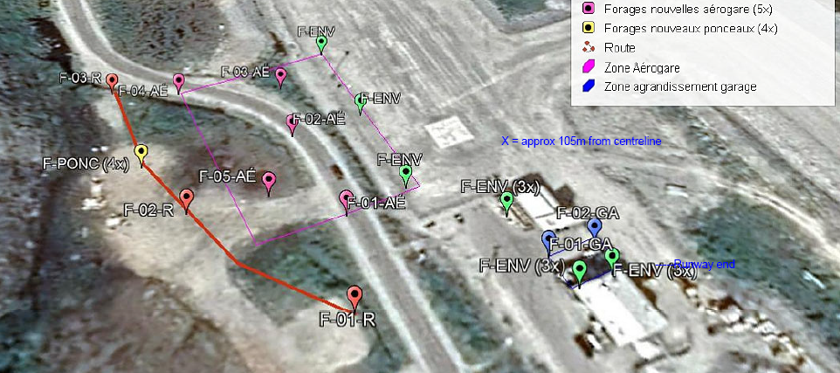
ᑲᖏᕐᓱᐊᓗᑦᔪᐊᖅ
ᐃᑰᑕᕐᓂᖅ ᓄᓇᐅᑉ ᐃᑭᐊᖓᓂᒃ ᖃᓄᐅᑦᑑᓂᖓᓂᒃ ᖃᐅᔨᒐᓱᐊᕐᓱᑎᒃ
-
ᔫᓂ 2021-ᒥᑦ ᔪᓓ 2021-ᒧᑦ

Slide 5
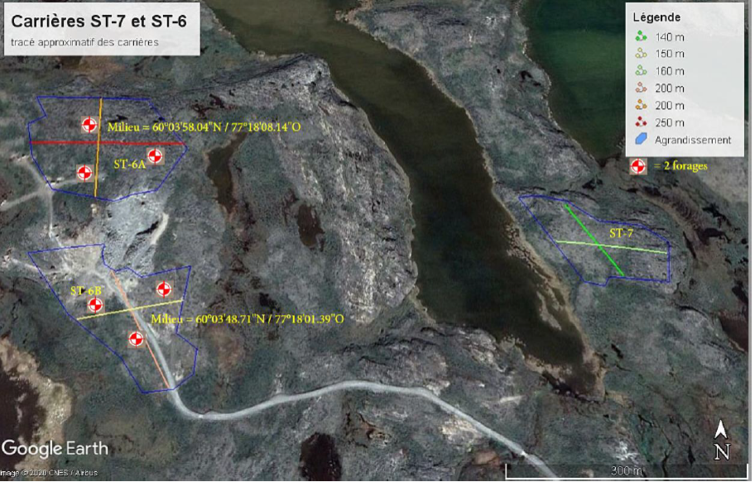
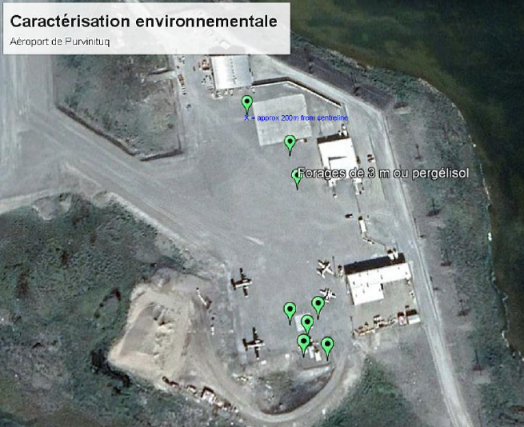
ᐳᕕᕐᓂᑐᖅ
ᐃᑰᑕᕐᓂᖅ ᓄᓇᐅᑉ ᐃᑭᐊᖓᓂᒃ ᖃᓄᐅᑦᑑᓂᖓᓂᒃ ᖃᐅᔨᒐᓱᐊᕐᓱᑎᒃ
-
ᔪᓓᒥᑦ ᐊᐅᒡᒍᓯᒧᑦ 2021

Slide 6
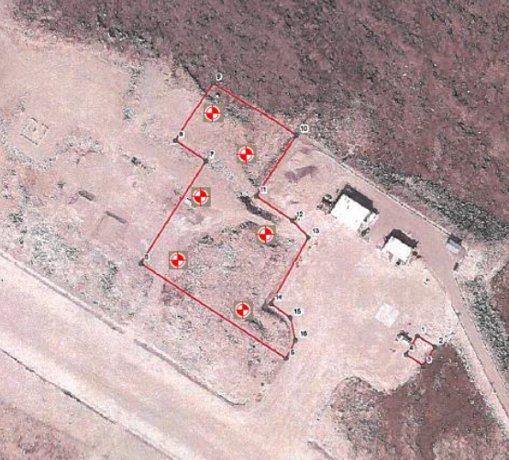
ᑲᖏᕐᓱᔪᐊᑉ ᒥᕝᕕᖓ
ᐃᑰᑕᕐᓂᖅ ᓄᓇᐅᑉ ᐃᑭᐊᖓᓂᒃ ᖃᓄᐅᑦᑑᓂᖓᓂᒃ ᖃᐅᔨᒐᓱᐊᕐᓱᑎᒃ
-
ᔪᓓᒥᑦ ᐊᐅᒡᒍᓯᒧᑦ 2021
Notes:
The drillings will help identify the suitable material to regenerate the gravel stockpile, contamination below fuel tanks, and a suitable location for AWOS.

Slide 7
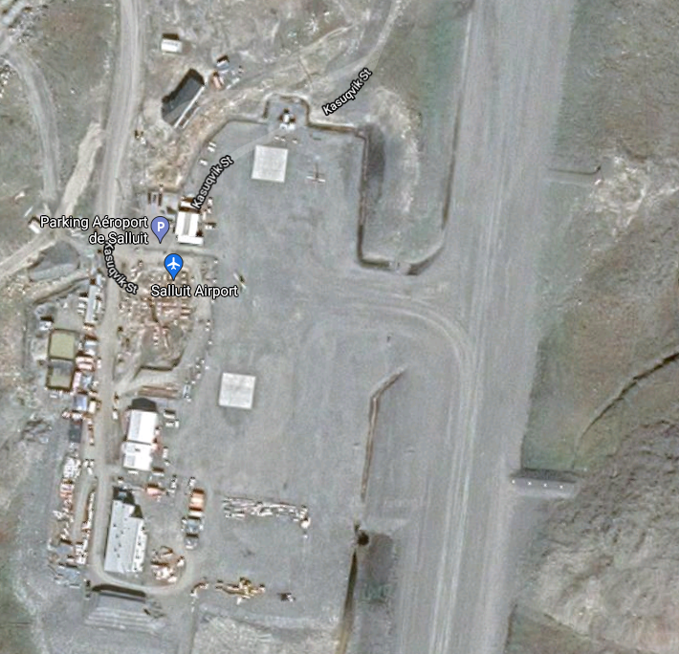
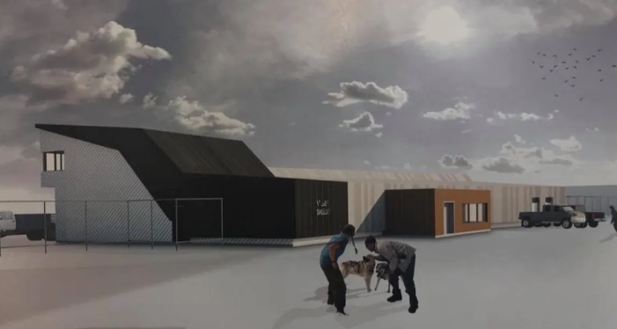
ᓴᓪᓗᐃᑦ ᒥᕝᕕᖓ
ᓄᑖᒥᒃ ᒥᕝᕕᒥ ᐅᑕᕐᕿᕕᓕᐅᕐᓂᖅ
-
ᔪᓓ 2021-ᒥ ᐱᔭᕇᕐᑕᐅᓛᕐᑐᖅ
Notes:
https://www.cbc.ca/news/canada/north/salluit-airport-makeover-1.4411074

Slide 8
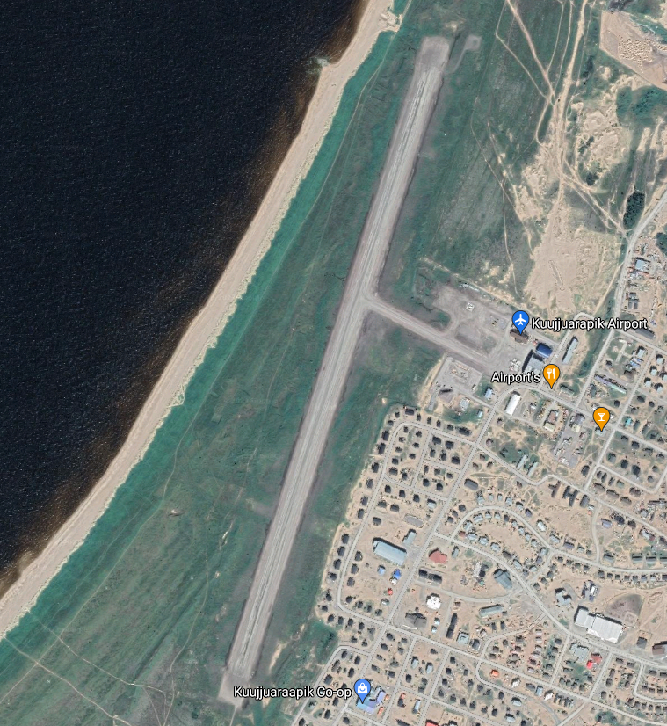
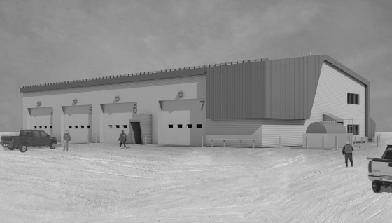
ᑰᑦᔪᐊᕌᐱᐅᑉ ᒥᕝᕕᖓ
ᒥᕝᕕᒥ ᓄᓇᒃᑰᔫᖃᐅᑎᓕᐅᕐᑐᑦ
ᓄᑕᒥᒃ
-
ᓯᑦᑎᒻᐱᕆ 2021-ᒥ ᐱᔭᕇᕐᑕᐅᓛᕐᑐᖅ

Slide 9
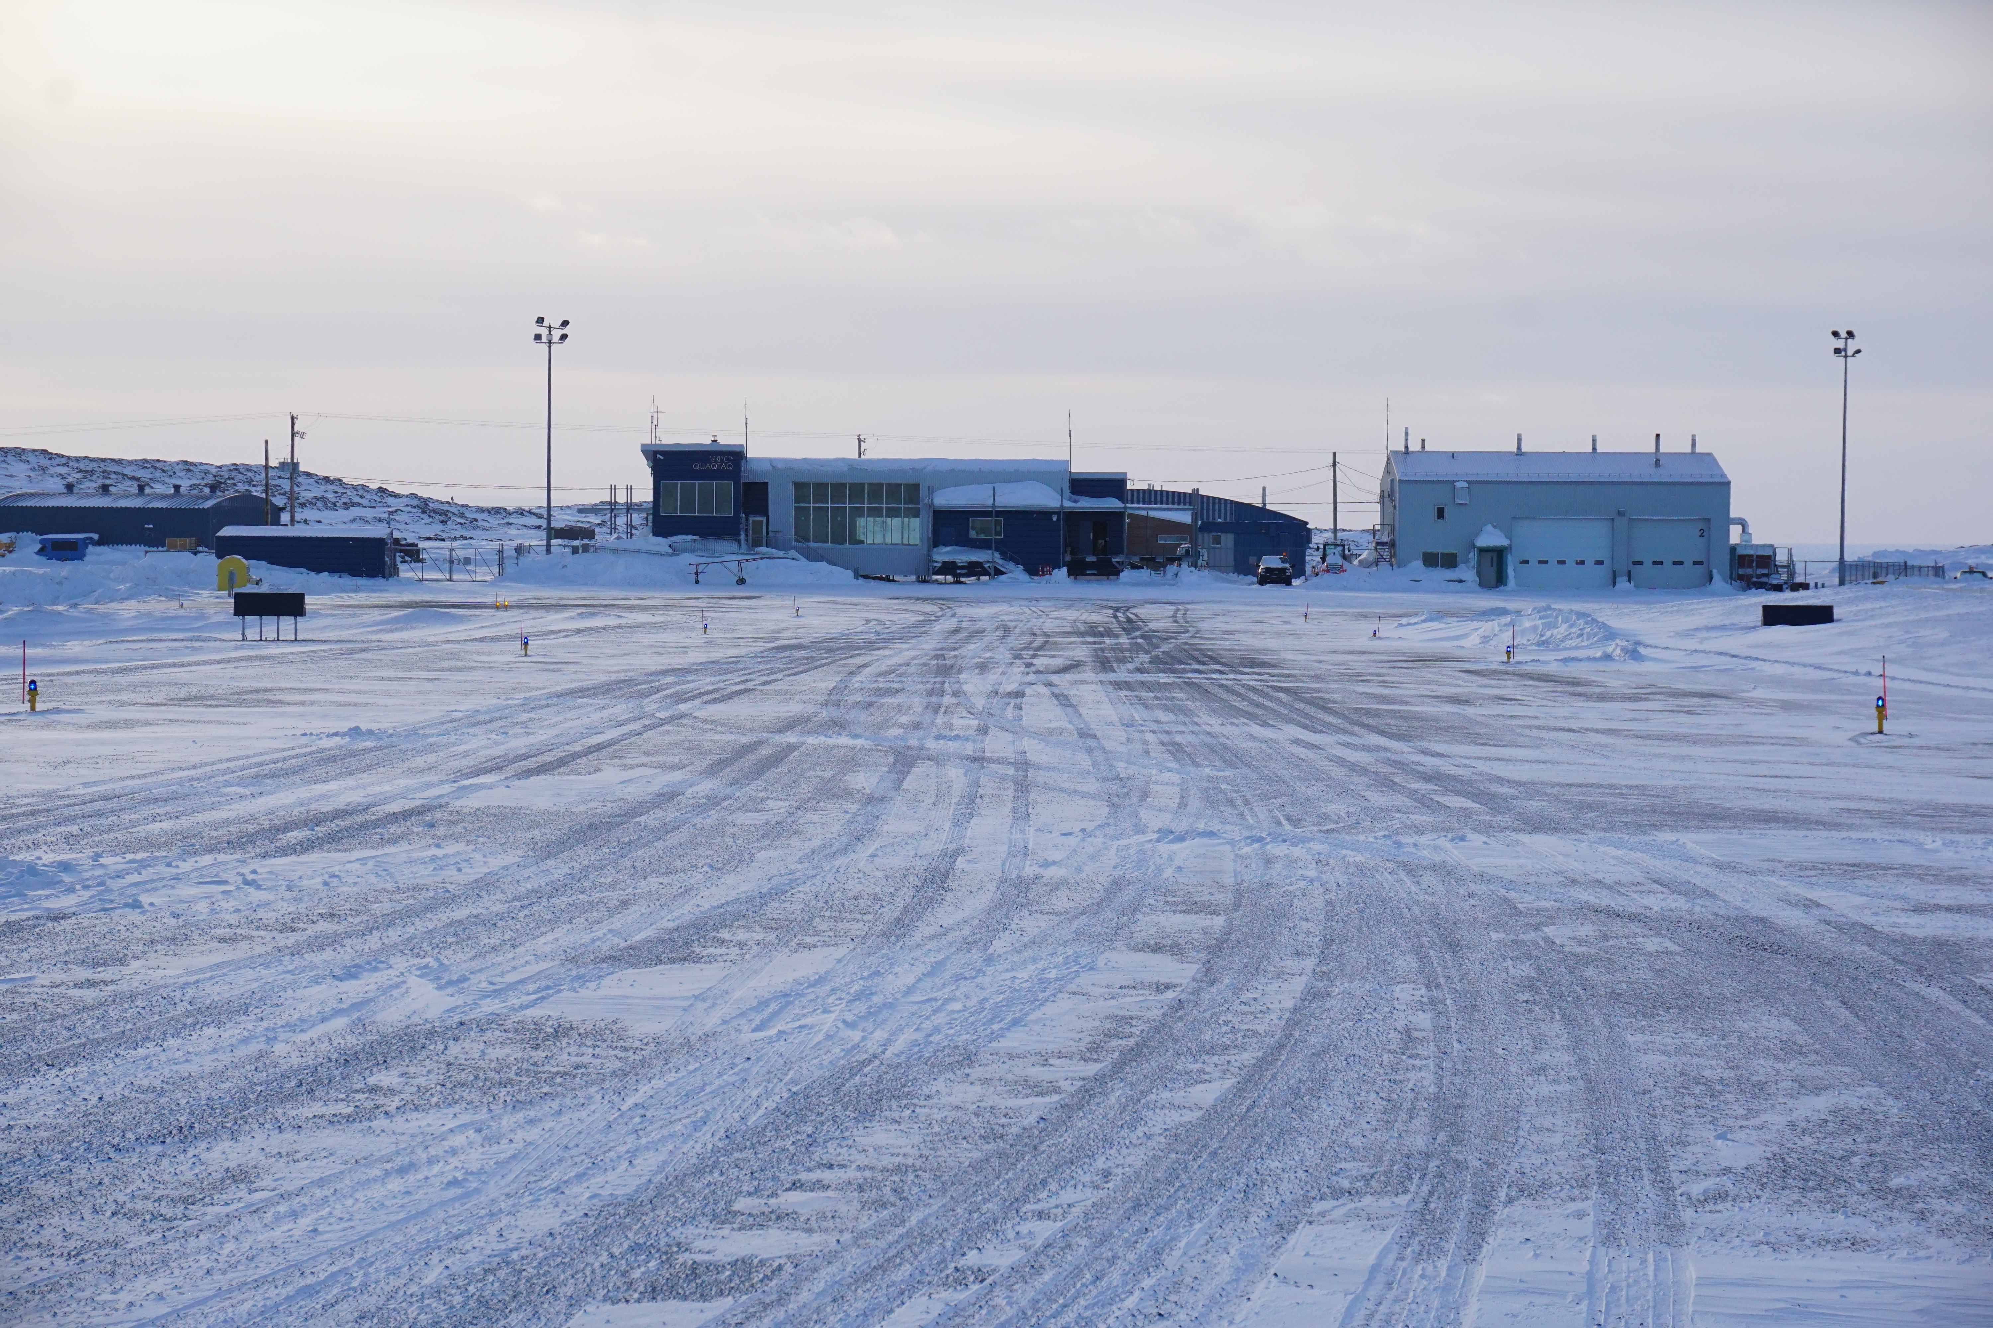
ᓇᑯᕐᒦᒃ

