Slide 1

Regional and local development department
Programs
Kativik Regional Government

Slide 2







Department mandate
The Regional and Local Development Department provides an essential link between the economic development strategies of the provincial and federal governments and the region’s businesses and social economy enterprises. It is also closely involved in community socio-economic planning and project implementation. The Department delivers programs serving three main sectors:
Regional development
Local development
Business development
Nunavik Elders Committee
Inuit Women’s Association
of Nunavik

Slide 3
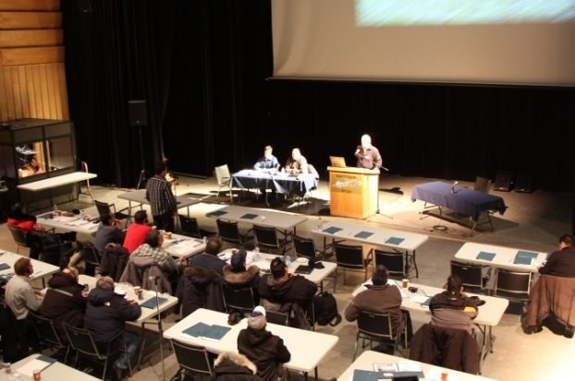
Department mandate
Public consultation and Advice on development:
Until 2003: the role of the Kativik Regional Development Council (KRDC) (JBNQA)
2004 Sivunirmut Agreement : KRG assumes greater autonomy in the establishment of its priorities, its mandates and the allocation of its funds
Spring of 2015: Bill 28, recognizes the KRG as the primary interlocutor of the Government for the territory or community it represents as regards regional development
Qarjuit Youth Council replaces Saputiit Youth Association

Slide 4
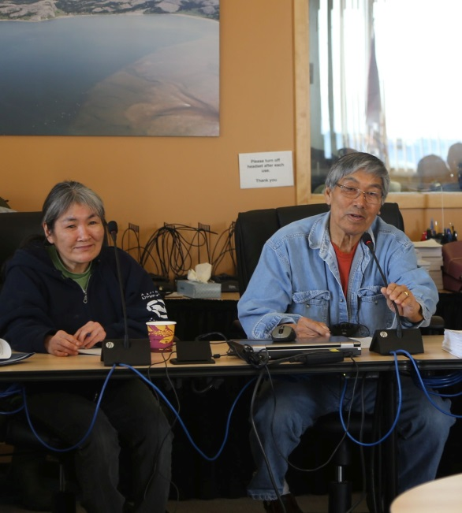
Department Support: Regional Sectors
Elders
Regional Adaptation to Enhance Seniors’ Living Agreement
social involvement
value intergenerational relationships
fight elder abuse
promote access to cultural activities
support vulnerable seniors
access to information technologies
improve living conditions
Wide-range of projects
(except infrastructure projects)

Slide 5

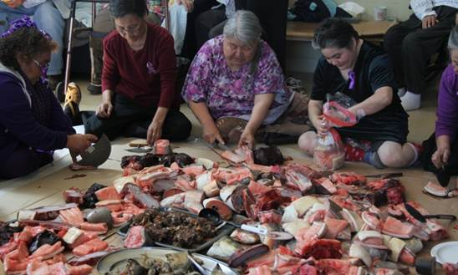
Department Support: Regional Sectors
Municipality Friend of Elders (MFE/MADA)
Elders’ have the leading role in the MADA process in each community
An Age Friendly Municipality, means that as a community, you are committed to provide a supportive environment for the elders, in a way that will better their quality of life on a daily basis
A local process will ensure that a local committee will write-up a multi-year plan to include projects responding to elders’ expectation to improve their living conditions
Nunavimmiut are encouraged to learn and explore concrete ways on how to better work with the elders in areas that have a direct impact on their lives, such as health, housing and transportation to name only a few

Slide 6
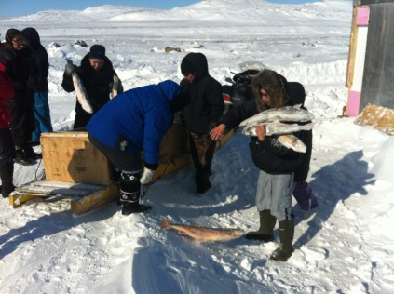
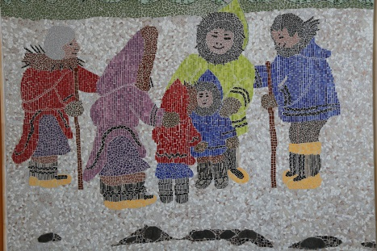
Department Support: Regional Sectors
Culture
Agreement for the improvement of the conditions of artists and writers (Avataq - MCCCF-CALQ- KRG)
  Through Avataq, provides funding to Nunavik artists and writers in many disciplines through competitions. Average prize between $3,000 to $5,000
  Annual funding to increase economic benefits to artists through marketing and competitive products
Women
Agreement on Equality between women and men
  Through Saturviit Inuit Women Association, projects and events related to equality issues and to enhance the participation of women in political representations are funded

Slide 7
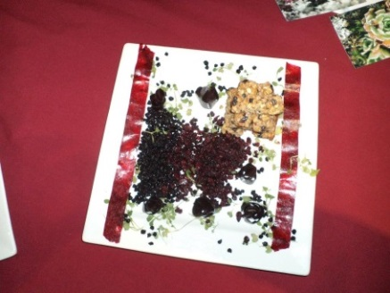
Department Support: Regional Sectors
Agro Food Development
Research and development
Job development
Participate in the sector’s development
Assisting in the
creation of new
businesses
Business
expansion

Slide 8
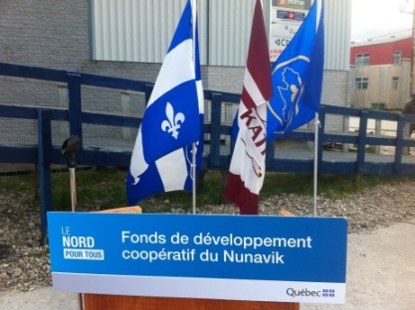
Department Support: Regional Sectors
Social Economy
Training needs
Consultation and networking relationships
On-the job trainings
Job creation opportunities
Consolidate, test and develop new social economy niches and projects
Local and regional
promotional
strategies
Foster new
generation
entrepreneurs
Participate in the
sector’s development

Slide 9
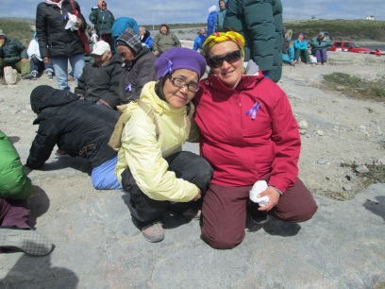
Department programs
Nunavik Family Houses Projects
Provide a safe and friendly space for community activities geared towards bringing the family closer, i.e. community kitchen, parenting workshops, etc
Support to families and their children
Counselling regarding parenting roles with participation of the community resources especially the elders
Funding is available for infrastructure renovation through KRG Sanarrutik funding for equipment and working capital, through consolidated Makigiarutiit Fund I&II and through Makigiarutiit III when the applicant qualifies as a social economy enterprise

Slide 10
Department programs
Inuit Business Development Fund (IBDF)
Research & Development
Establishment of businesses
Economic development projects
(varies according to availability of the yearly funds)
Important Factors: limited funding to participate in projects and economic development activities
Business Equity Fund
Complement promoter’s equity to assist in undertaking business projects by leveraging KRG/KLDC and other funding/financing programs
Direct Contributions

Slide 11
Department programs
Consolidated Makigiarutiit I and II Fund
Improve economic environment in the community/region
Maximum: $150,000 in:
loans, contributions and/or investments in preferred shares (maximum 15 years)
maximum contribution amounts for projects promoted by women and youth is 50% of eligible costs
Serves business and social economy enterprises, as well as specific economic sectors and community projects
Made-in-Nunavik policy
Promoter to invest 10%* of project total
Loans requires loan security
Interest rate: 4.5%
Important Factors
*Economic sectors requiring support, and local employment and development projects, are exempt from equity requirement

Slide 12
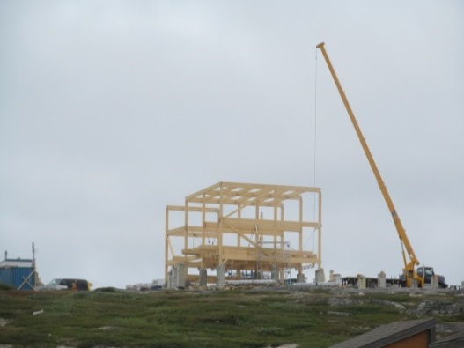
Department programs
Makigiarutiit Fund
Establish the conditions promoting the emergence of economic development
(including expansion of businesses assistance)
Create and/or develop businesses and/or consolidate jobs
Foster entrepreneurship among women and young people
Maximum participation of $1,000,000
Loans
Contributions
Investment in preferred shares to be redeemed within a maximum period of 15 years
Promoter to invest 10% of project total
Loans requires loan security offered by promoter
Interest rate 4.5%
Important Factors

Slide 13
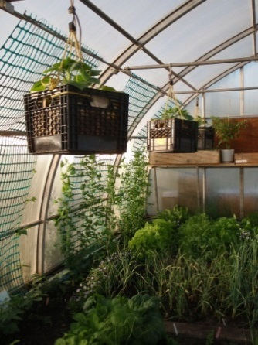
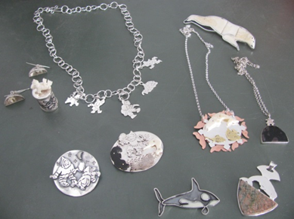
Department programs
KLDC support measures: included in KRG RLDD Programs
Entrepreneurship Support Measure Fund
Technical assistance to support entrepreneurs
  Feasibility studies
  Market surveys
  Product Development
Support Measures for Emerging Enterprises Fund
Technical assistance and support next generation entrepreneurs
  Business startup
  Monitoring and coaching
Socio-economic firms
Funding for non profit community firms providing community service
KLDC was dissolved upon adoption of Bill 28. Its mandate is assumed by the KRG –RLD Department

